Slide 1

Lucknow Airport
Static Lightbox

Slide 2

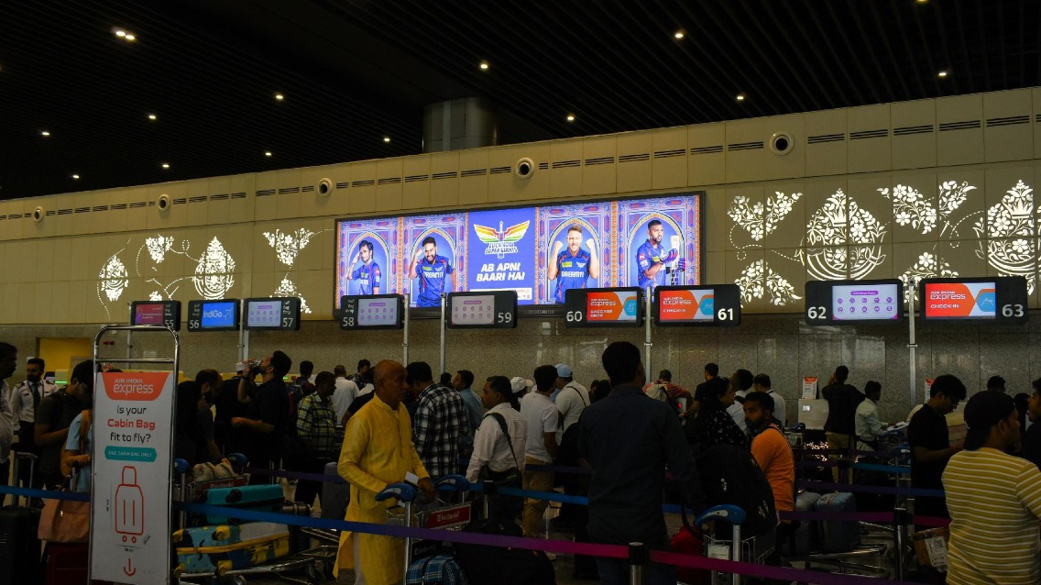


T3- DOMESTIC
Departure | Check In Area | 30 W X 7 H ft (Package Of 2 Units) | Back Lit
Static Lightbox Single Sided
www.themediaant.com
Notes:
‹#›

Slide 3
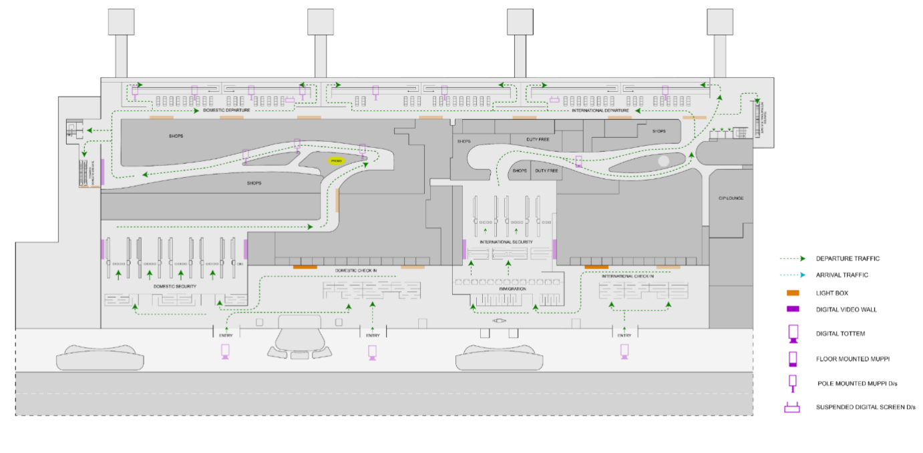
T3- DOMESTIC
Departure | Check In Area | 30 W X 7 H ft (Package Of 2 Units) | Back Lit
www.themediaant.com
Notes:
‹#›

Slide 4





www.themediaant.com
ad@themediaant.com
Thank You
080-067415510
Empowering All To Advertise
Notes:
‹#›

