Slide 1

Lucknow Airport
Media Kit

Slide 2
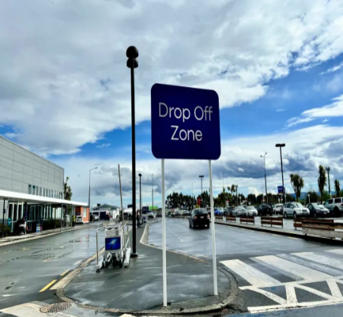
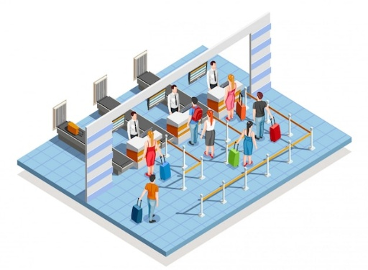
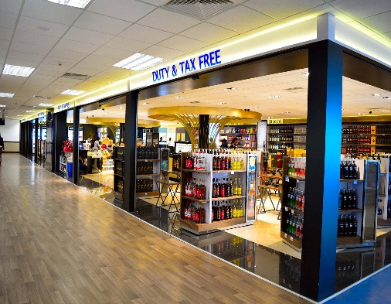
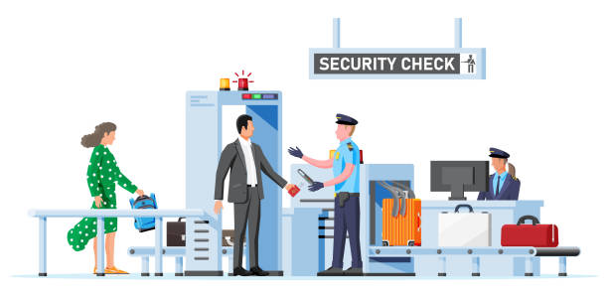
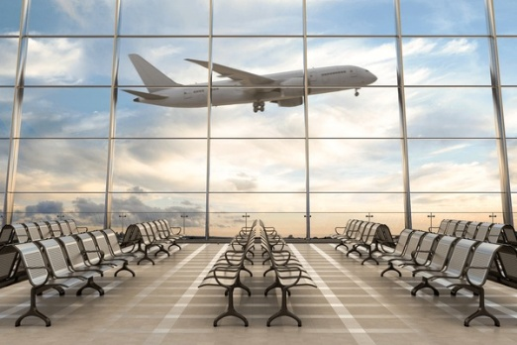
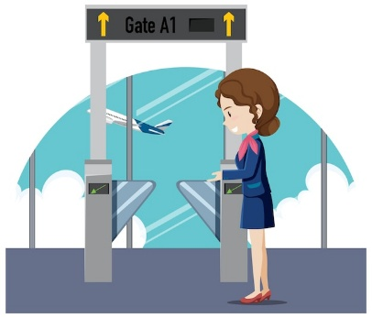


Drop Off
Check In Area
Target travelers and Waiting area Meeters & Greeters.
High Traffic Areas for Impactful advertising.
AIRPORT LAYOUT DEPARTURE
Retail Area
Security check Area
Opportunities for ads in shopping & Dinning Zone.
Captive Audience for targeted advertising
Boarding Area/ Lounge
Boarding Gate
High Dwell time area for awareness-based campaign.
Waiting Areas ideal for engagement.
www.themediaant.com

Slide 3
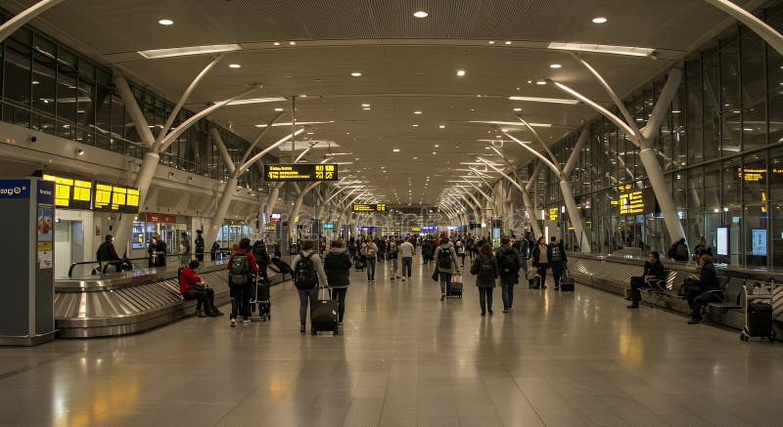
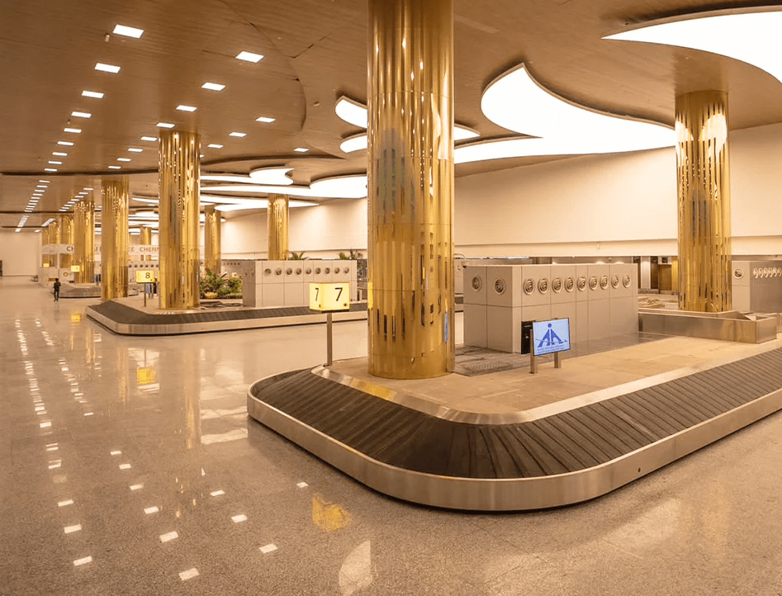
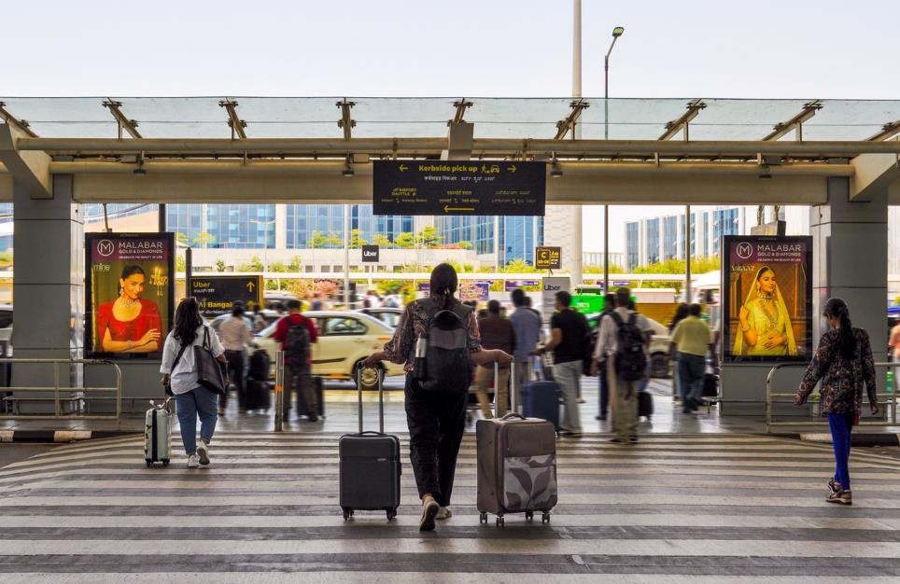
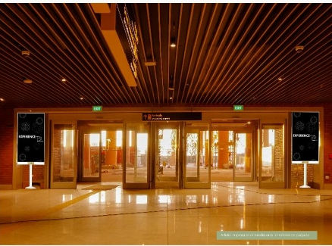
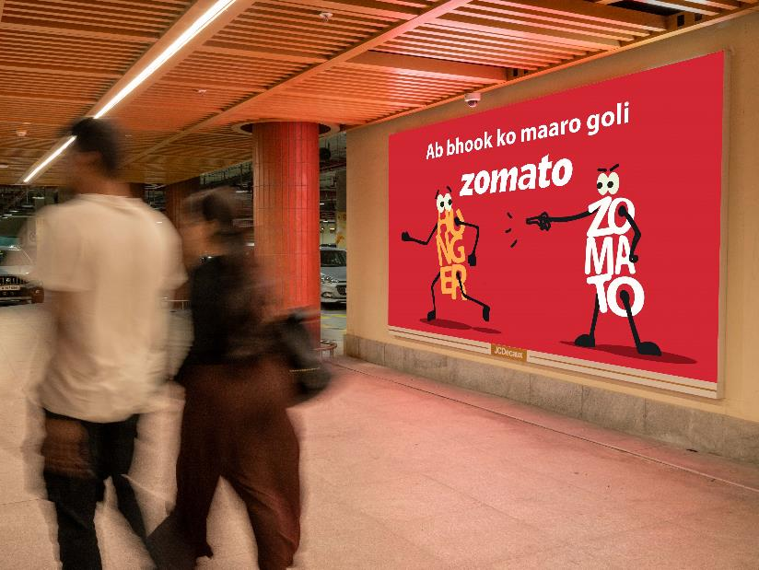
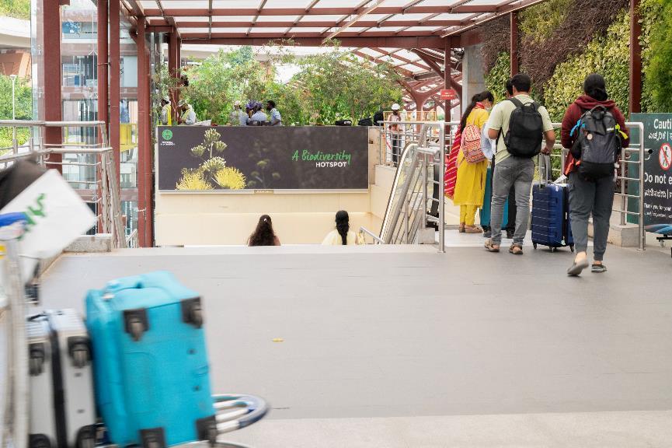
Arrival Hall
Baggage Belt
Welcoming spaces for arrival focused advertisement .
High Traffic & High Dwell time area for awareness-based campaign.
AIRPORT LAYOUT ARRIVAL
Meet & Greet Area
Exit Gate
Unique and large screen brand placement
100 % Arriving passenger coverage – Impact placement
Parking
Bus / Taxi Pick Up
www.themediaant.com

Slide 4
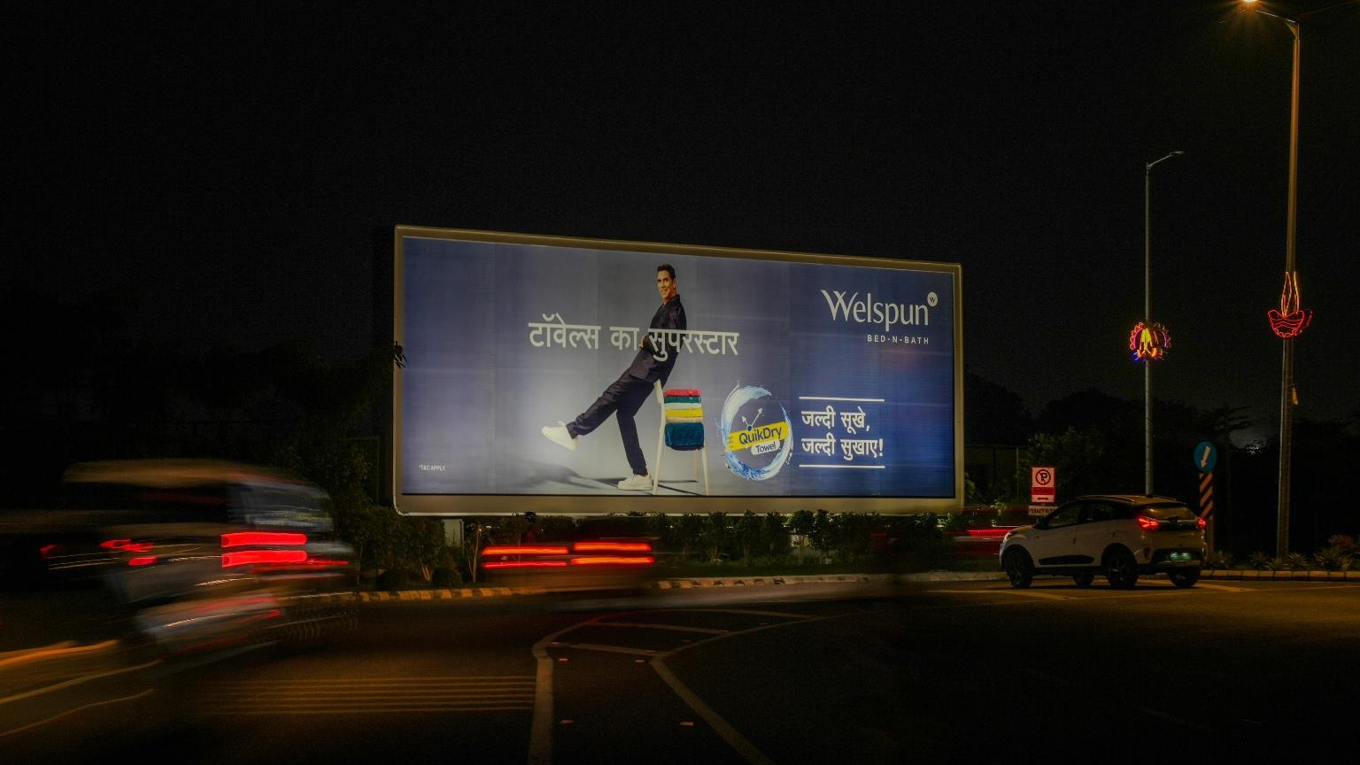


T3- DOMESTIC
Departure | Main Departure Road | 60 W X 20 H ft (Only 1 Unit) | Back Lit
Hoarding
Rental Cost | 12,00,000/- P/M
Production Cost | 48,000/-
www.themediaant.com
Notes:
‹#›

Slide 5
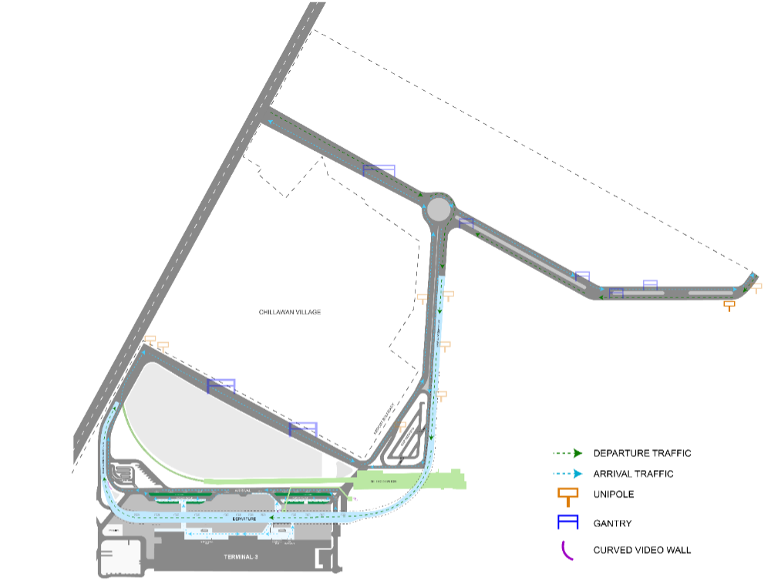
T3- DOMESTIC
Departure | Main Departure Road | 60 W X 20 H ft (Only 1 Unit) | Back Lit
www.themediaant.com
Notes:
‹#›

Slide 6
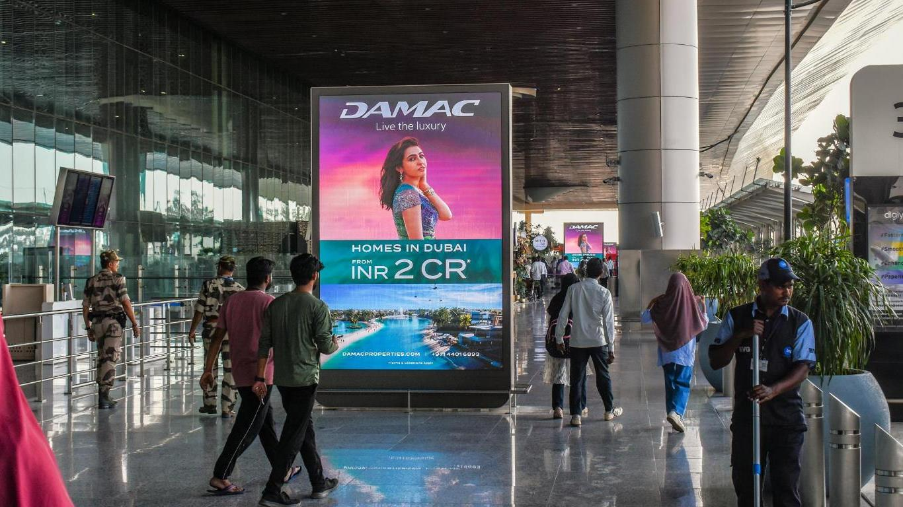
T3- DOMESTIC
Departure | Departure Approach | 6 W X 11 H ft (Package Of 3 Units) | 10 Sec In Every 1 Min
Digital Totem Double Sided
Rental Cost | 9,00,000/- P/M Per Slot
Production Cost | 10,000/-
www.themediaant.com
Notes:
‹#›

Slide 7
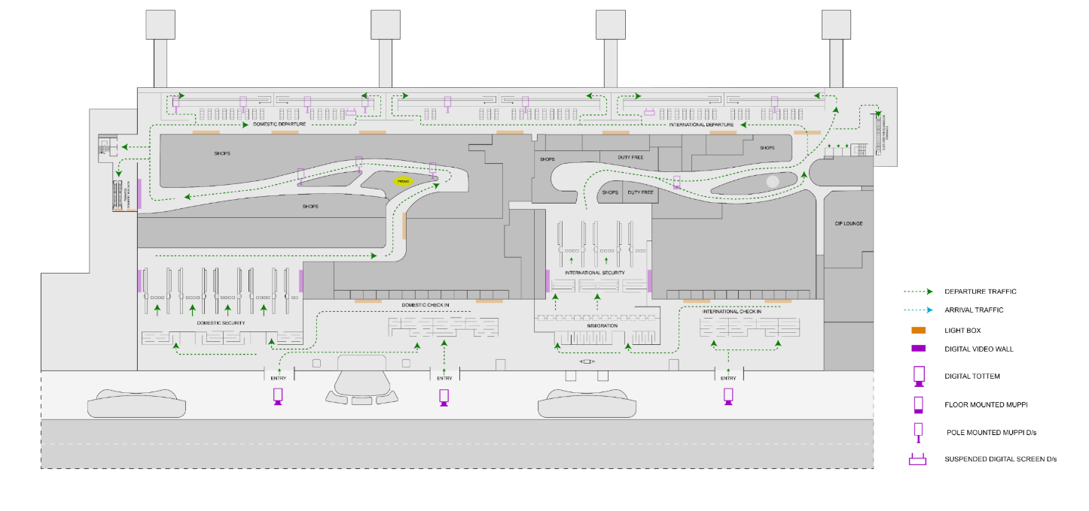
T3- DOMESTIC
Departure | Departure Approach | 6 W X 11 H ft (Package Of 3 Units) | 10 Sec In Every 1 Min
www.themediaant.com
Notes:
‹#›

Slide 8
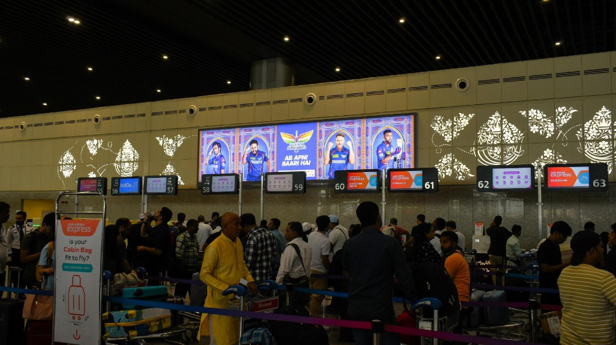

T3- DOMESTIC
Departure | Check In Area | 30 W X 7 H ft (Package Of 2 Units) | Back Lit
Static Lightbox Single Sided
Rental Cost | 16,00,000/- P/M
Production Cost | 44,100/-
www.themediaant.com
Notes:
‹#›

Slide 9
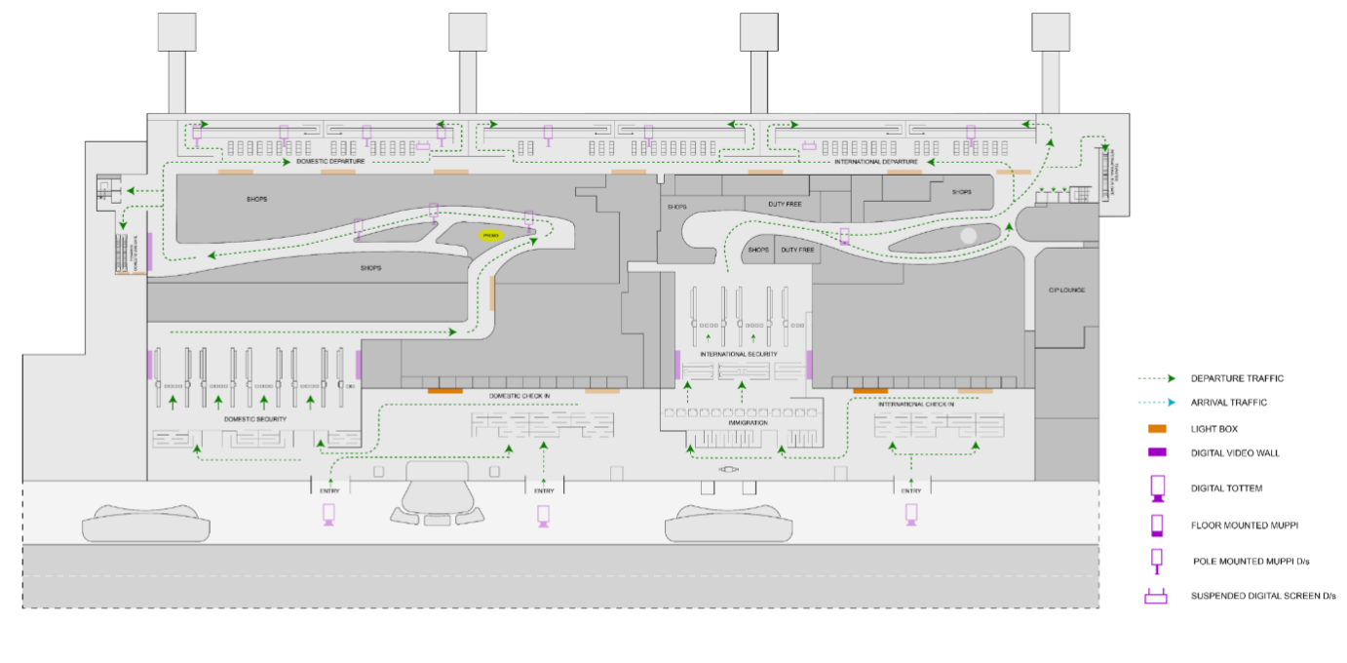
T3- DOMESTIC
Departure | Check In Area | 30 W X 7 H ft (Package Of 2 Units) | Back Lit
www.themediaant.com
Notes:
‹#›

Slide 10
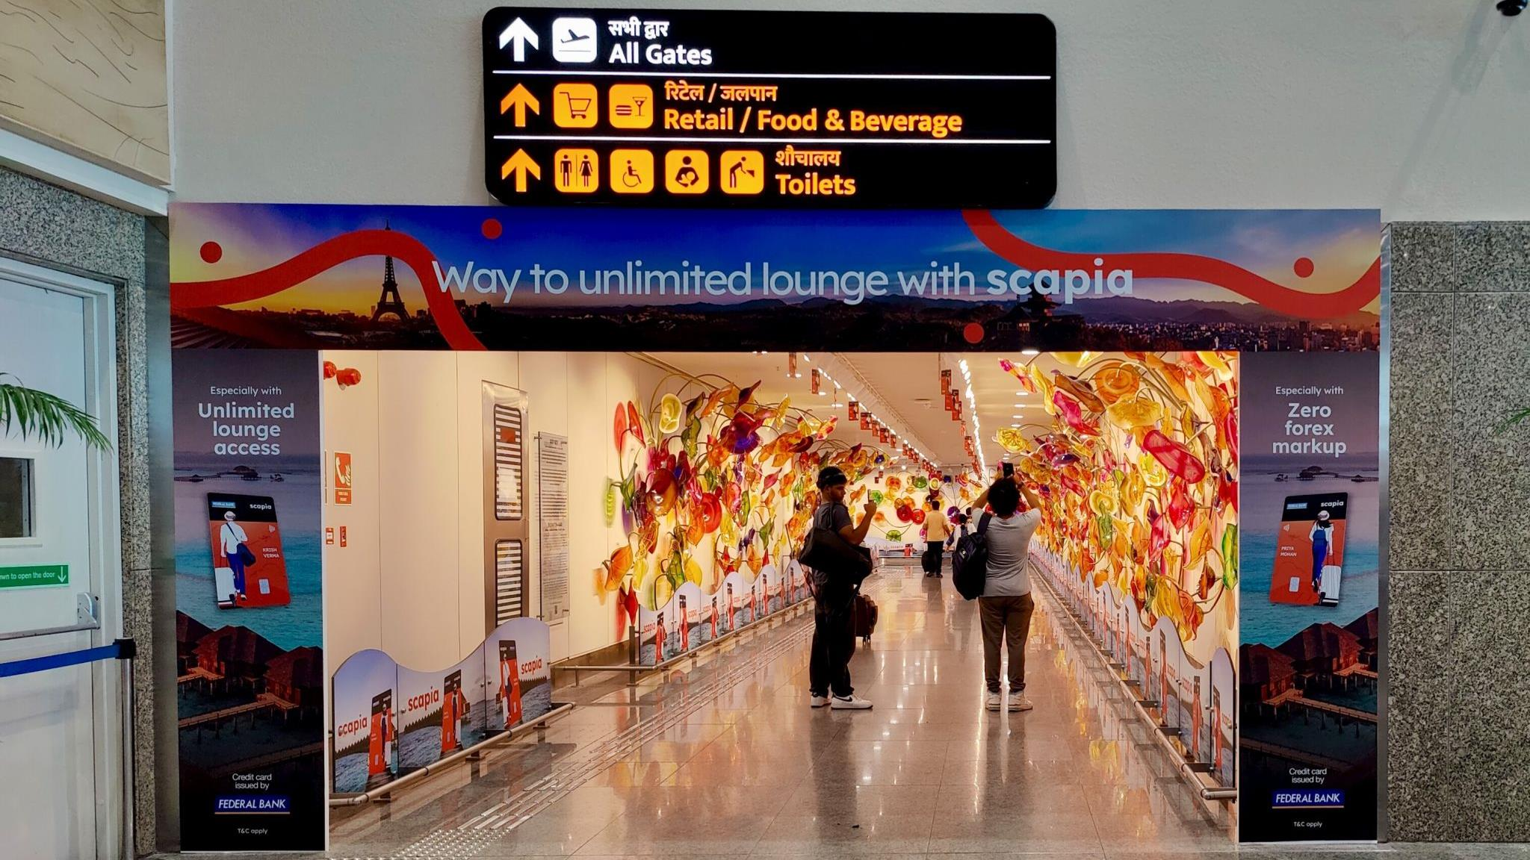
T3- DOMESTIC
Departure | Phoolon Wali Gali- Post Security Check | On Request | Non Lit
Static Panel Single Sided
Rental Cost | 14,00,000/- P/M
Production Cost | 2,00,000/-
www.themediaant.com
Notes:
‹#›

Slide 11
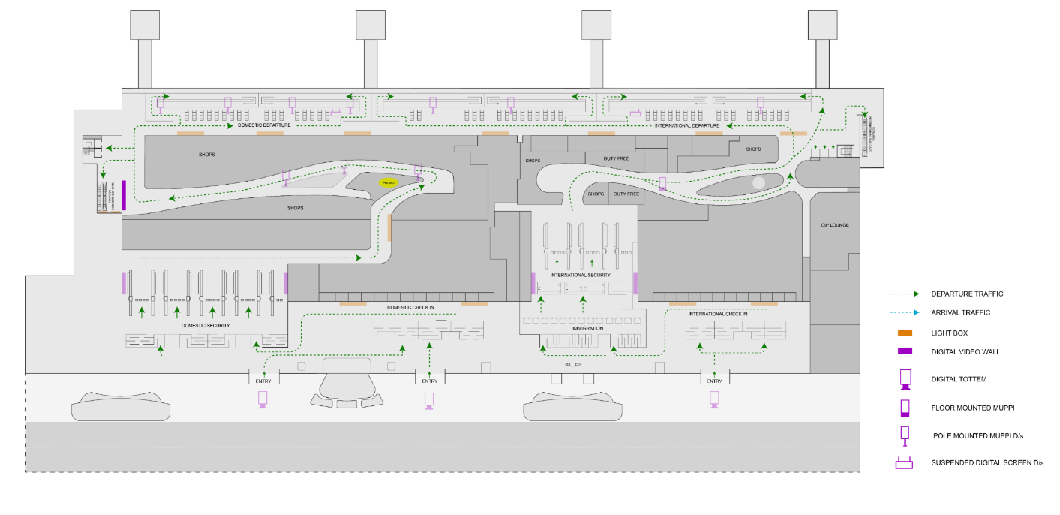
T3- DOMESTIC
Departure | Phoolon Wali Gali- Post Security Check | On Request | Non Lit
www.themediaant.com
Notes:
‹#›

Slide 12
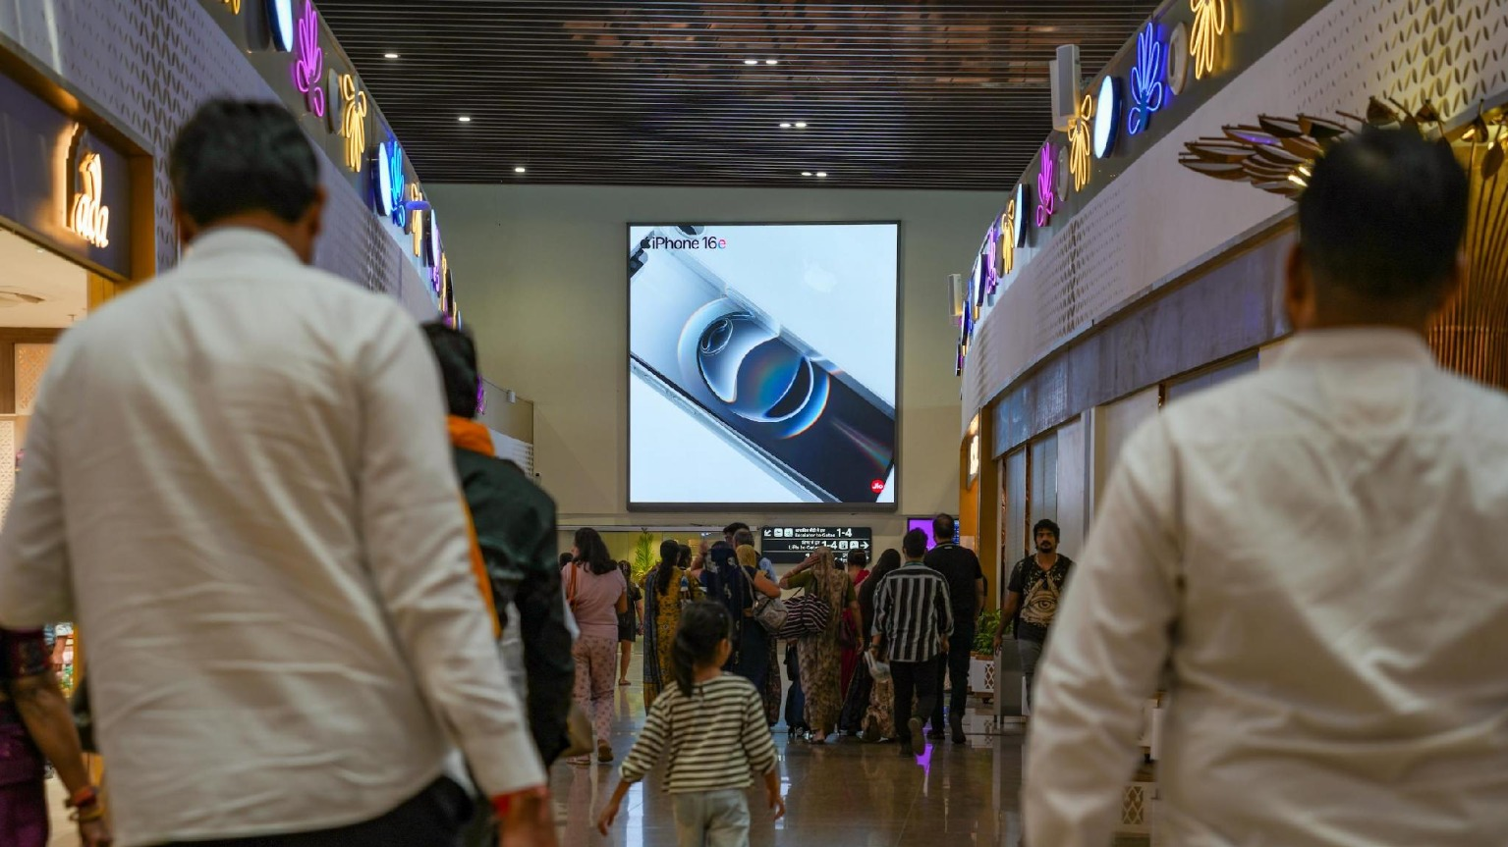
T3- DOMESTIC
Departure | Post Retail Area | 20 W X 20 H ft (Only 1 Unit) | 10 Sec In Every 30 Sec
Digital Wall
Rental Cost | 12,00,000/- P/M Per Slot
Production Cost | 10,000/-
www.themediaant.com
Notes:
‹#›

Slide 13
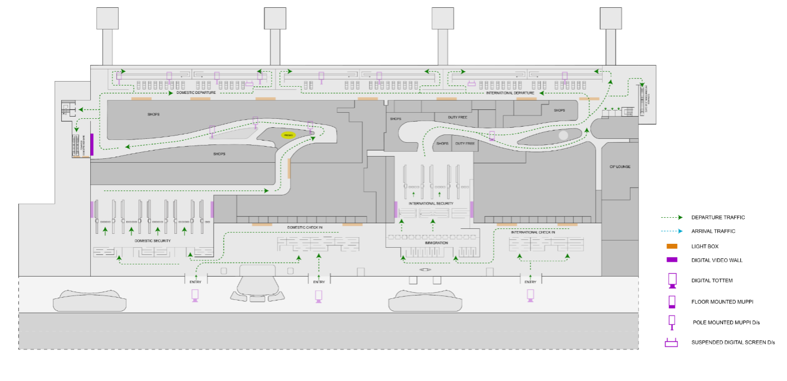
T3- DOMESTIC
Departure | Post Retail Area | 20 W X 20 H ft (Only 1 Unit) | 10 Sec In Every 30 Sec
www.themediaant.com
Notes:
‹#›

Slide 14
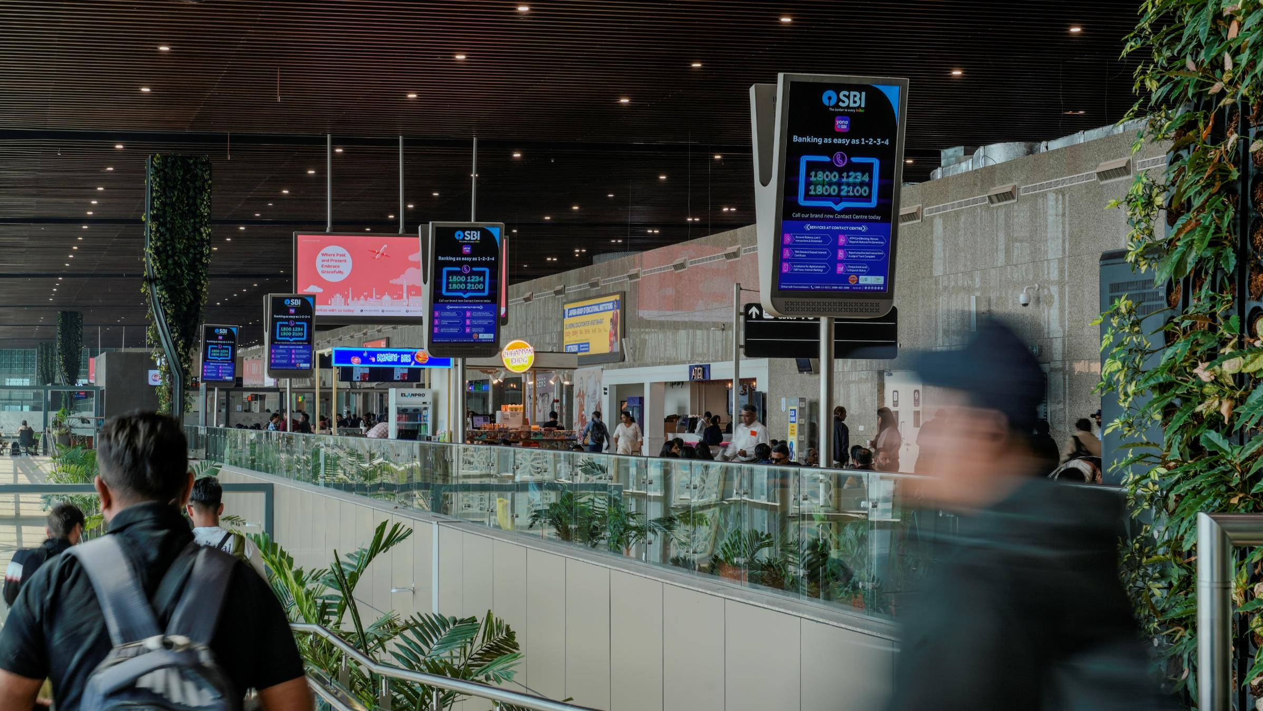
T3- DOMESTIC
Departure | Boarding Gate Area | 3 W X 5.5 H ft (Package Of 22 Units) 2160 W X 3840 H px | 10 Sec In Every 120 Sec
Digital Pole
Rental Cost | 12,00,000/- P/M Per Slot
Production Cost | 10,000/-
www.themediaant.com
Notes:
‹#›

Slide 15
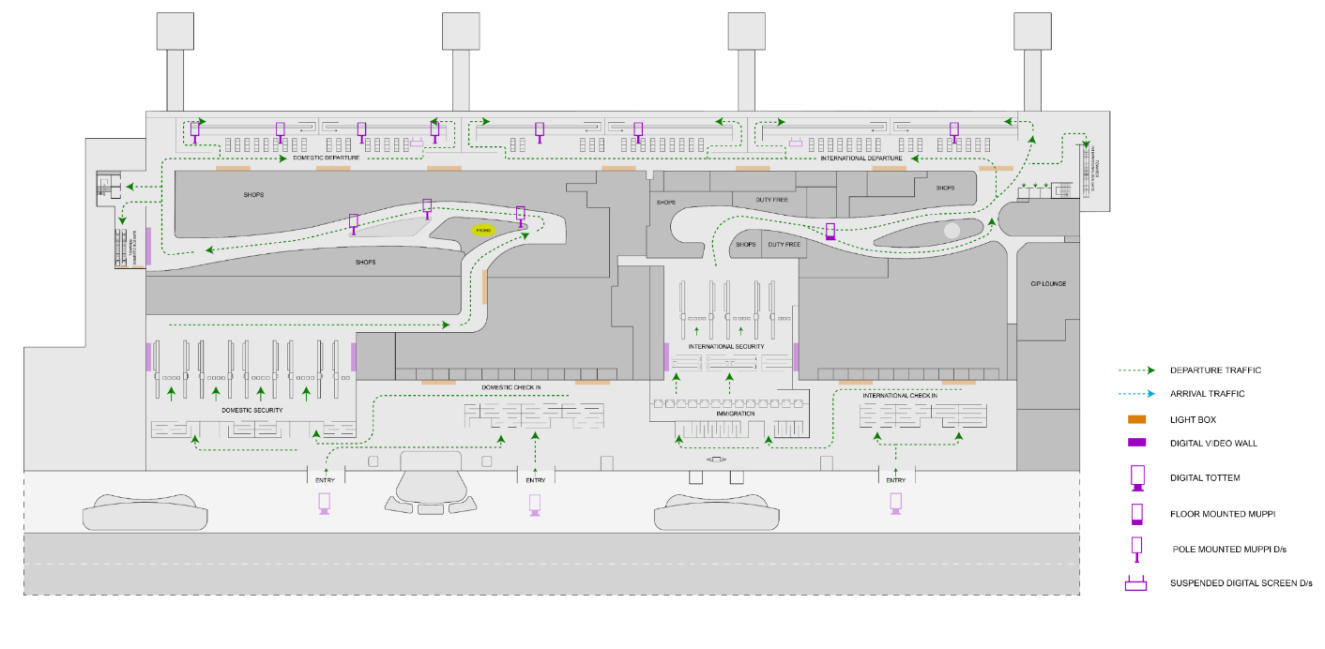
T3- DOMESTIC
Departure | Boarding Gate Area | 3 W X 5.5 H ft (Package Of 22 Units) 2160 W X 3840 H px | 10 Sec In Every 120 Sec
www.themediaant.com
Notes:
‹#›

Slide 16
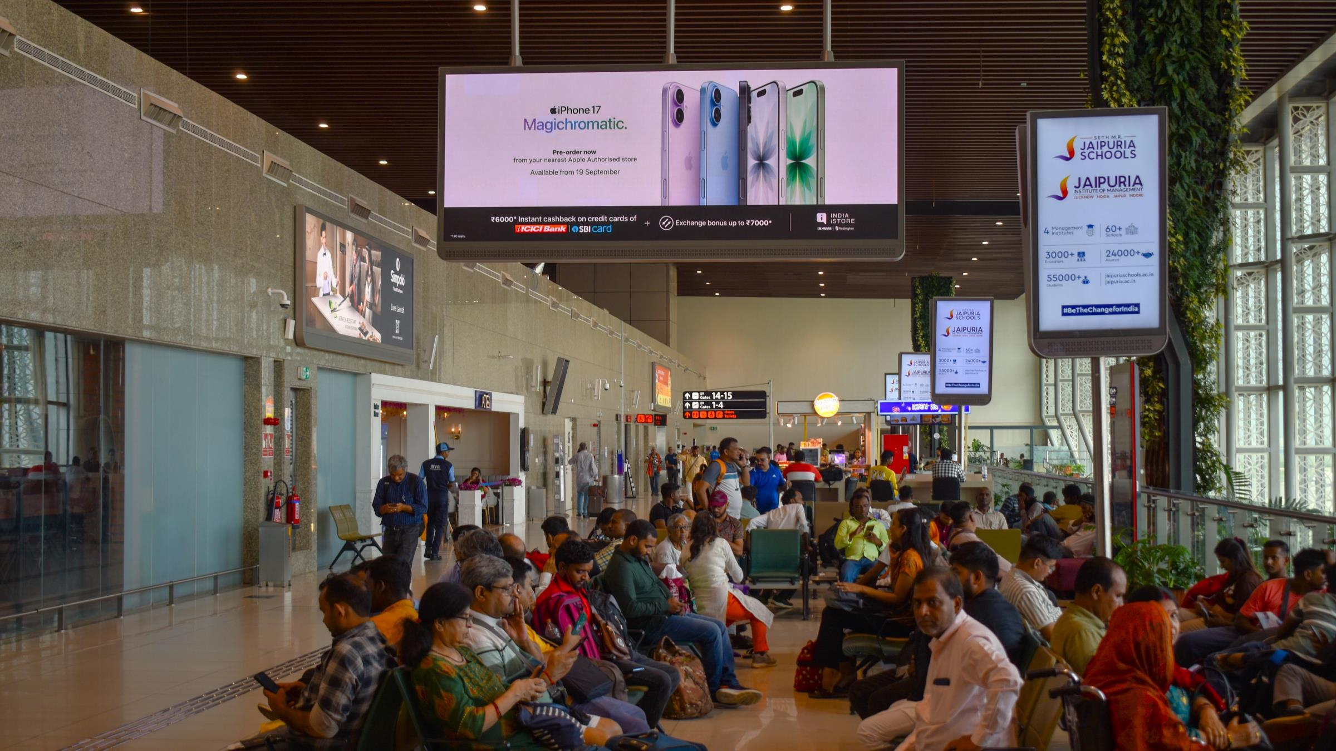
T3- DOMESTIC
Departure | Boarding Gate Area | 20 W X 8 H ft (Package Of 2 Units) 2304 W X 864 H px | 10 Sec In Every 60 Sec
Digital Wall Double Sided
Rental Cost | 9,50,000/- P/M Per Slot
Production Cost | 10,000/-
www.themediaant.com
Notes:
‹#›

Slide 17
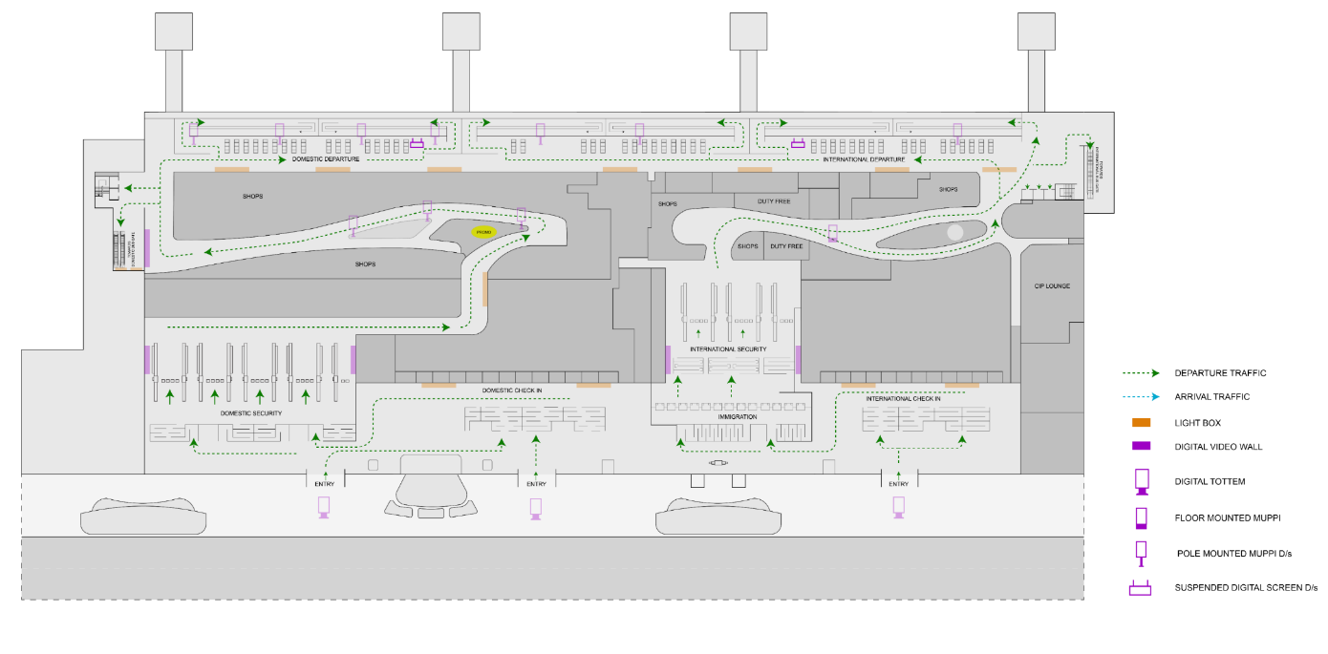
T3- DOMESTIC
Departure | Boarding Gate Area | 20 W X 8 H ft (Package Of 2 Units) 2304 W X 864 H px | 10 Sec In Every 60 Sec
www.themediaant.com
Notes:
‹#›

Slide 18
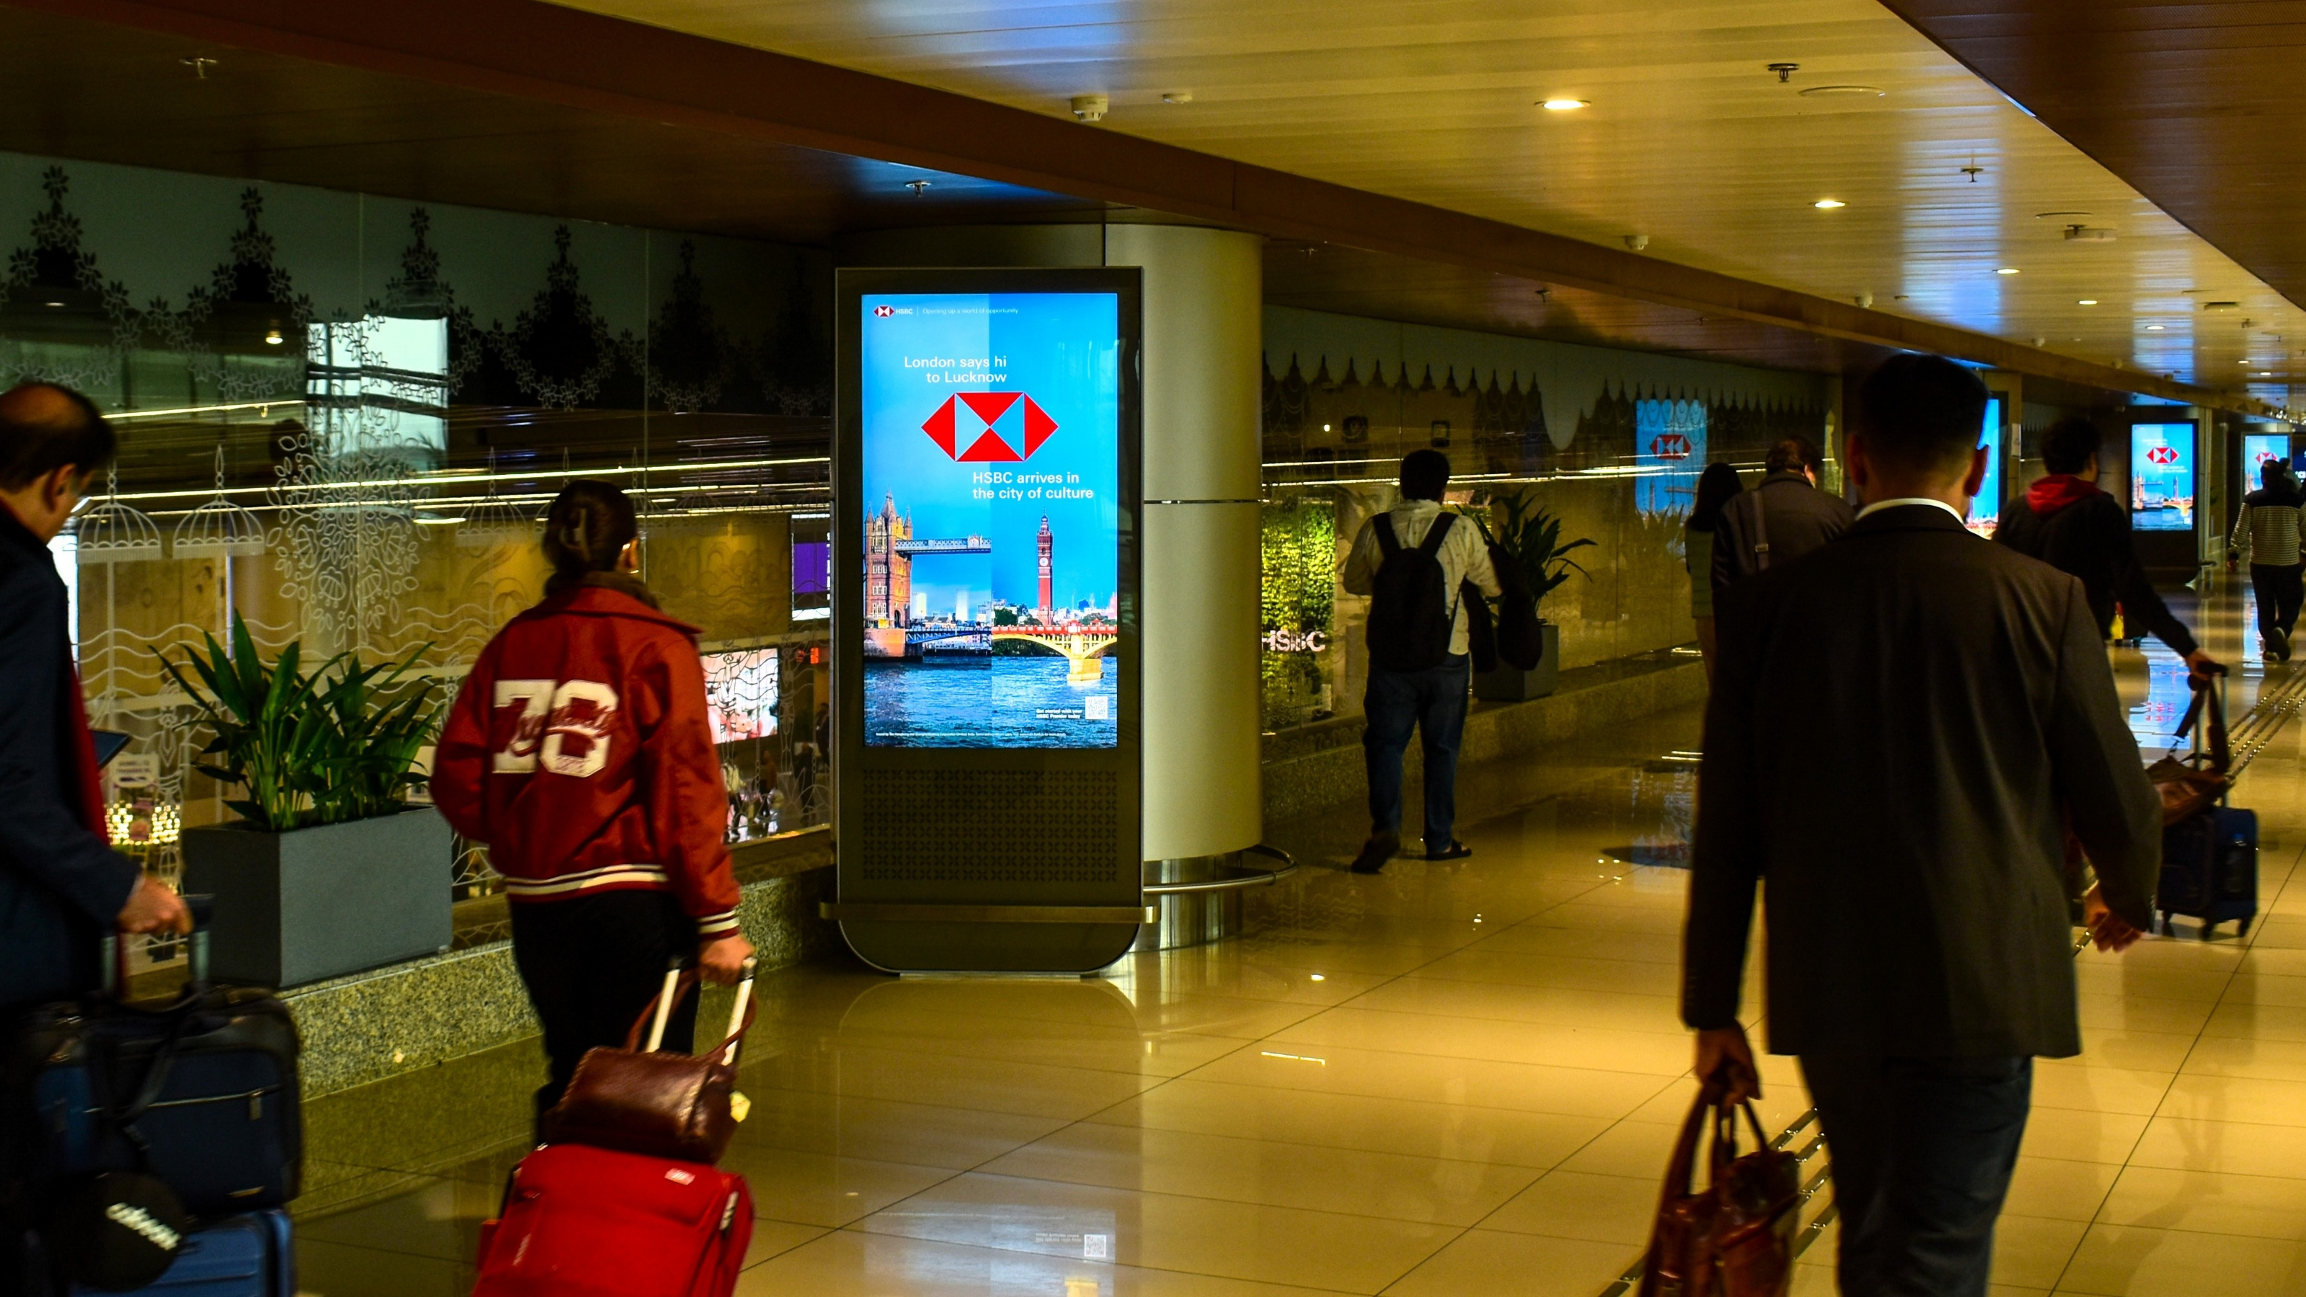
T3- DOMESTIC
Arrival | Arrival Area | 3 W X 5.5 H ft (Package Of 12 Units) 2160 W X 3840 H px | 10 Sec In Every 60 Sec
Digital Pod
Rental Cost | 9,00,000/- P/M Per Slot
Production Cost | 10,000/-
www.themediaant.com
Notes:
‹#›

Slide 19
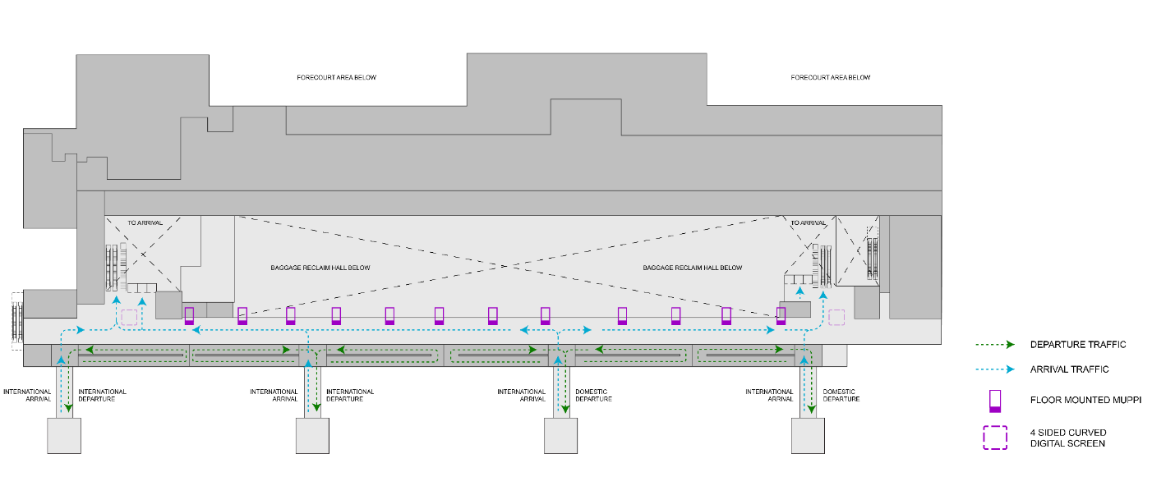
T3- DOMESTIC
Arrival | Arrival Area | 3 W X 5.5 H ft (Package Of 12 Units) 2160 W X 3840 H px | 10 Sec In Every 60 Sec
www.themediaant.com
Notes:
‹#›

Slide 20
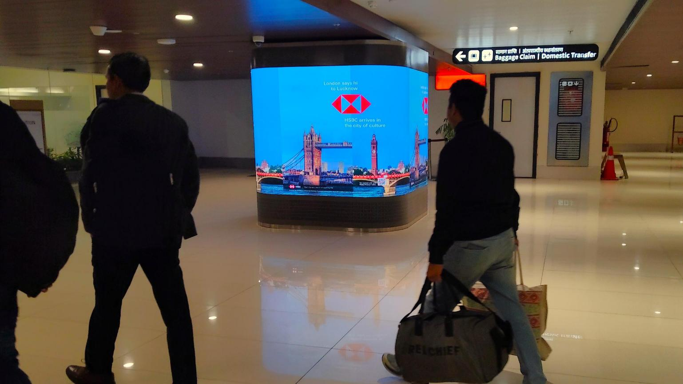
T3- DOMESTIC
Arrival | Arrival Area | 6 W X 6 H ft (Package Of 2 Units) | Exclusive
Digital Wall Quad Sided
Rental Cost | 12,00,000/- P/M Per Slot
Production Cost | 10,000/-
Note: This is an exclusive media placement dedicated to a single advertiser and runs continuously throughout the operating hours. There is no fixed minimum or maximum creative duration; the advertiser can determine the creative duration based on their requirements.
www.themediaant.com
Notes:
‹#›

Slide 21
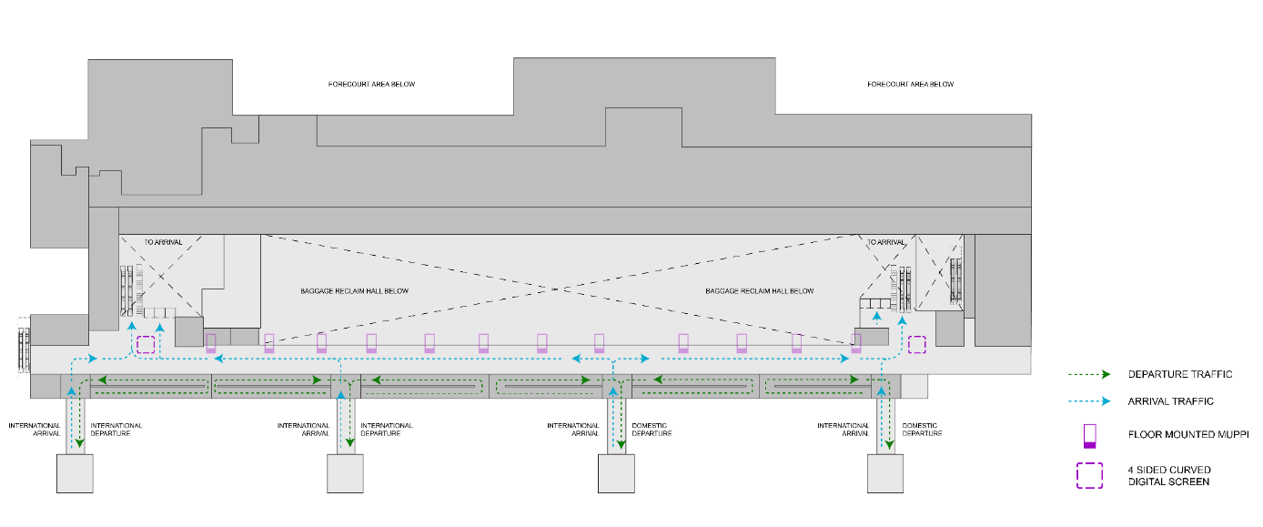
T3- DOMESTIC
Arrival | Arrival Area | 6 W X 6 H ft (Package Of 2 Units) | Exclusive
www.themediaant.com
Notes:
‹#›

Slide 22
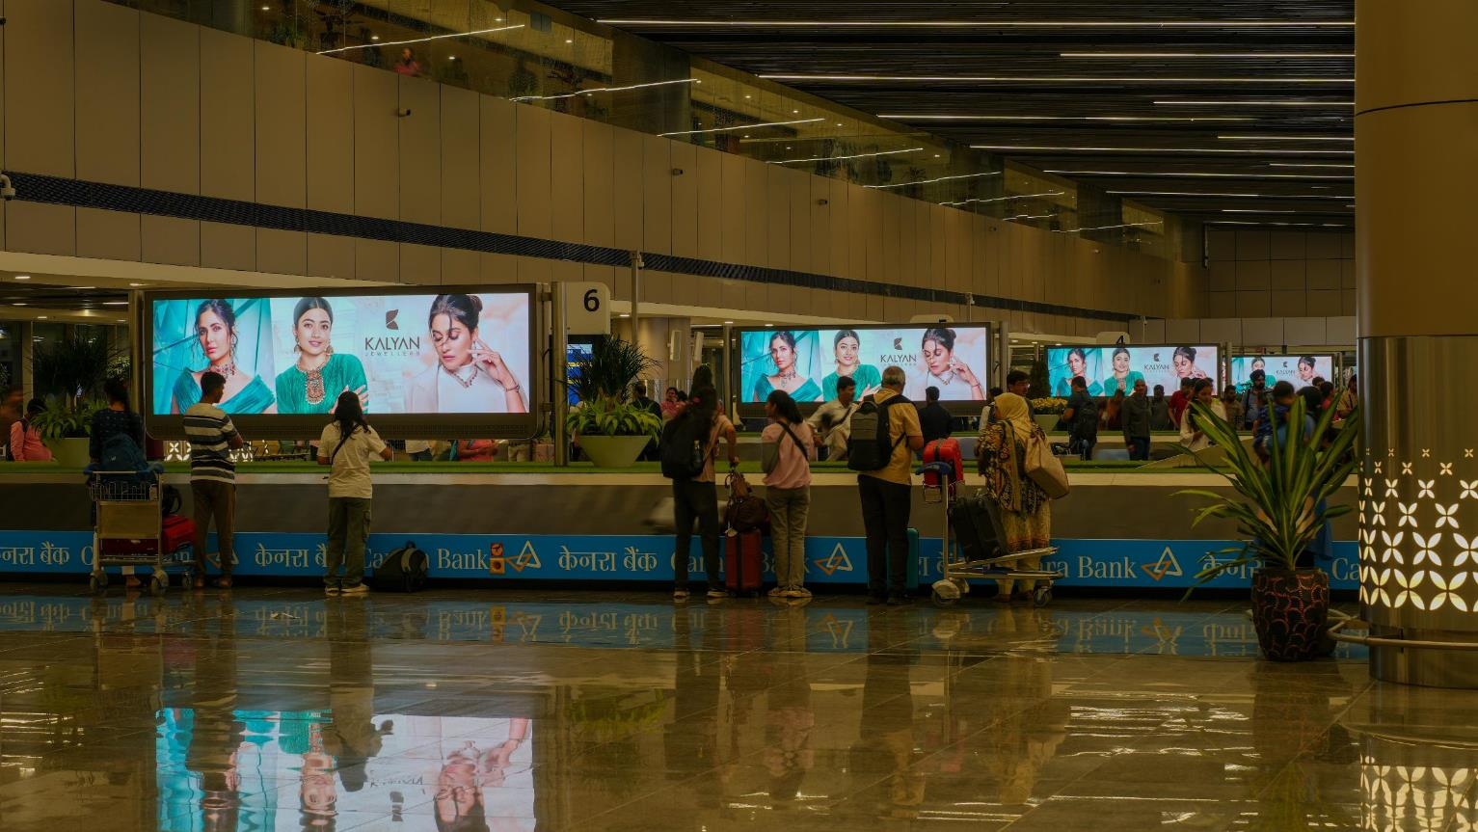
T3- DOMESTIC
Arrival | Baggage Claim | 12 W X 4 H ft (Package Of 7 Units) 1536 W X 432 H px | 10 Sec In Every 120 Sec
Digital Wall Double Sided
Rental Cost | 12,00,000/- P/M Per Slot
Production Cost | 10,000/-
www.themediaant.com
Notes:
‹#›

Slide 23
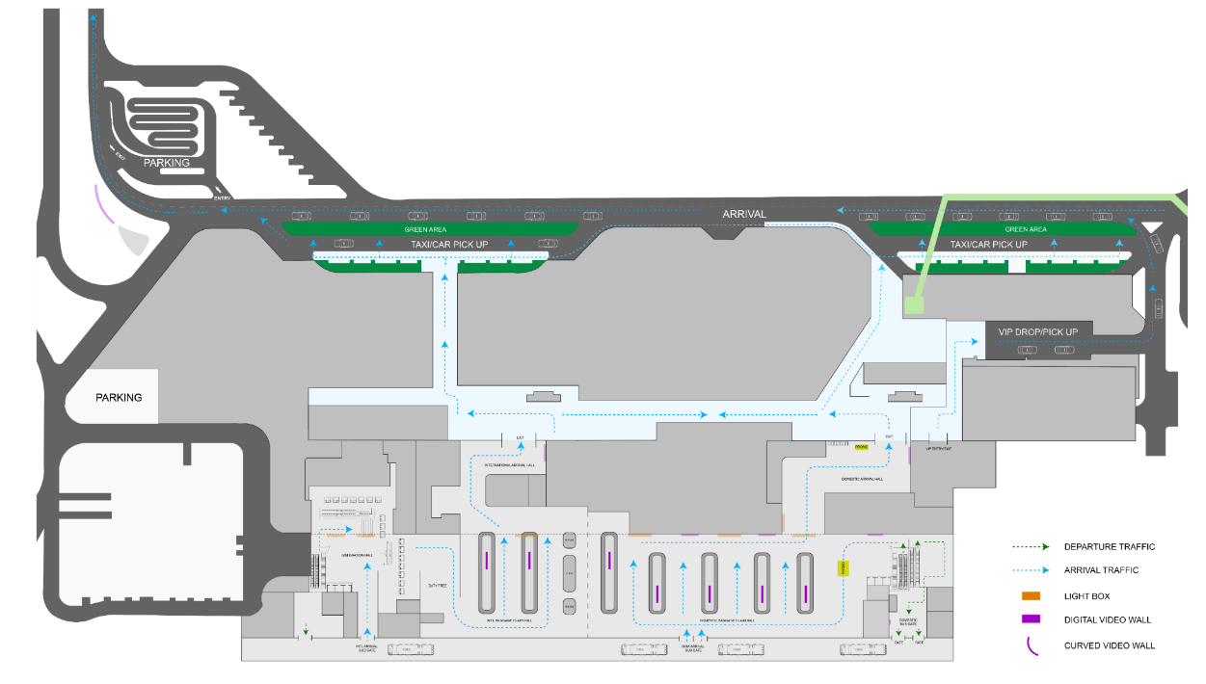
T3- DOMESTIC
Arrival | Baggage Claim | 12 W X 4 H ft (Package Of 7 Units) 1536 W X 432 H px | 10 Sec In Every 120 Sec
www.themediaant.com
Notes:
‹#›

Slide 24
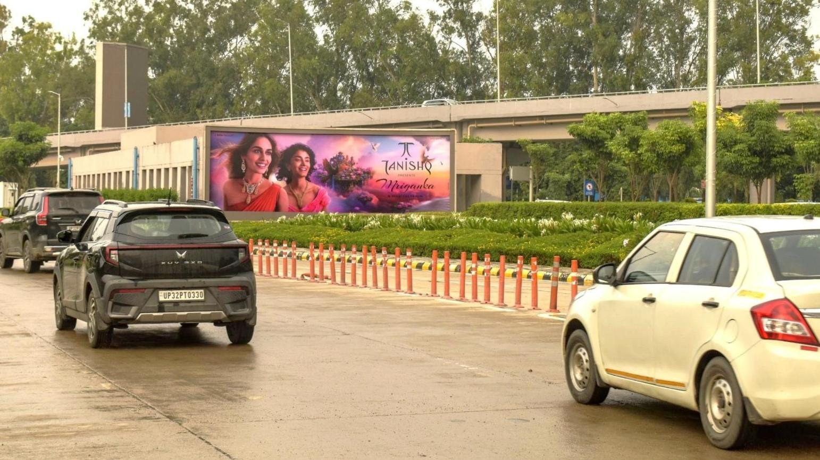
T3- DOMESTIC
Arrival | Arrival Exit Lane | 30 W X 10 H ft (Only 1 Unit) | Back Lit
Hoarding
Rental Cost | 10,00,000/- P/M
Production Cost | 31,500/-
www.themediaant.com
Notes:
‹#›

Slide 25
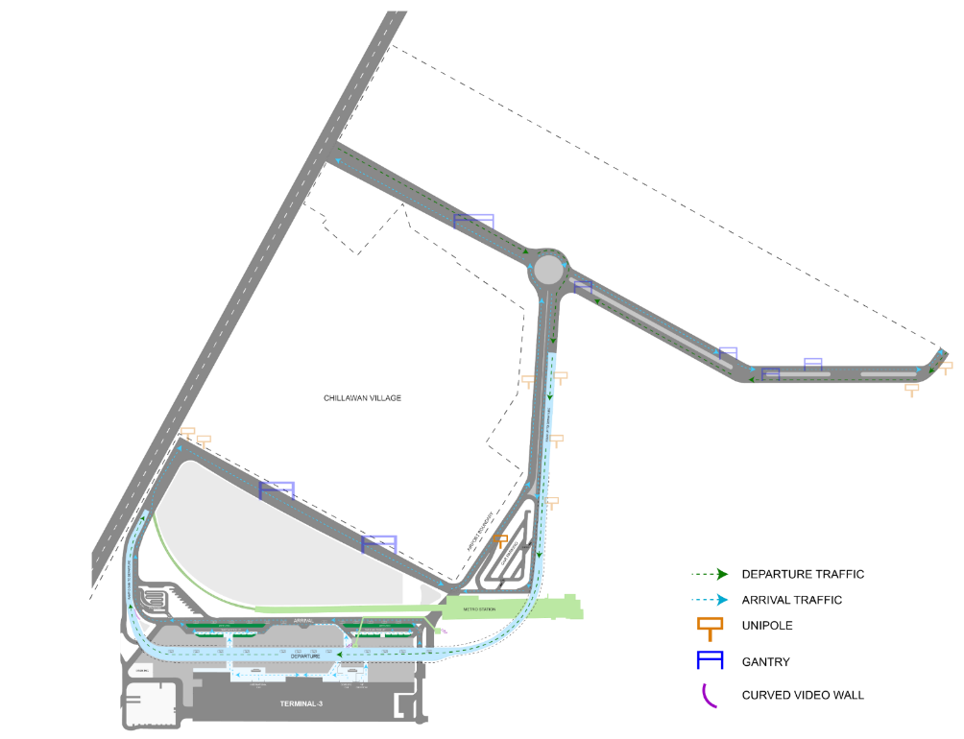
T3- DOMESTIC
Arrival | Arrival Exit Lane | 30 W X 10 H ft (Only 1 Unit) | Back Lit
www.themediaant.com
Notes:
‹#›

Slide 26
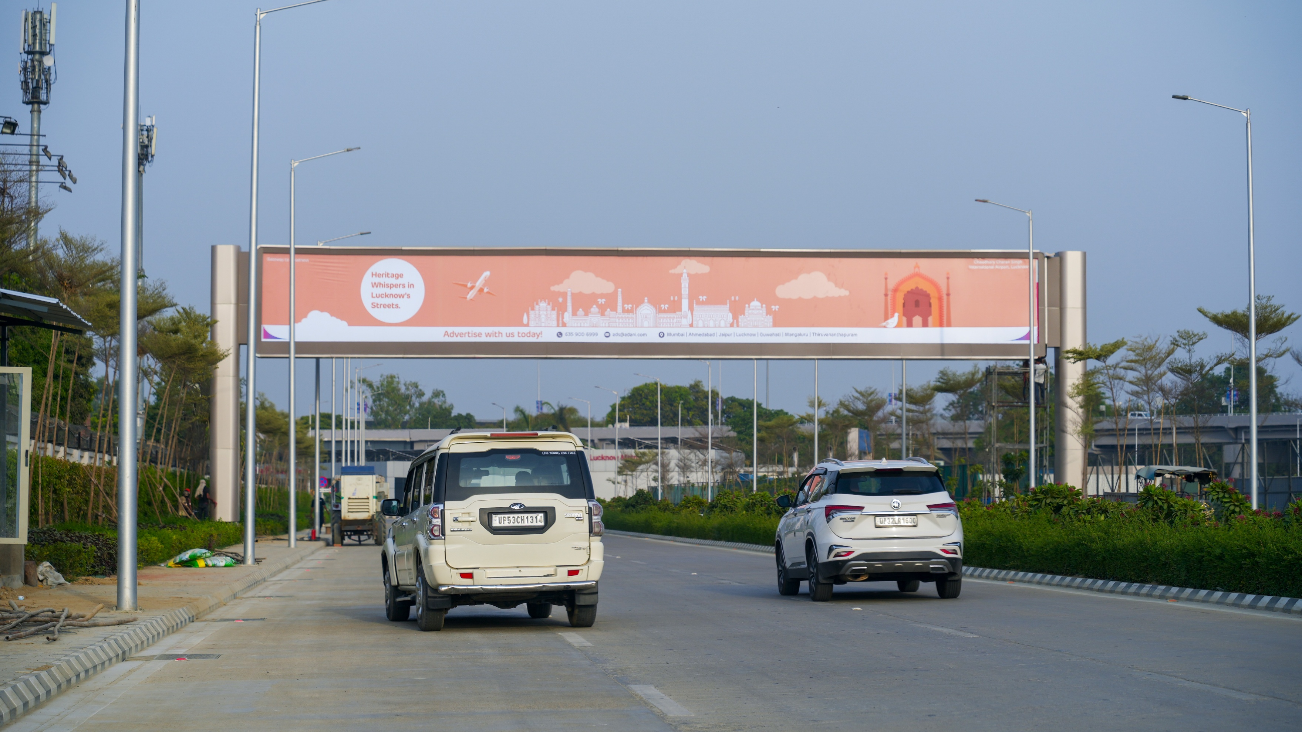
T3- DOMESTIC
Arrival | Outdoor Arrival Road | 85 W X 10 H ft (Only 1 Unit) | Back Lit
Hoarding
Rental Cost | 10,00,000/- P/M
Production Cost | 93,500/-
www.themediaant.com
Notes:
‹#›

Slide 27
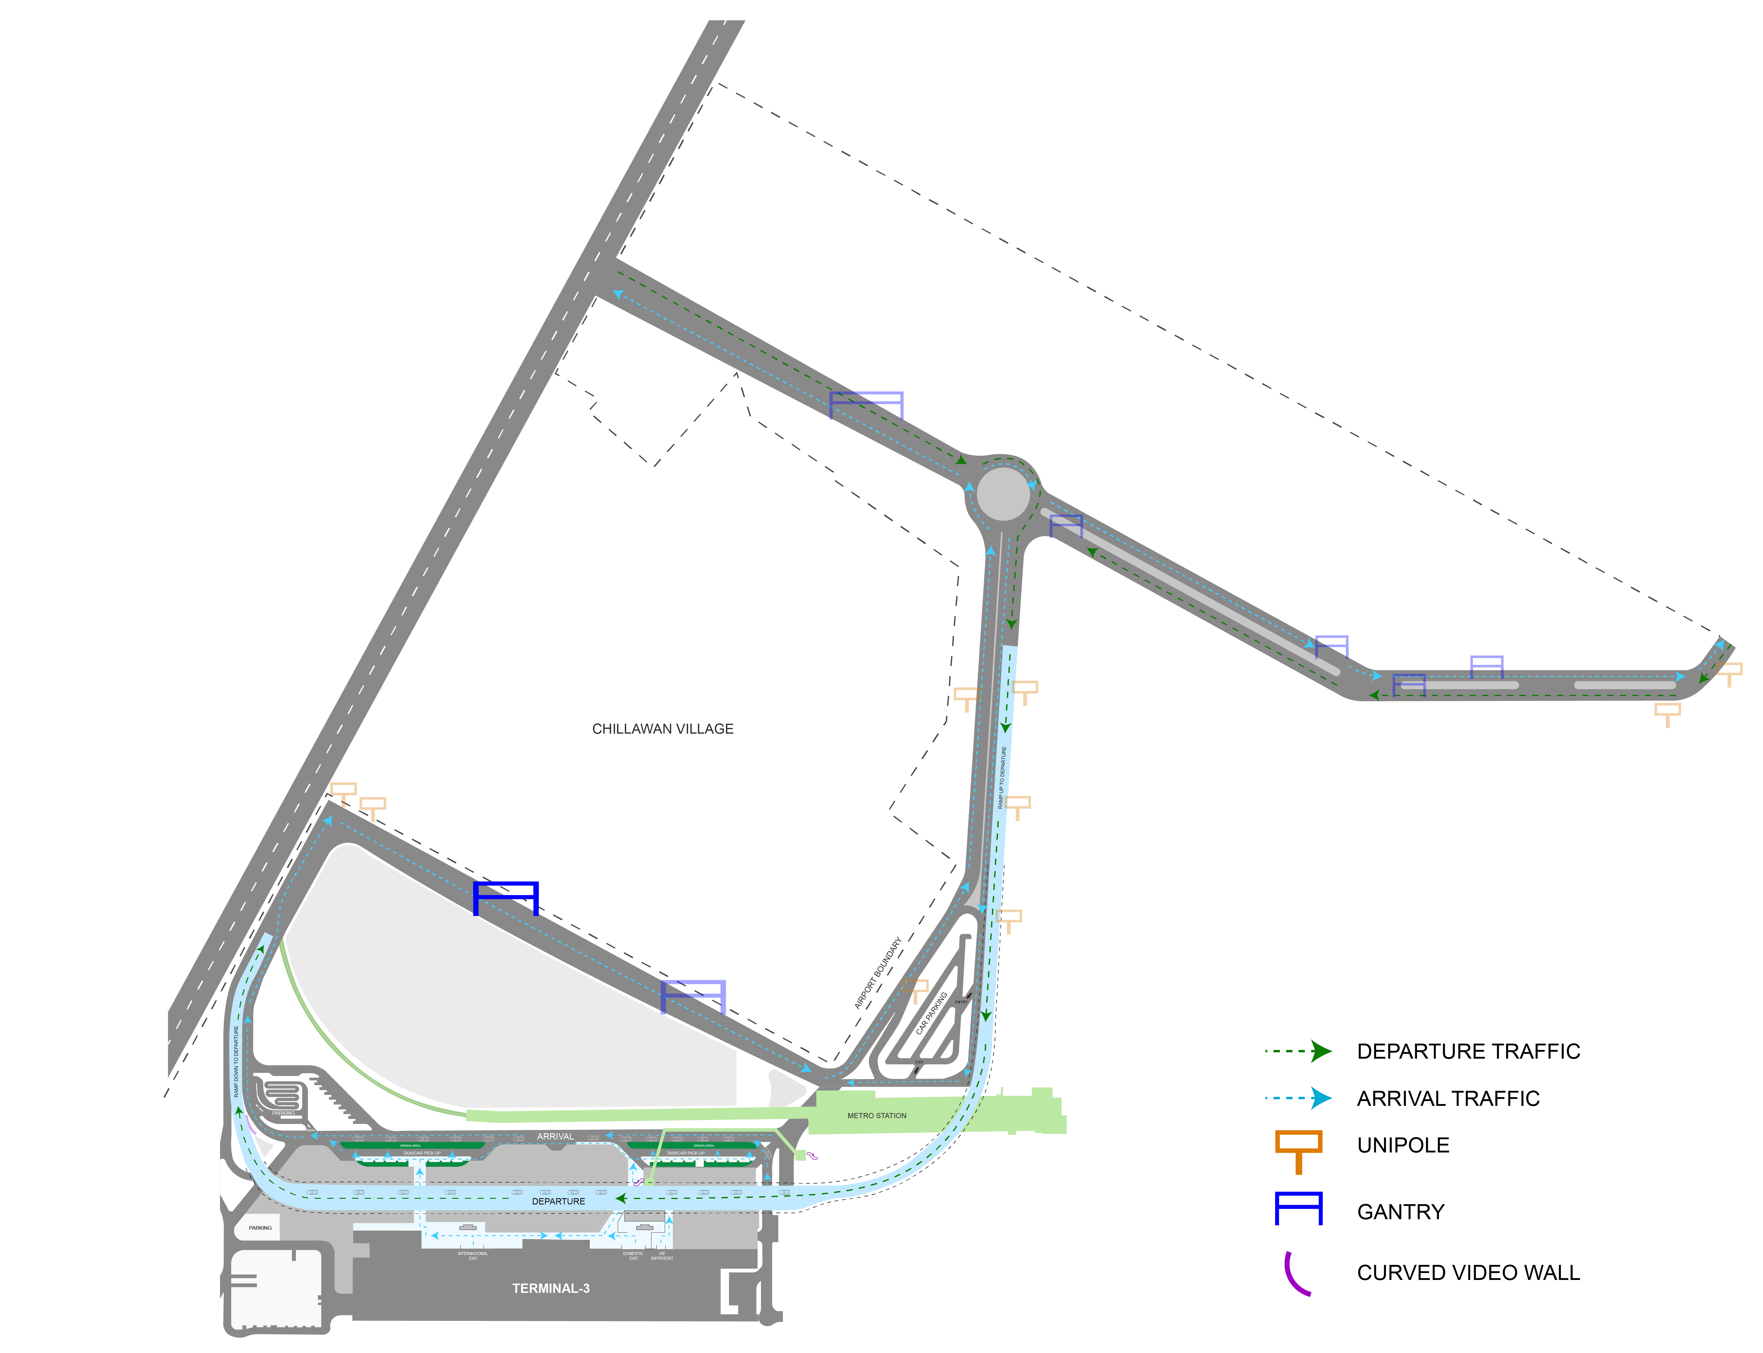
T3- DOMESTIC
Arrival | Outdoor Arrival Road | 85 W X 10 H ft (Only 1 Unit) | Back Lit
www.themediaant.com
Notes:
‹#›

Slide 28





www.themediaant.com
ad@themediaant.com
Thank You
080-067415510
Empowering All To Advertise
Notes:
‹#›

