Slide 1

Jaipur Airport
Digital Screen

Slide 2
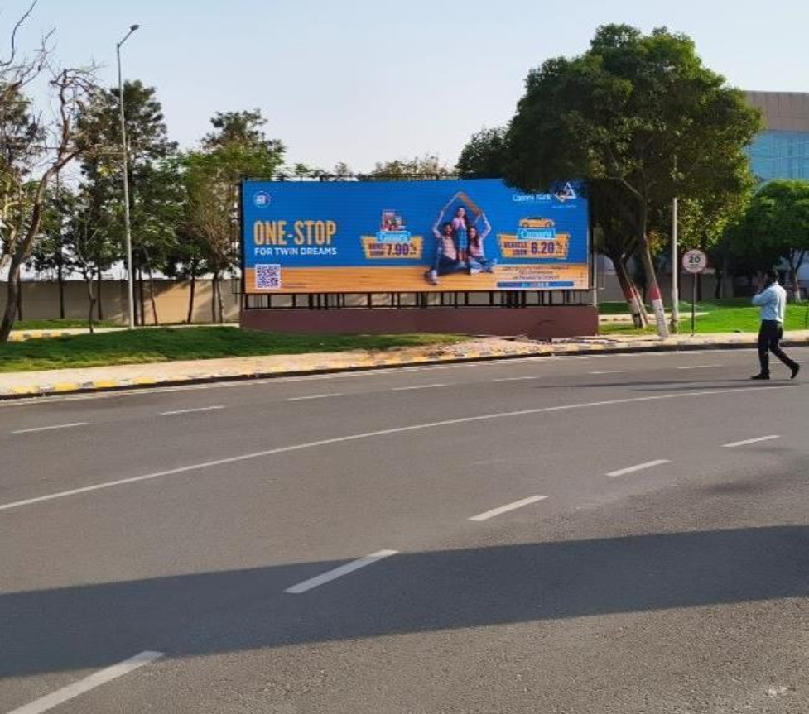


T2- DOMESTIC
Departure | Towards Departure Area | 30 W X 10 H ft (Only 1 Unit) | 15 Sec In Every 1 Min
Digital Wall
www.themediaant.com
Notes:
‹#›

Slide 3
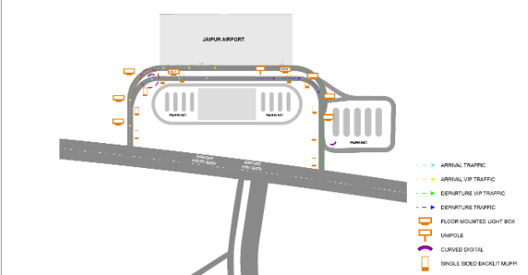
T2- DOMESTIC
Departure | Towards Departure Area | 30 W X 10 H ft (Only 1 Unit) | 15 Sec In Every 1 Min
www.themediaant.com
Notes:
‹#›

Slide 4
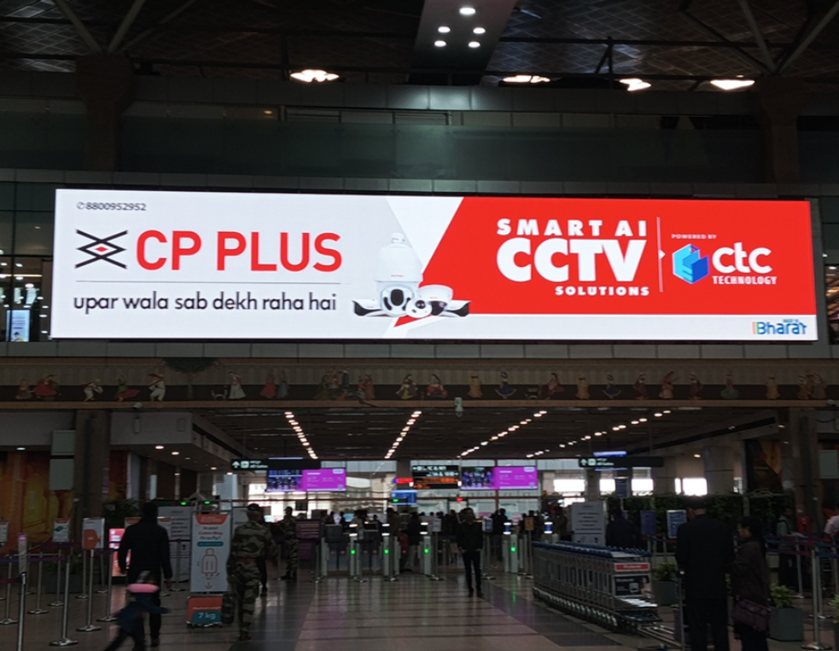
T2- DOMESTIC
Departure | Check In Hall | 65 W X 16 H ft Only 1 Unit) | 10 Sec In Every 30 Sec
Digital Wall
www.themediaant.com
Notes:
‹#›

Slide 5
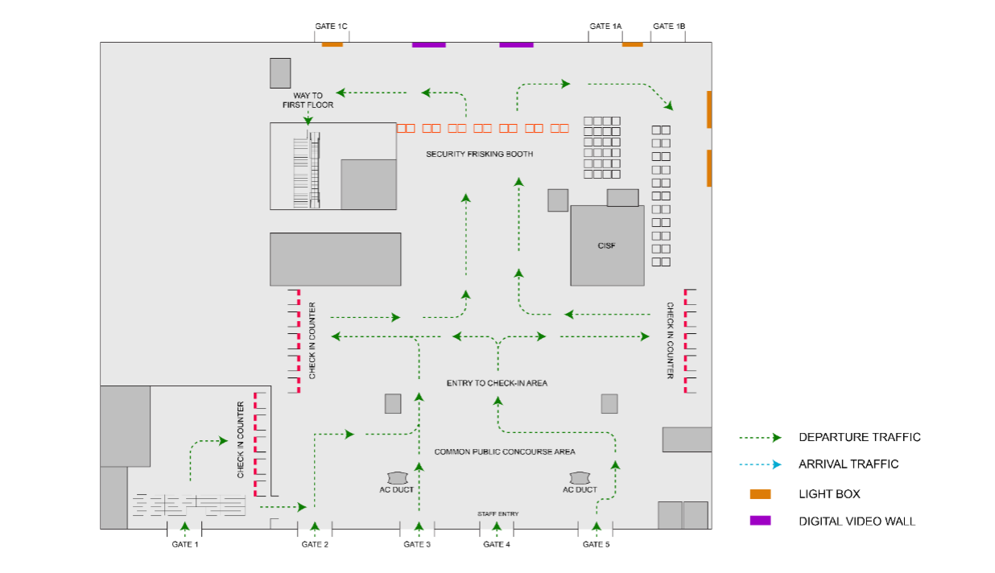
T2- DOMESTIC
Departure | Check In Hall | 65 W X 16 H ft Only 1 Unit) | 10 Sec In Every 30 Sec
www.themediaant.com
Notes:
‹#›

Slide 6
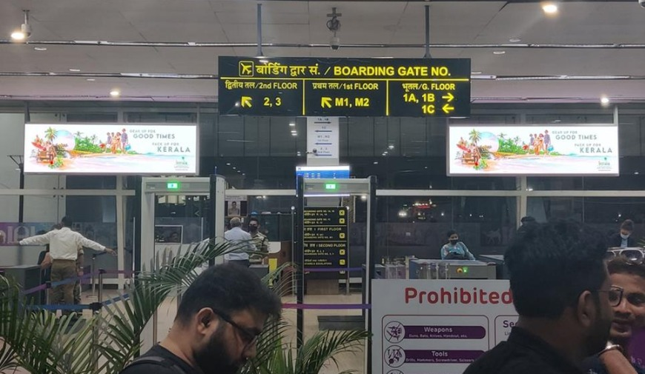
T2- DOMESTIC
Departure | Security Check Area | 12 W X 4 H ft (Package Of 2 Units) | 10 Sec In Every 2 Min
Digital Wall
www.themediaant.com
Notes:
‹#›

Slide 7
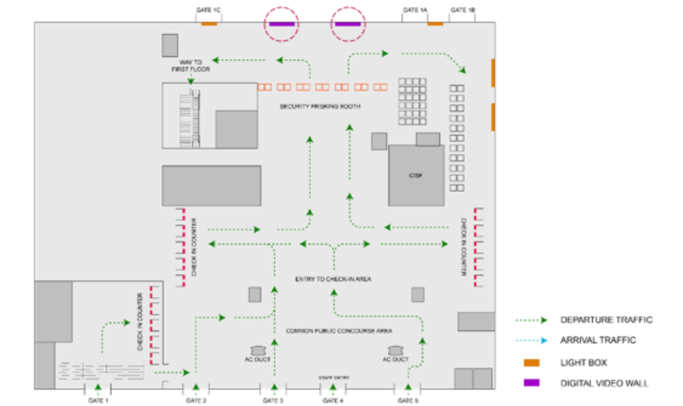
T2- DOMESTIC
Departure | Security Check Area | 12 W X 4 H ft (Package Of 2 Units) | 10 Sec In Every 2 Min
www.themediaant.com
Notes:
‹#›

Slide 8
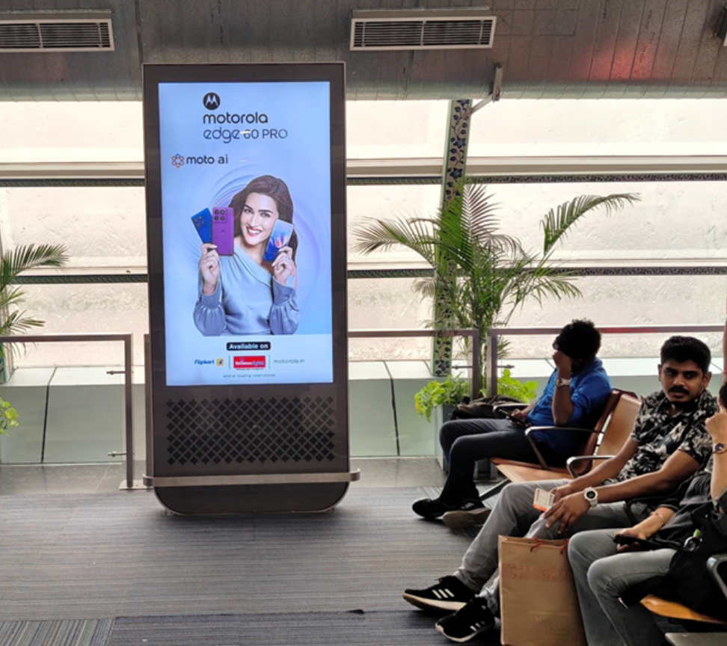
T2- DOMESTIC
Arrival & Departure | Arrival & Departure Area | 75 Inches (Package Of 17 Units)- Departure & 65 Inches (Package Of 6 Units)- Arrival | 10 Sec In Every 120 Sec
Digital Pod
www.themediaant.com
Notes:
‹#›

Slide 9
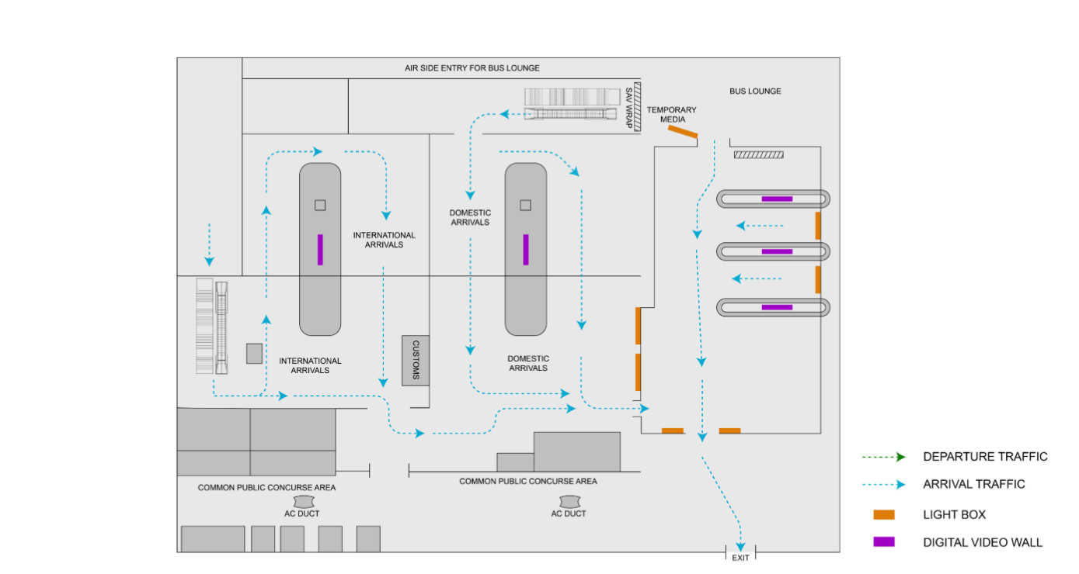

T2- DOMESTIC
Arrival & Departure | Arrival & Departure Area | 75 Inches (Package Of 17 Units)- Departure & 65 Inches (Package Of 6 Units)- Arrival | 10 Sec In Every 120 Sec
www.themediaant.com
Notes:
‹#›

Slide 10
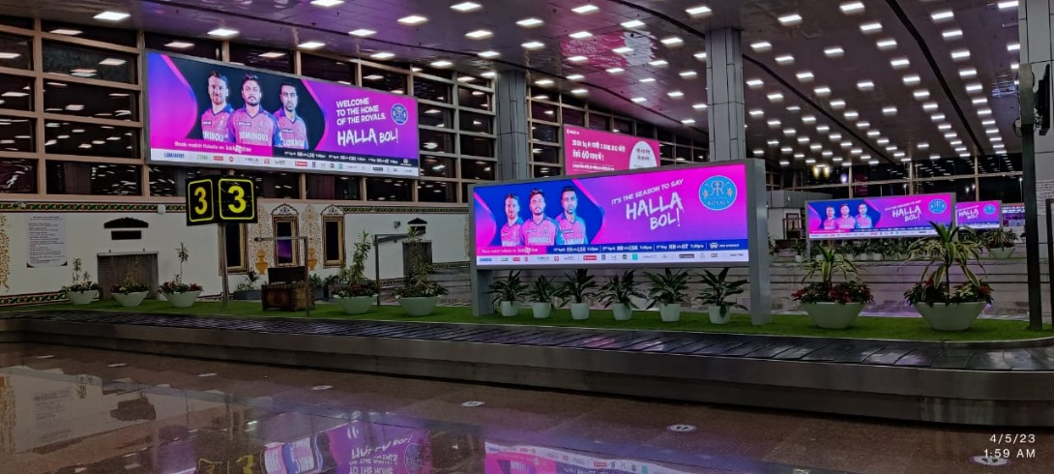
T1 & T2- DOMESTIC + INTERNATIONAL
Arrival | Baggage Claim Area | 12 W X 4 H f (Package Of 5 Units) | 10 Sec In Every 2 Min
Digital Wall Double Sided
www.themediaant.com
Notes:
‹#›

Slide 11
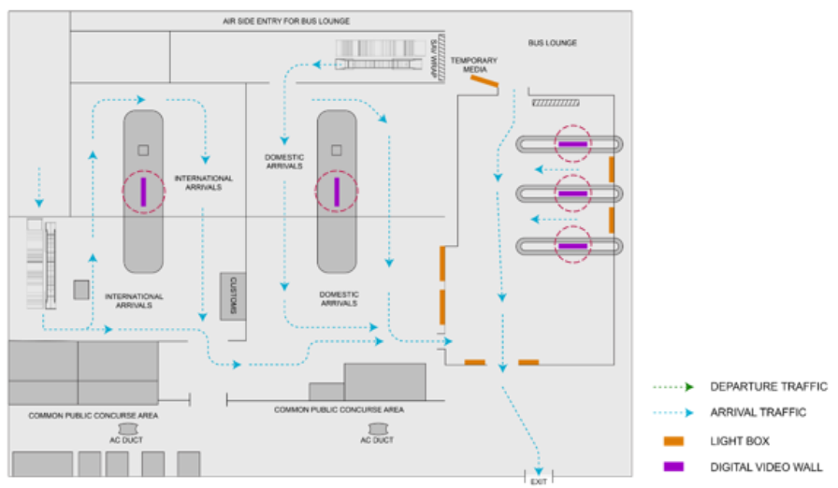
T1 & T2- DOMESTIC + INTERNATIONAL
Arrival | Baggage Claim Area | 12 W X 4 H f (Package Of 5 Units) | 10 Sec In Every 2 Min
www.themediaant.com
Notes:
‹#›

Slide 12
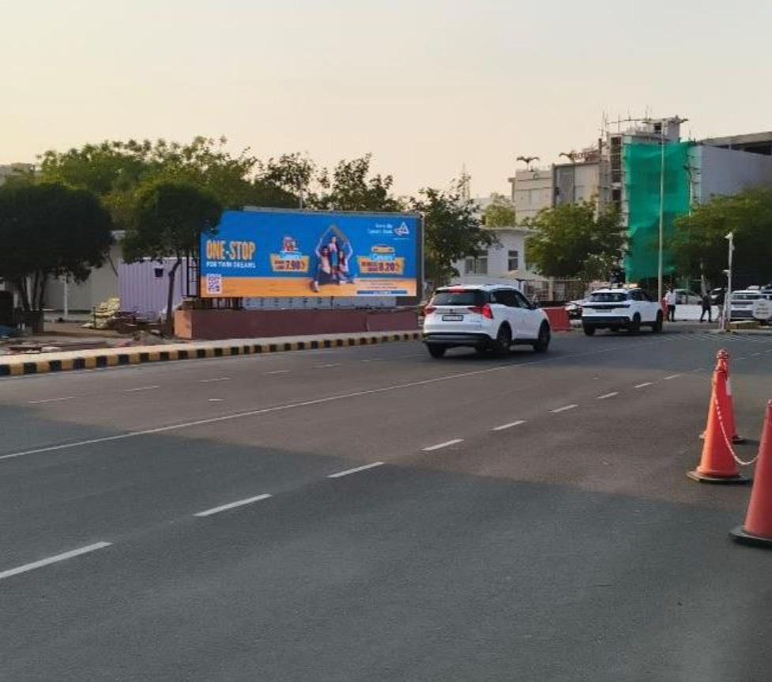
T2- DOMESTIC
Arrival | Arrival Road | 30 W X 10 H ft (Only 1 Unit) | 15 Sec In Every 1 Min
Digital Wall
www.themediaant.com
Notes:
‹#›

Slide 13
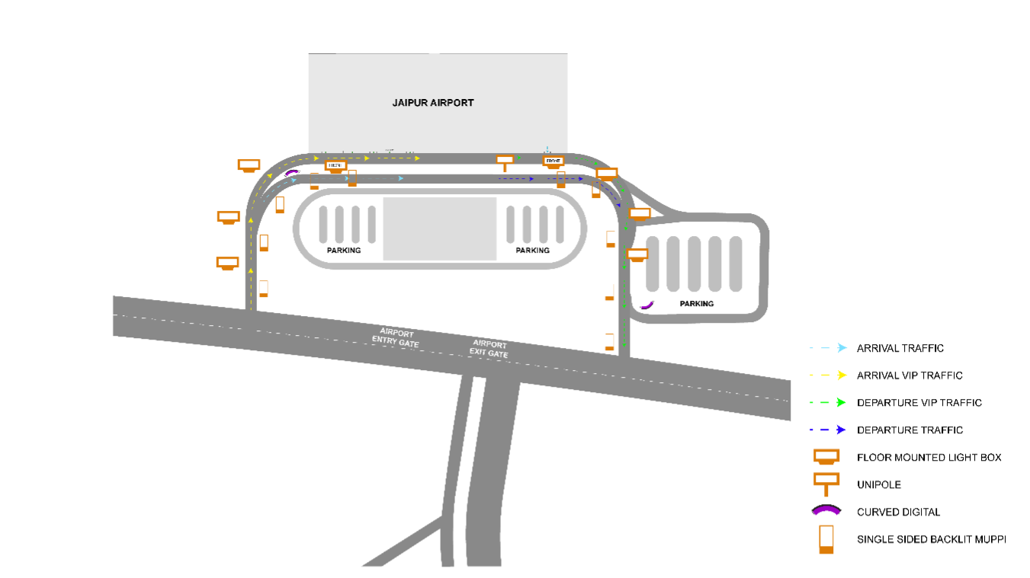
T2- DOMESTIC
Arrival | Arrival Road | 30 W X 10 H ft (Only 1 Unit) | 15 Sec In Every 1 Min
www.themediaant.com
Notes:
‹#›

Slide 14





www.themediaant.com
ad@themediaant.com
Thank You
080-067415510
Empowering All To Advertise
Notes:
‹#›

