Slide 1

Jaipur Airport
Media Kit

Slide 2
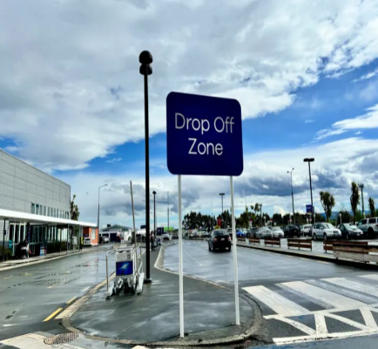
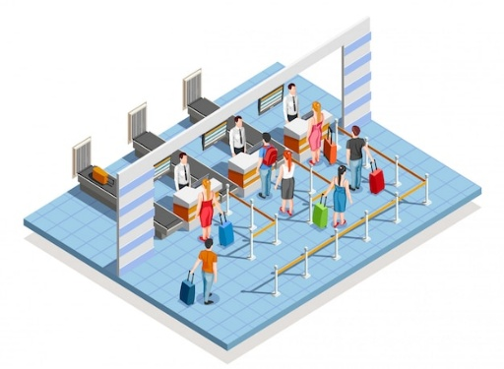
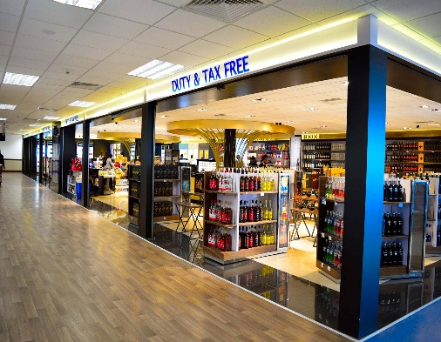
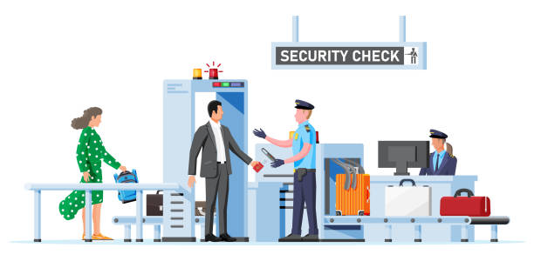
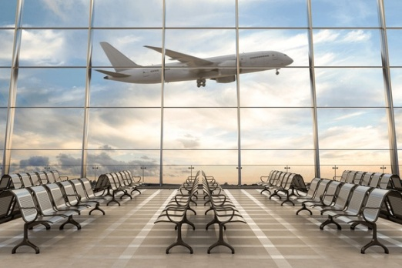
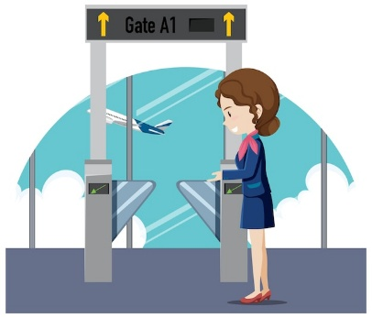


Drop Off
Check In Area
Target travelers and Waiting area Meeters & Greeters.
High Traffic Areas for Impactful advertising.
AIRPORT LAYOUT DEPARTURE
Retail Area
Security check Area
Opportunities for ads in shopping & Dinning Zone.
Captive Audience for targeted advertising
Boarding Area/ Lounge
Boarding Gate
High Dwell time area for awareness-based campaign.
Waiting Areas ideal for engagement.
www.themediaant.com

Slide 3
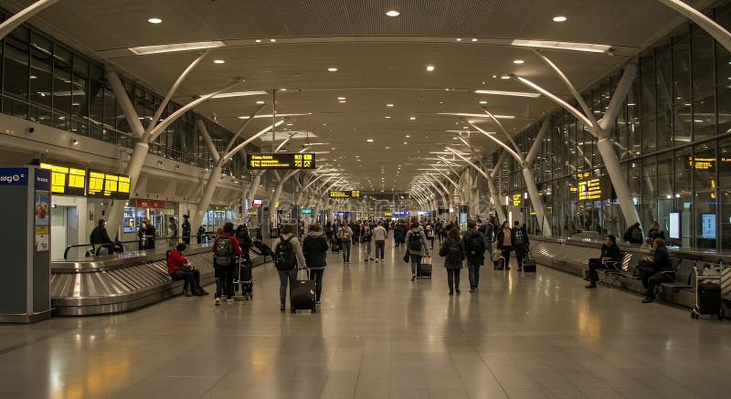
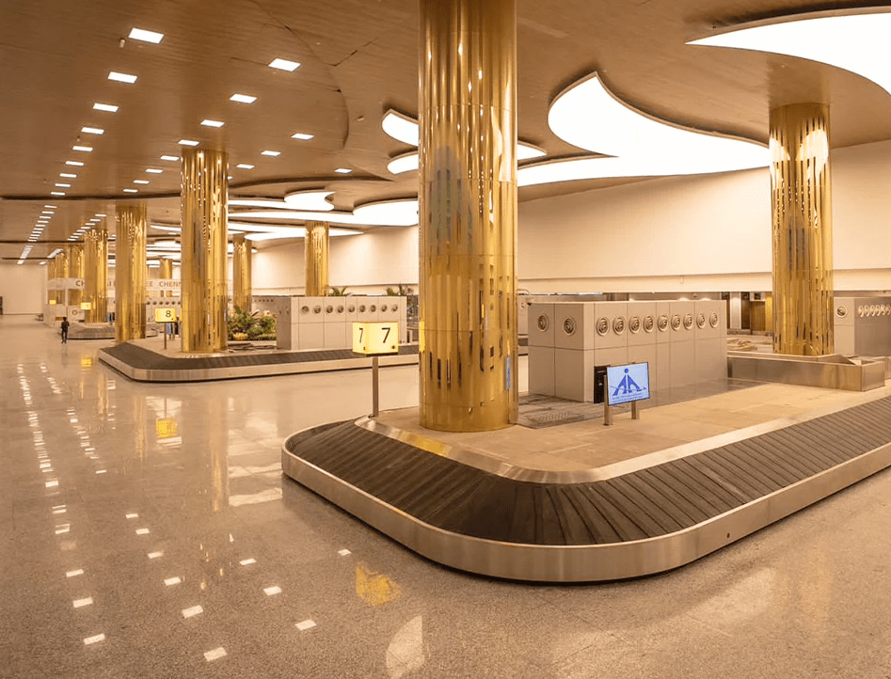
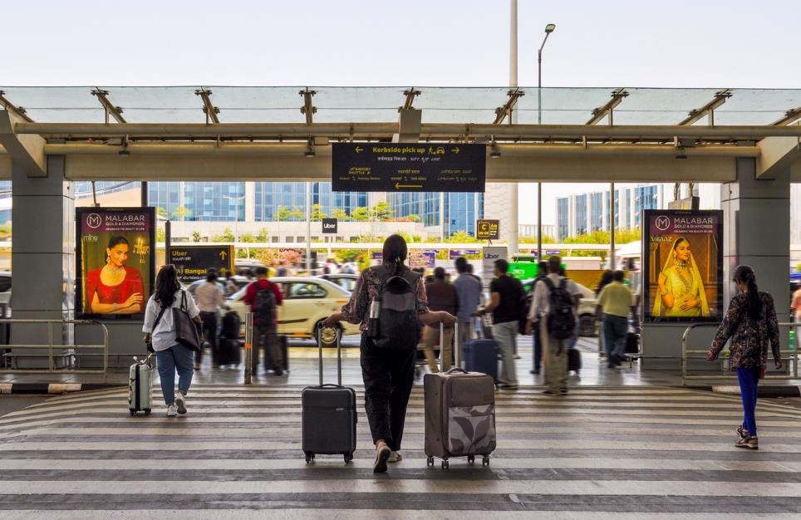
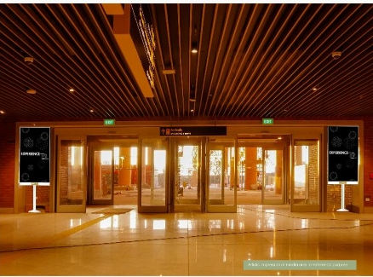
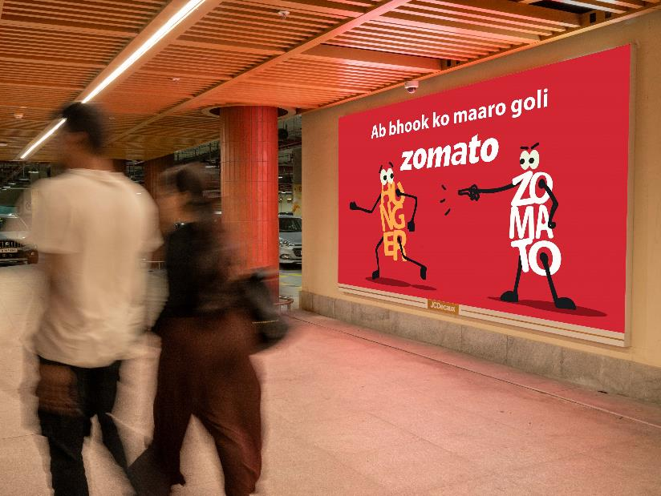
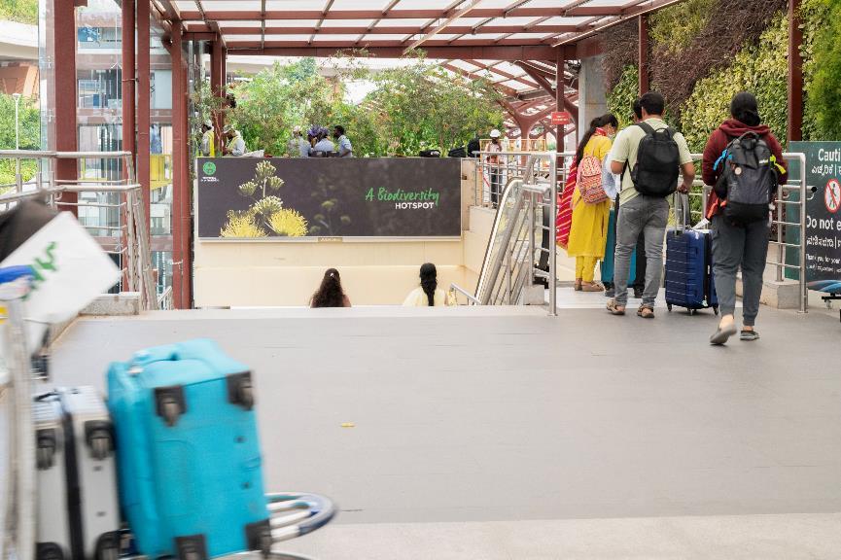
Arrival Hall
Baggage Belt
Welcoming spaces for arrival focused advertisement .
High Traffic & High Dwell time area for awareness-based campaign.
AIRPORT LAYOUT ARRIVAL
Meet & Greet Area
Exit Gate
Unique and large screen brand placement
100 % Arriving passenger coverage – Impact placement
Parking
Bus / Taxi Pick Up
www.themediaant.com

Slide 4
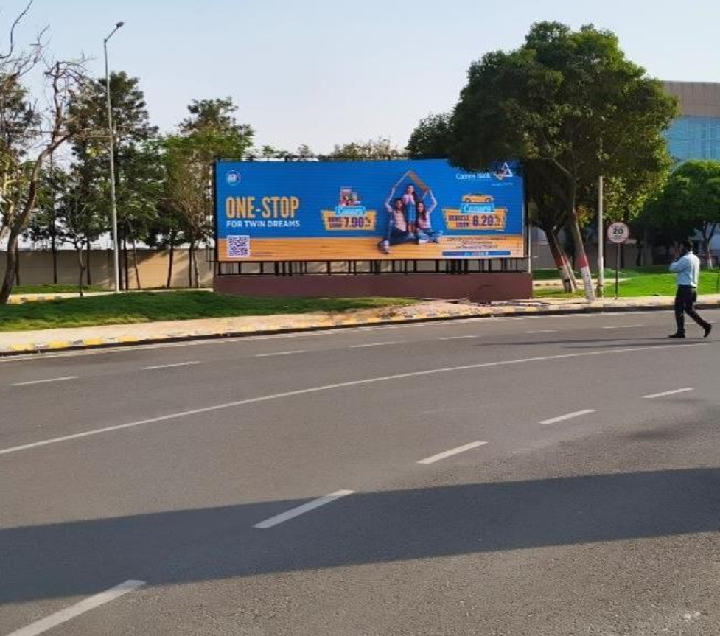

T2- DOMESTIC
Departure | Towards Departure Area | 30 W X 10 H ft (Only 1 Unit) | 15 Sec In Every 1 Min
Digital Wall
Rental Cost | 8,00,000/- P/M Per Slot
Production Cost | 10,000/-
www.themediaant.com
Notes:
‹#›

Slide 5
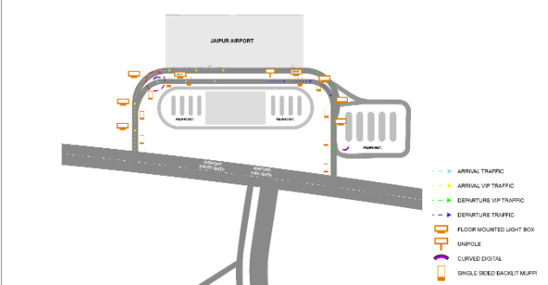
T2- DOMESTIC
Departure | Towards Departure Area | 30 W X 10 H ft (Only 1 Unit) | 15 Sec In Every 1 Min
www.themediaant.com
Notes:
‹#›

Slide 6
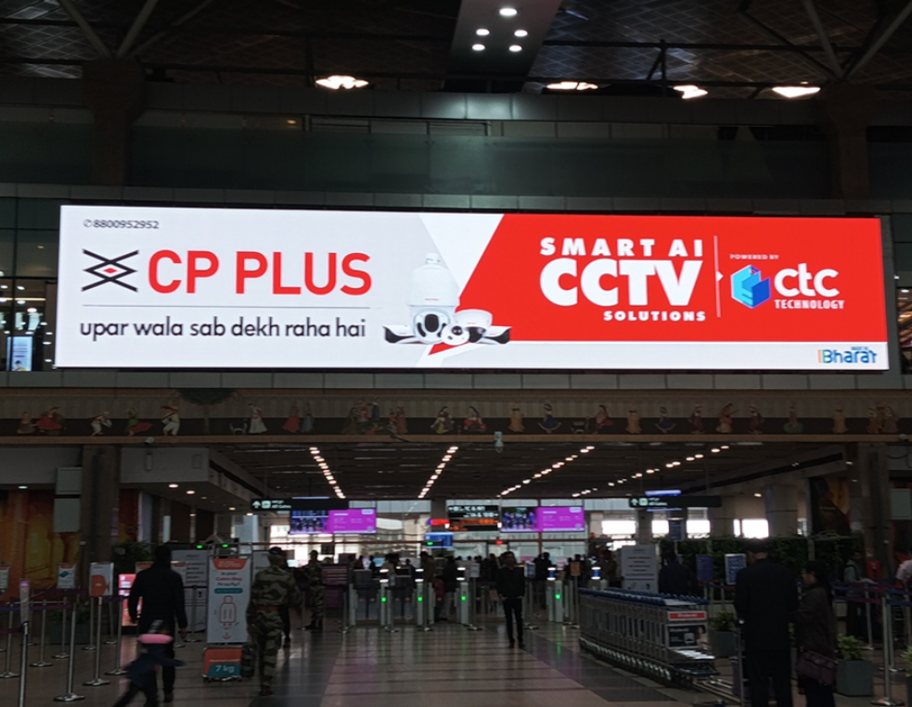
T2- DOMESTIC
Departure | Check In Hall | 65 W X 16 H ft Only 1 Unit) | 10 Sec In Every 30 Sec
Digital Wall
Rental Cost | 21,00,000/- P/M Per Slot
Production Cost | 10,000/-
www.themediaant.com
Notes:
‹#›

Slide 7
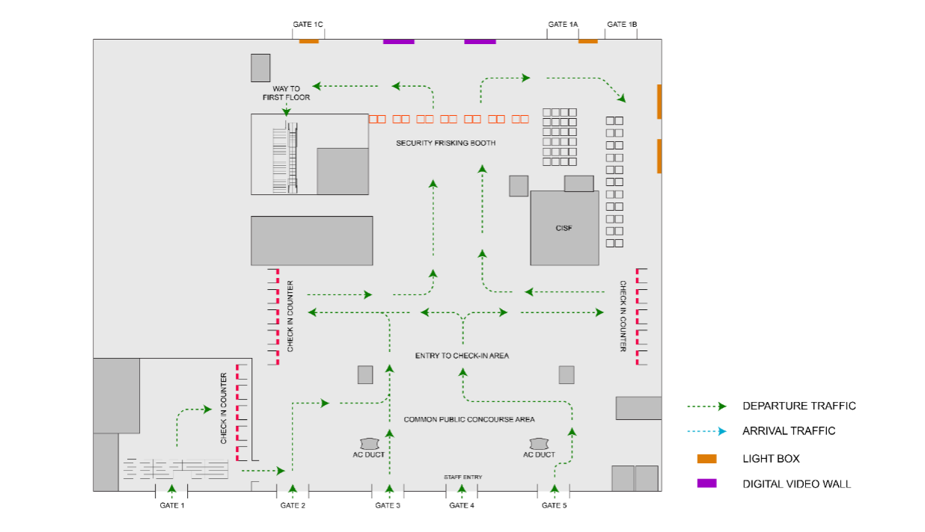
T2- DOMESTIC
Departure | Check In Hall | 65 W X 16 H ft Only 1 Unit) | 10 Sec In Every 30 Sec
www.themediaant.com
Notes:
‹#›

Slide 8
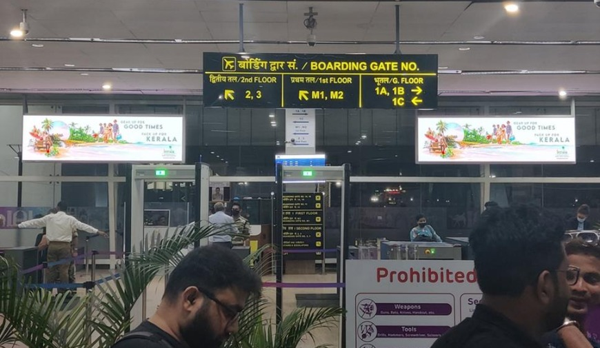
T2- DOMESTIC
Departure | Security Check Area | 12 W X 4 H ft (Package Of 2 Units) | 10 Sec In Every 2 Min
Digital Wall
Rental Cost | 12,00,000/- P/M Per Slot
Production Cost | 10,000/-
www.themediaant.com
Notes:
‹#›

Slide 9
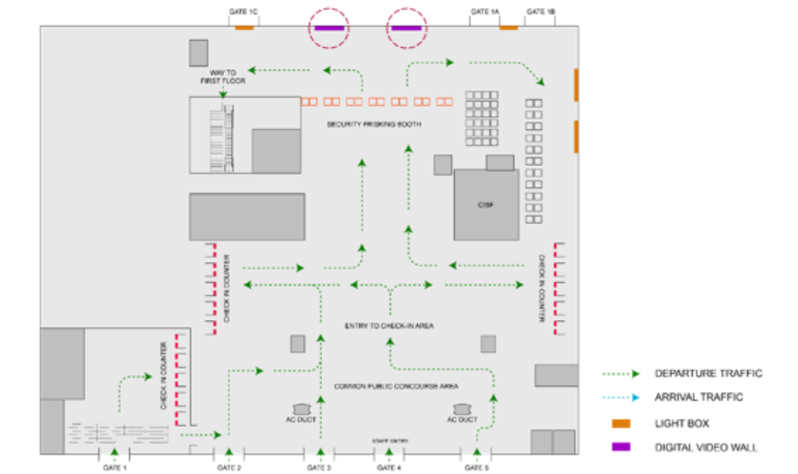
T2- DOMESTIC
Departure | Security Check Area | 12 W X 4 H ft (Package Of 2 Units) | 10 Sec In Every 2 Min
www.themediaant.com
Notes:
‹#›

Slide 10
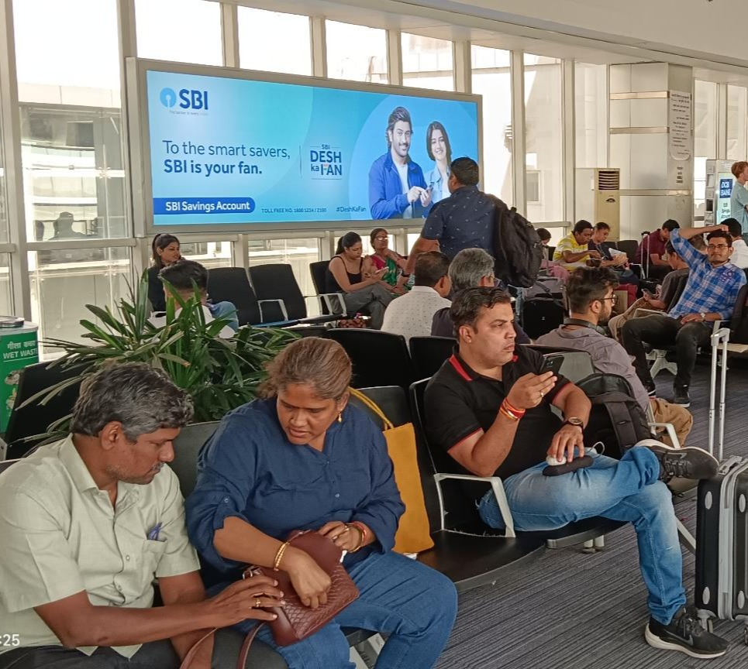
T2- DOMESTIC
Departure | Gate No.2 Seating Area | 14.7 W X 6.9 H ft (Only 1 Unit) | Back Lit
Static Lightbox Single Sided
Rental Cost | 8,00,000/- P/M
Production Cost | 10200/-
www.themediaant.com
Notes:
‹#›

Slide 11
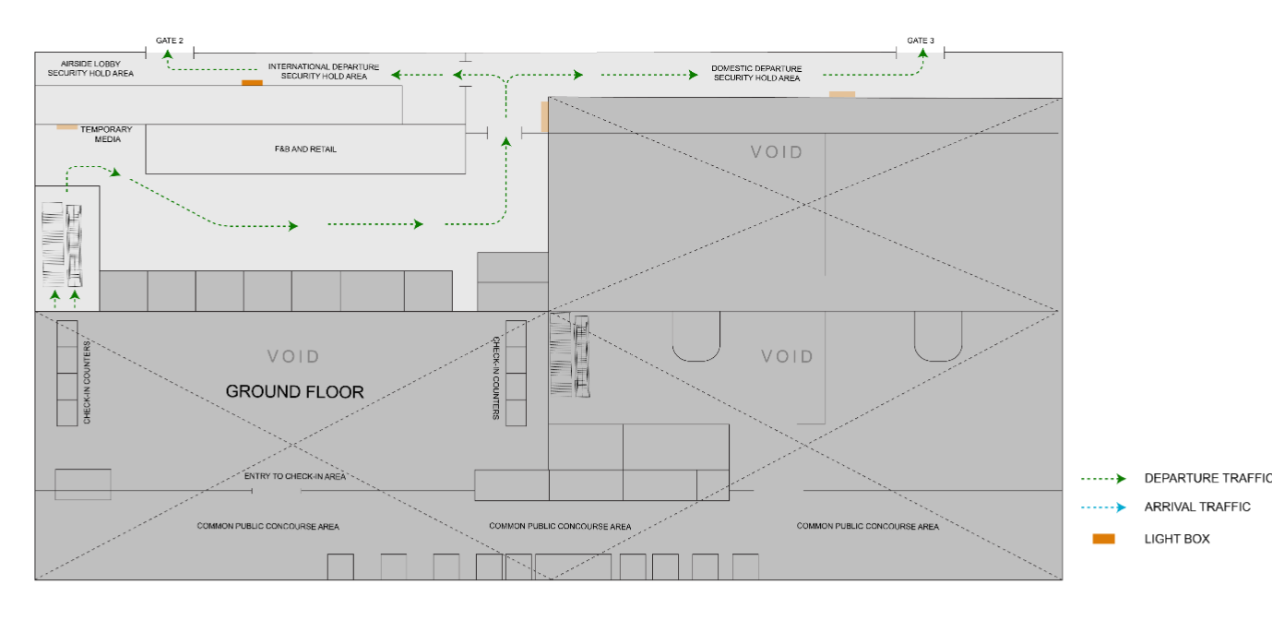
T2- DOMESTIC
Departure | Gate No.2 Seating Area | 14.7 W X 6.9 H ft (Only 1 Unit) | Back Lit
www.themediaant.com
Notes:
‹#›

Slide 12
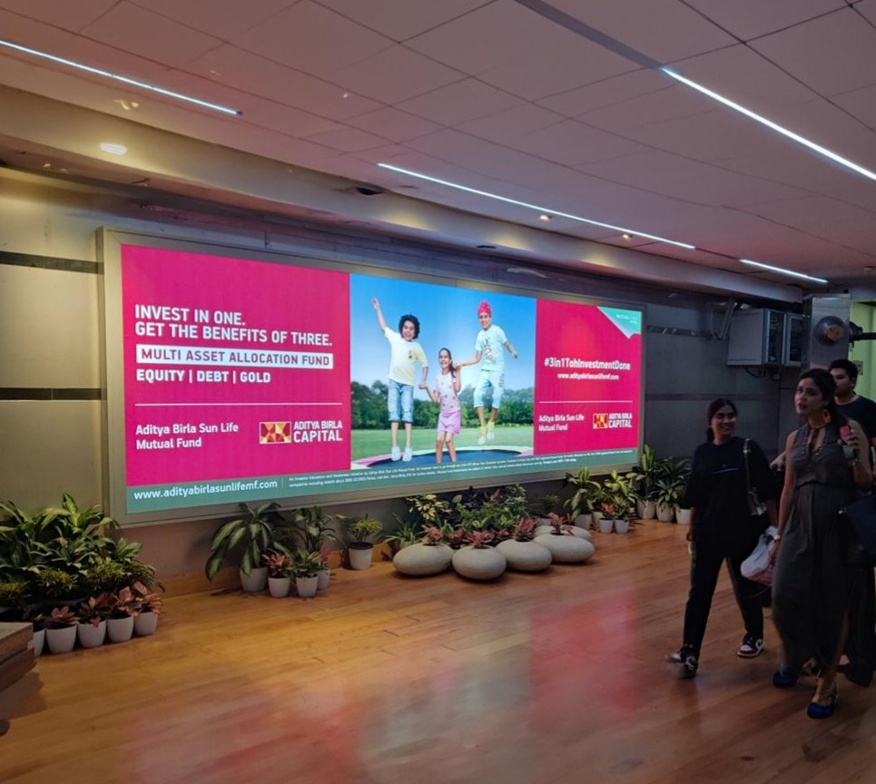
T2- DOMESTIC
Departure | Gate No.2 Seating Area | 14.7 W X 6.9 H ft (Only 1 Unit) | Back Lit
Static Lightbox Single Sided
Rental Cost | 8,00,000/- P/M
Production Cost | 46,200/-
www.themediaant.com
Notes:
‹#›

Slide 13
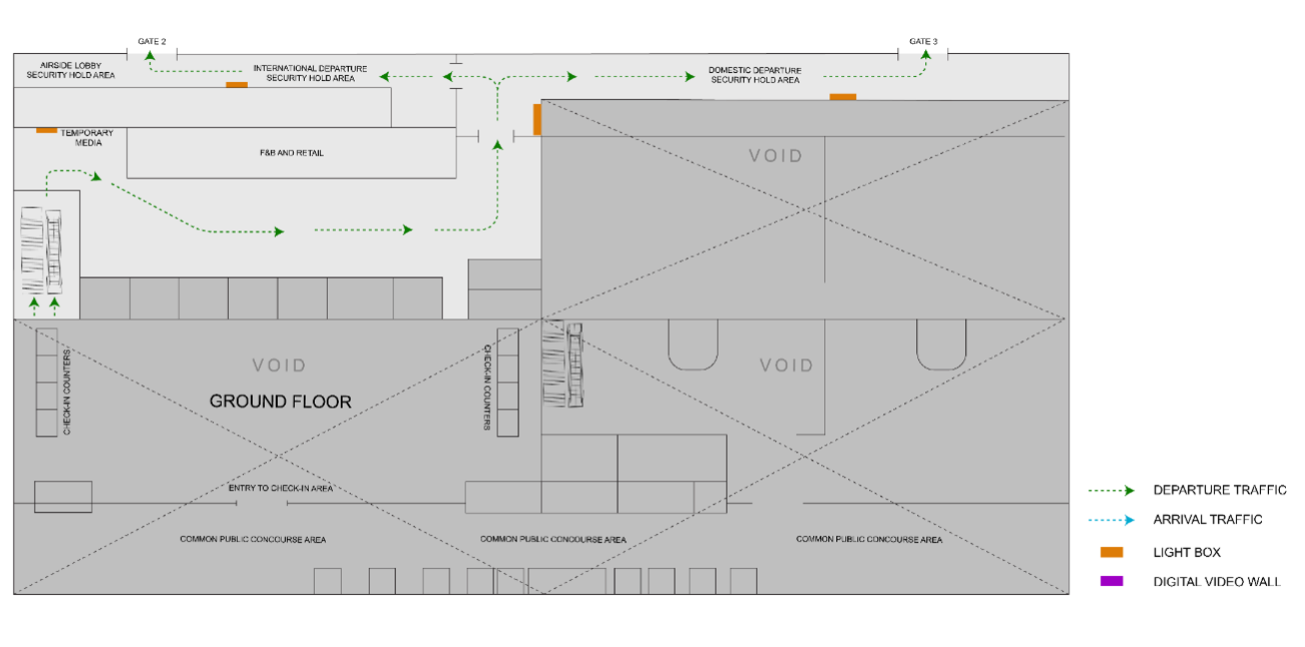
T2- DOMESTIC
Departure | Gate No.3 Seating Area | 14.7 W X 6.9 H ft (Only 1 Unit) | Back Lit
www.themediaant.com
Notes:
‹#›

Slide 14
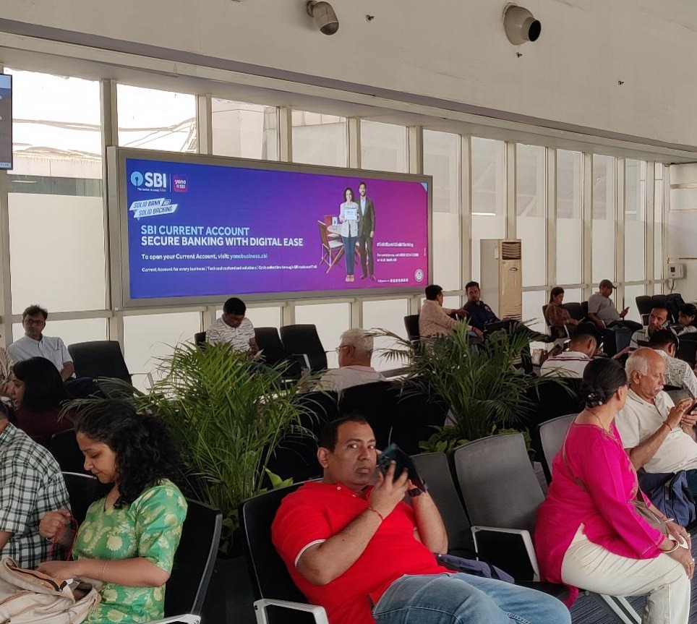
T2- DOMESTIC
Departure | Gate No.3 Seating Area | 14.7 W X 6.9 H ft (Only 1 Unit) | Back Lit
Static Lightbox Single Sided
Rental Cost | 8,00,000/- P/M
Production Cost | 10200/-
www.themediaant.com
Notes:
‹#›

Slide 15
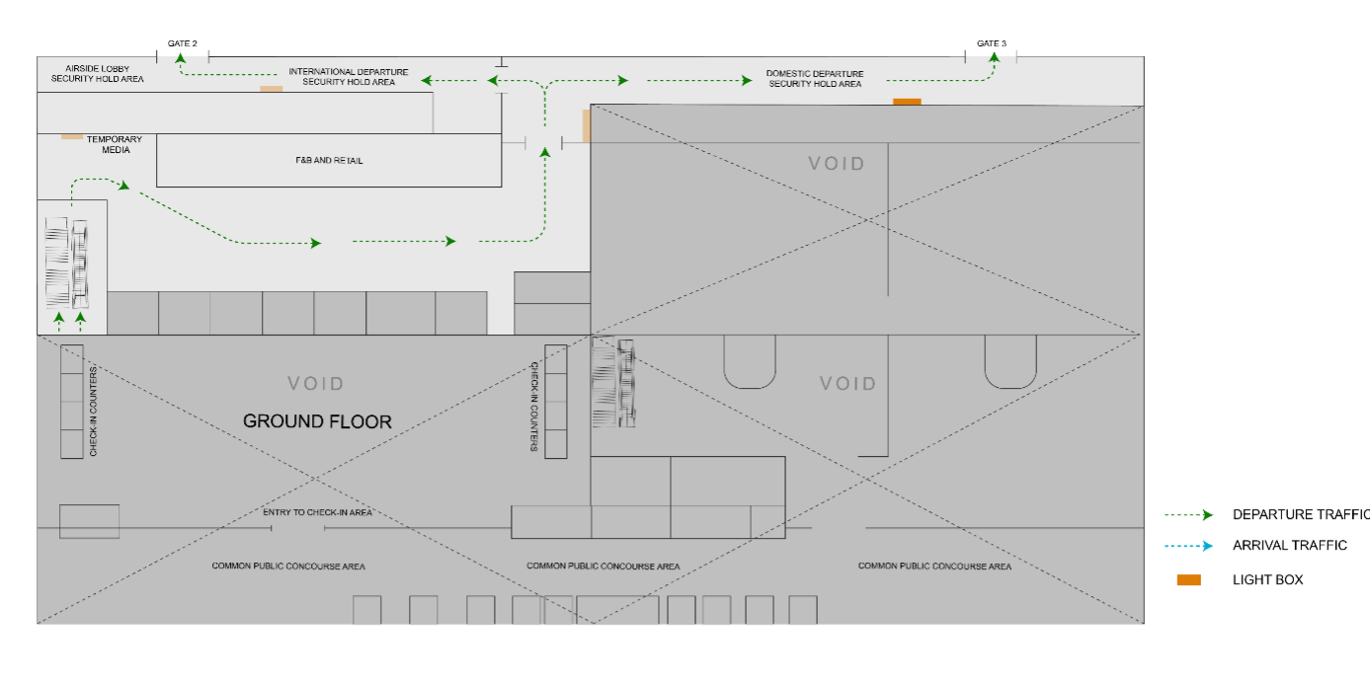
T2- DOMESTIC
Departure | Gate No.3 Seating Area | 14.7 W X 6.9 H ft (Only 1 Unit) | Back Lit
www.themediaant.com
Notes:
‹#›

Slide 16
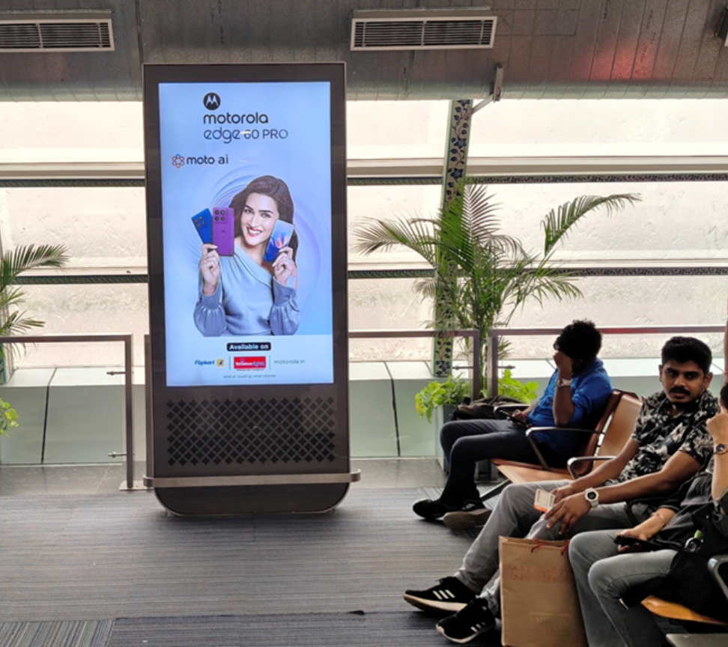
T2- DOMESTIC
Arrival & Departure | Arrival & Departure Area | 75 Inches (Package Of 17 Units)- Departure & 65 Inches (Package Of 6 Units)- Arrival | 10 Sec In Every 120 Sec
Digital Pod
Rental Cost | 9,00,000/- P/M Per Slot
Production Cost | 10,000/-
www.themediaant.com
Notes:
‹#›

Slide 17
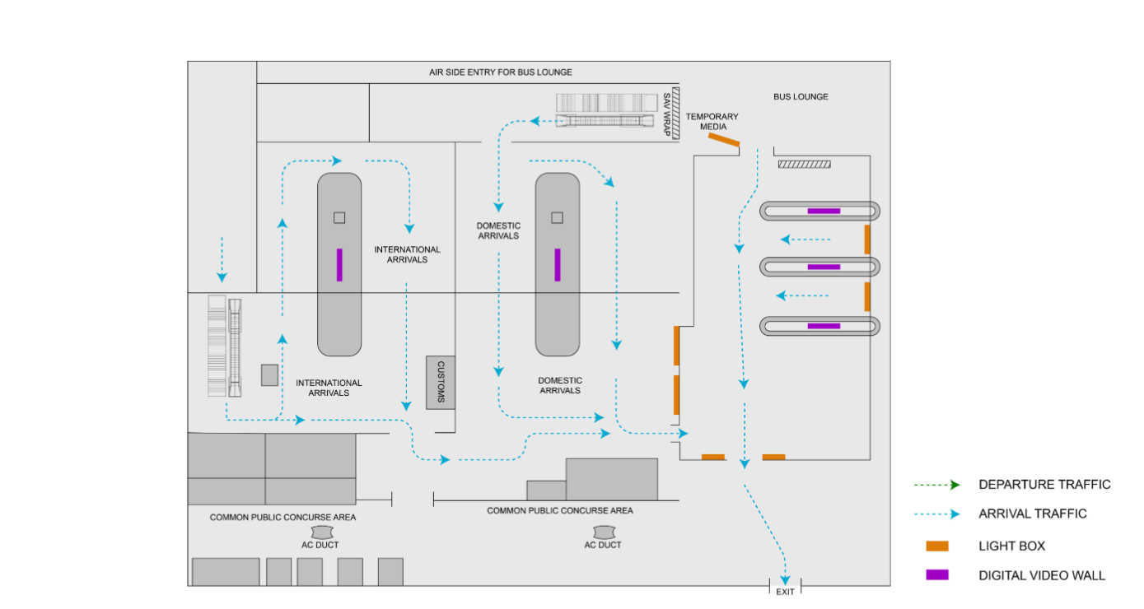

T2- DOMESTIC
Arrival & Departure | Arrival & Departure Area | 75 Inches (Package Of 17 Units)- Departure & 65 Inches (Package Of 6 Units)- Arrival | 10 Sec In Every 120 Sec
www.themediaant.com
Notes:
‹#›

Slide 18
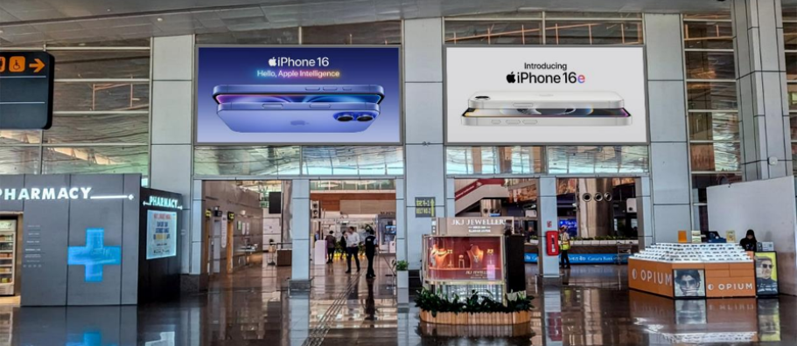
T2- DOMESTIC
Arrival | Arrival Hall | 20 W X 10 H ft (Package Of 2 Units) | Back Lit
Static Lightbox Single Sided
Rental Cost | 24,00,000/- P/M
Production Cost | 24,000/-
www.themediaant.com
Notes:
‹#›

Slide 19
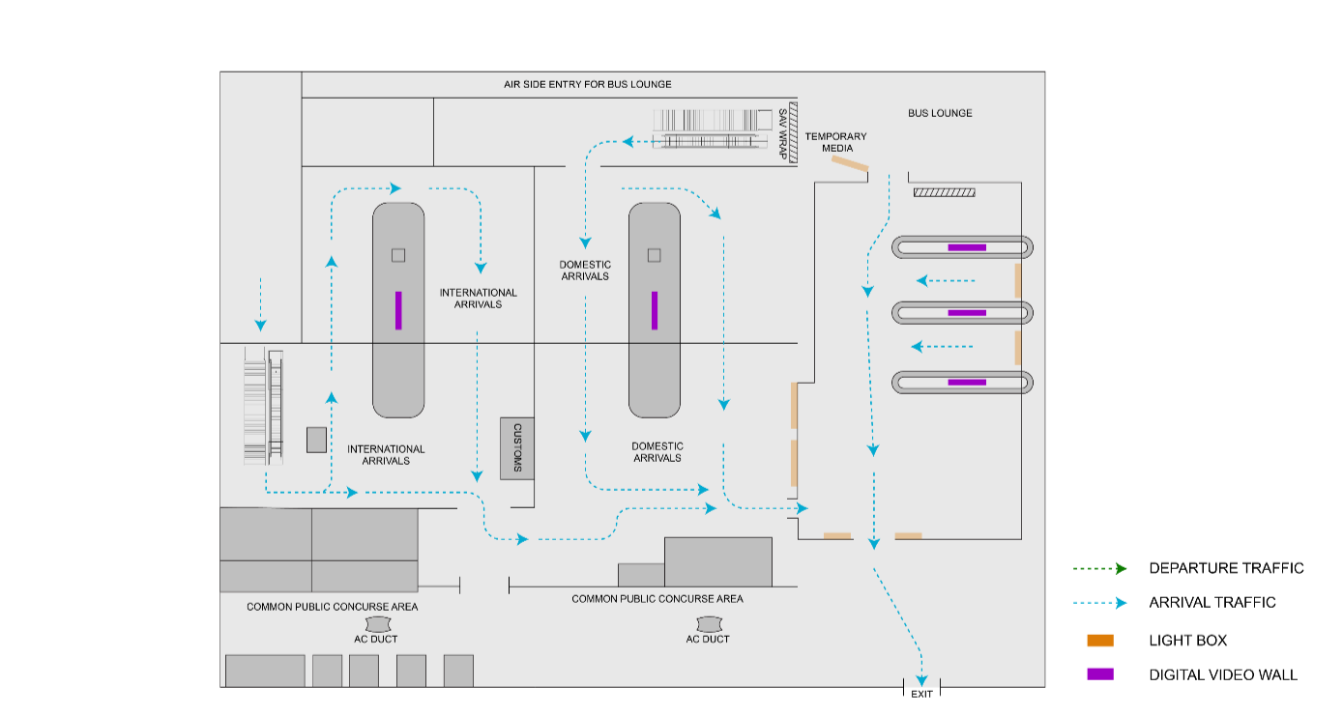
T2- DOMESTIC
Arrival | Arrival Hall | 20 W X 10 H ft (Package Of 2 Units) | Back Lit
www.themediaant.com
Notes:
‹#›

Slide 20
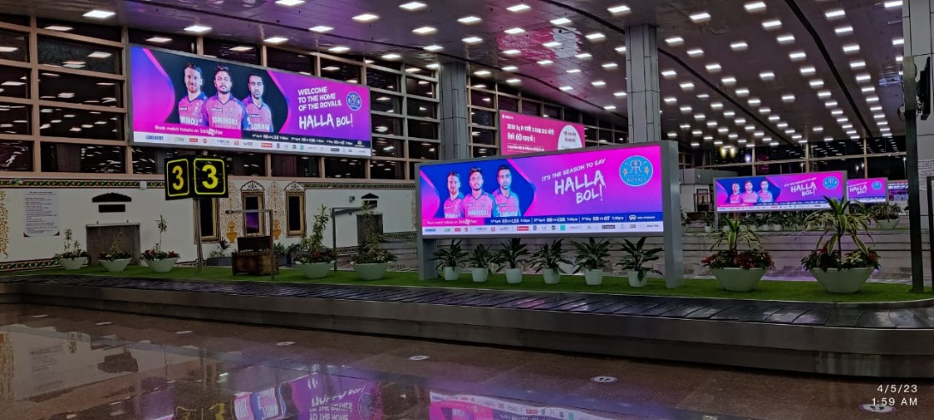
T1 & T2- DOMESTIC + INTERNATIONAL
Arrival | Baggage Claim Area | 12 W X 4 H f (Package Of 5 Units) | 10 Sec In Every 2 Min
Digital Wall Double Sided
Rental Cost | 14,00,000/- P/M Per Slot
Production Cost | As Per Actual Cost
www.themediaant.com
Notes:
‹#›

Slide 21
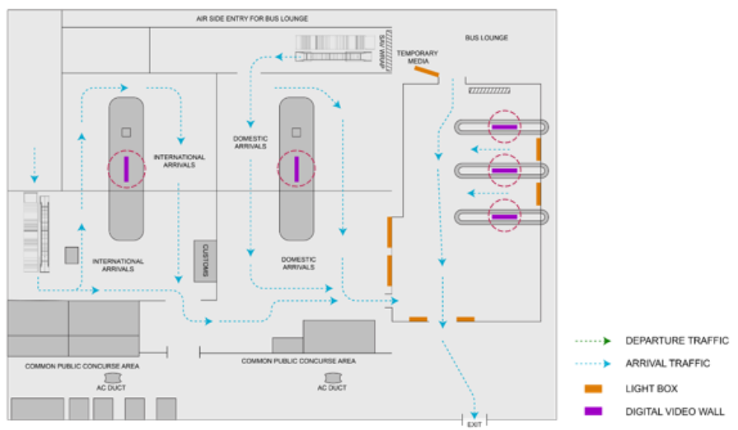
T1 & T2- DOMESTIC + INTERNATIONAL
www.themediaant.com
Notes:
‹#›

Slide 22
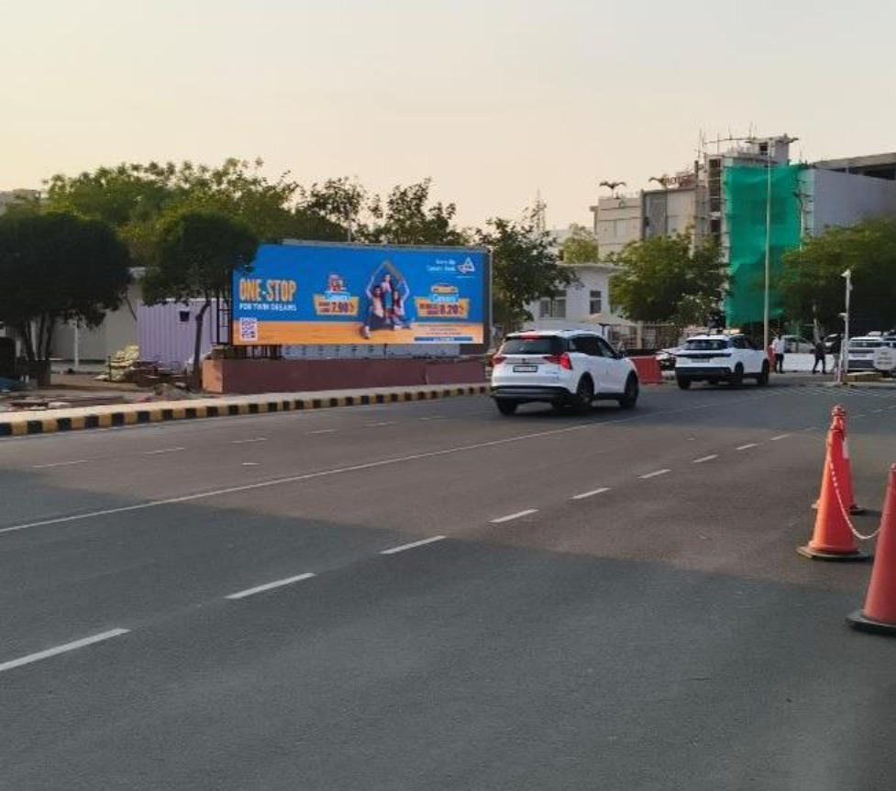
T2- DOMESTIC
Arrival | Arrival Road | 30 W X 10 H ft (Only 1 Unit) | 15 Sec In Every 1 Min
Digital Wall
Rental Cost | 8,00,000/- P/M Per Slot
Production Cost | 10,000/-
www.themediaant.com
Notes:
‹#›

Slide 23
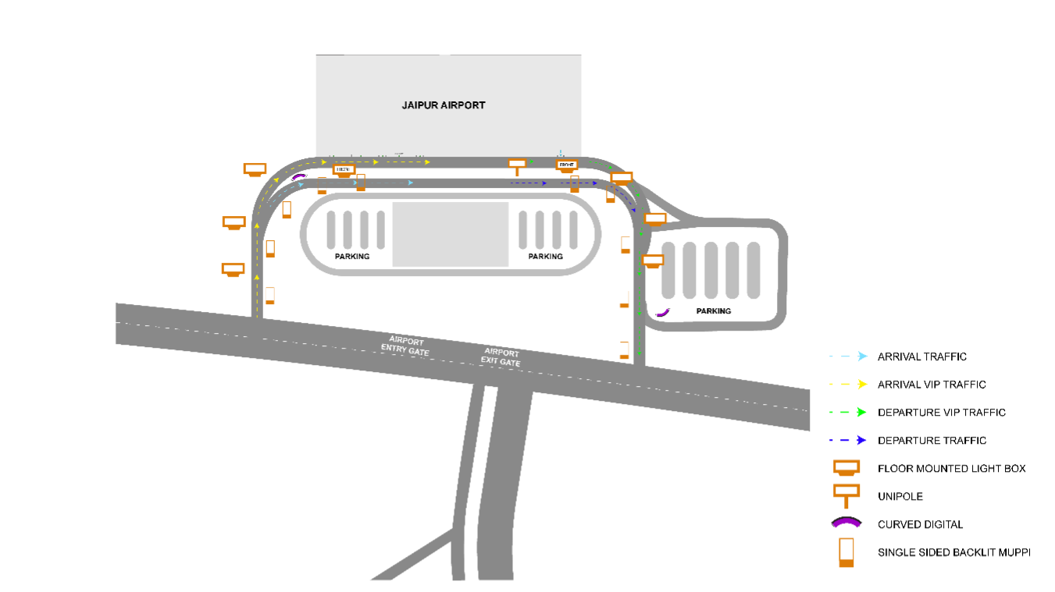
T2- DOMESTIC
Arrival | Arrival Road | 30 W X 10 H ft (Only 1 Unit) | 15 Sec In Every 1 Min
www.themediaant.com
Notes:
‹#›

Slide 24
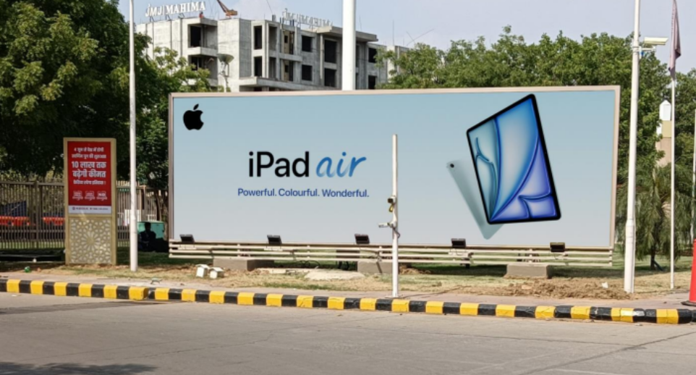
T2- DOMESTIC
Arrival | Arrival Exit | 30 W X 10 H ft (Only 1 Unit) | Front Lit
Hoarding
Rental Cost | 17,00,000/- P/M
Production Cost | As Per Actual Cost
www.themediaant.com
Notes:
‹#›

Slide 25
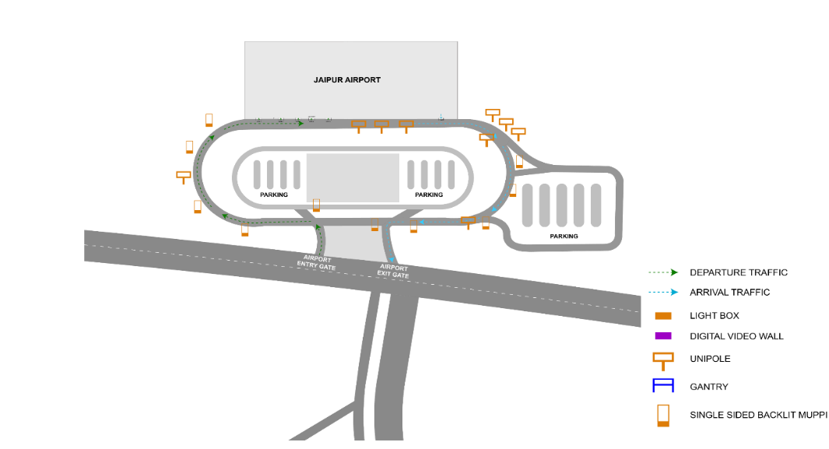
T2- DOMESTIC
Arrival | Arrival Exit | 30 W X 10 H ft (Only 1 Unit) | Front Lit
www.themediaant.com
Notes:
‹#›

Slide 26





www.themediaant.com
ad@themediaant.com
Thank You
080-067415510
Empowering All To Advertise
Notes:
‹#›

