Slide 1
















Reference images

Slide 2
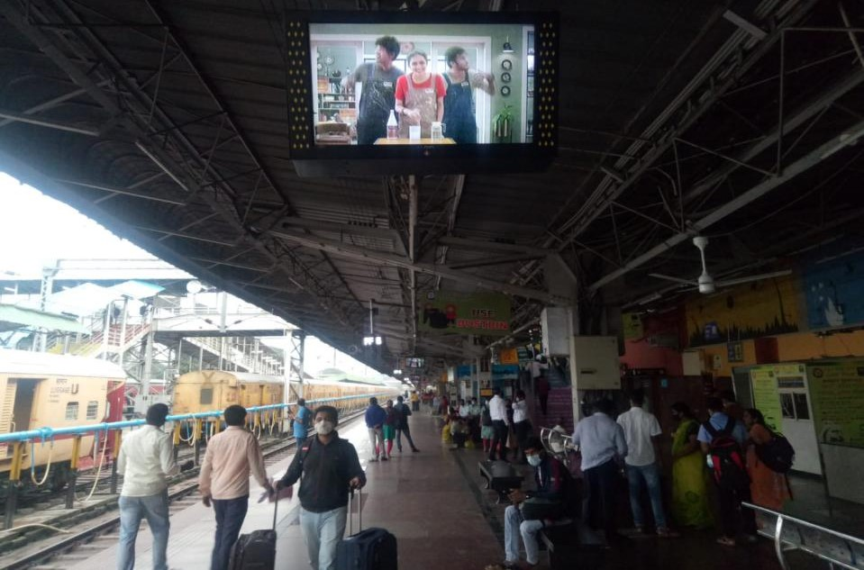
DIGITAL
SCREENS
DIGITAL
SCREENS
Location: Platform1 to 6
No. of Screens : 60
Dimension: 32 Inch (28 in x 16 in)
http://www.themediaant.com/
http://www.themediaant.com/

Slide 3
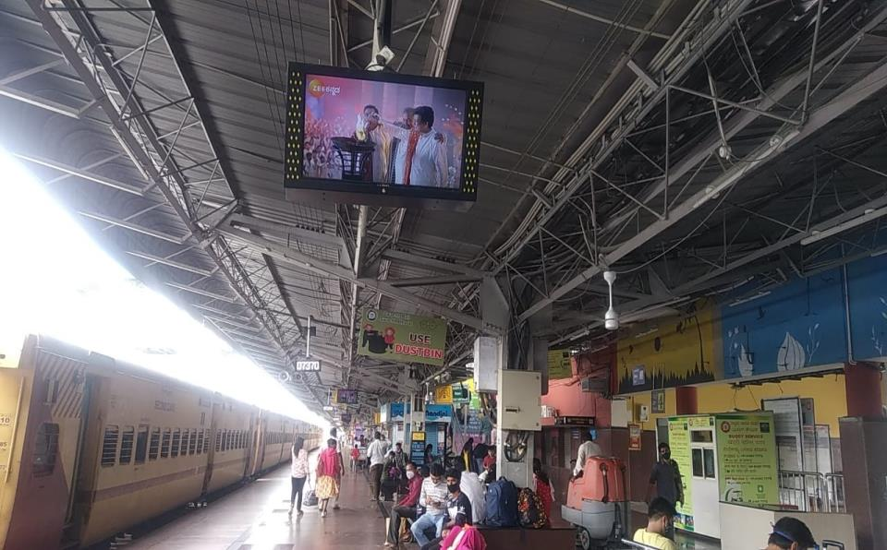
DIGITAL
SCREENS
Location: Platform1 to 6
No. of Screens : 60
Dimension: 32 Inch (28 in x 16 in)
http://www.themediaant.com/

Slide 4
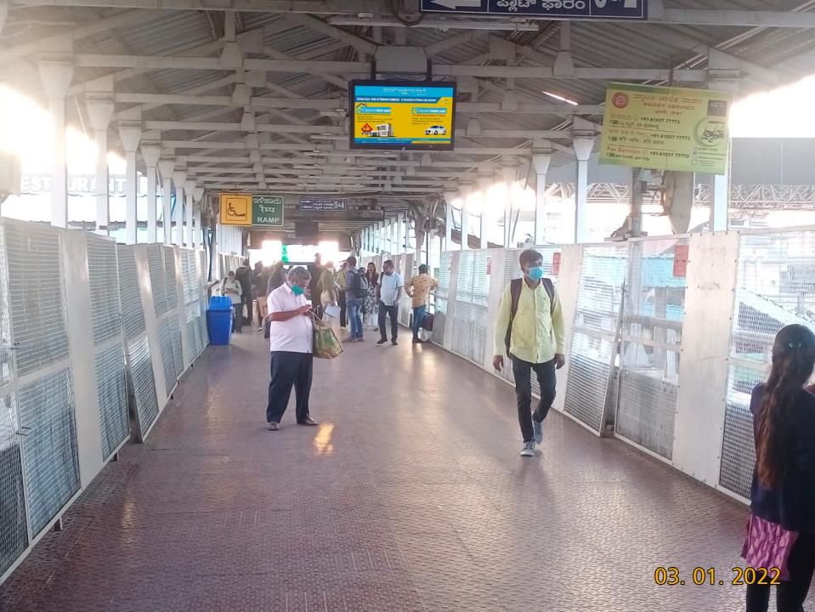
DIGITAL
SCREENS
Location: Platform1 to 6
No. of Screens : 60
Dimension: 32 Inch (28 in x 16 in)
http://www.themediaant.com/

Slide 5











Thank You

