Slide 1
















Reference images

Slide 2
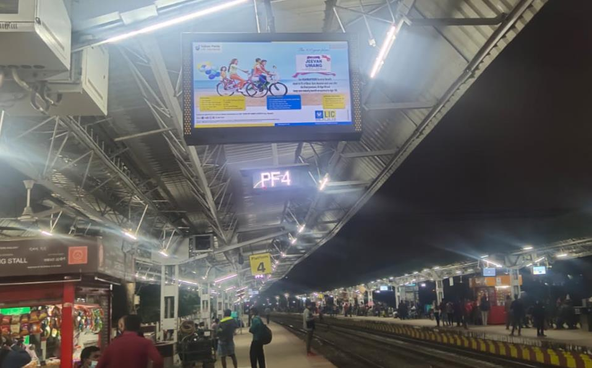
DIGITAL
SCREENS
Location: PF1 to 4
No. of Screens: 47 Dimension: 43inch and 32 Inch
http://www.themediaant.com/

Slide 3
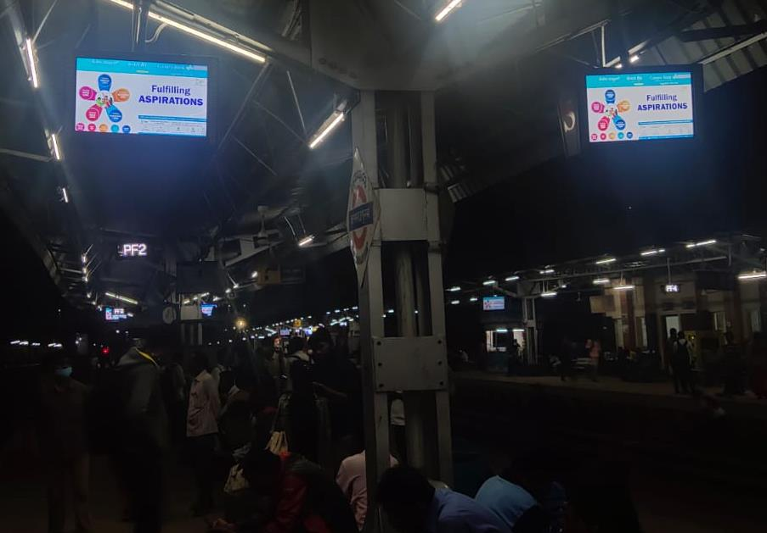
DIGITAL
SCREENS
Digital Screens
Location: PF1 to 4
No. of Screens: 47 Dimension: 43inch and 32 Inch
http://www.themediaant.com/

Slide 4











Thank You

