Slide 1
















Reference images

Slide 2
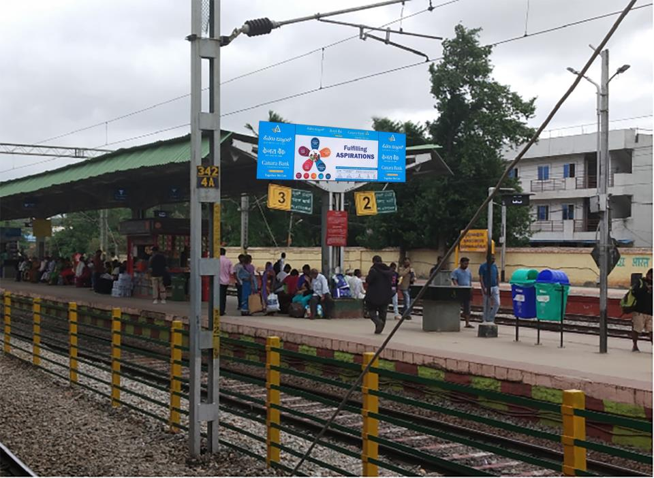
Location: PF2 and 3 Entrance on the Shelter
Dimension: 10ft x 3ft = 30 Sqft
http://www.themediaant.com/

Slide 3
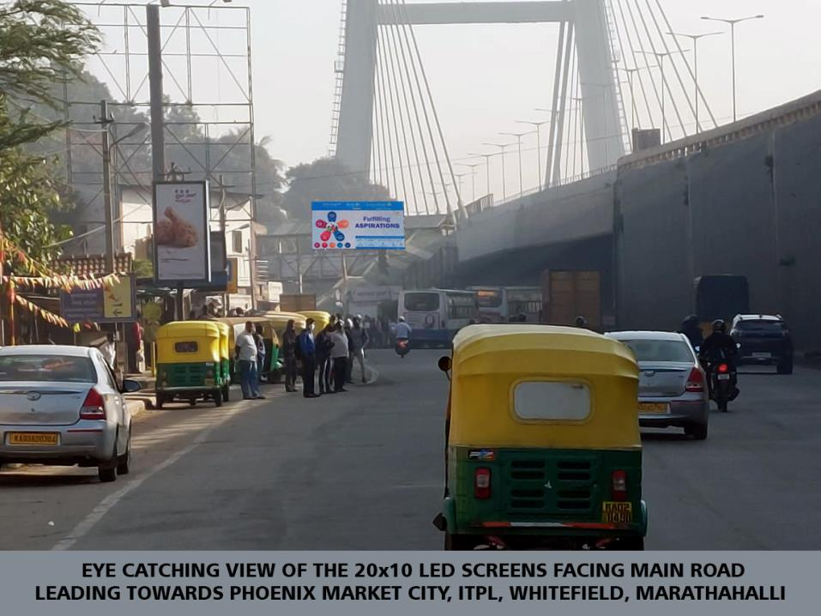
Location: PF4 Main Entrance Facing Main Road
Towards Phoenix Market City, ITPL, Whitefield, Marathahalli
No. of Screens: 1 Dimension: 20ft x 10ft = 200 Sqft
http://www.themediaant.com/

Slide 4











Thank You

