Slide 1
















Reference images

Slide 2
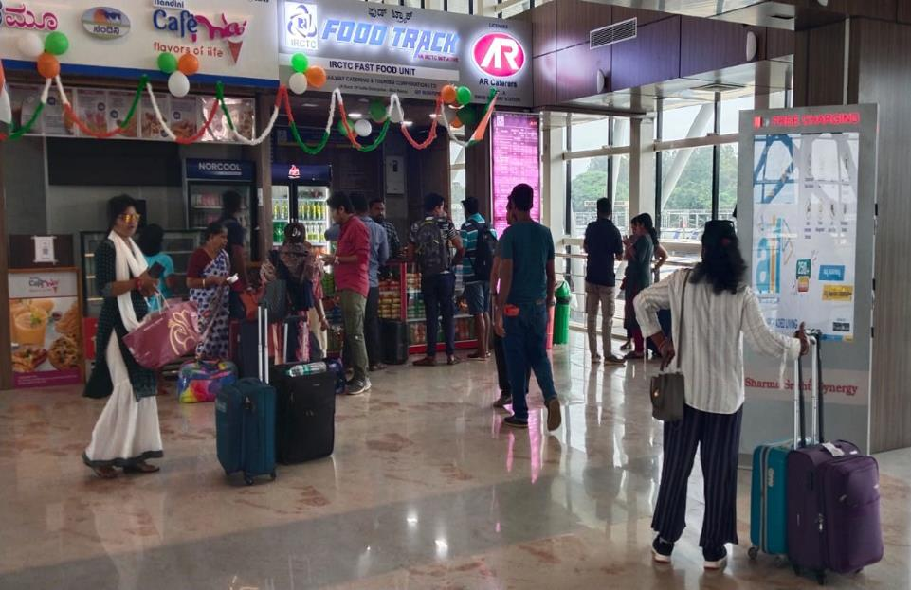
S.M.V.T RAILWAY STATION, B’LORE
MOBILE CHARGERS
Location: Concourse Area and First Floor Near Food Court
No. of Screens: 3 Dimension: 55’’ Mobile Chargers
http://www.themediaant.com/

Slide 3
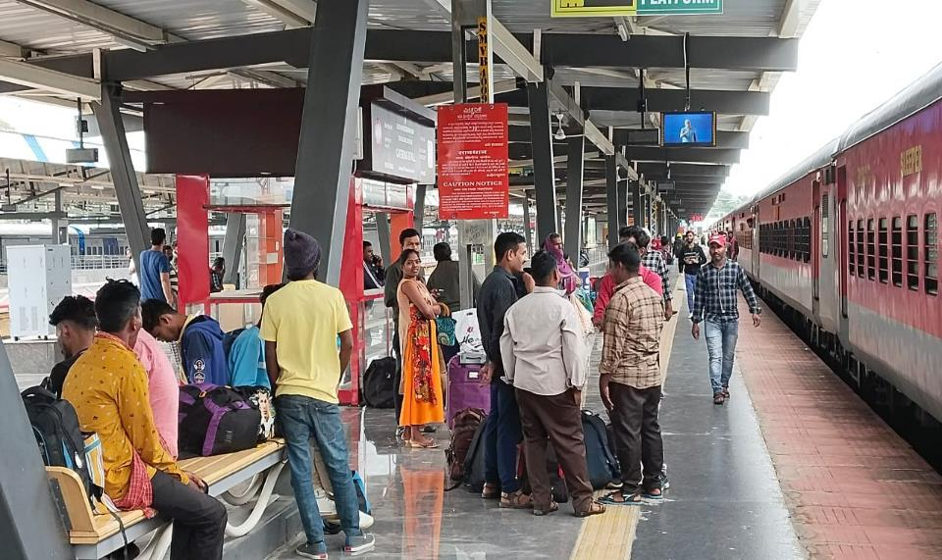
S.M.V.T RAILWAY STATION, BANGALORE
DIGITAL AUDIO/VIDEO VISUAL
Location: Platform1 to 5
No. of Screens: 28 Dimension: 32Inch
http://www.themediaant.com/

Slide 4











Thank You

