Slide 1
















Reference images

Slide 2
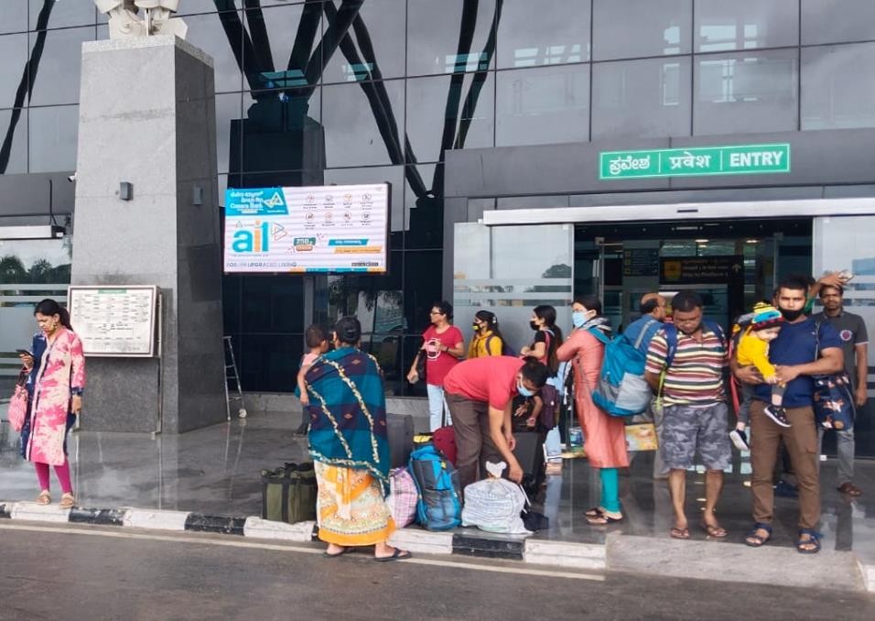
S.M.V.T RAILWAY STATION, BANGALORE
VIDEO WALLS
Location: Main Entrance
No. of Screens: 1 Dimension: 6ft x 3ft = 18 Sqft
http://www.themediaant.com/
http://www.themediaant.com/

Slide 3
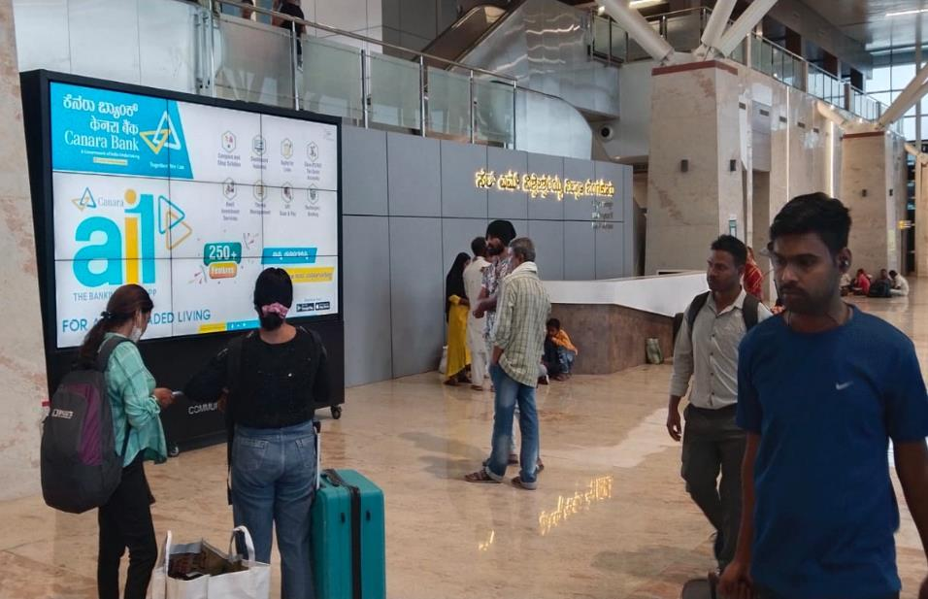
S.M.V.T RAILWAY STATION, BANGALORE
VIDEO WALLS
Location: Concourse Area Next to Information Desk
No. of Screens: 1 Dimension: 10ft x 6ft = 60 Sqft
http://www.themediaant.com/

Slide 4
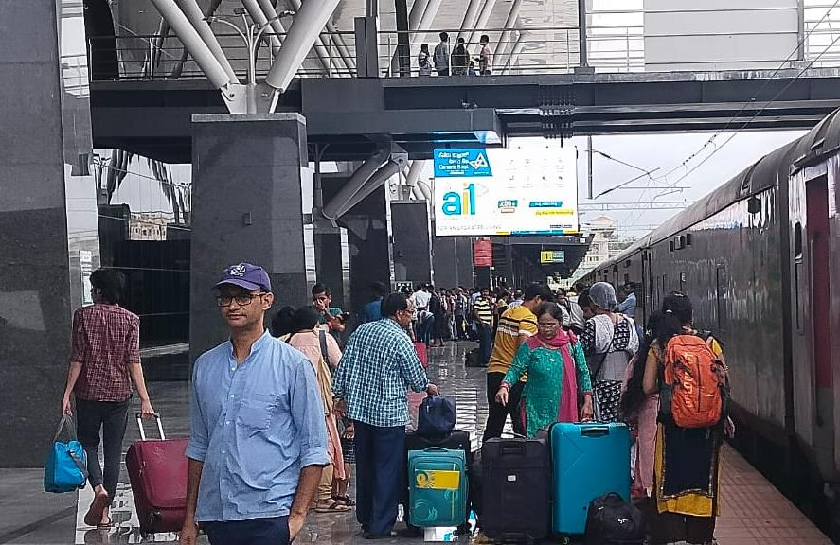
S.M.V.T RAILWAY STATION, BANGALORE
VIDEO WALLS
Location: Platform1 (Double Sided)
No. of Screens: 2 Dimension: 10ft x 6ft = 120 Sqft
http://www.themediaant.com/

Slide 5











Thank You

