Slide 1
















Reference images

Slide 2
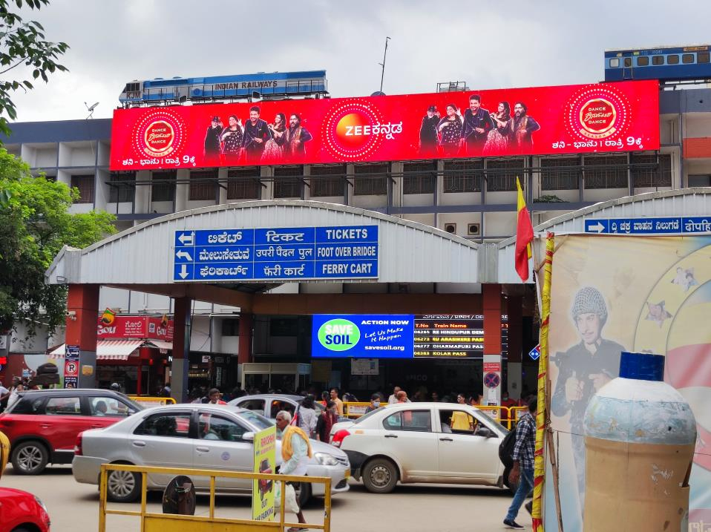
VIDEO WALLS
Location: Front Entrance Building Top
No. of Screens: 1 Dimension: 80ft x 10ft
http://www.themediaant.com/

Slide 3
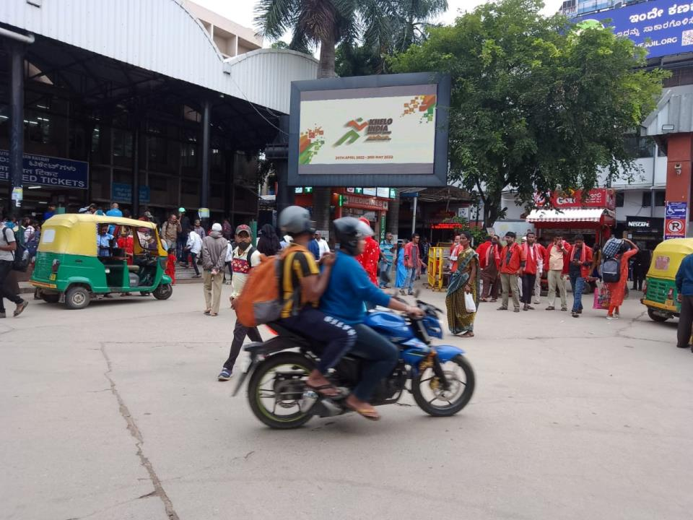
VIDEO WALLS
Location: Front Entrance Near UTS Ticket Booking Office Building
No. of Screens: 1 Dimension: 15ft x 9ft
http://www.themediaant.com/

Slide 4
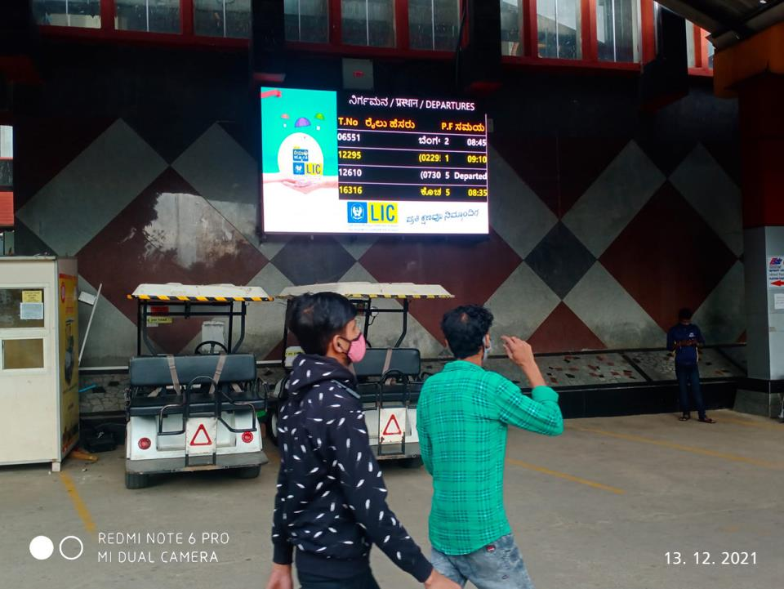
VIDEO WALLS
Location: Front Entrance Near the Battery Car Pickup point
No. of Screens: 1 Dimension: 10ft x 6ft
http://www.themediaant.com/

Slide 5
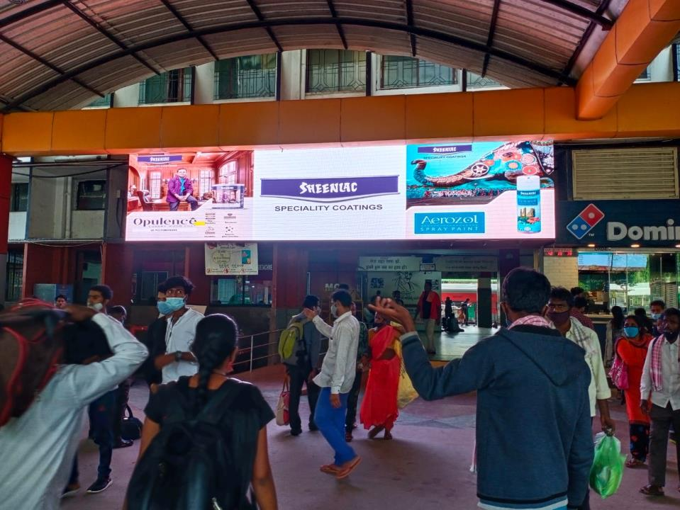
VIDEO WALLS
Location: Front Entrance Near Domino’s
No. of Screens: 1 Dimension: 30ft x 6ft
http://www.themediaant.com/

Slide 6
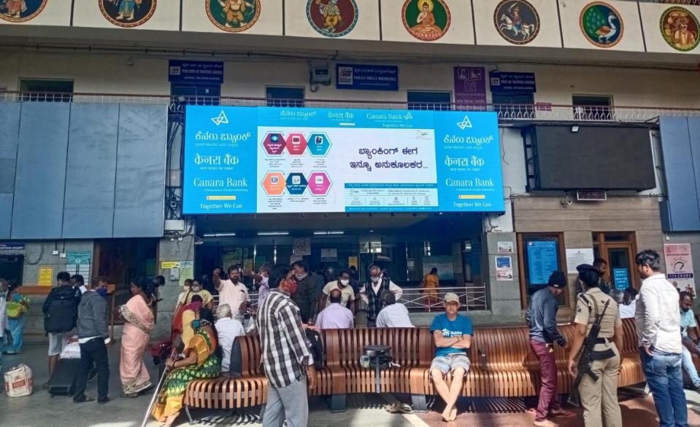
VIDEO WALLS
Location: Front Entrance Concourse Area
No. of Screens: 1 Dimension: 30ft x 10ft
http://www.themediaant.com/

Slide 7
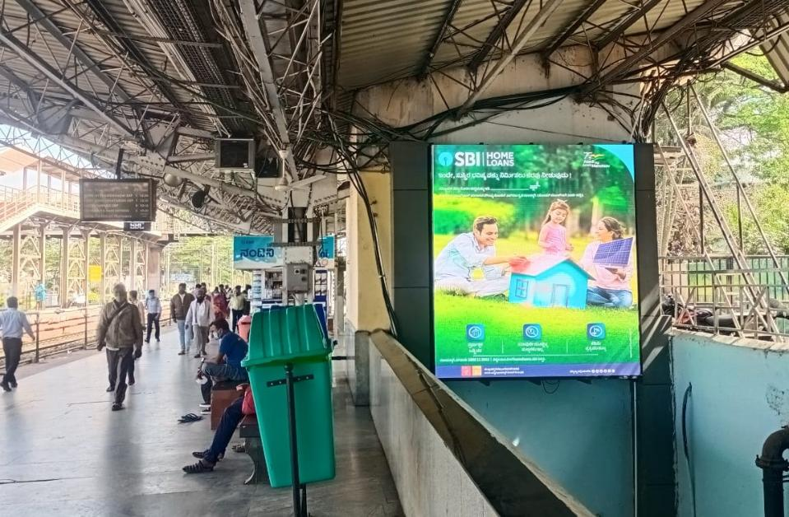
VIDEO WALLS
Location: Near Underpass of Platform 1
No. of Screens: 1 Dimension: 8ft x 10ft
http://www.themediaant.com/

Slide 8
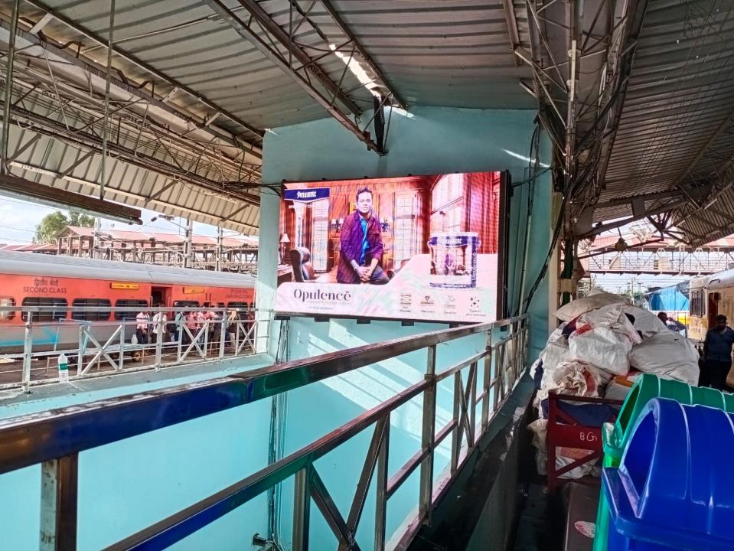
VIDEO WALLS
Location: Near Underpass of Platform 2 & 3
No. of Screens: 1 Dimension: 10ft x 6ft
http://www.themediaant.com/

Slide 9
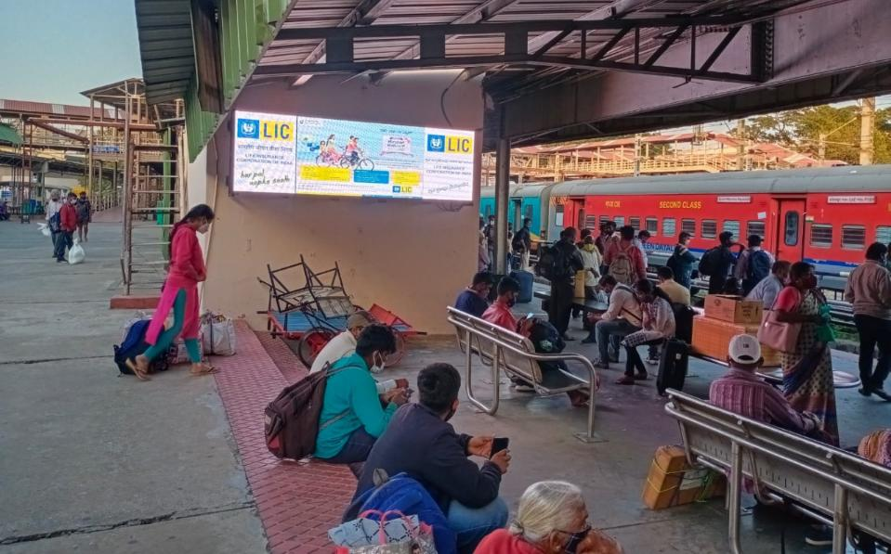
VIDEO WALLS
Location: Near Underpass of Platform 5 & 6
No. of Screens: 1 Dimension: 10ft x 3ft
http://www.themediaant.com/

Slide 10
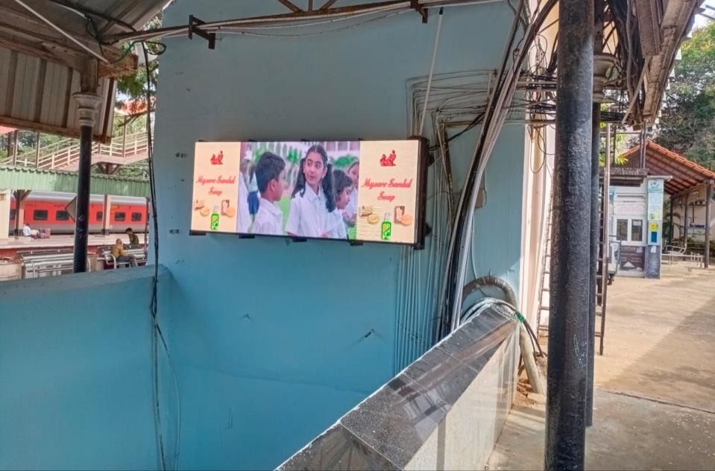
VIDEO WALLS
Location: Near Underpass of Platform 7 & 8
No. of Screens: 1 Dimension: 8ft x 3ft
http://www.themediaant.com/

Slide 11
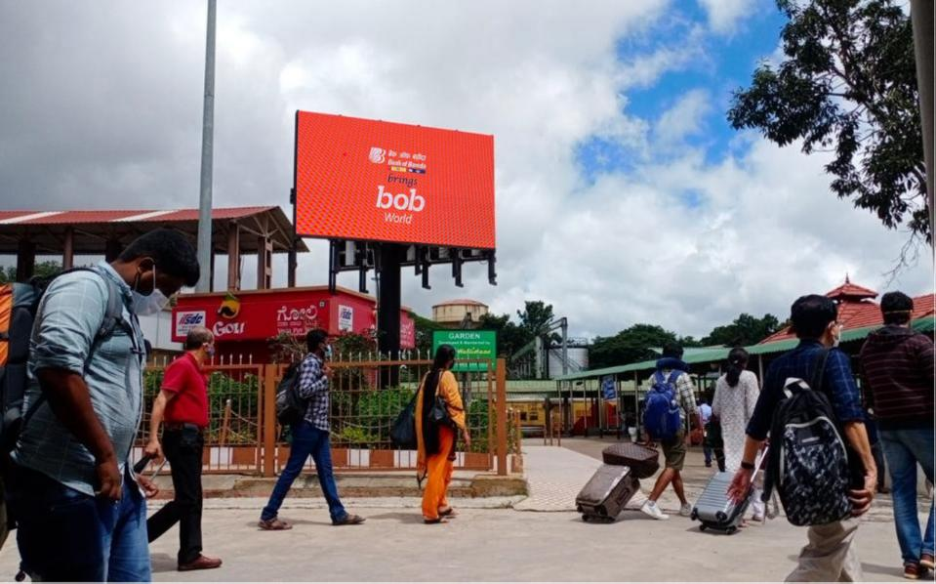
VIDEO WALLS
Location: Near Food Track Garden on Platform8 back gate
No. of Screens: 1 Dimension: 10ft x 6ft
http://www.themediaant.com/

Slide 12
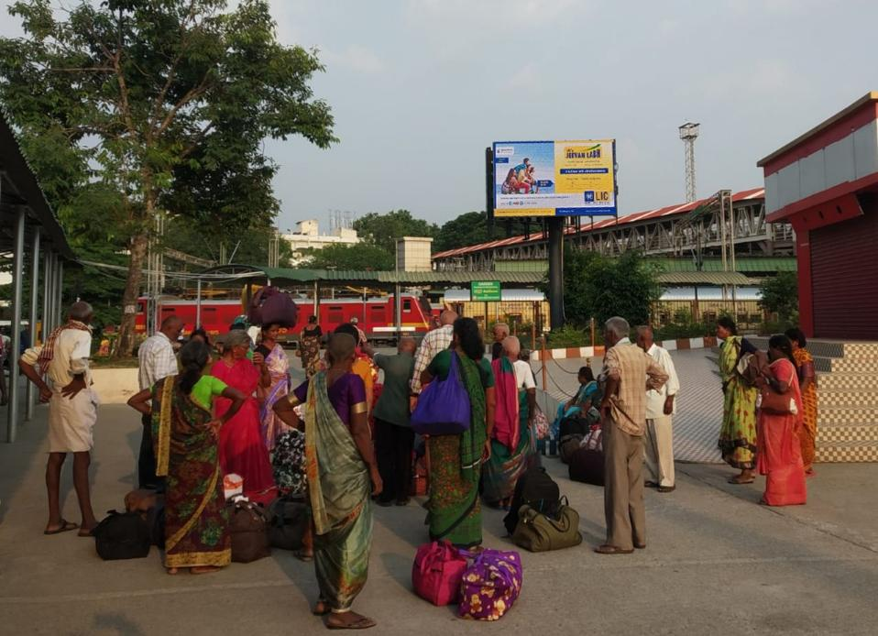
VIDEO WALLS
Location: Near Food Track Garden on Platform8 back gate
No. of Screens: 1 Dimension: 10ft x 6ft
http://www.themediaant.com/

Slide 13
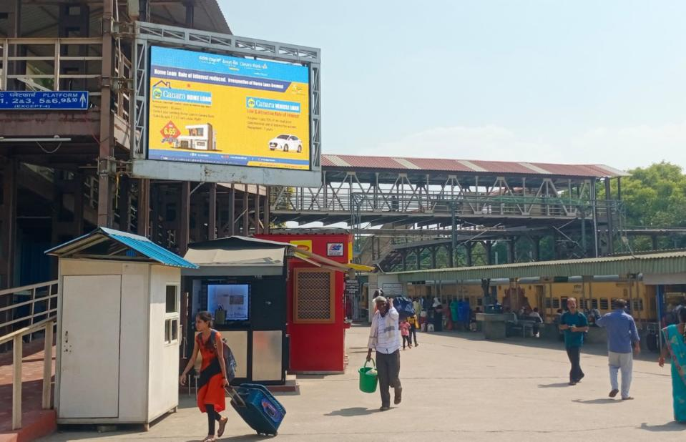
VIDEO WALLS
Location: Back Gate Near Entrance to Platform 8
No. of Screens: 1 Dimension: 8ft x 6ft
http://www.themediaant.com/

Slide 14
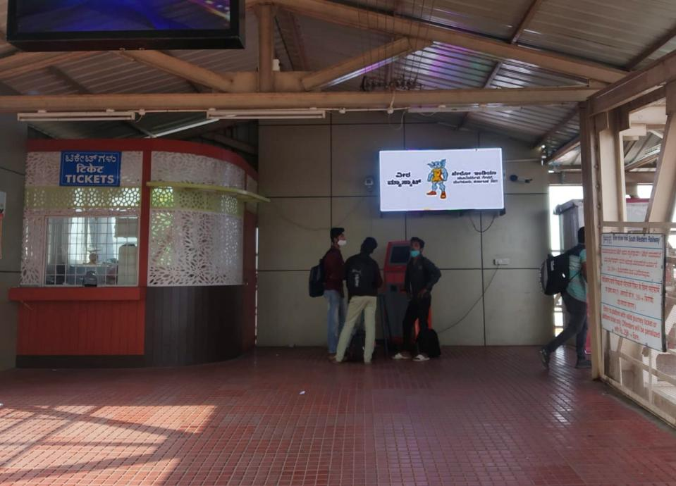
VIDEO WALLS
Location: On the FOB Back Entrance of Metro Station
No. of Screens: 1 Dimension: 6ft x 3ft
http://www.themediaant.com/

Slide 15

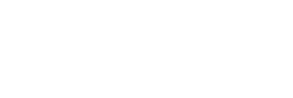


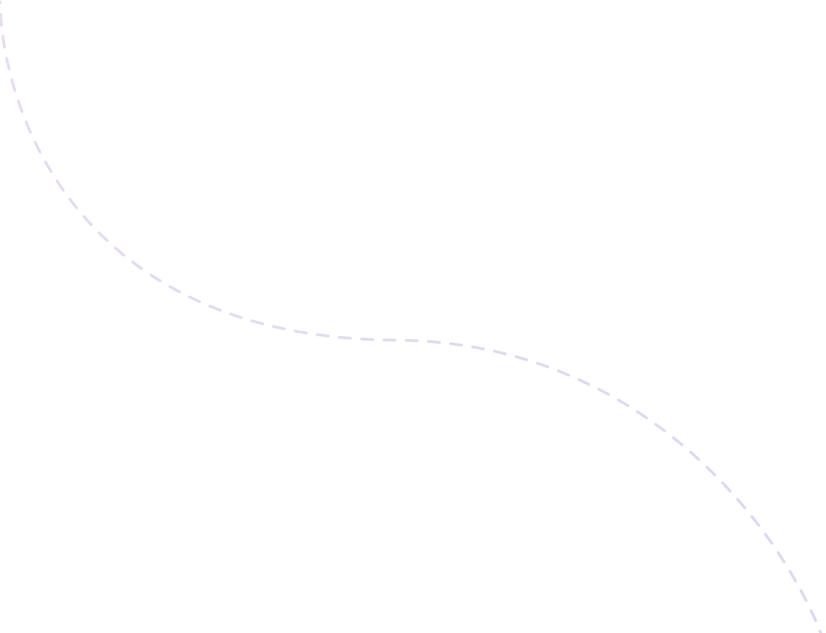
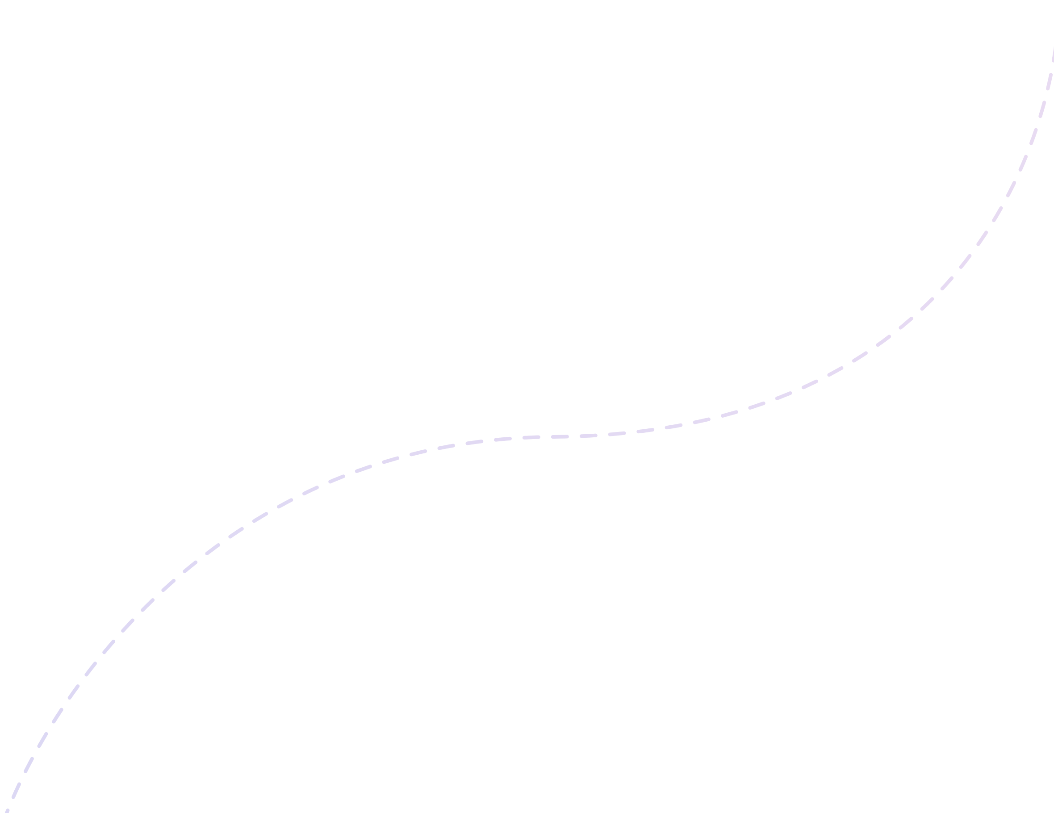





Thank You

