Slide 1
















Reference images

Slide 2
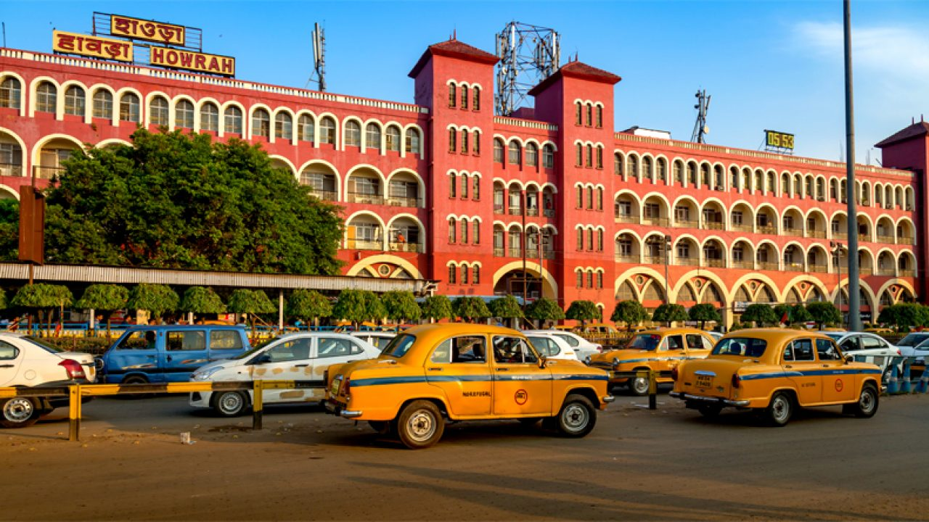
LED SCREEN AT HOWRAH STATION
http://www.themediaant.com/

Slide 3
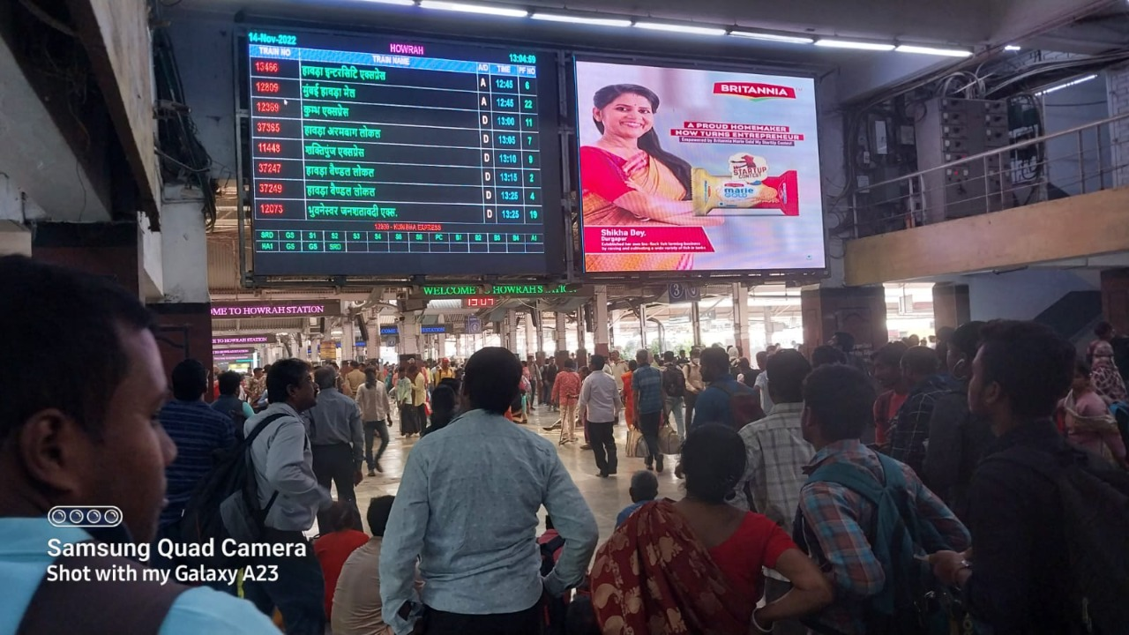
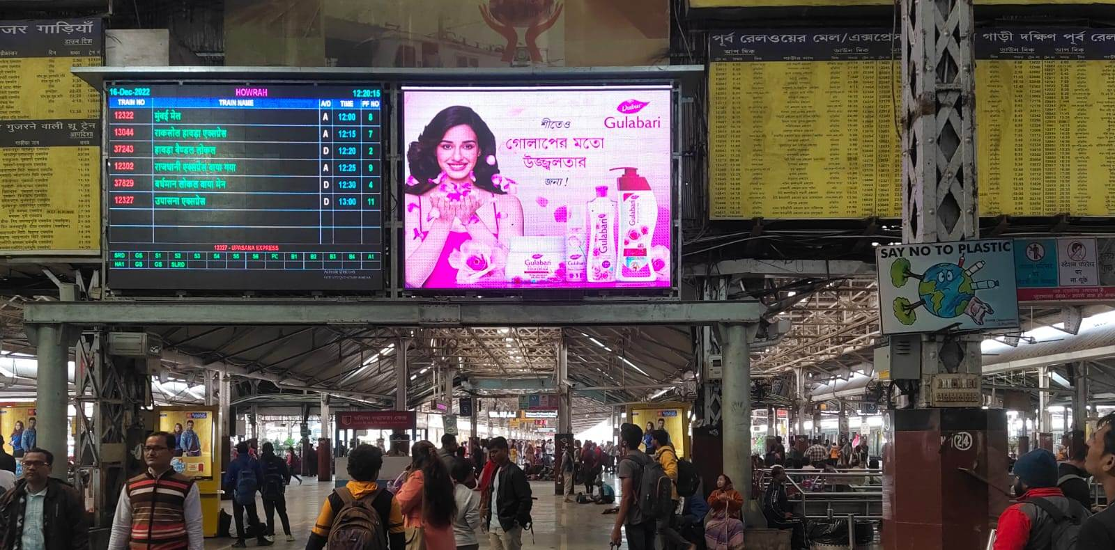
Howrah Station LED
Subway, Way to Platform No 1-3
In front of Platform No. 6 & 7
http://www.themediaant.com/

Slide 4
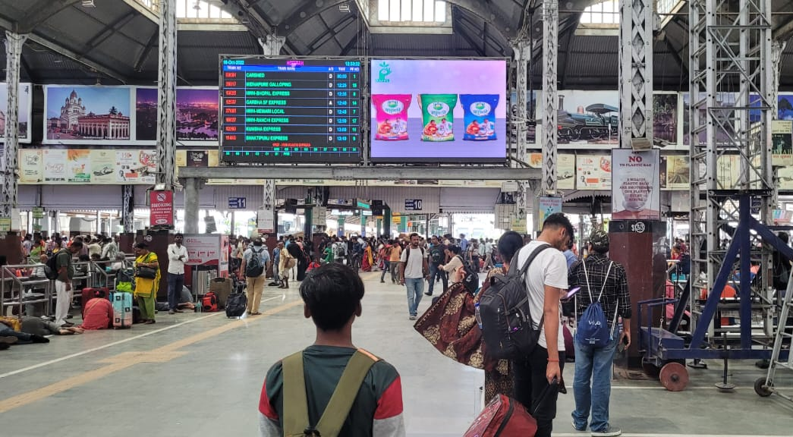
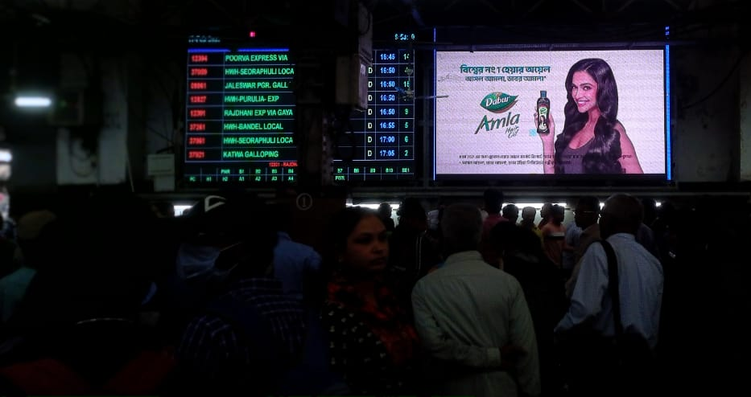
Howrah Station Inside LED
In front of Platform No. 10
Way to Platform No. 13-14
http://www.themediaant.com/

Slide 5
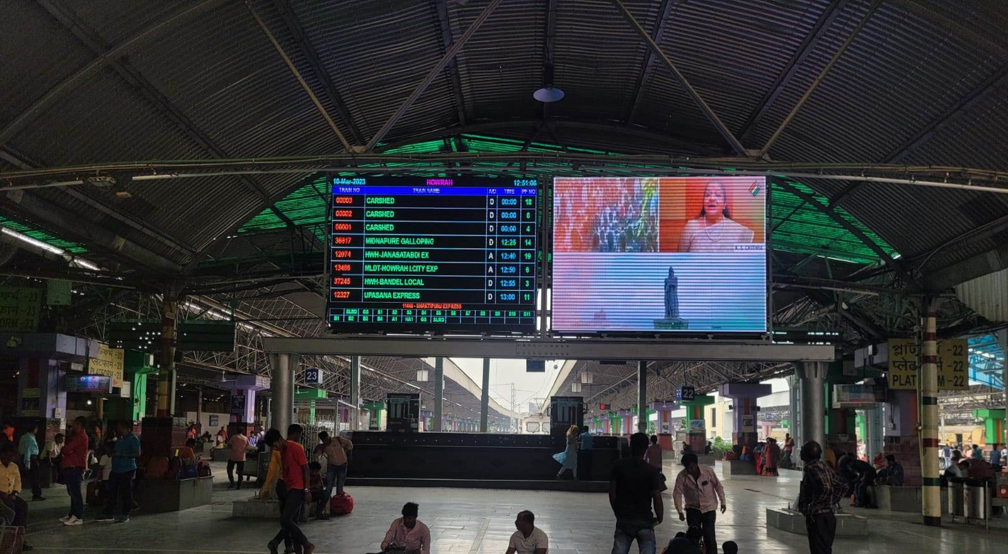
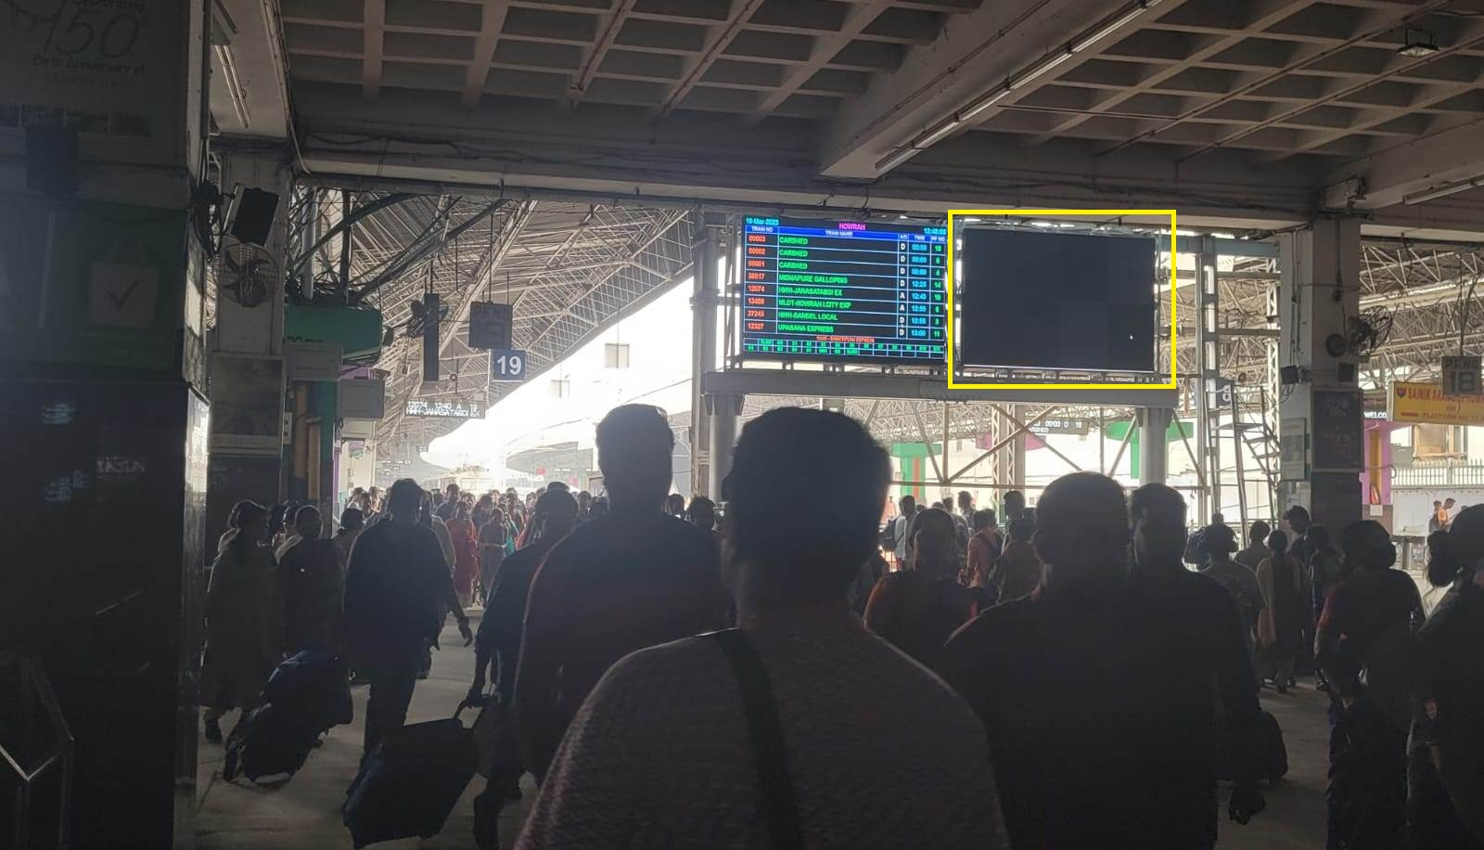
Howrah Station LED
Concourse area of PF 22-23
Concourse area of PF 17-21
http://www.themediaant.com/

Slide 6
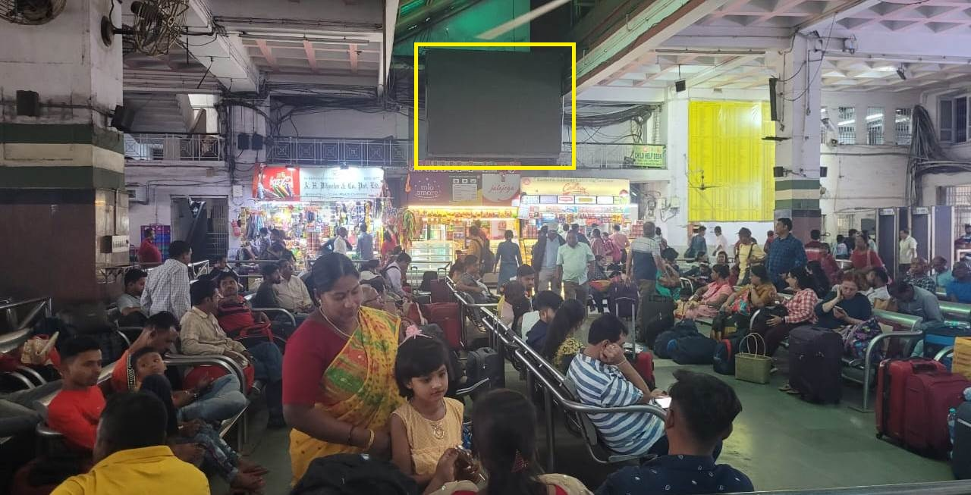
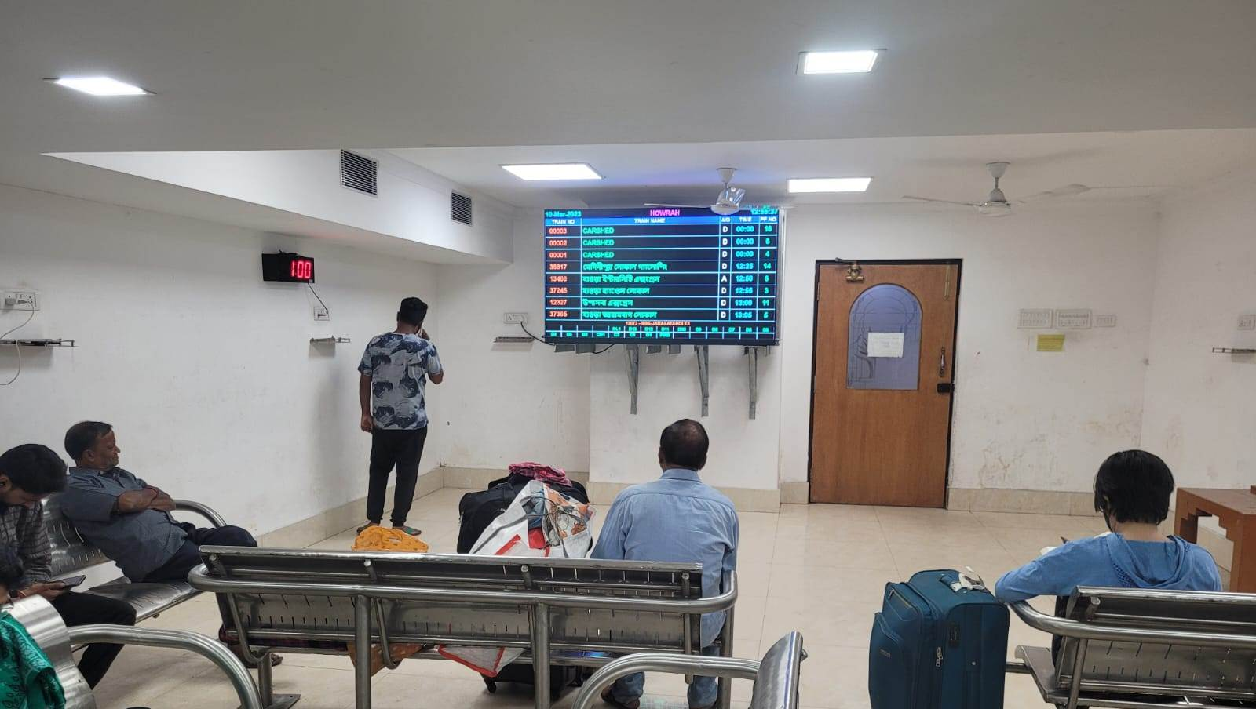
Howrah Station LED
General Waiting Hall (New Complex)
1st Class waiting Hall (New Complex)
http://www.themediaant.com/

Slide 7
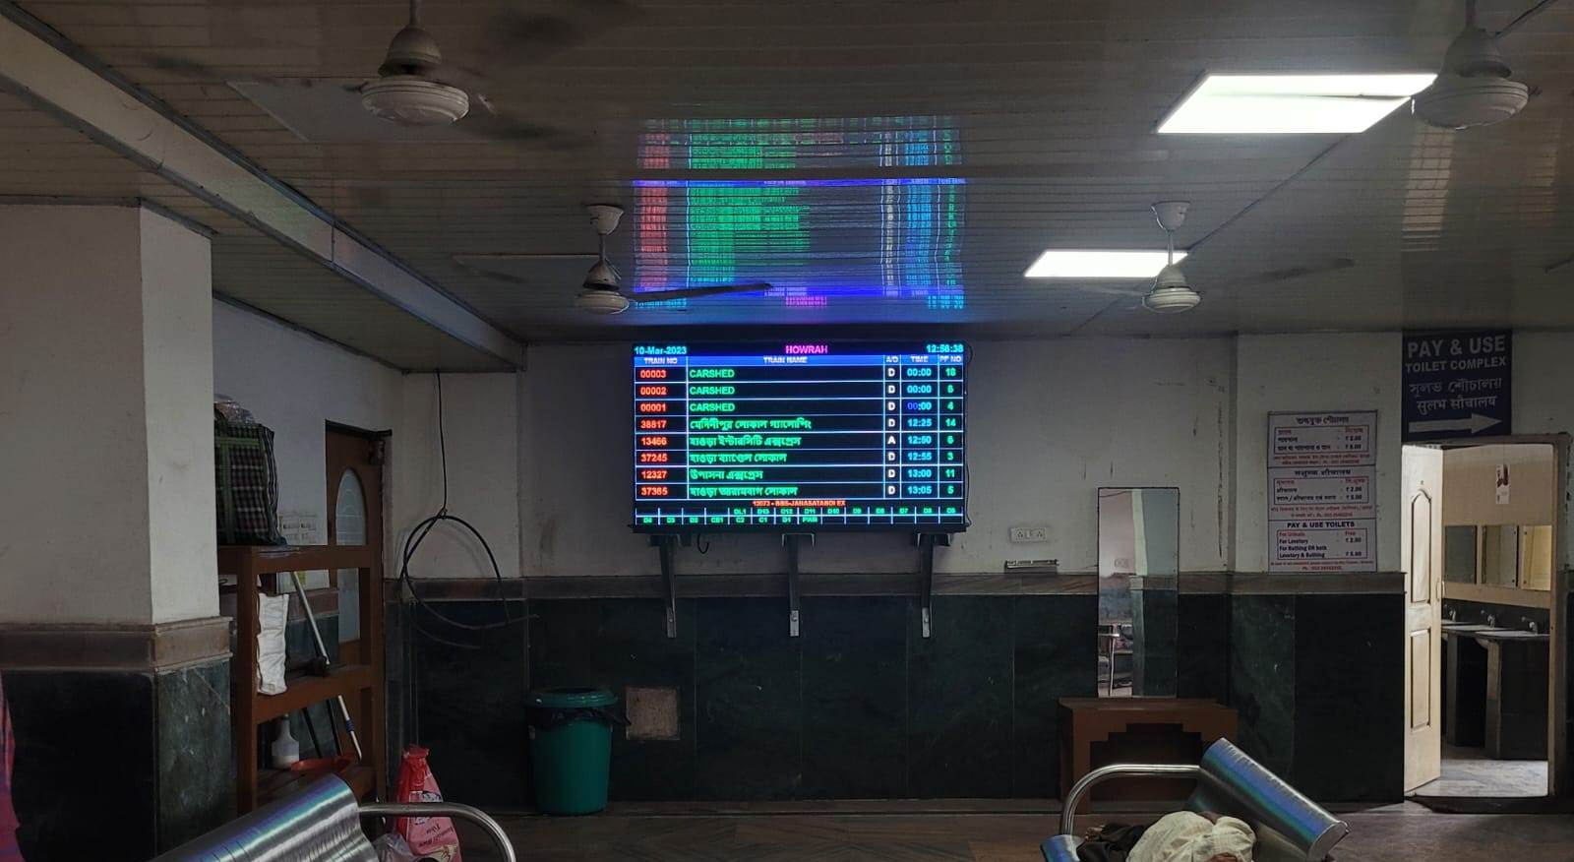
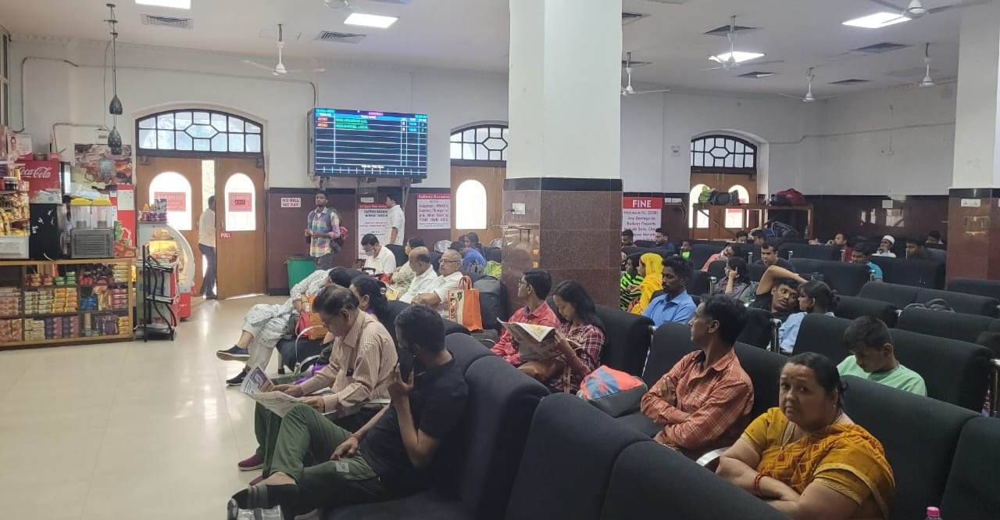
Howrah Station LED
Sleeper Class waiting Hall (New Complex)
1st Class waiting Hall (Old Complex)
http://www.themediaant.com/

Slide 8
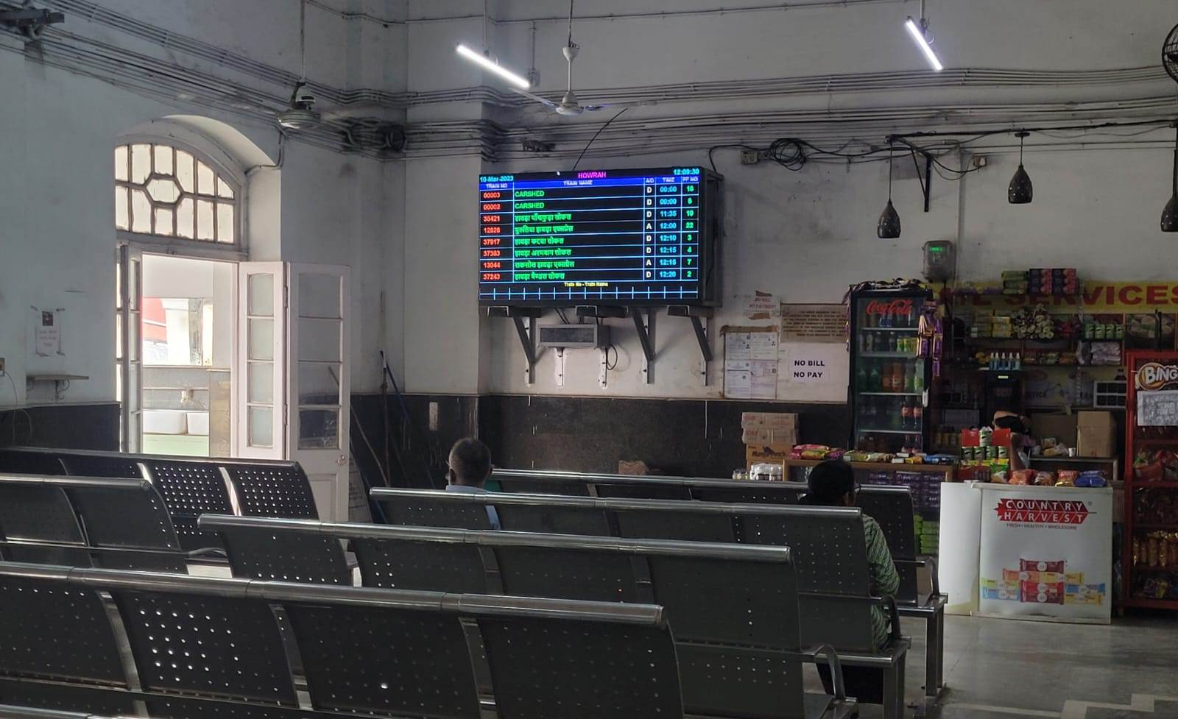
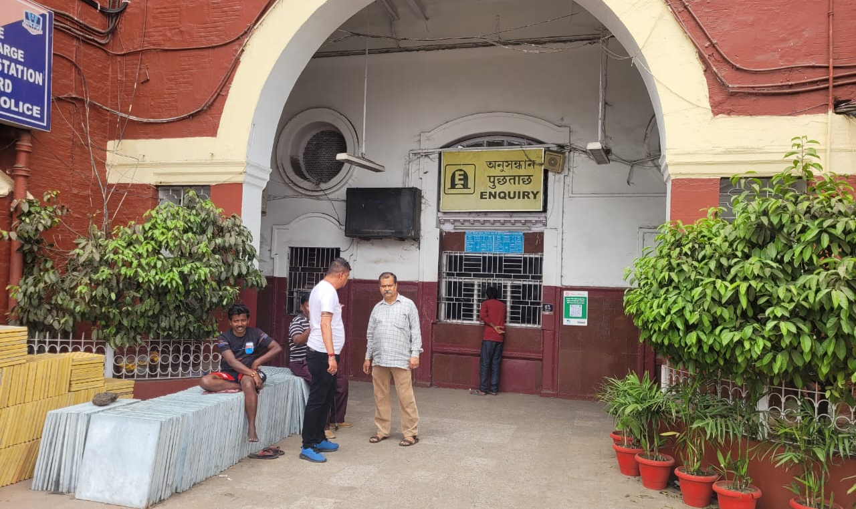
Howrah Station LED
Sleeper Class waiting hall (Old Complex)
In front of Enquiry Counter (Old Complex)
http://www.themediaant.com/

Slide 9
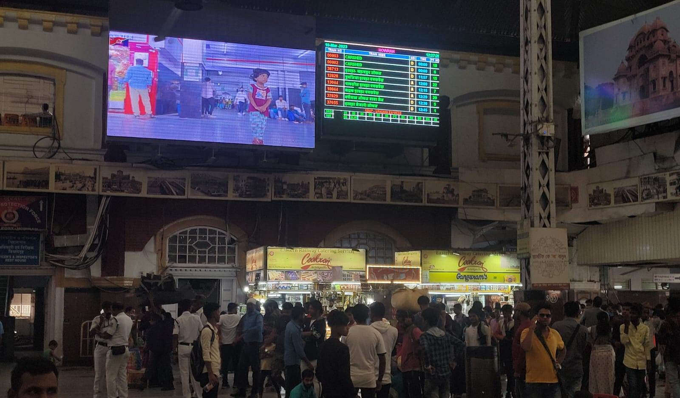
Howrah Station LED
In Front of Platform No. 12/ Near Food Plaza Wall
http://www.themediaant.com/

Slide 10











Thank You

