Slide 1
















Backlit Branding

Slide 2
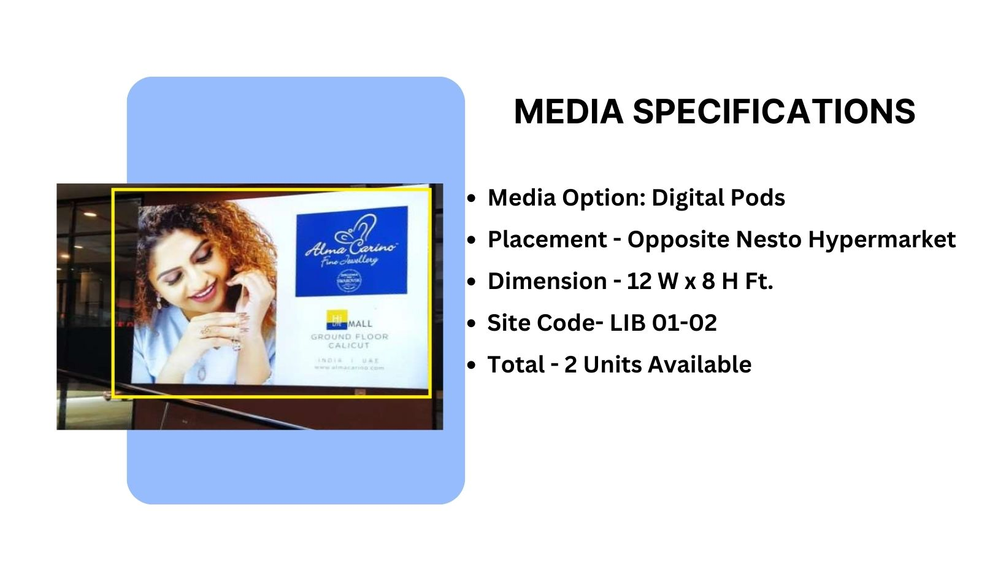
Façade Branding

Slide 3
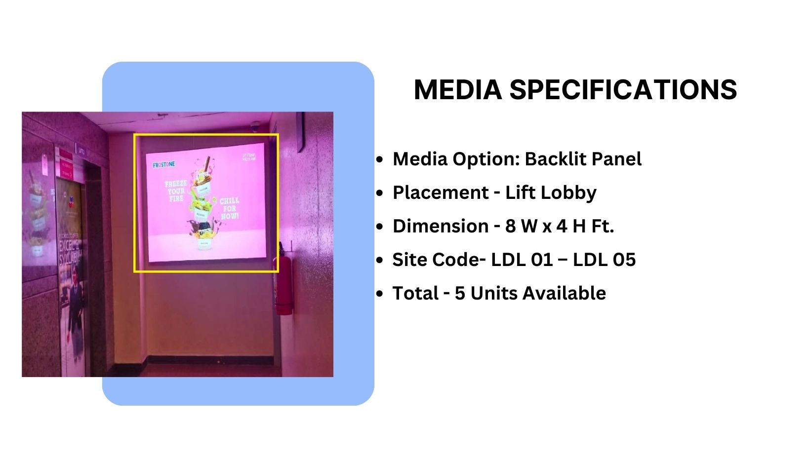
Façade Branding

Slide 4
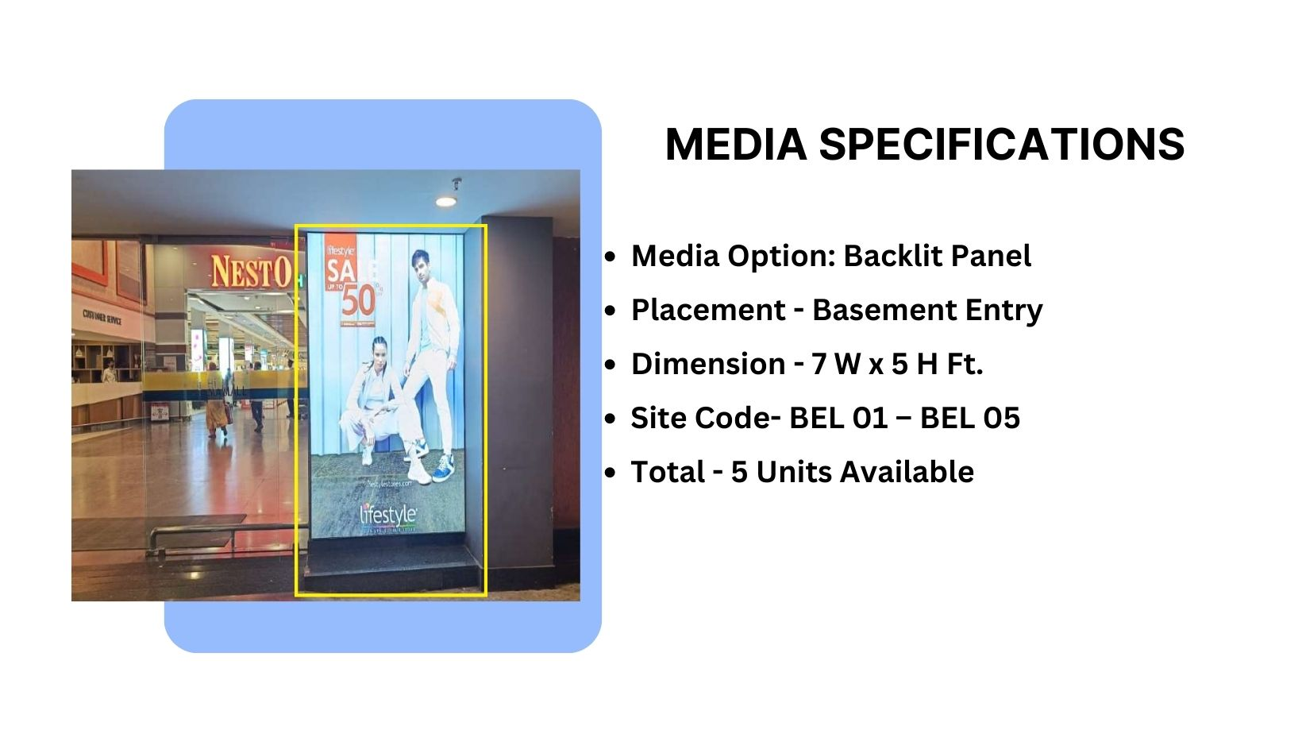
Façade Branding

Slide 5











Thank You

