Slide 1
















Digital Screen Branding

Slide 2
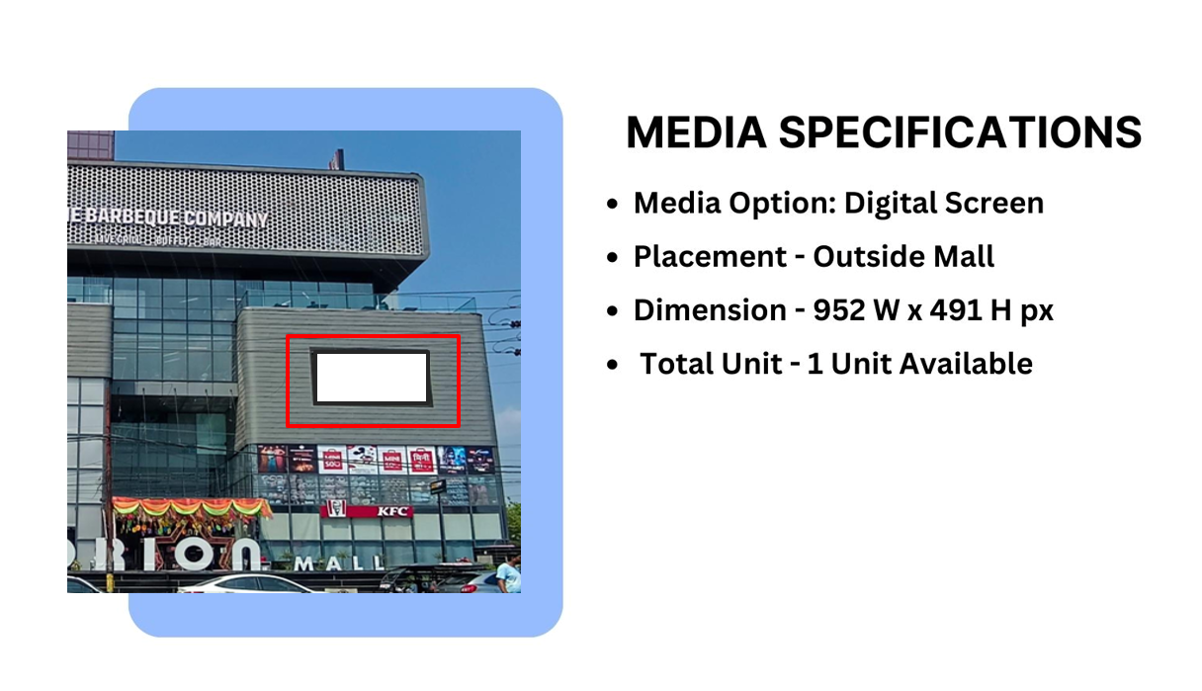

Slide 3
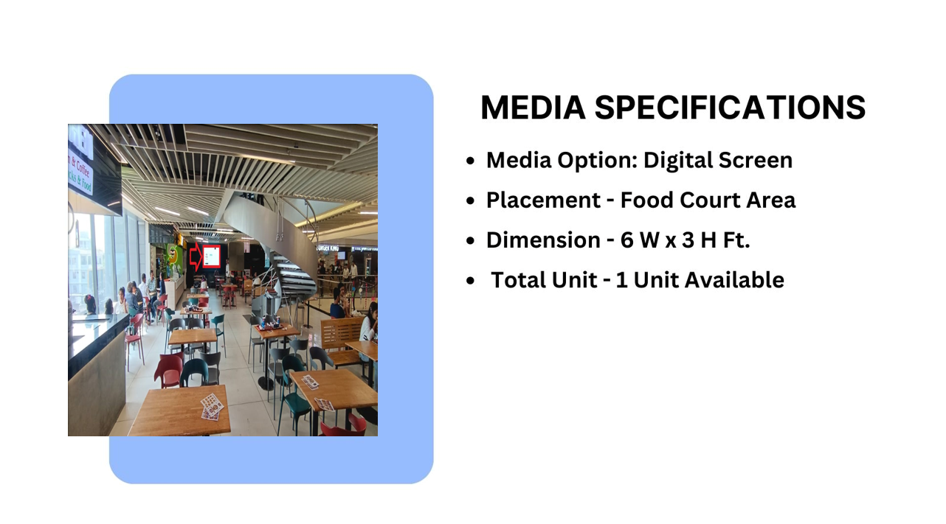

Slide 4
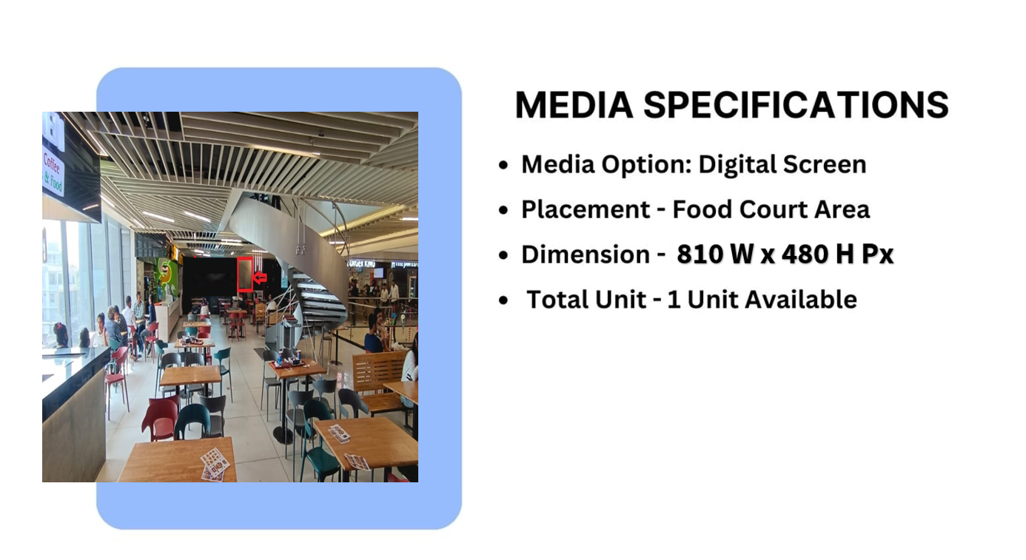

Slide 5











Thank You

