Slide 1
















Digital Screen Branding

Slide 2
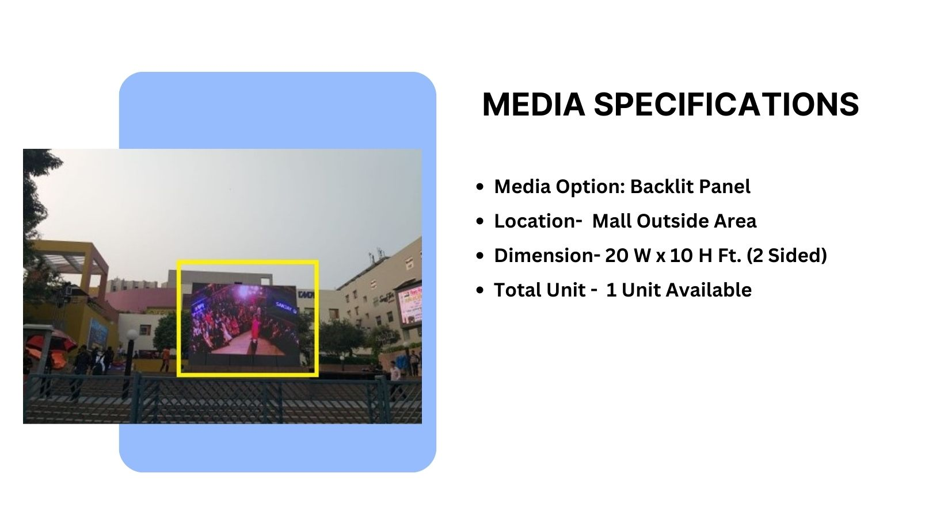

Façade Branding

Slide 3
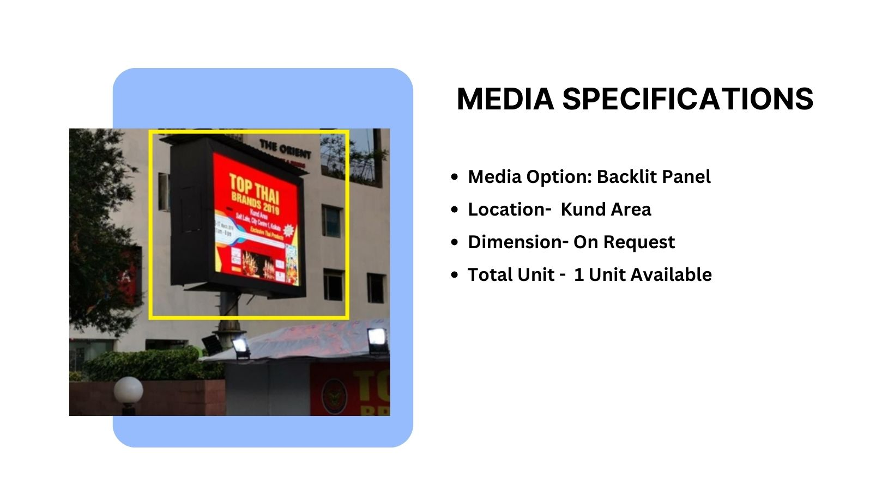
Façade Branding

Slide 4
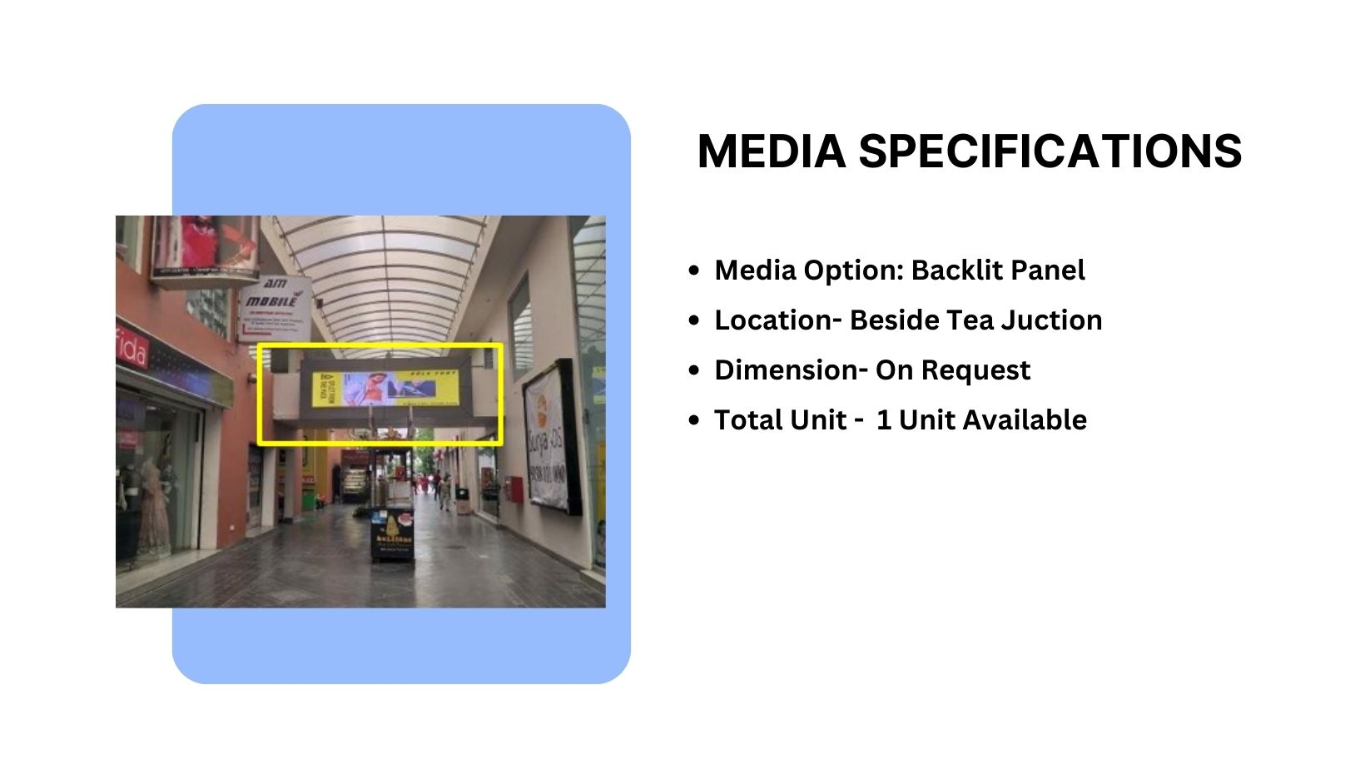
Façade Branding

Slide 5











Thank You

