Slide 1
















Wall Signage Branding

Slide 2
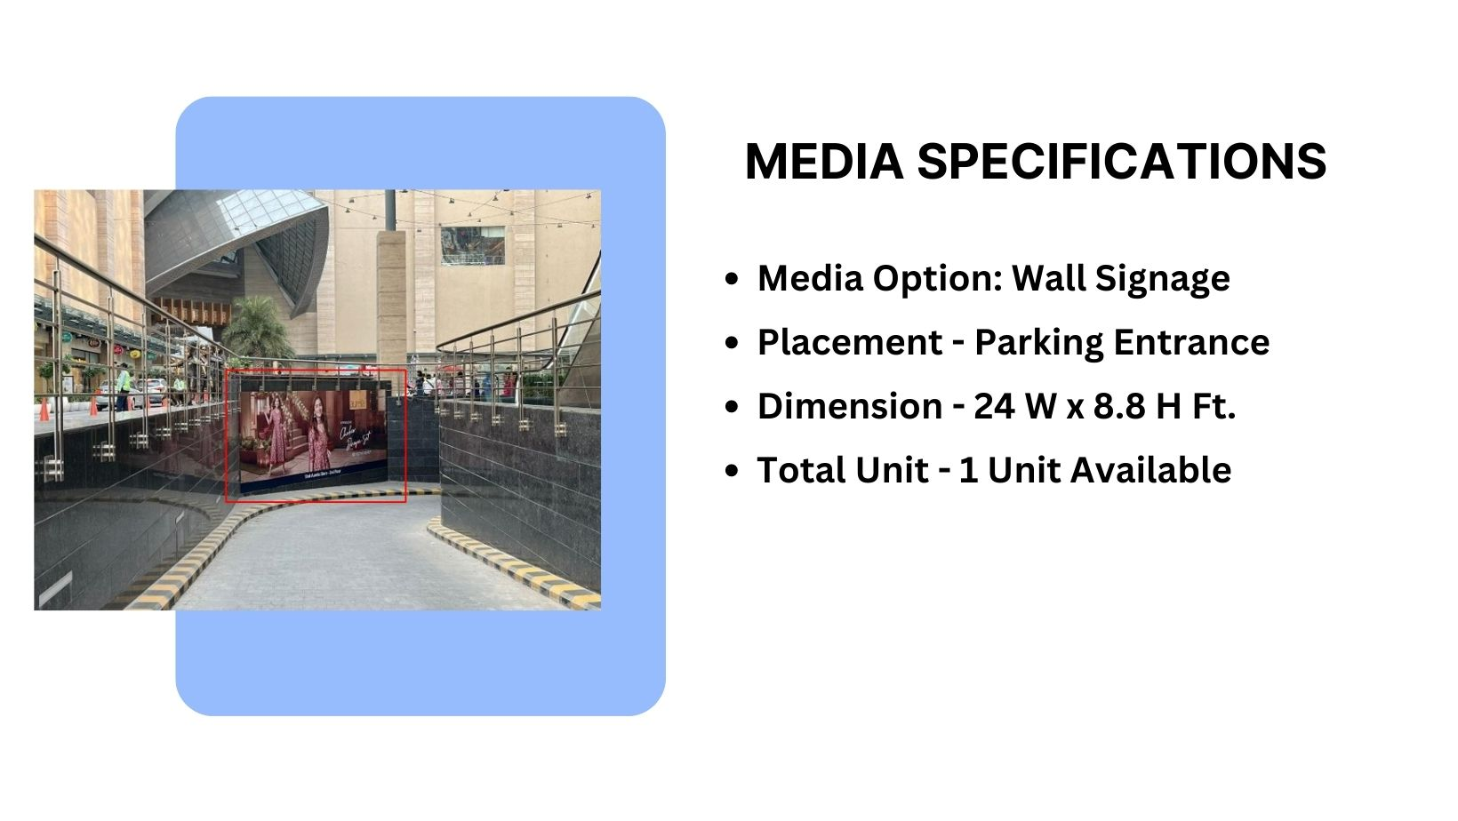
Façade Branding

Slide 3
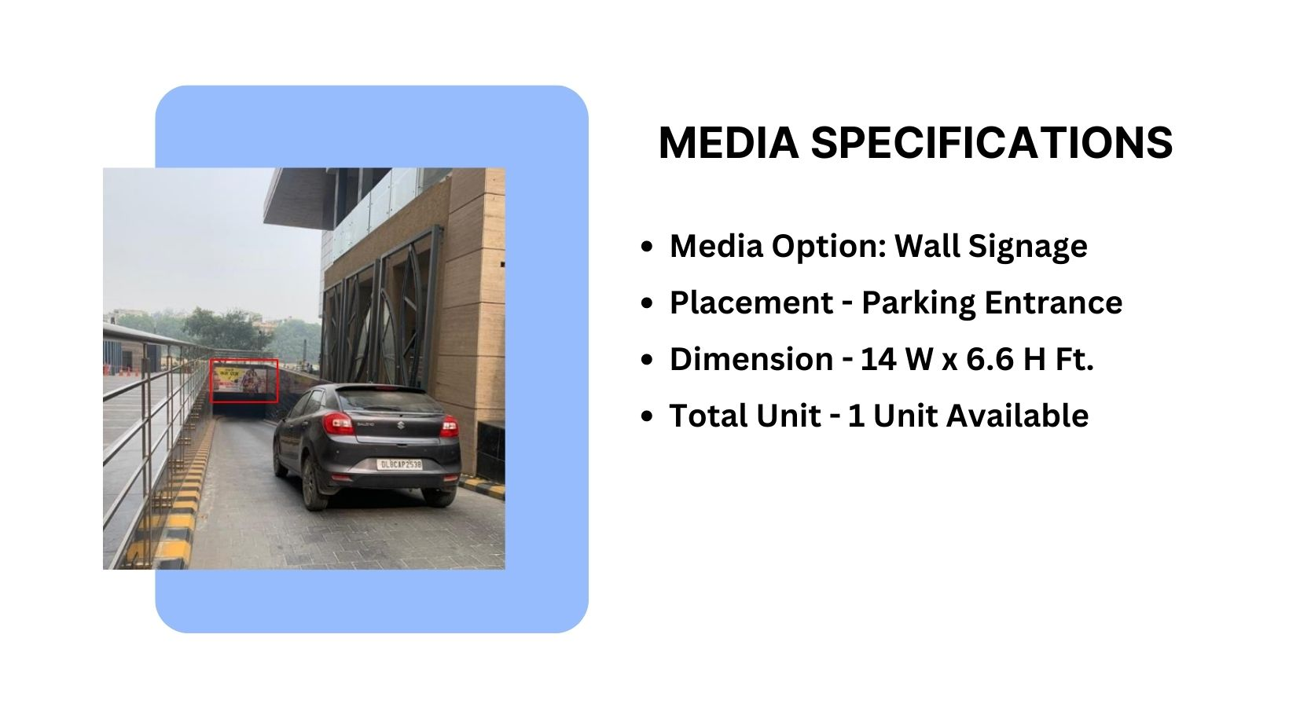
Façade Branding

Slide 4
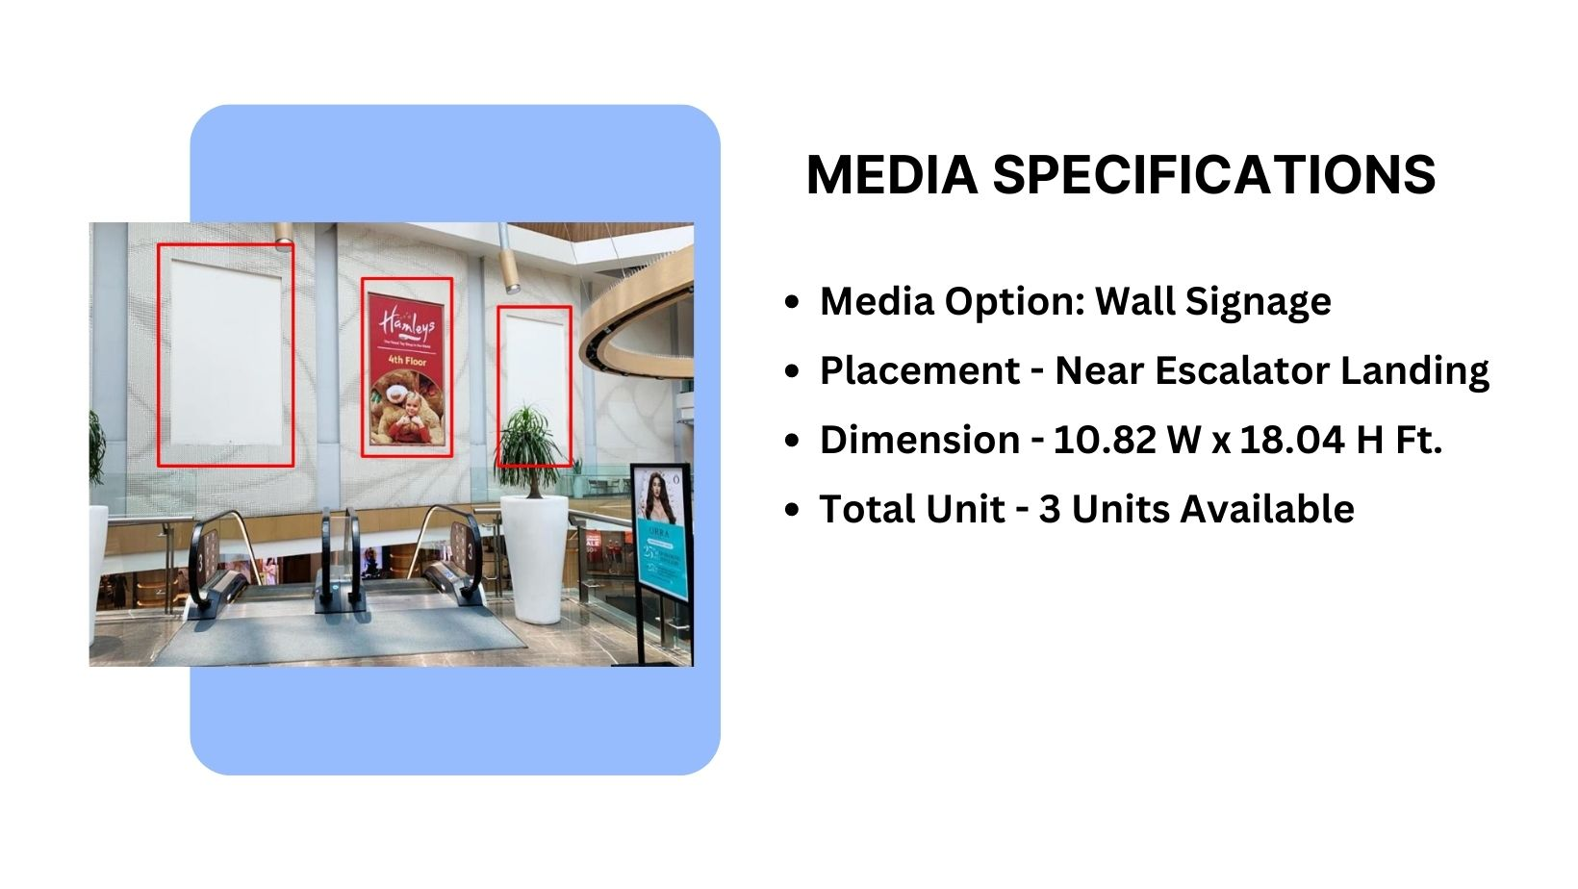
Façade Branding

Slide 5
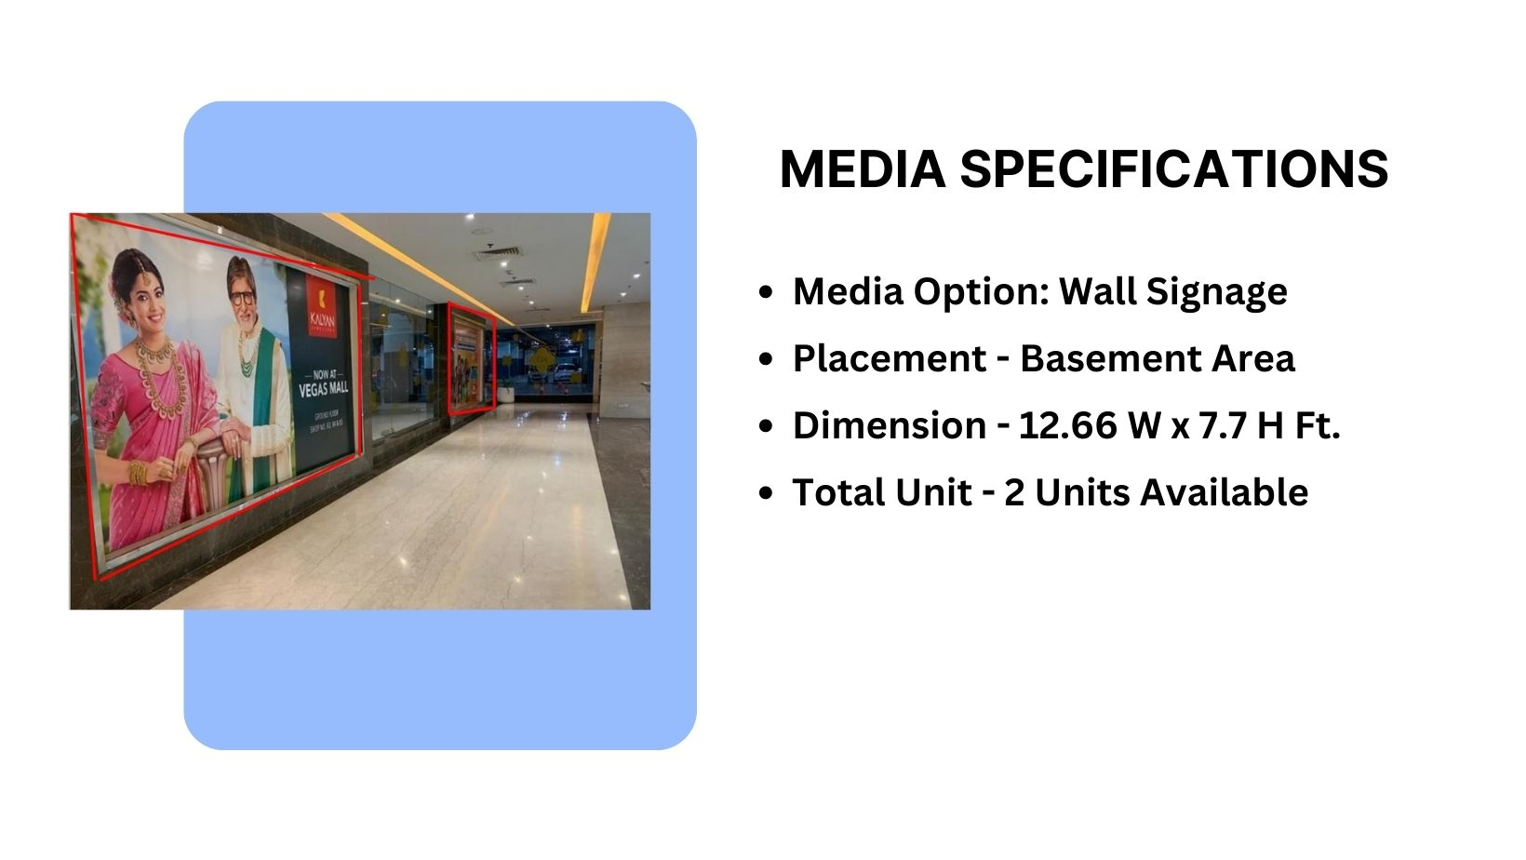
Façade Branding

Slide 6
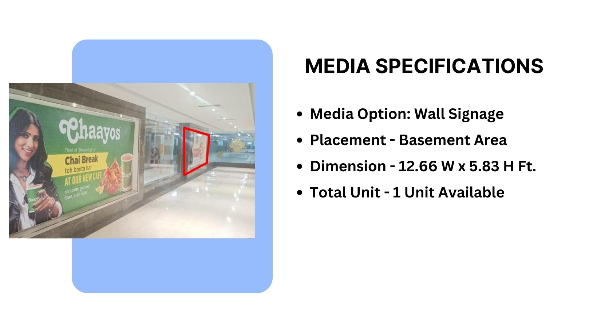
Façade Branding

Slide 7
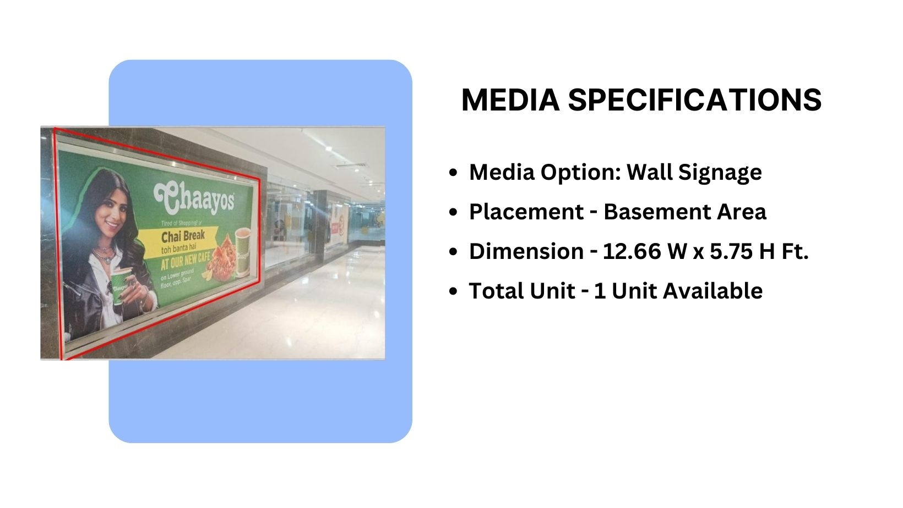
Façade Branding

Slide 8
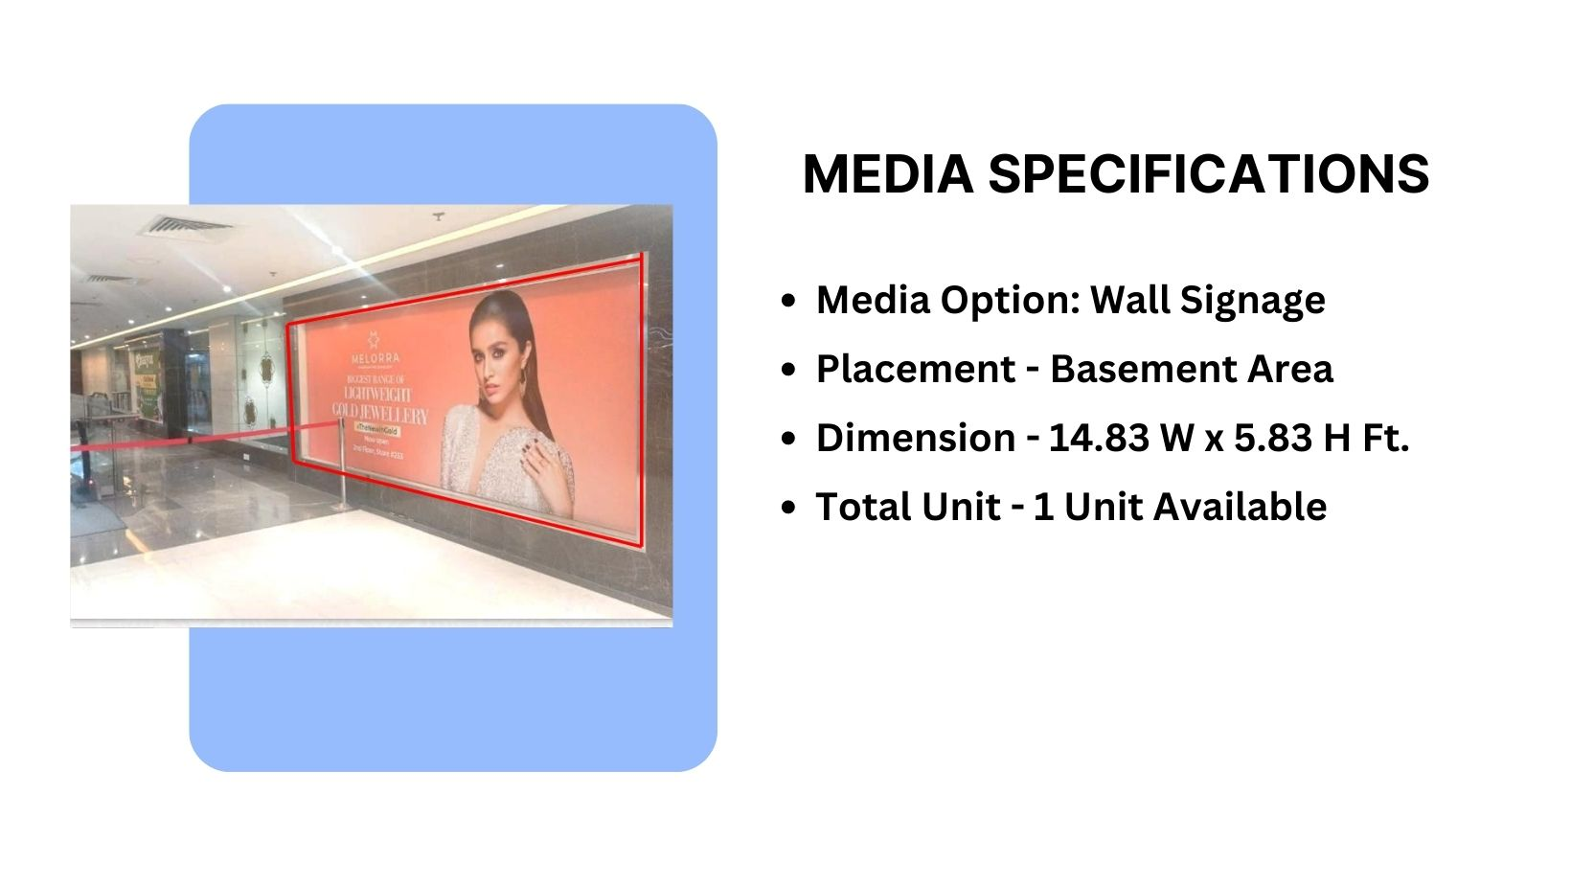
Façade Branding

Slide 9
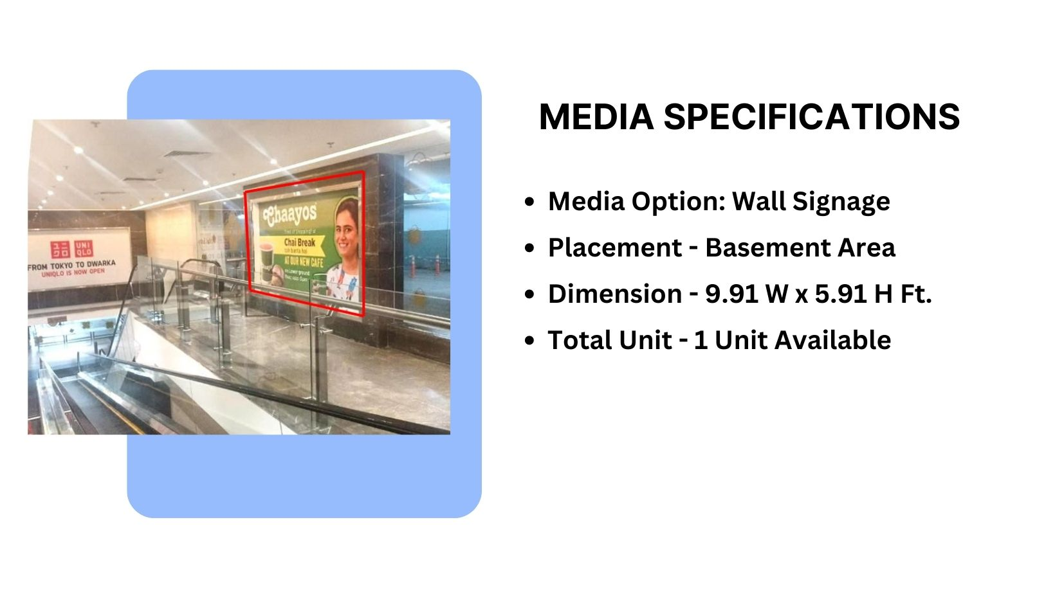
Façade Branding

Slide 10
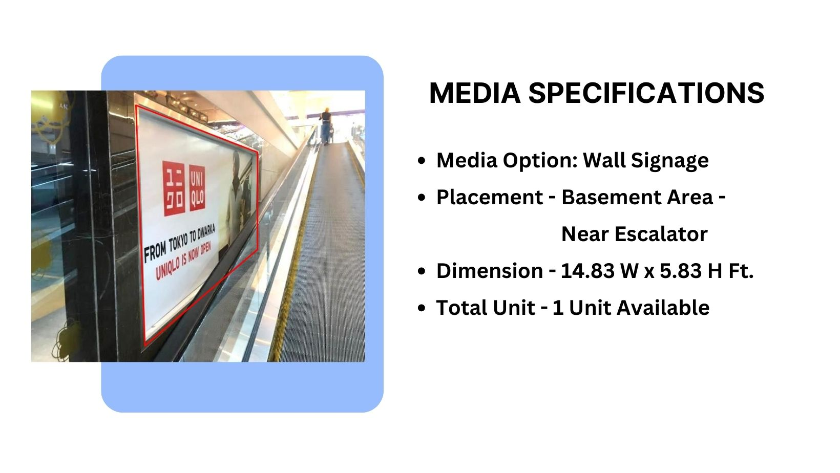
Façade Branding

Slide 11
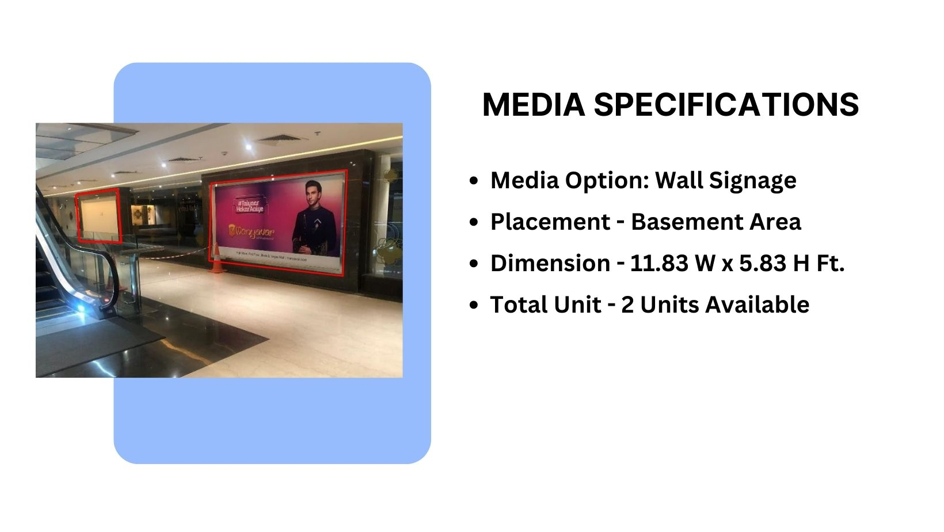
Façade Branding

Slide 12
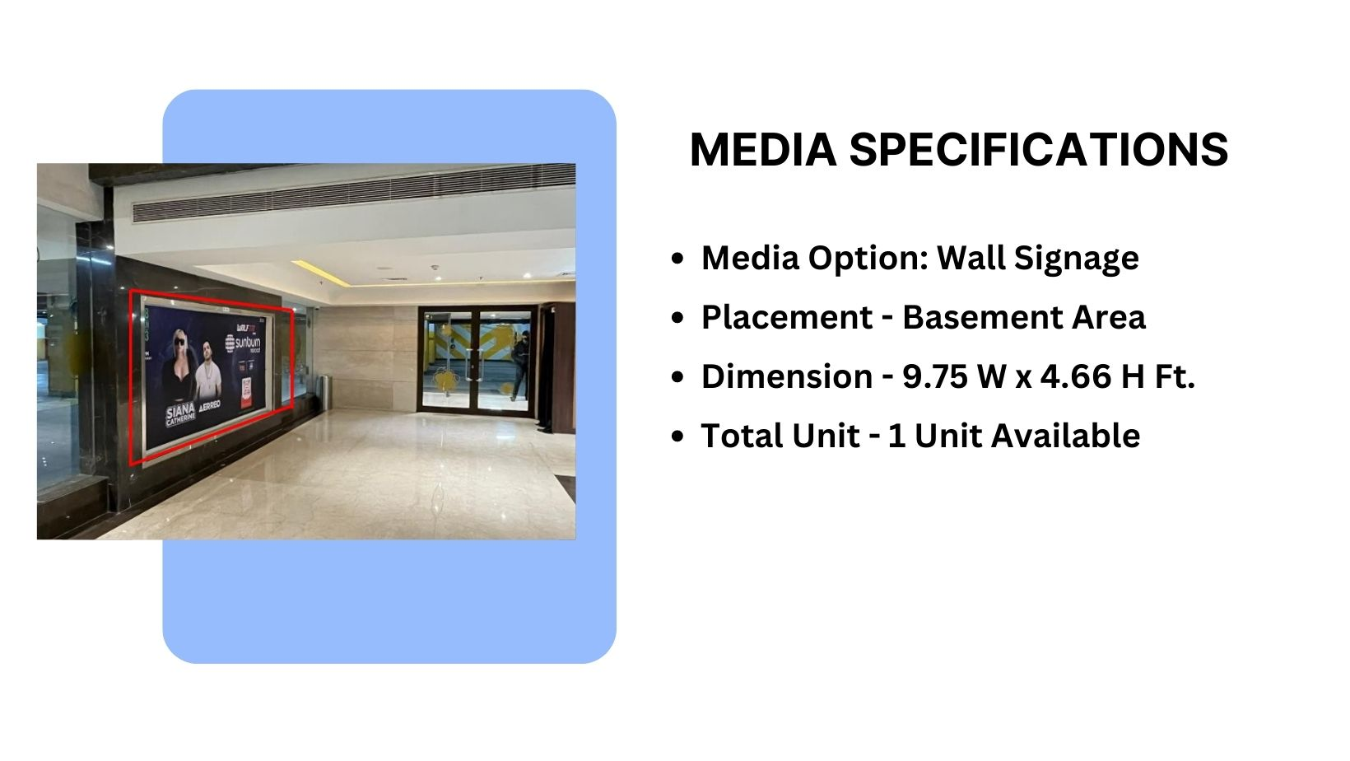
Façade Branding

Slide 13
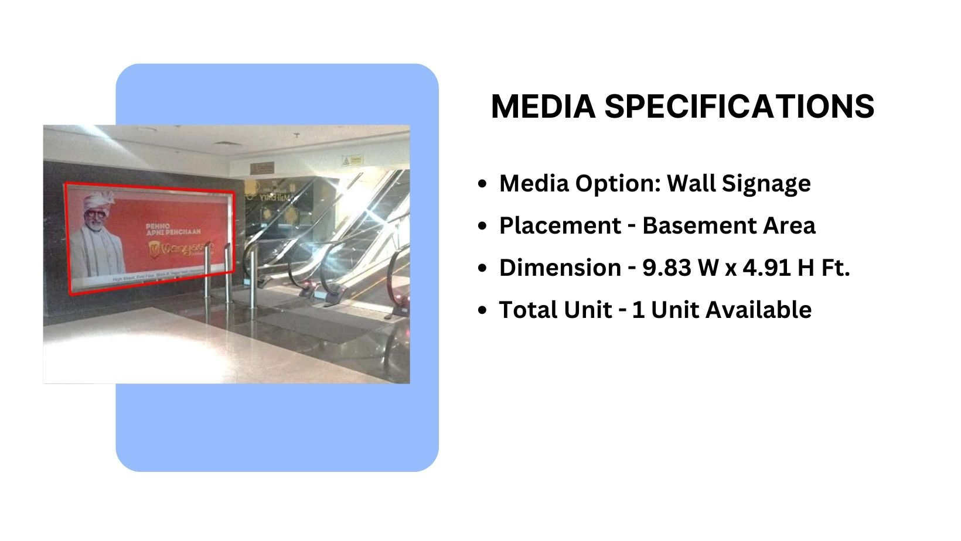
Façade Branding

Slide 14
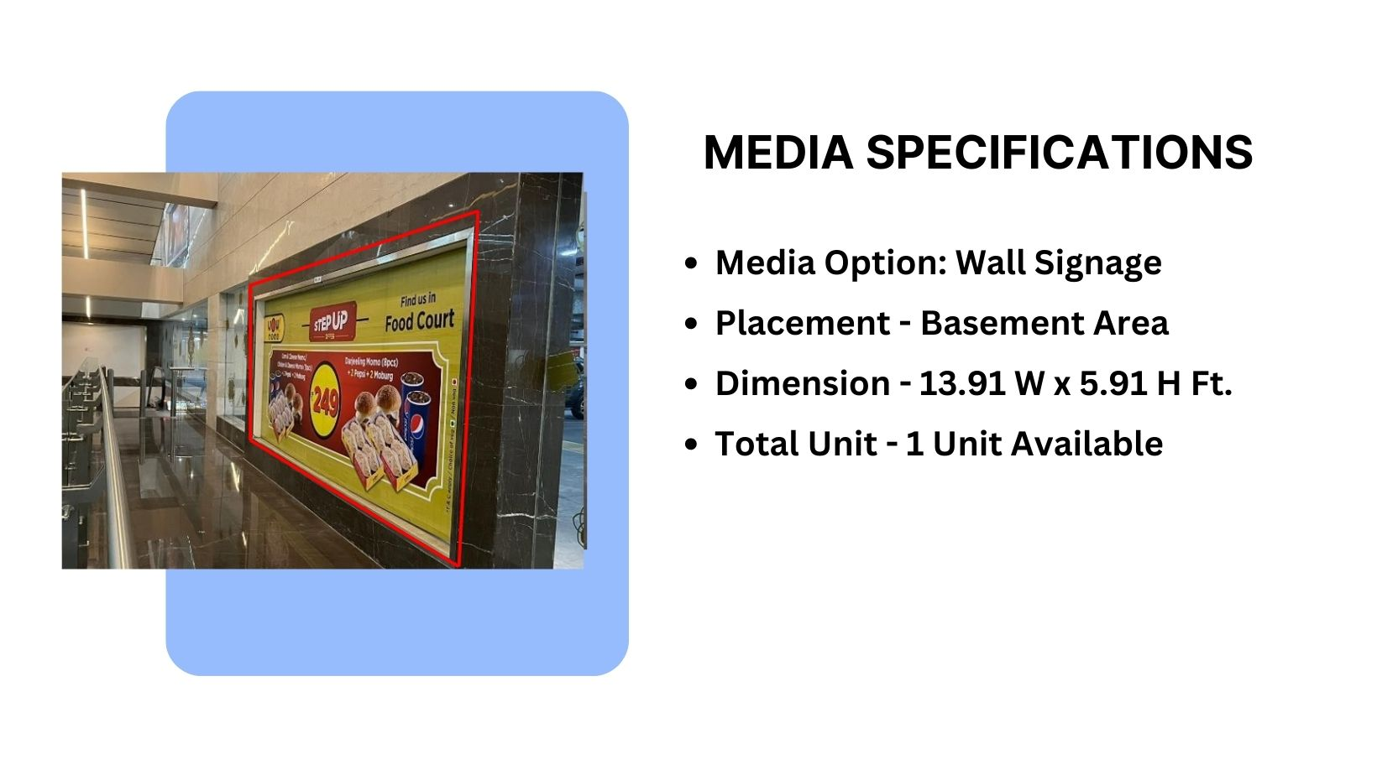
Façade Branding

Slide 15
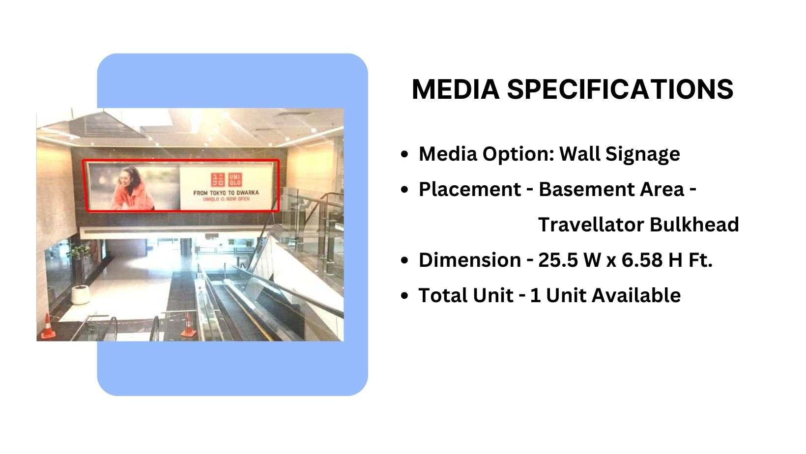
Façade Branding

Slide 16











Thank You

