Slide 1
















Facade Branding

Slide 2
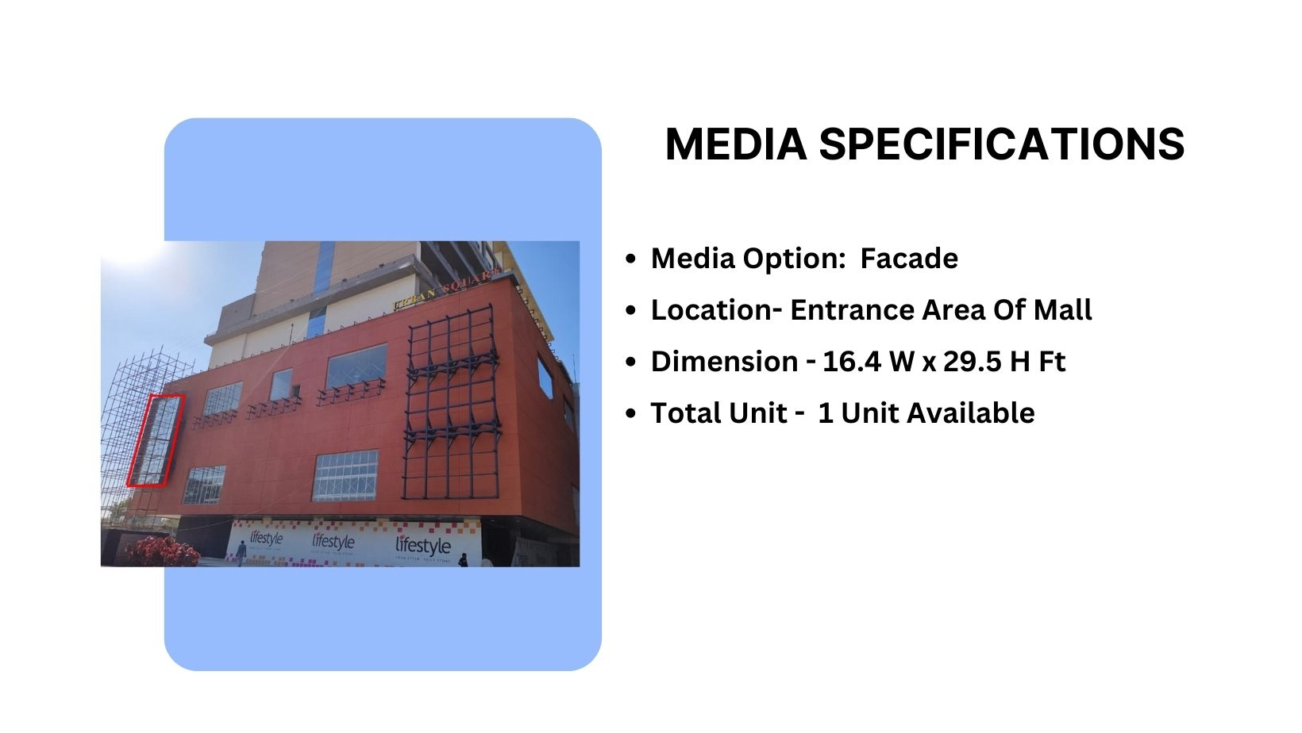
Site Code – R01
Façade Branding

Slide 3
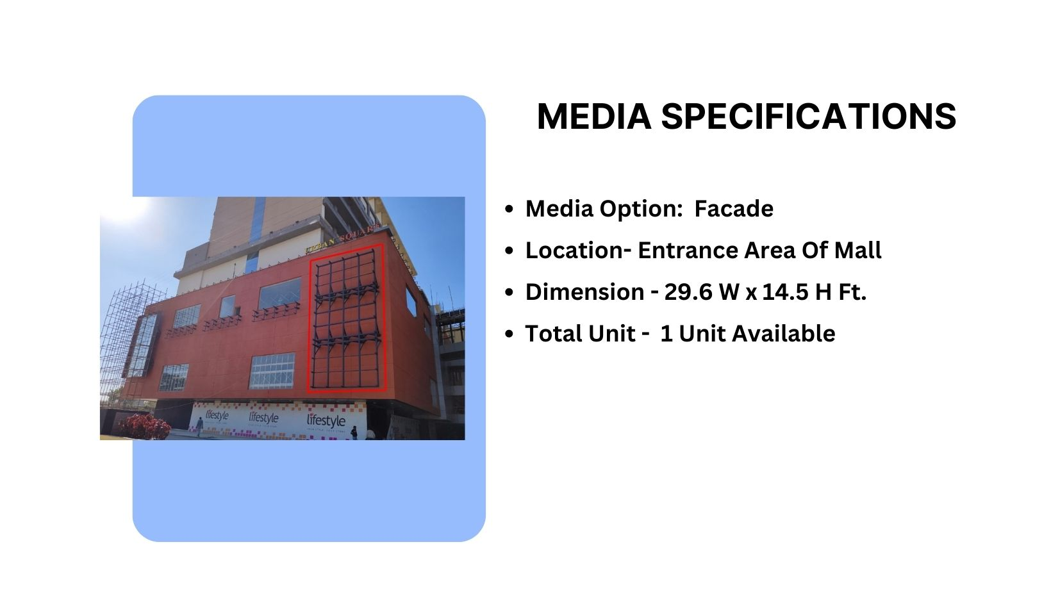
Site Code – R02
Façade Branding

Slide 4
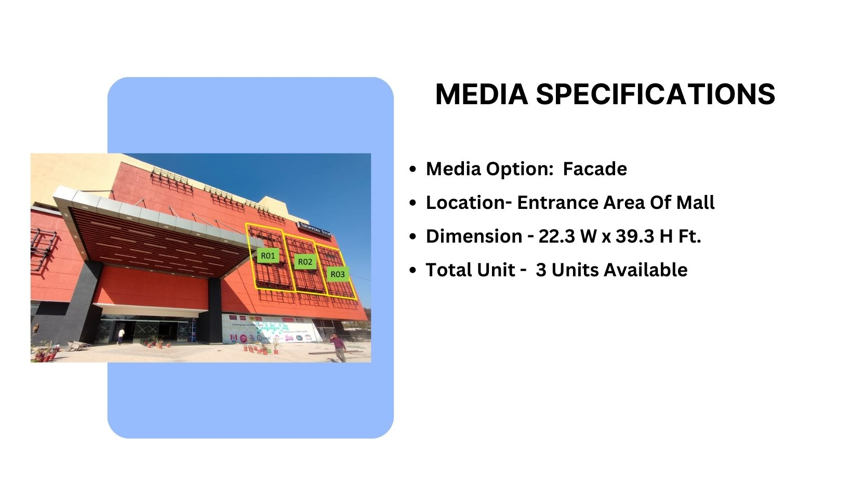
Site Code – R03-05
Façade Branding

Slide 5
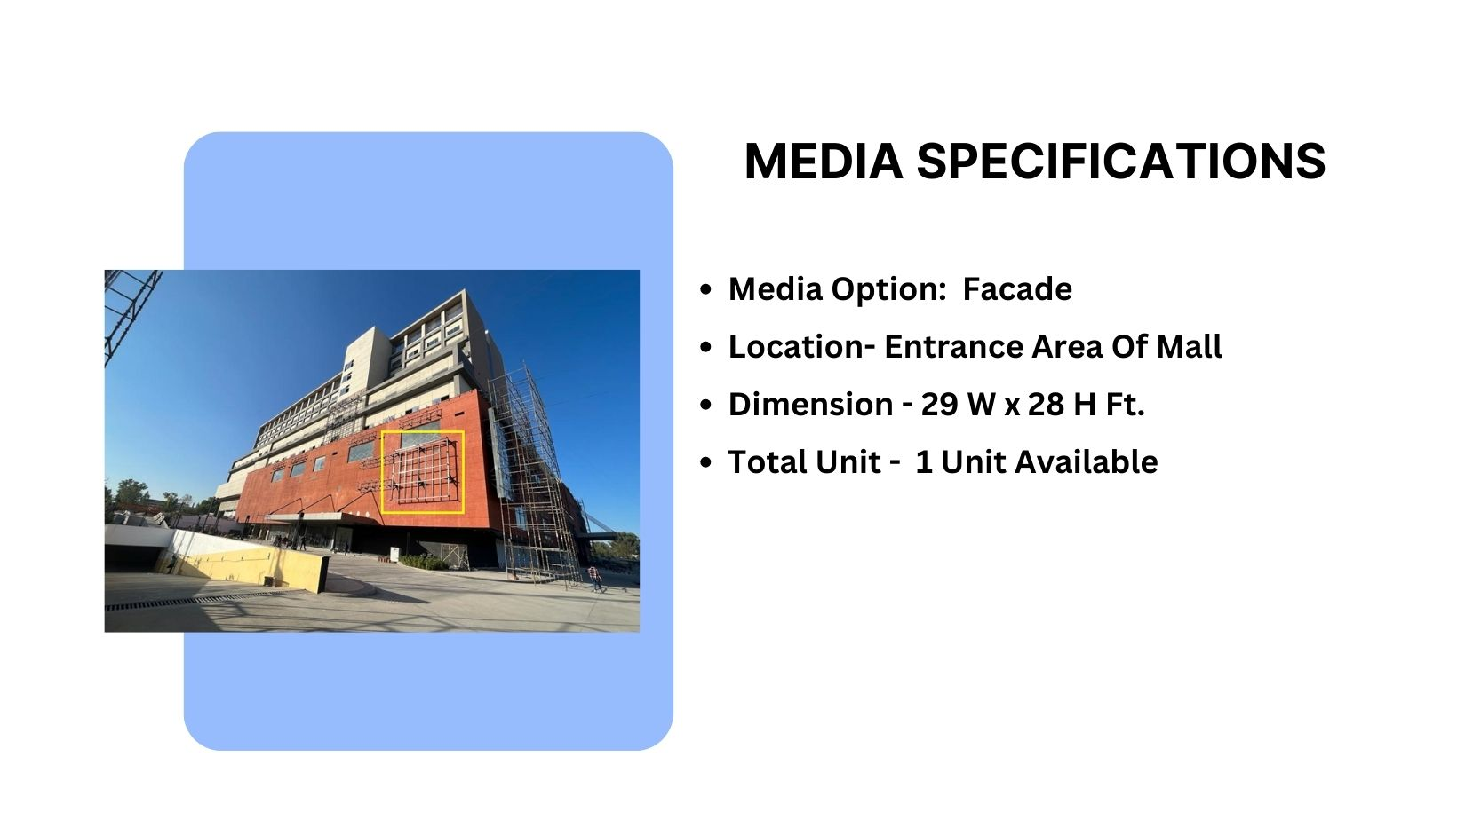

Site Code – R07
Façade Branding

Slide 6
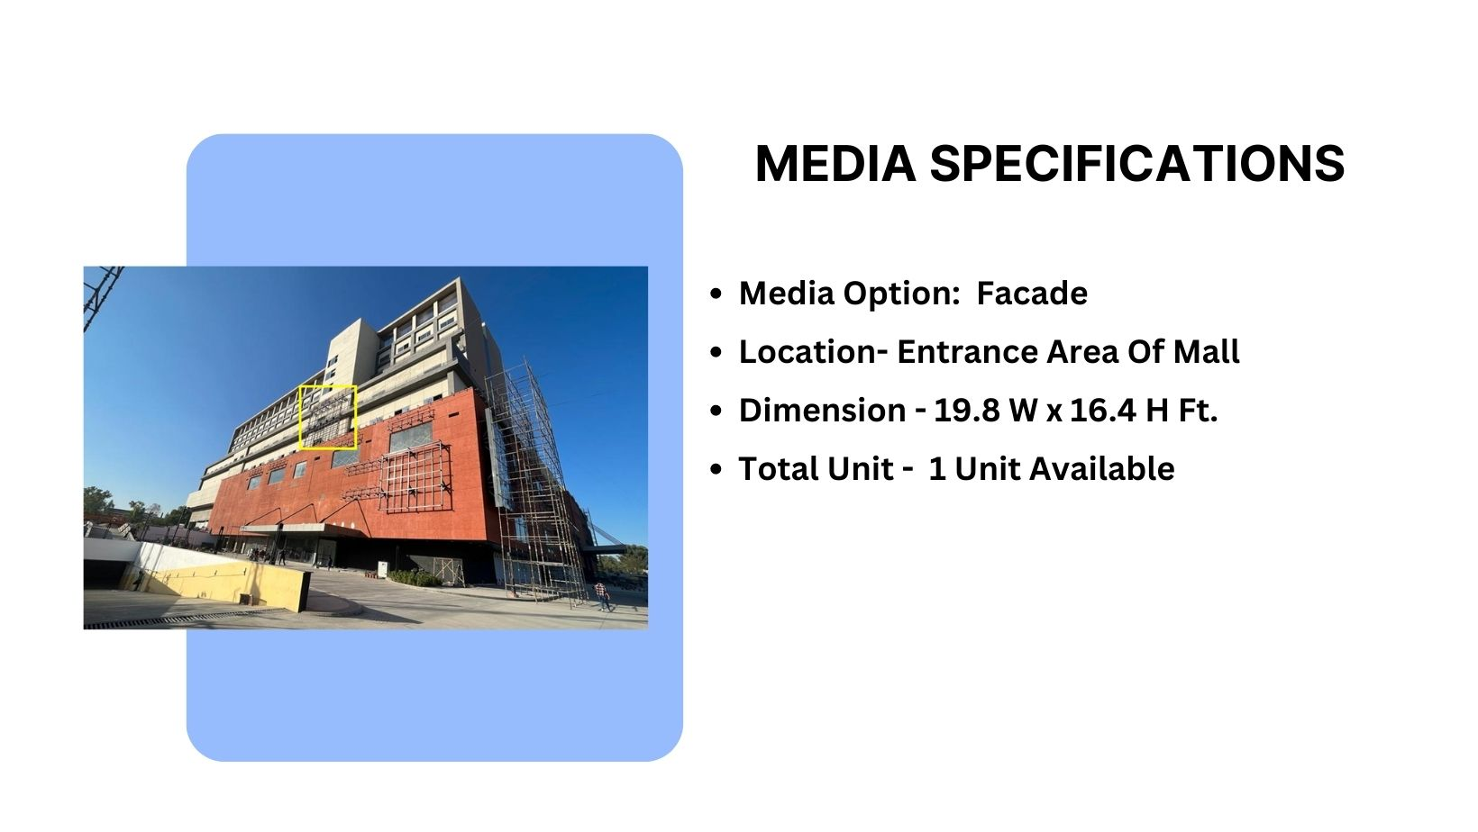

Site Code – R08
Façade Branding

Slide 7
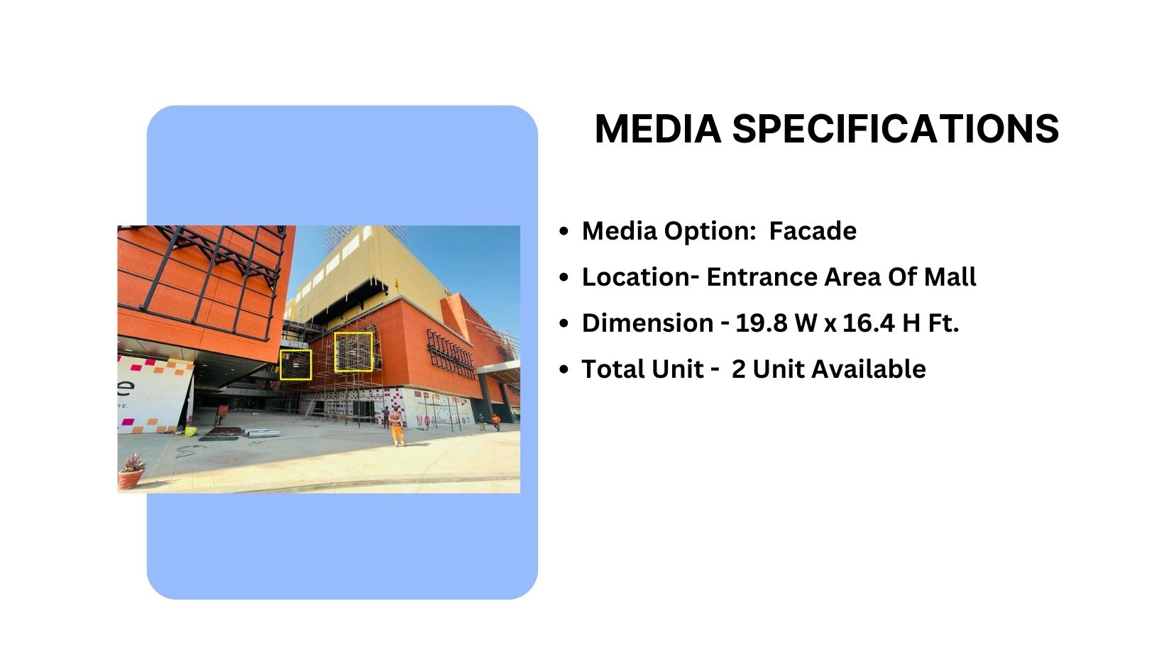
Site Code – R09-10
Façade Branding

Slide 8
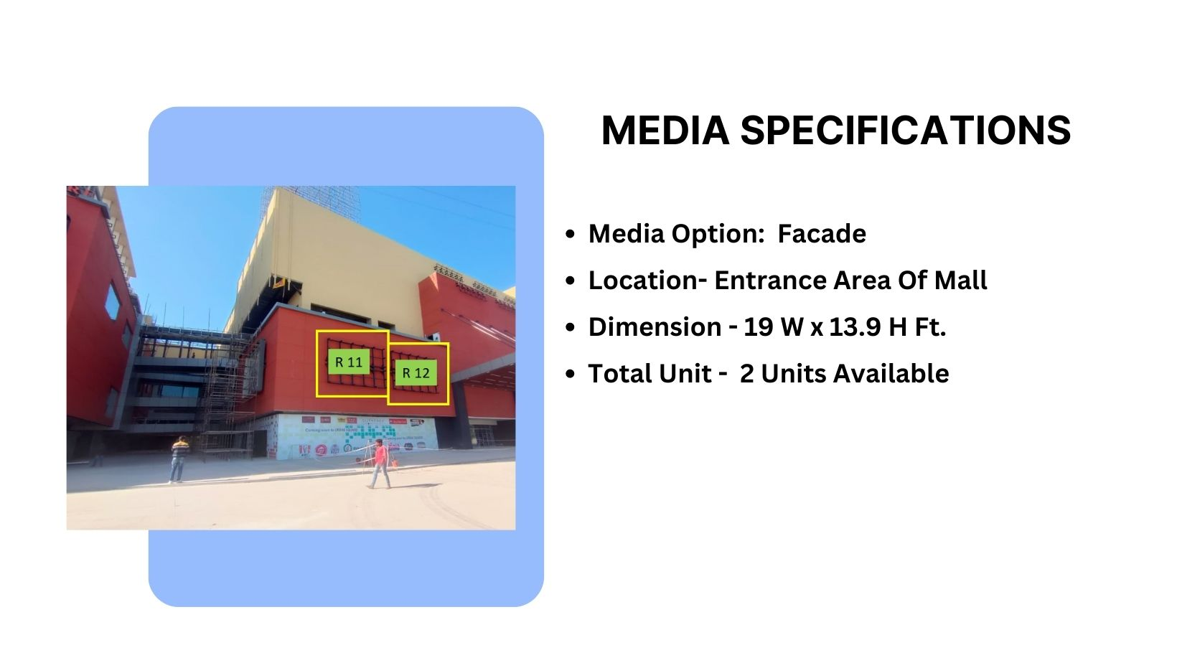
Site Code – R11-12
Façade Branding

Slide 9











Thank You

