Slide 1
















Wall Branding

Slide 2
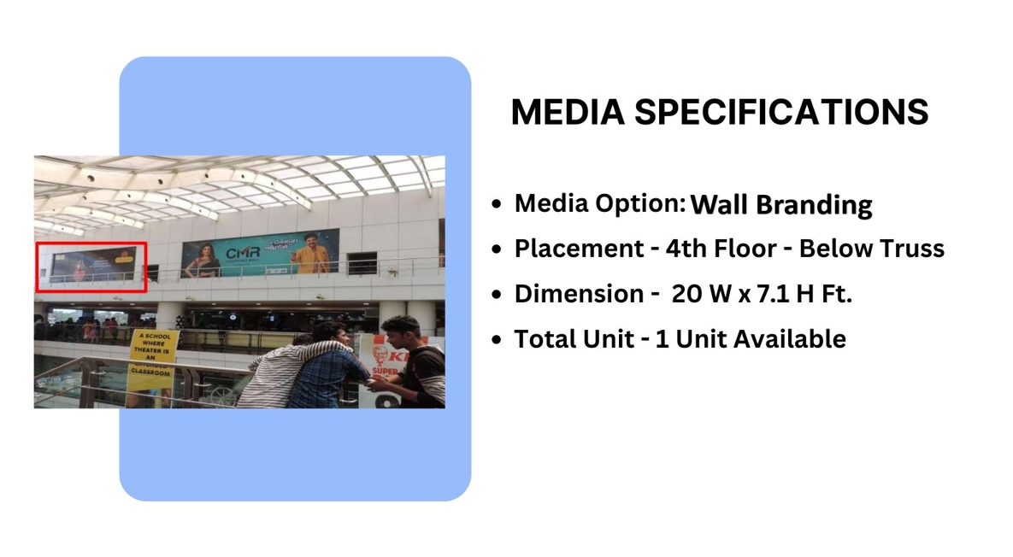
Façade Branding

Slide 3
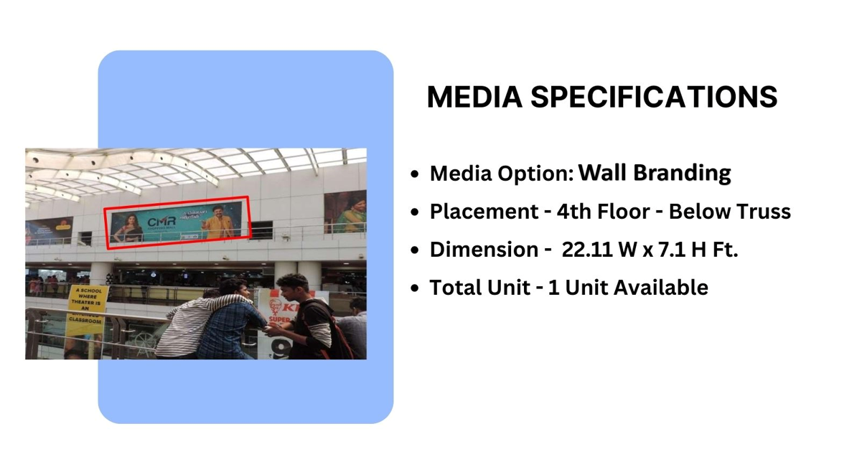
Façade Branding

Slide 4
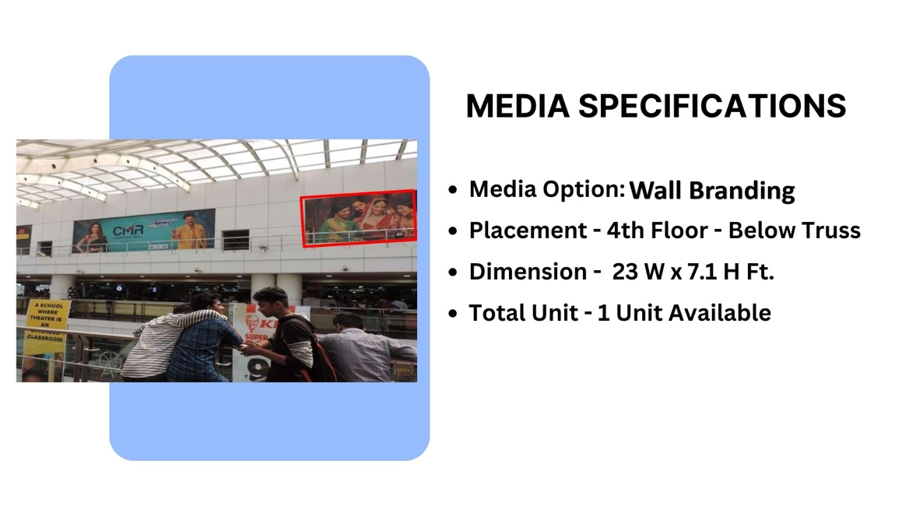
Façade Branding

Slide 5
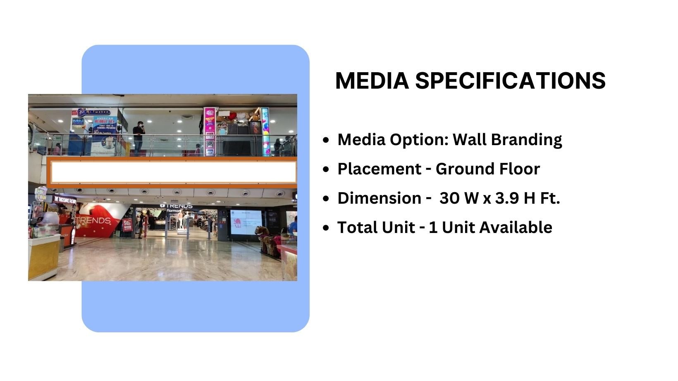
Façade Branding

Slide 6
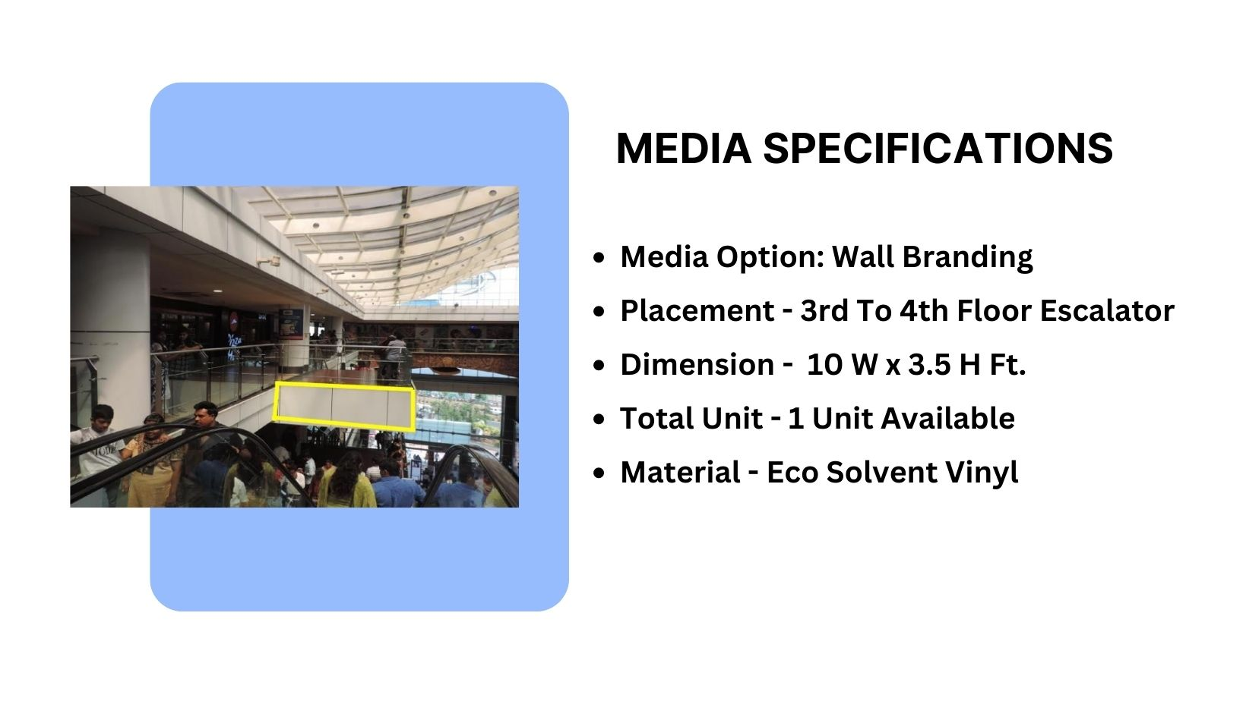
Façade Branding

Slide 7
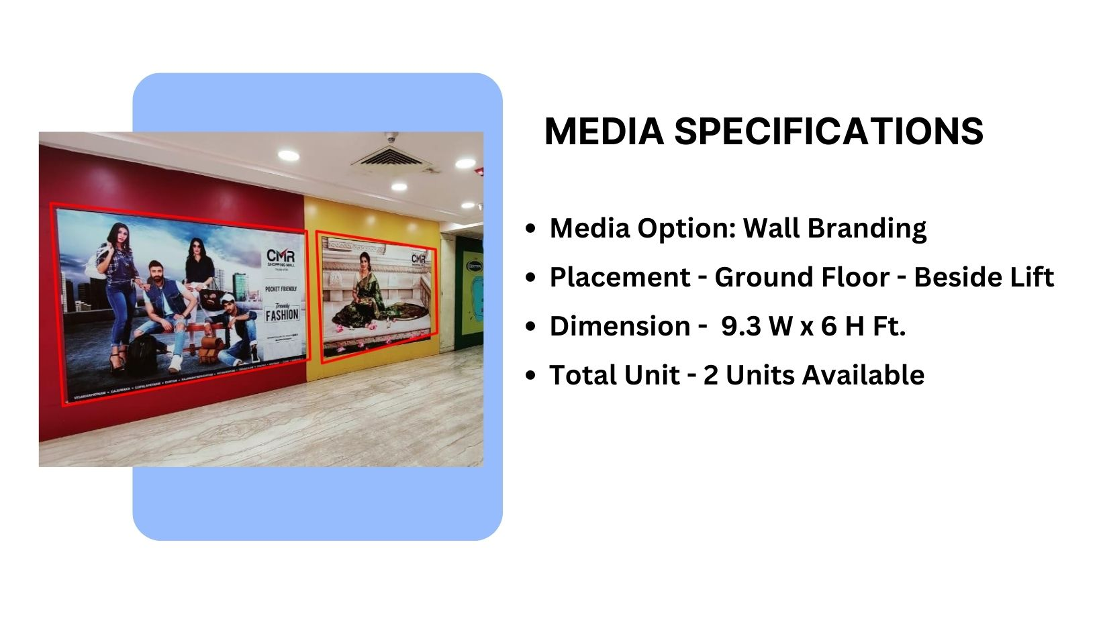
Façade Branding

Slide 8
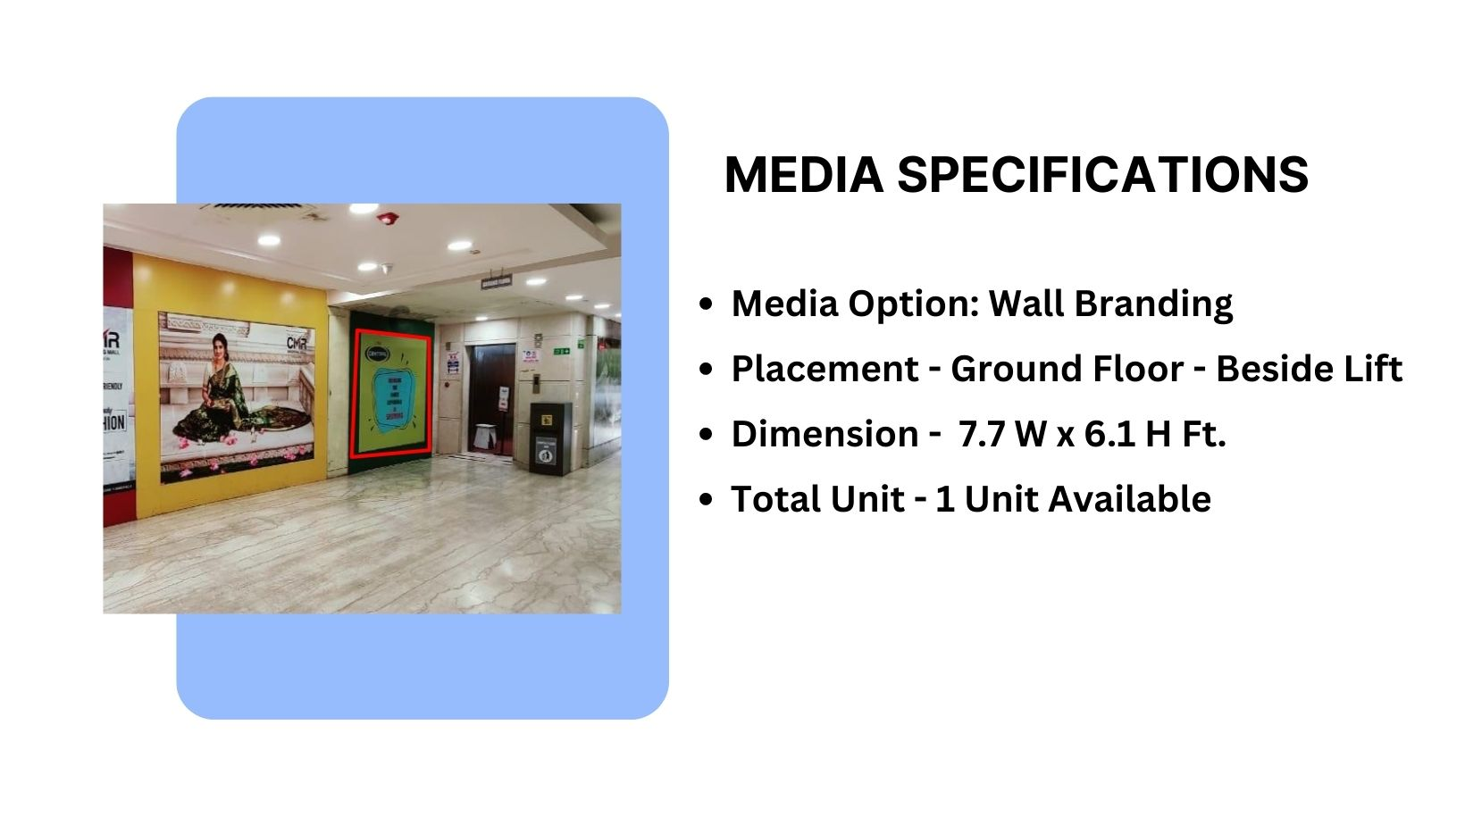
Façade Branding

Slide 9











Thank You

