Slide 1
















Facade Branding

Slide 2
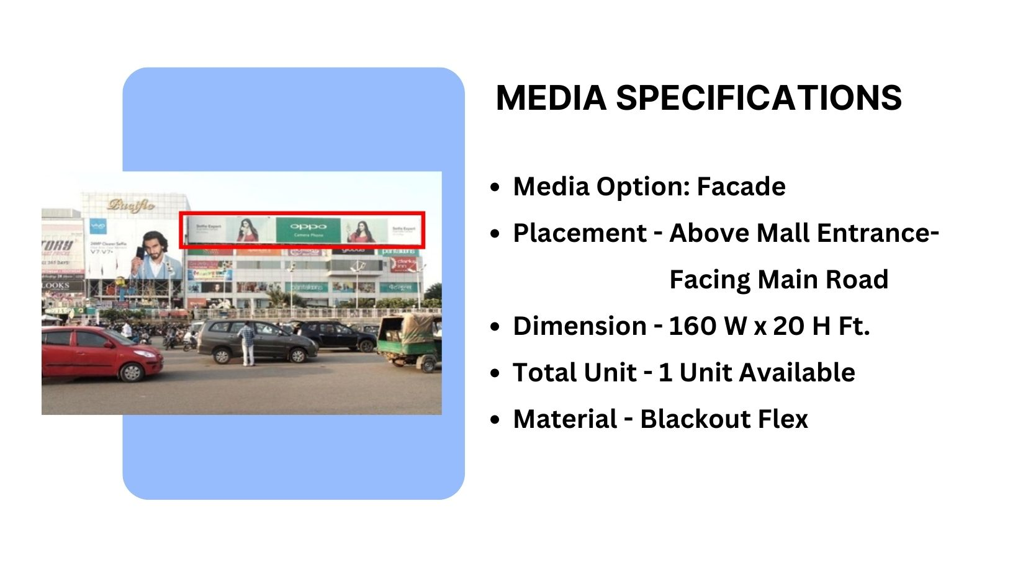
Façade Branding

Slide 3
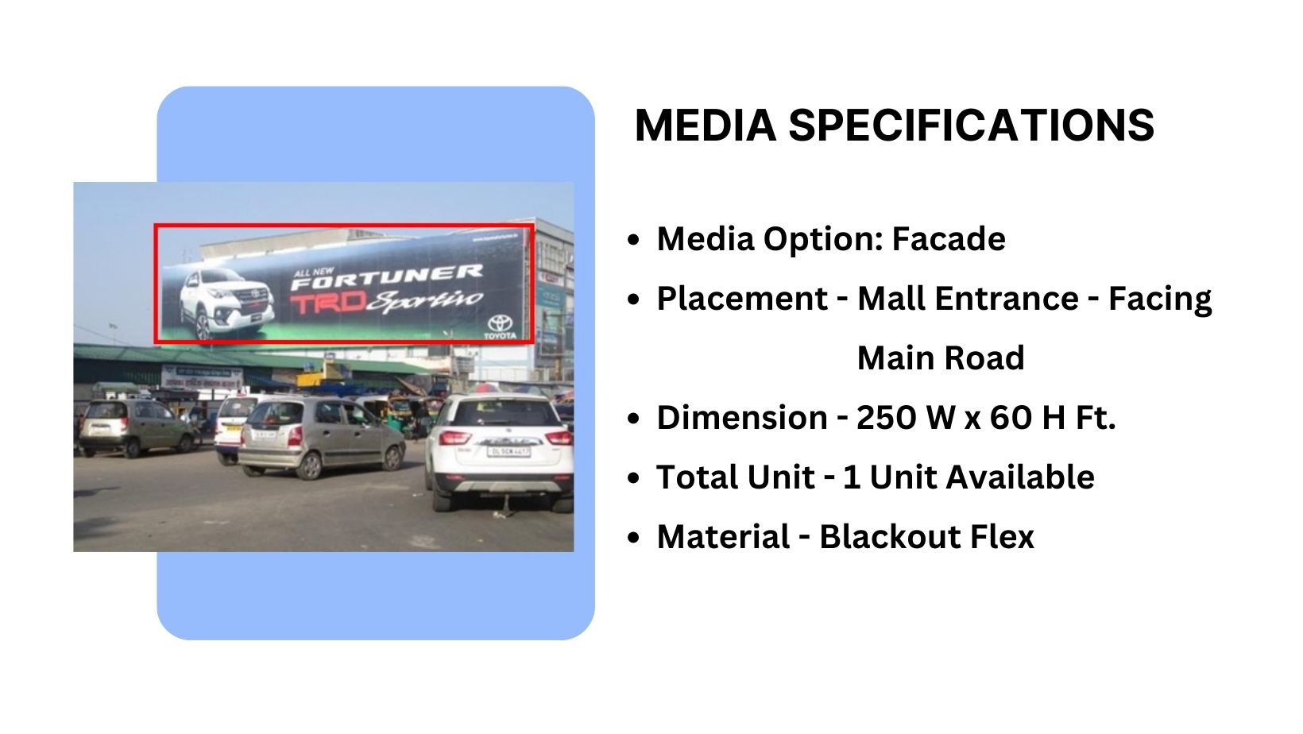
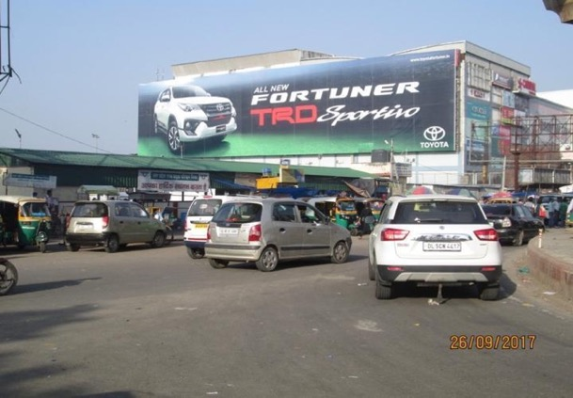
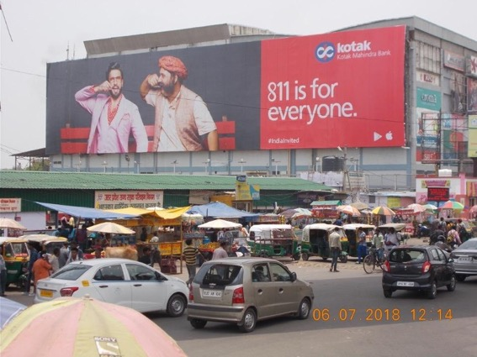

Ad 2Sell
Shot 1
Shot 2
Facing Ghaziabad Entry
- Main Road
Medium
Billboard
LOCATION :
Facing Ghaziabad Entry/Main road
Size
Material
Availability :
Immediate
250 (W) X 60 (H) ft AL
Blackout Flex

Slide 4
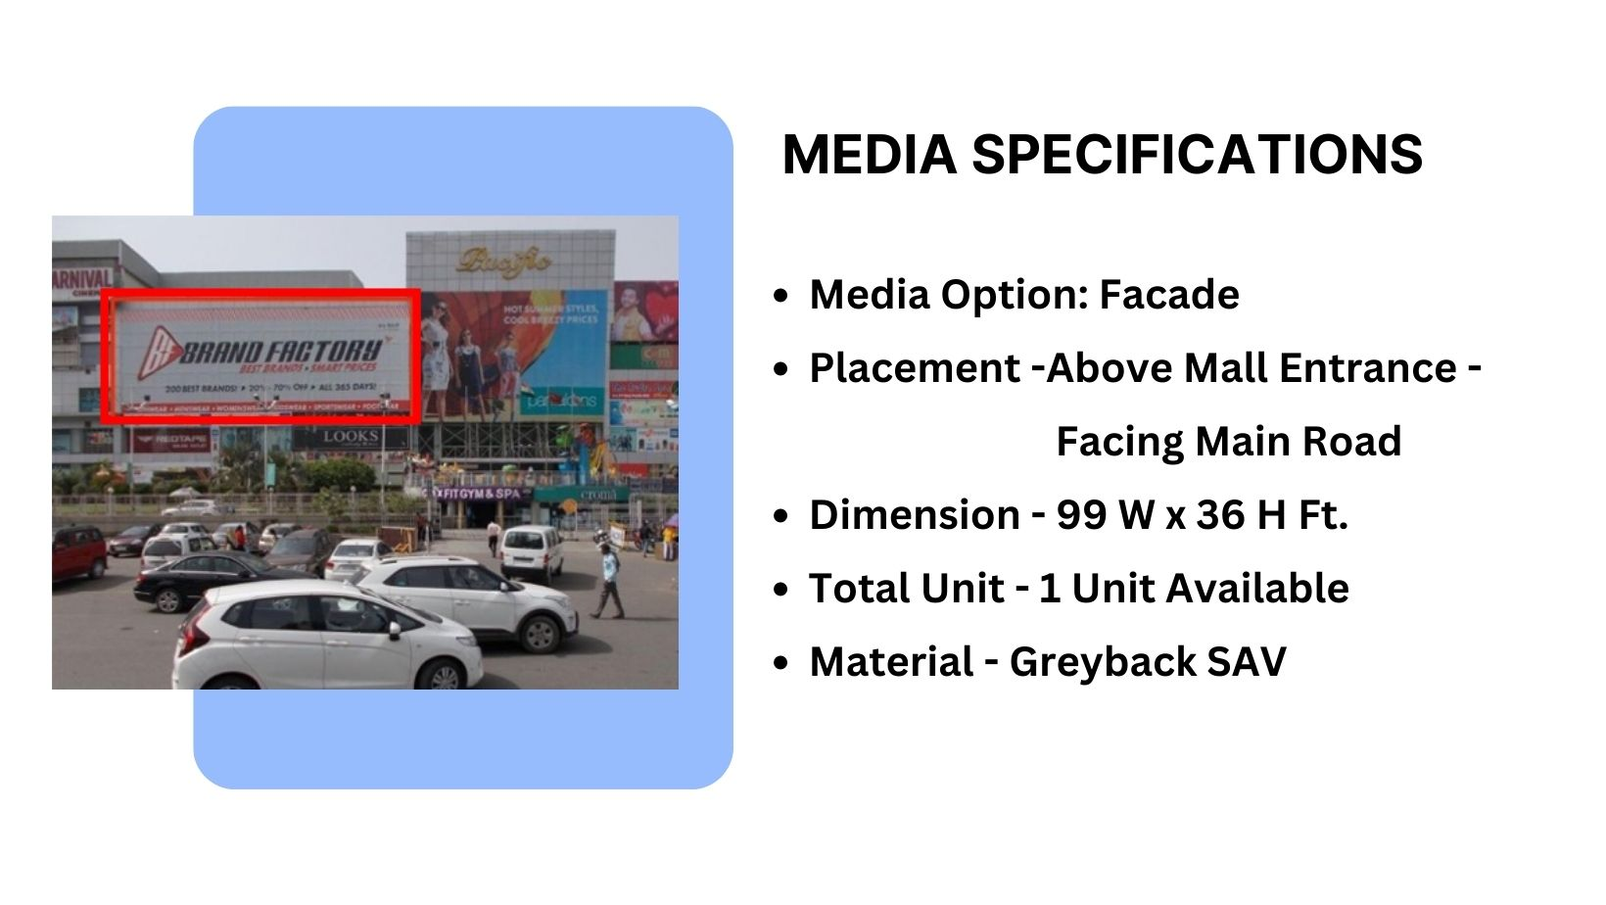
Façade Branding

Slide 5
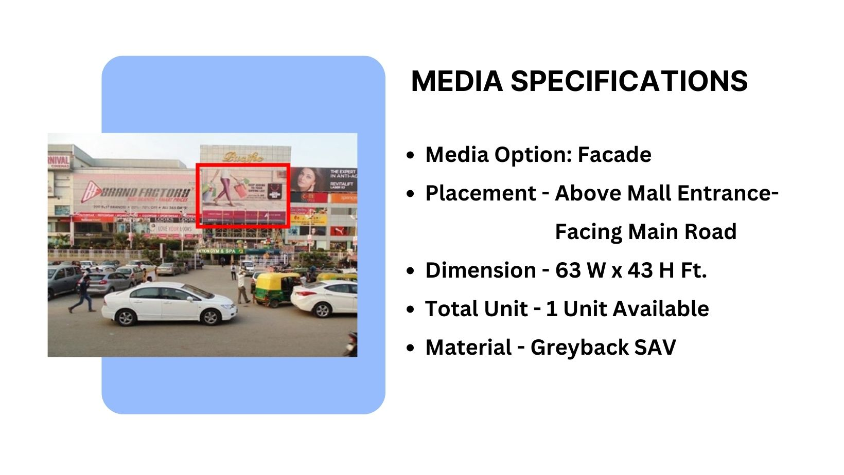
Façade Branding

Slide 6











Thank You

