Slide 1
















Backlit Branding

Slide 2
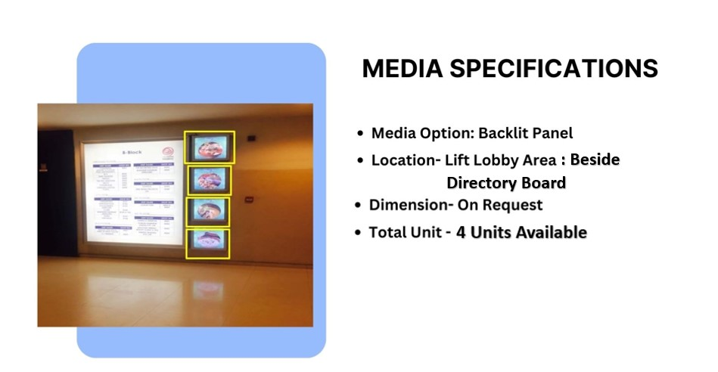

Façade Branding

Slide 3
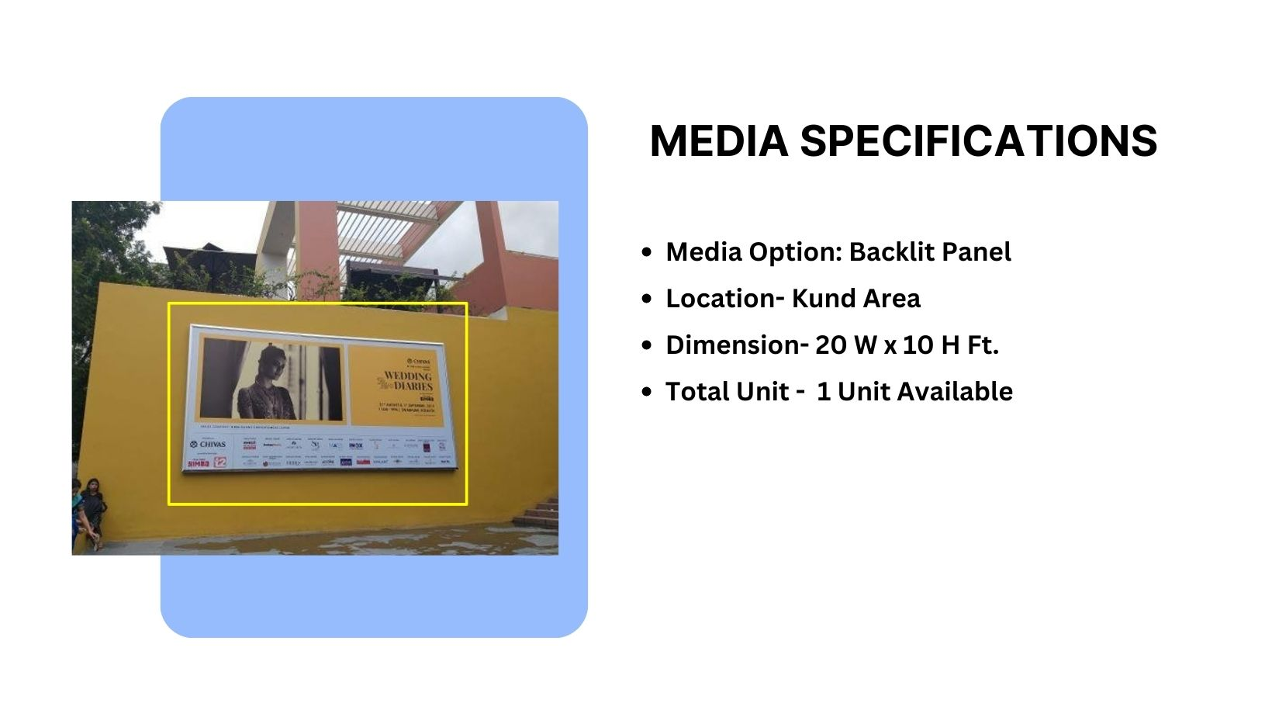
Façade Branding

Slide 4
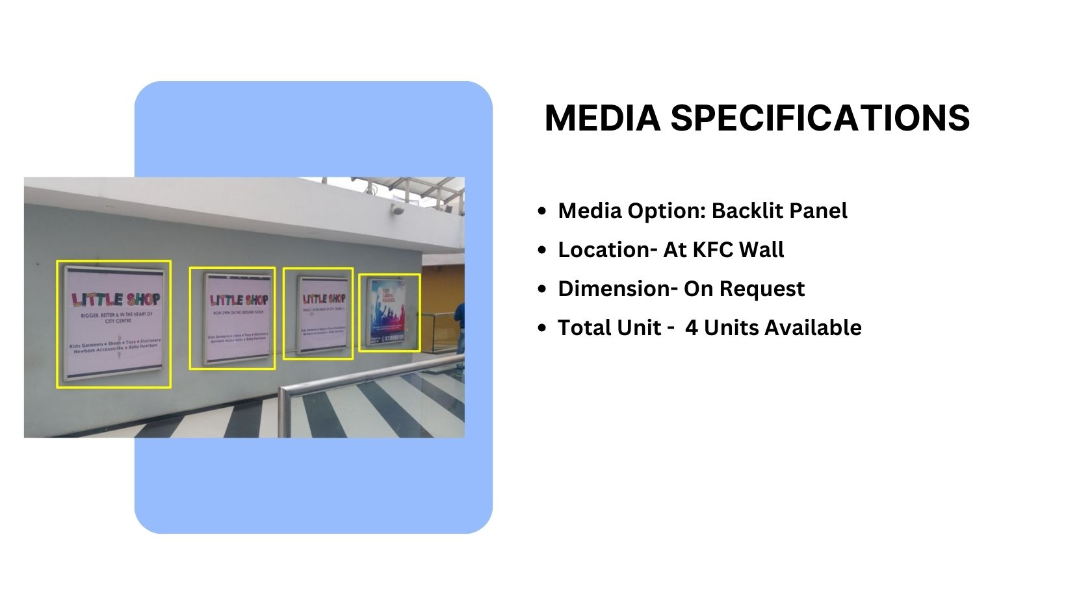
Façade Branding

Slide 5
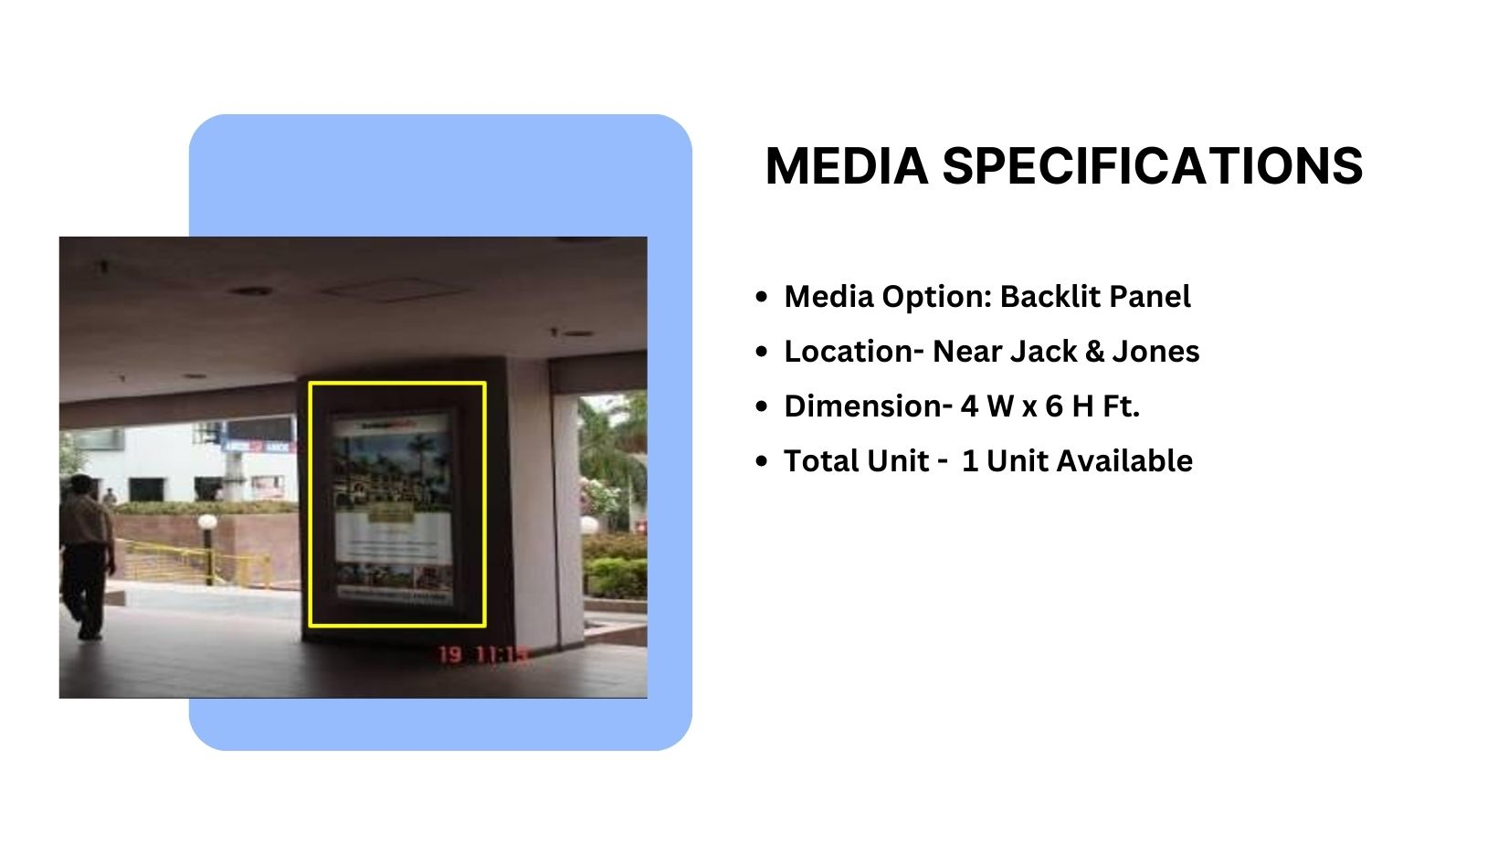
Façade Branding

Slide 6
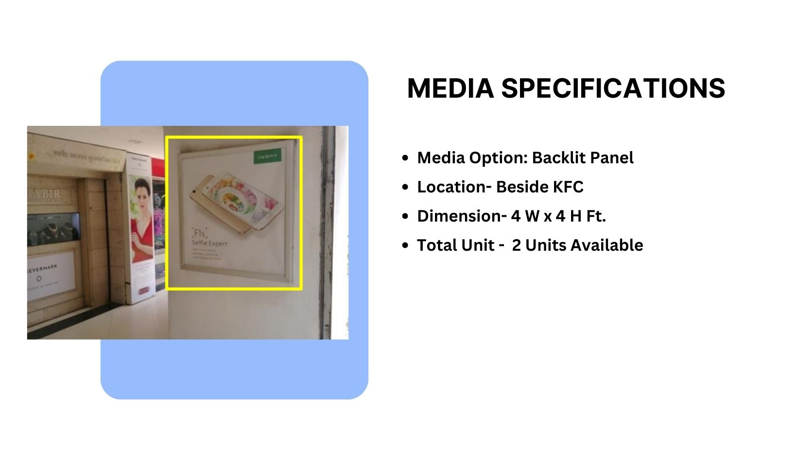
Façade Branding

Slide 7











Thank You

