Slide 1
















Facade Branding

Slide 2
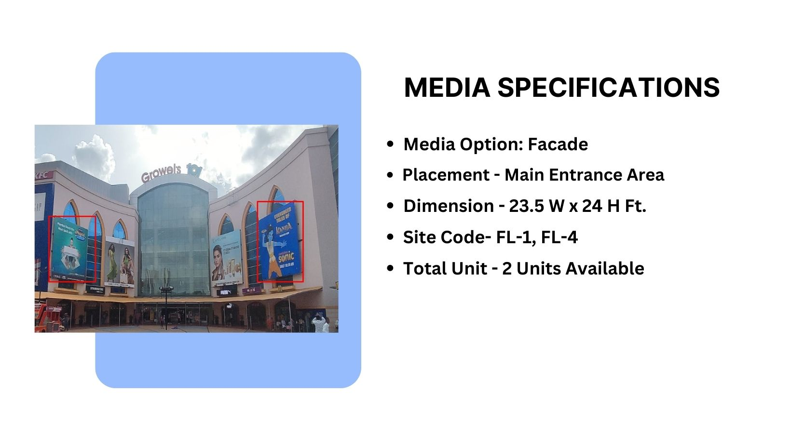
Façade Branding
Material - Front Lit Flex

Slide 3
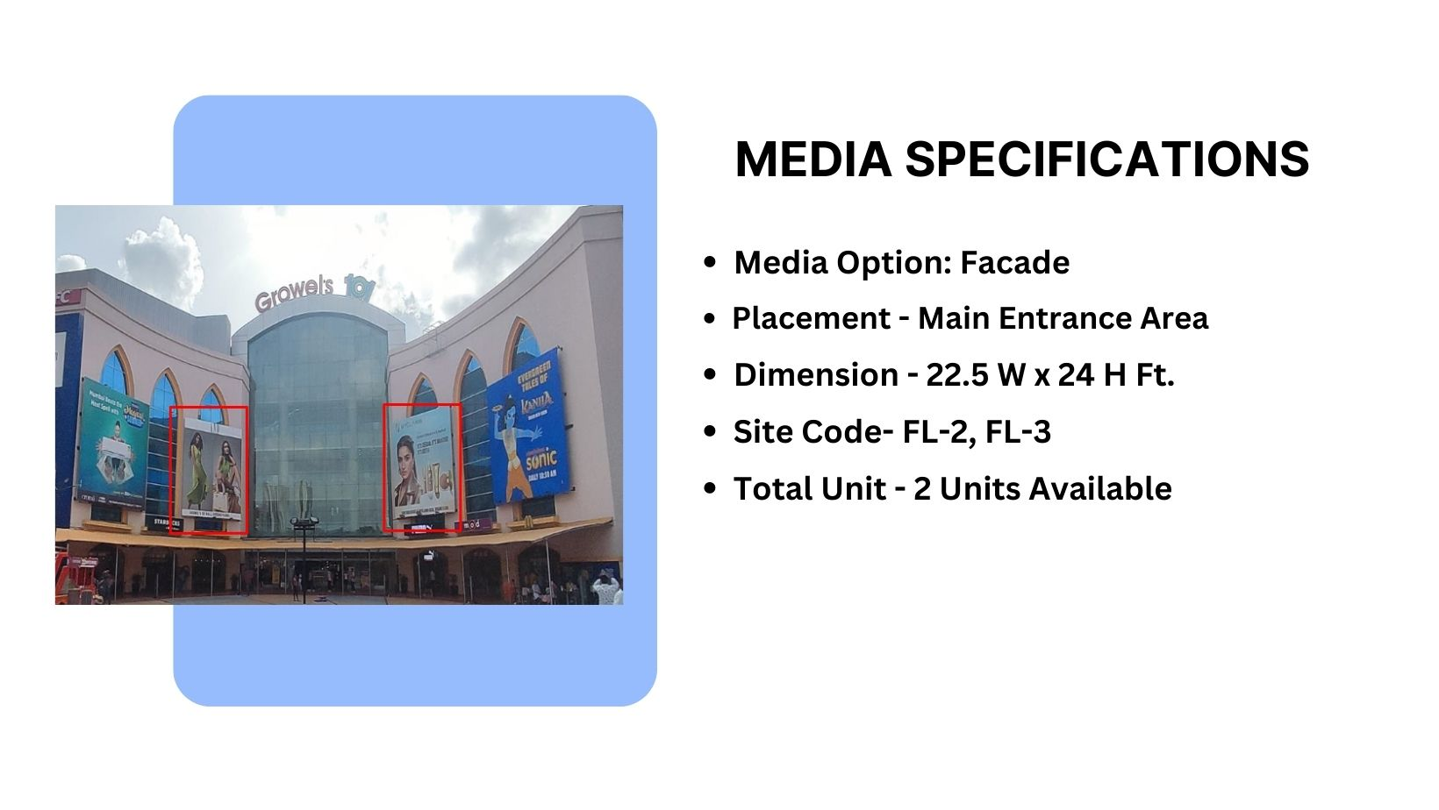

Façade Branding

Slide 4
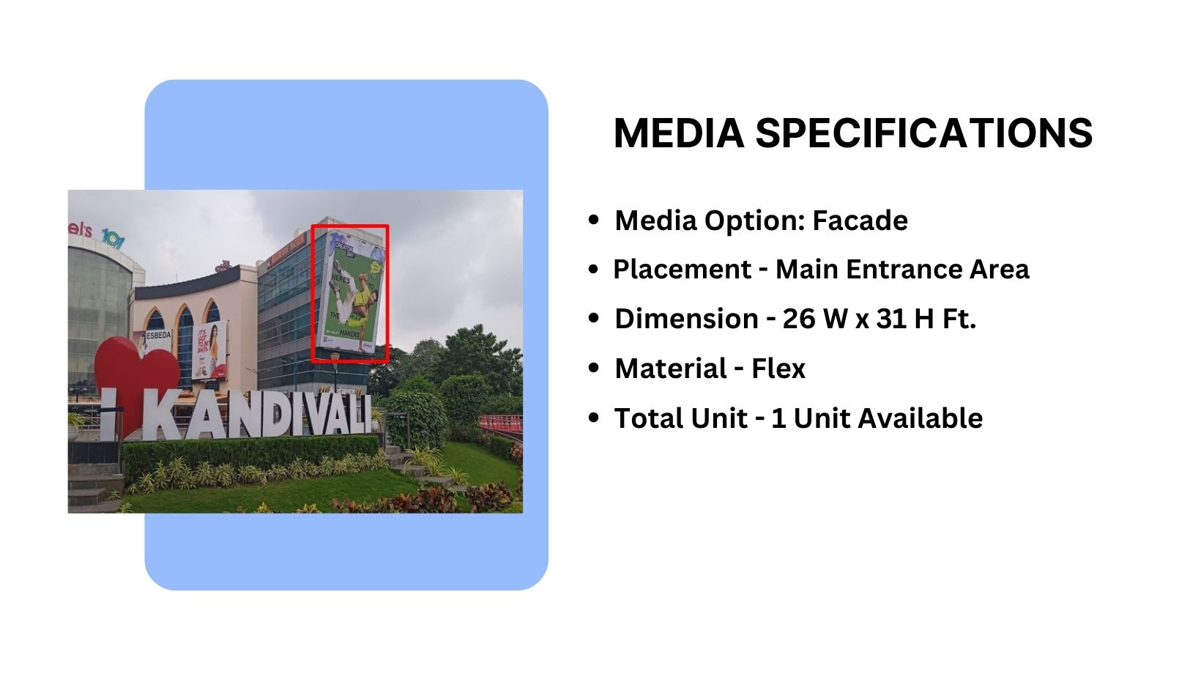
Façade Branding

Slide 5
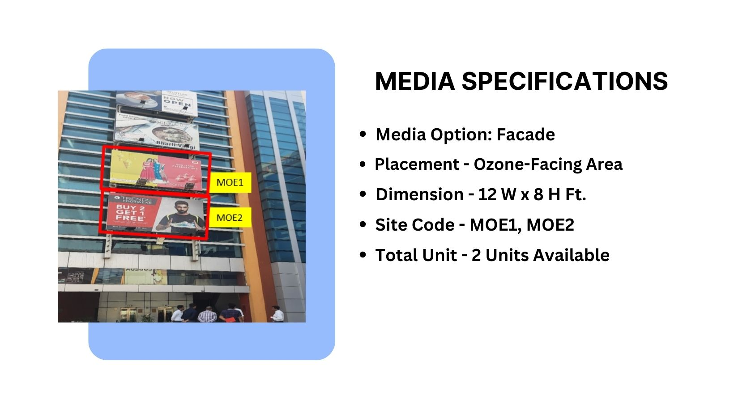


Façade Branding

Slide 6











Thank You

