Slide 1
















Branding Branding

Slide 2
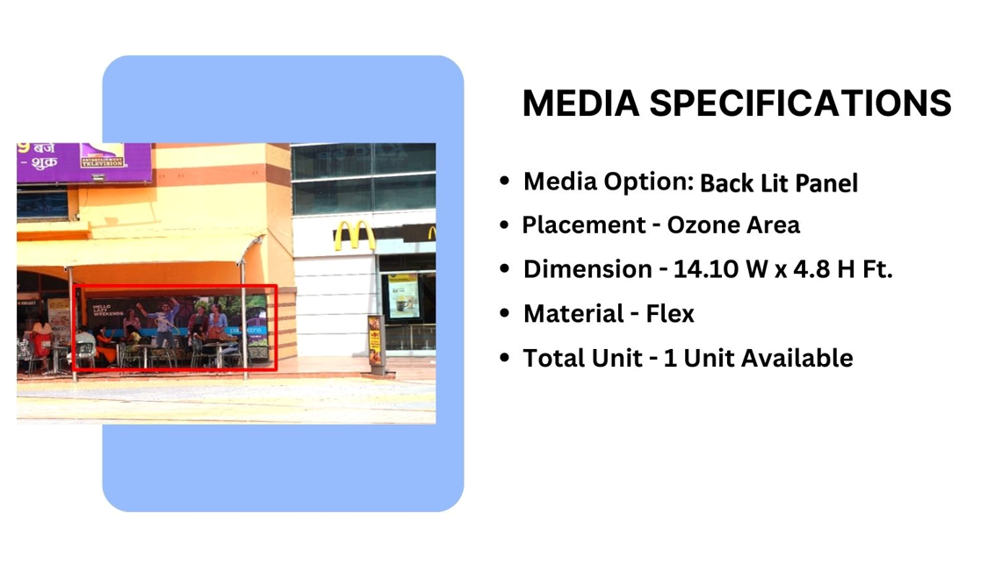
Façade Branding

Slide 3
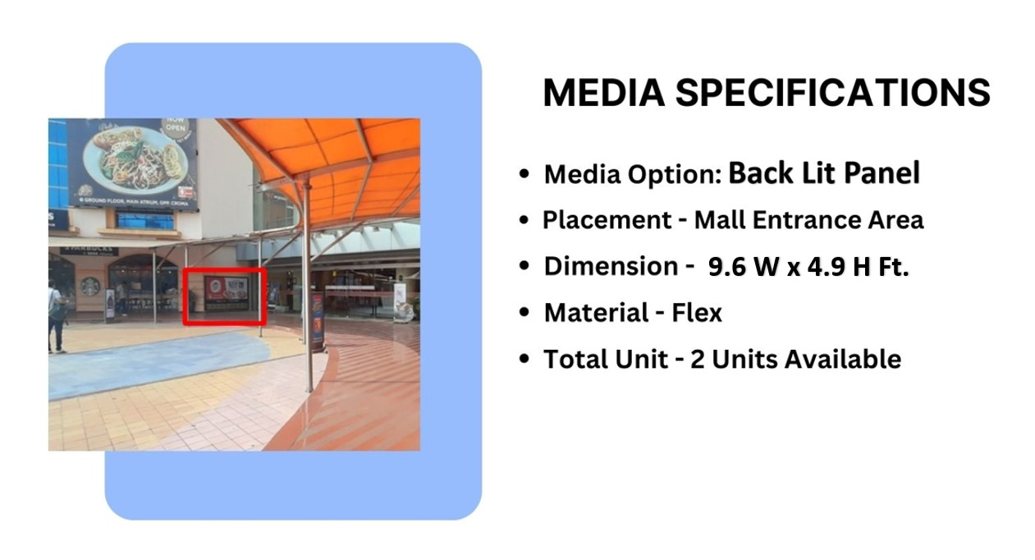
Façade Branding
Site Code – LHSBB,RHSBB

Slide 4
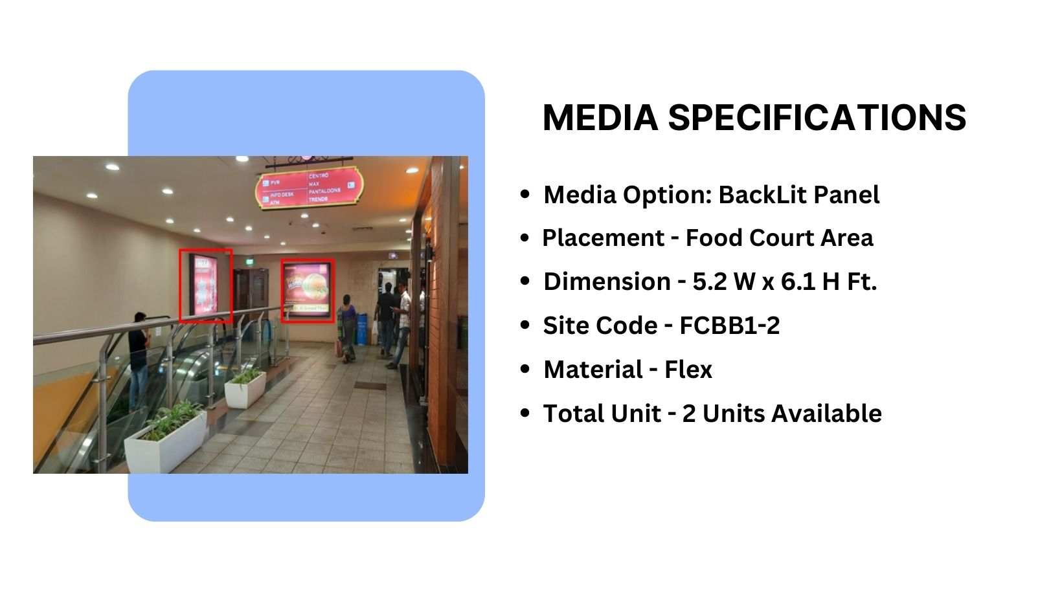
Façade Branding

Slide 5
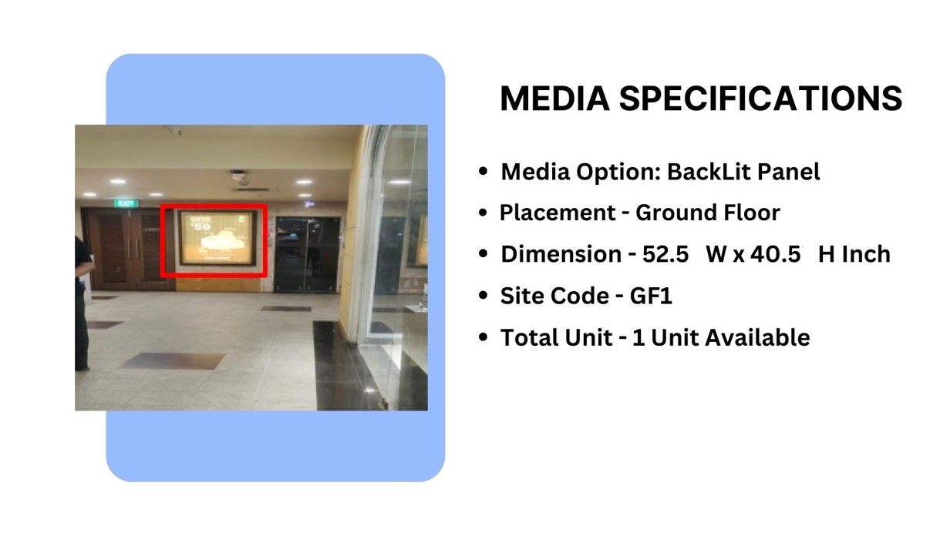
Façade Branding
Material – Trans Lit, Double
Density Print

Slide 6
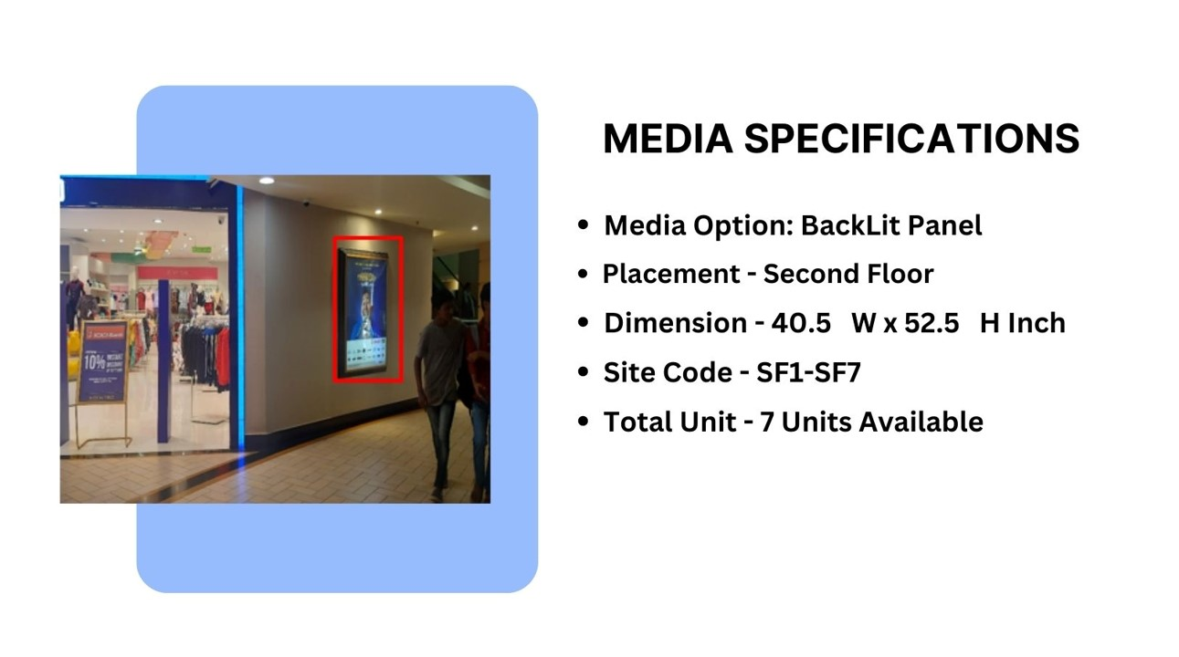

Façade Branding

Slide 7
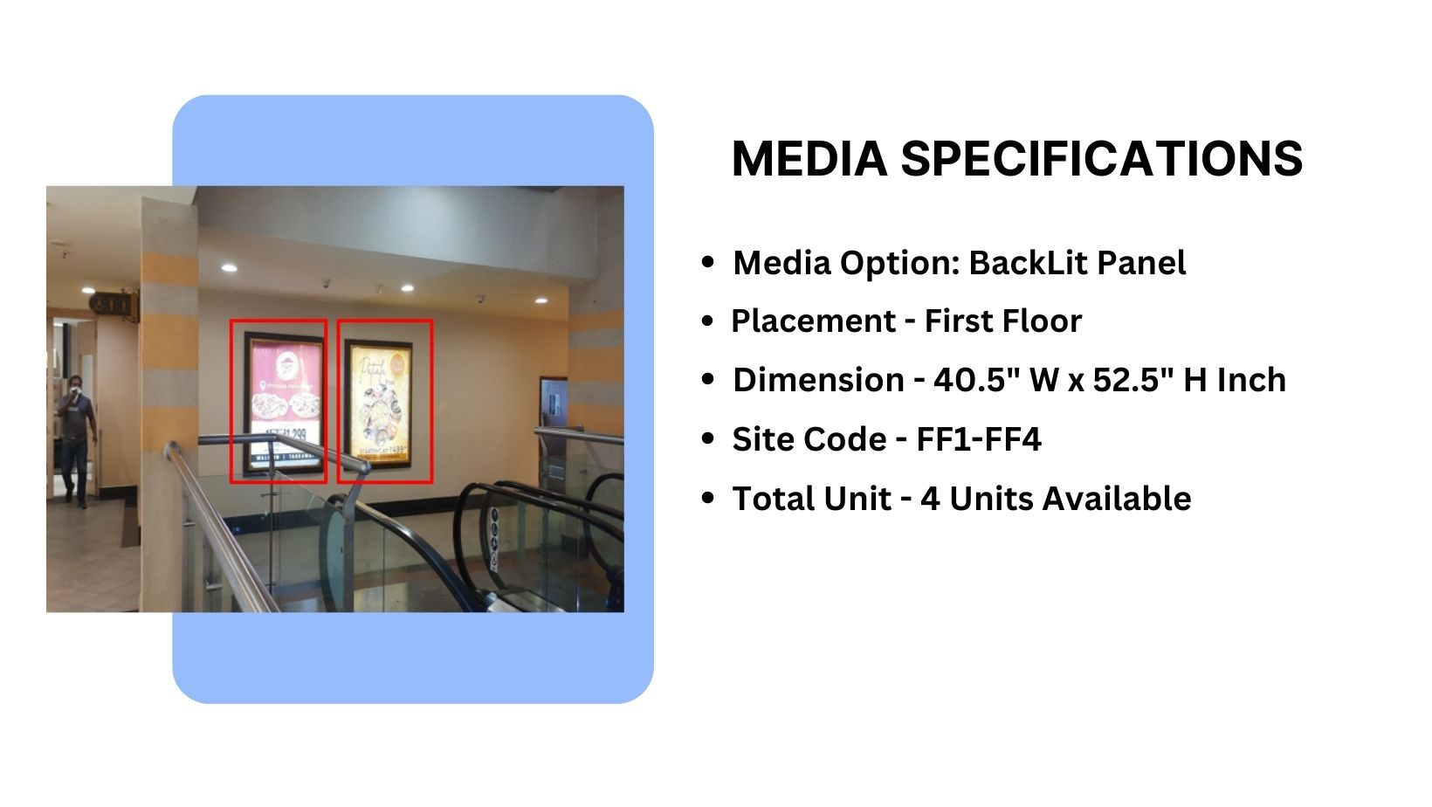
Façade Branding

Slide 8
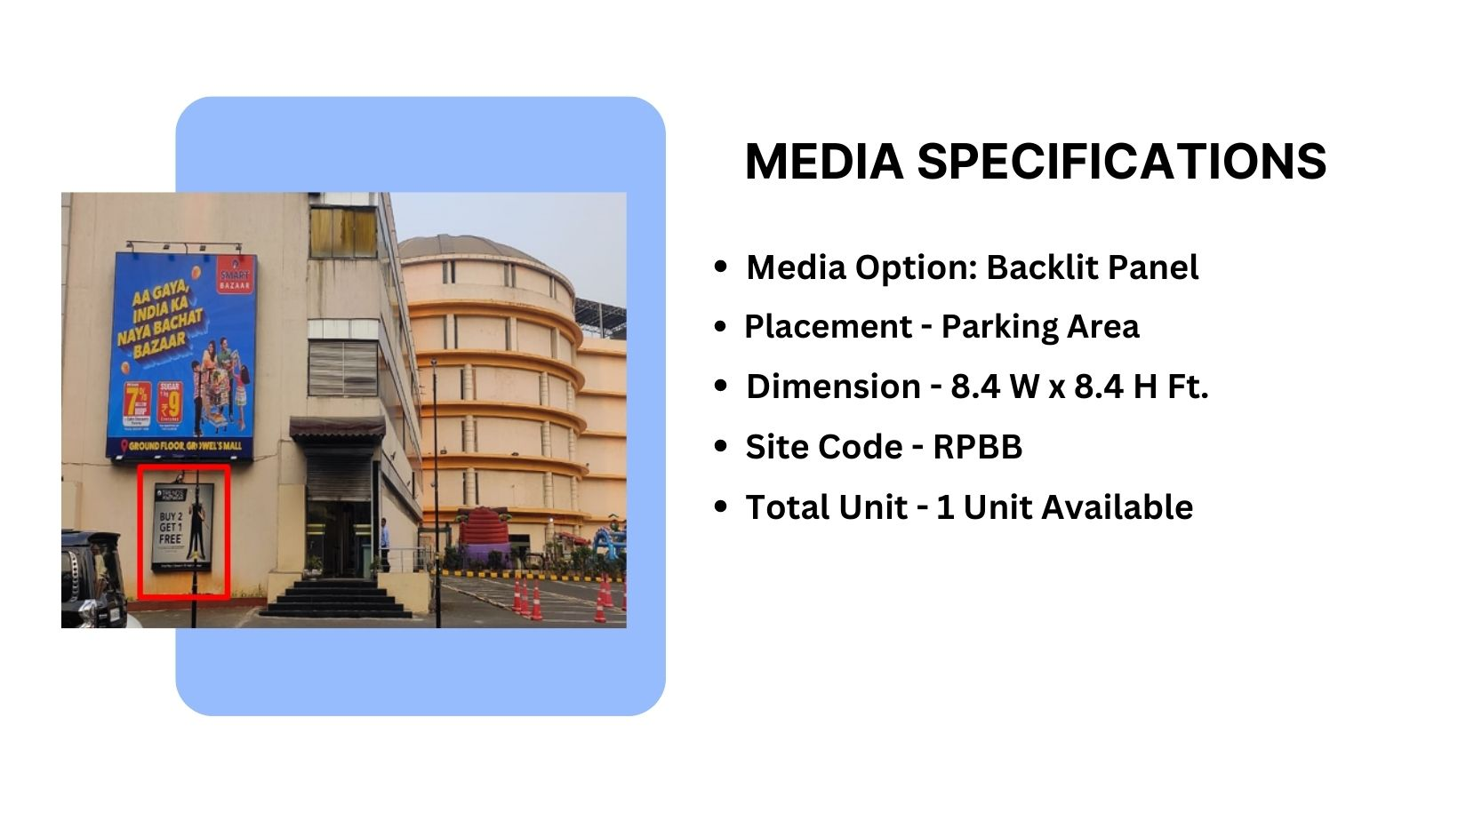

Parking Area: Driveway
Façade Branding
Material – Backlit Flex

Slide 9
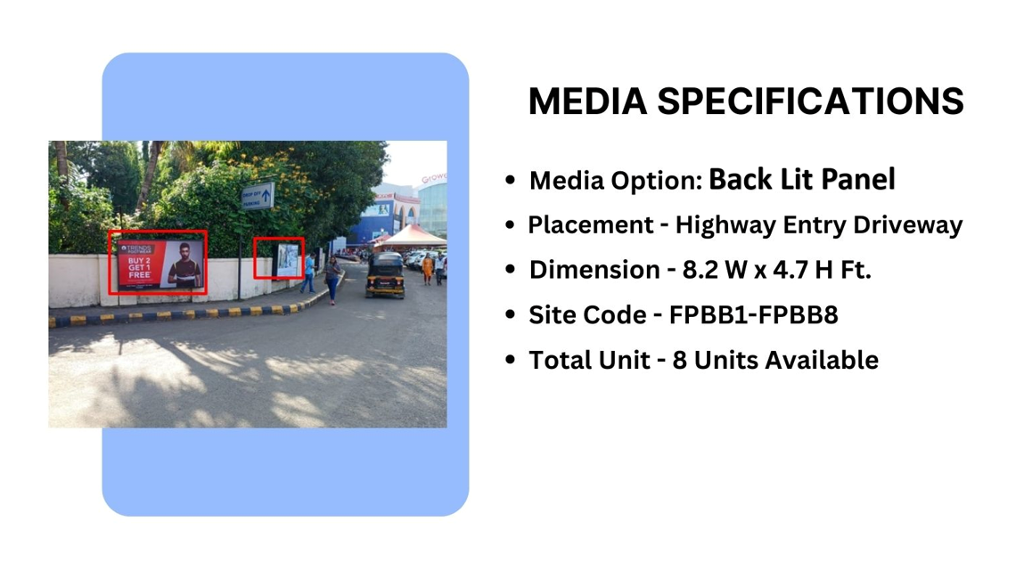
Façade Branding
Material – Backlit Flex

Slide 10











Thank You

