Slide 1
















Glass Branding

Slide 2
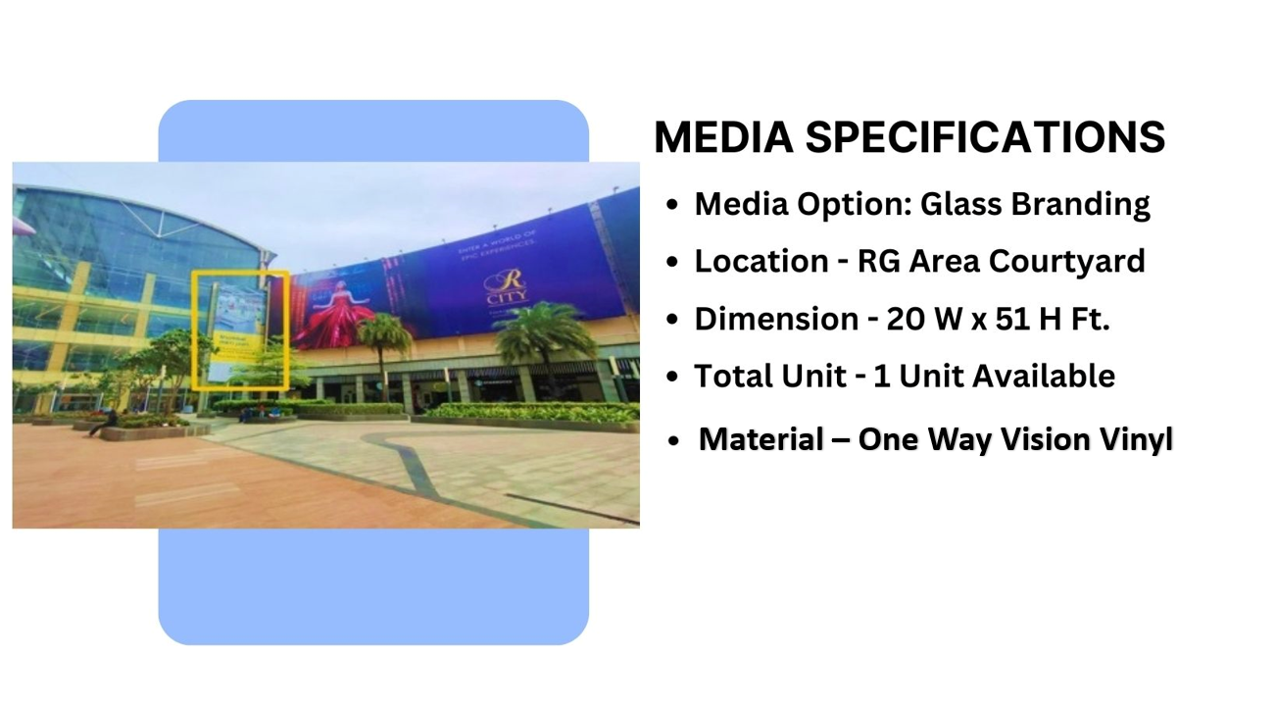

Slide 3
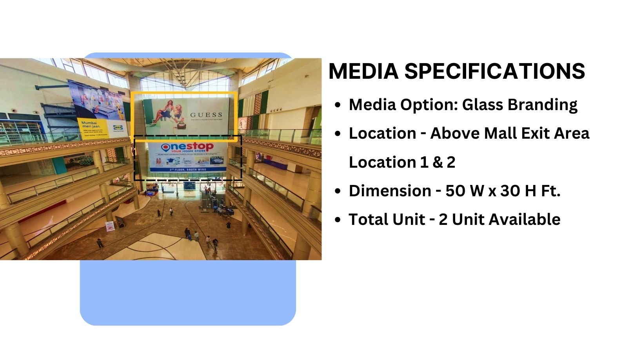
Material – Eco Solvent Vinyl

Slide 4
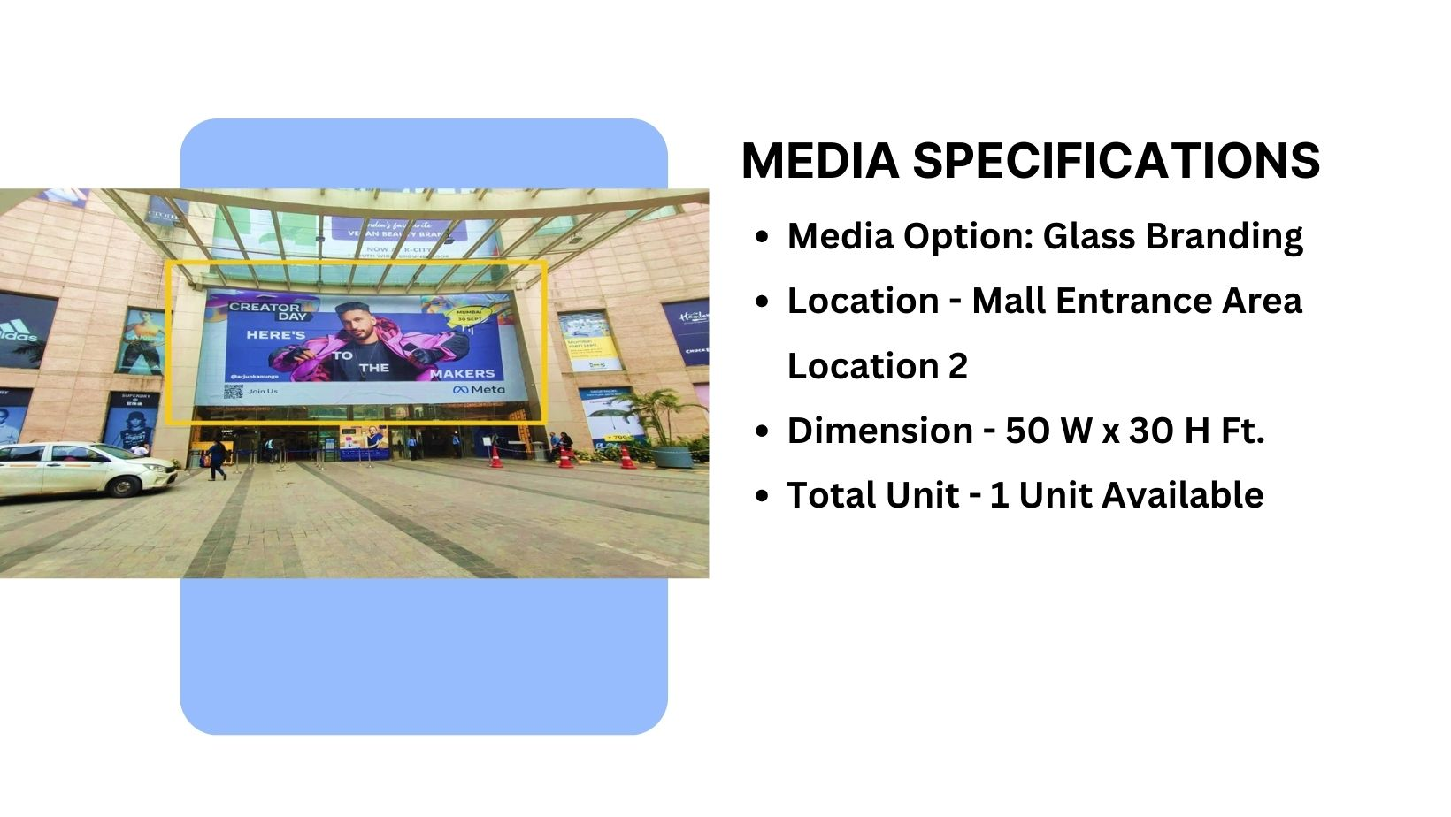


Slide 5
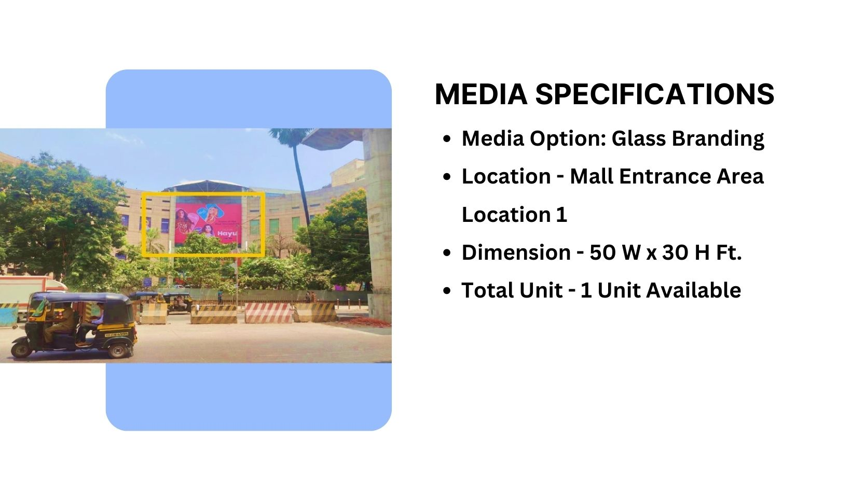

Slide 6











Thank You

