Slide 1
















Back Lit Board

Slide 2
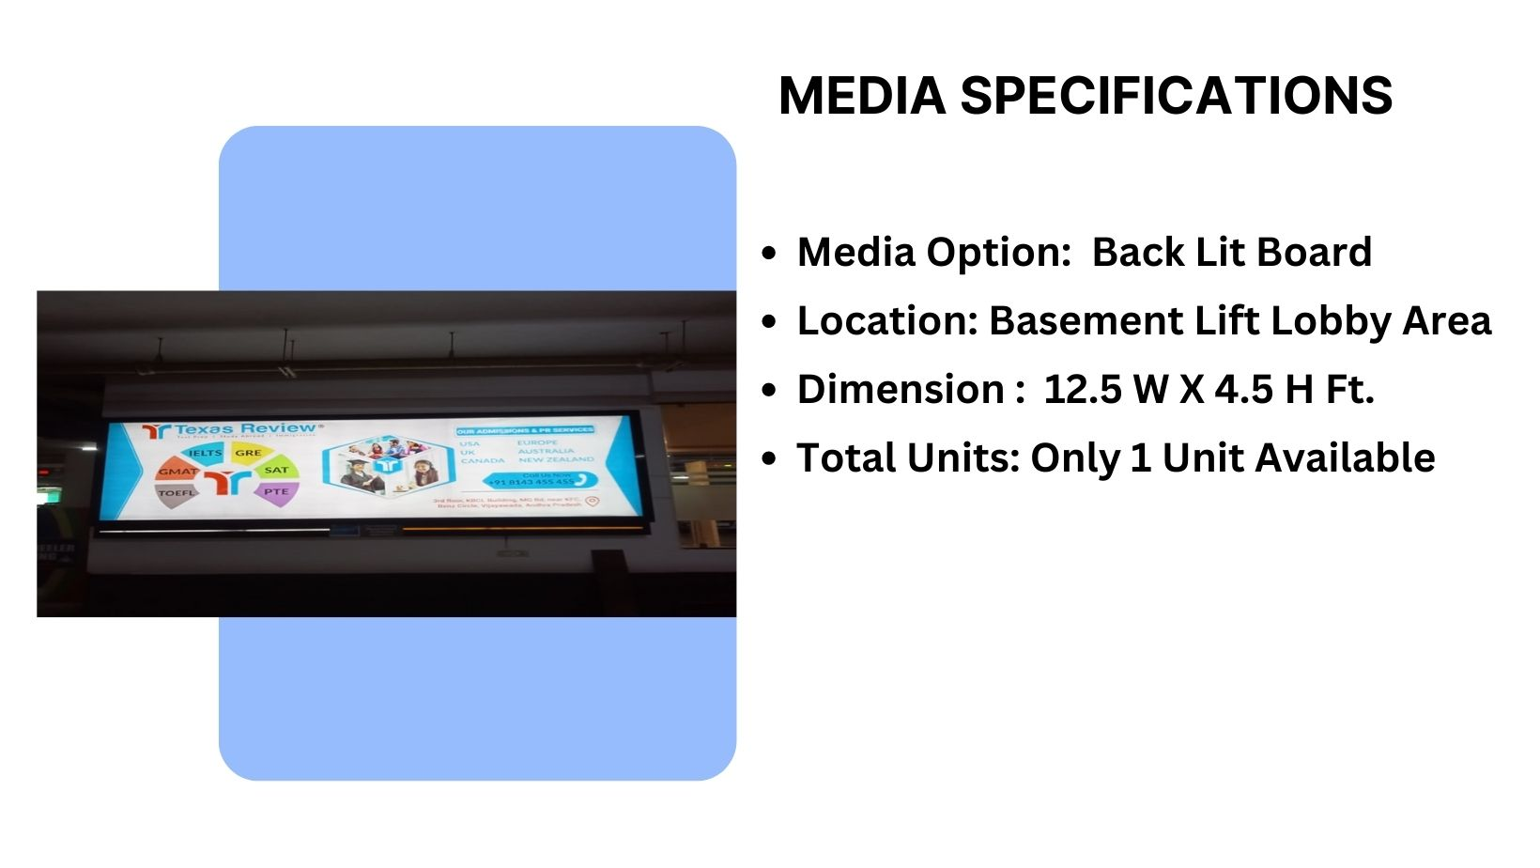

Site Code – LLB

Slide 3
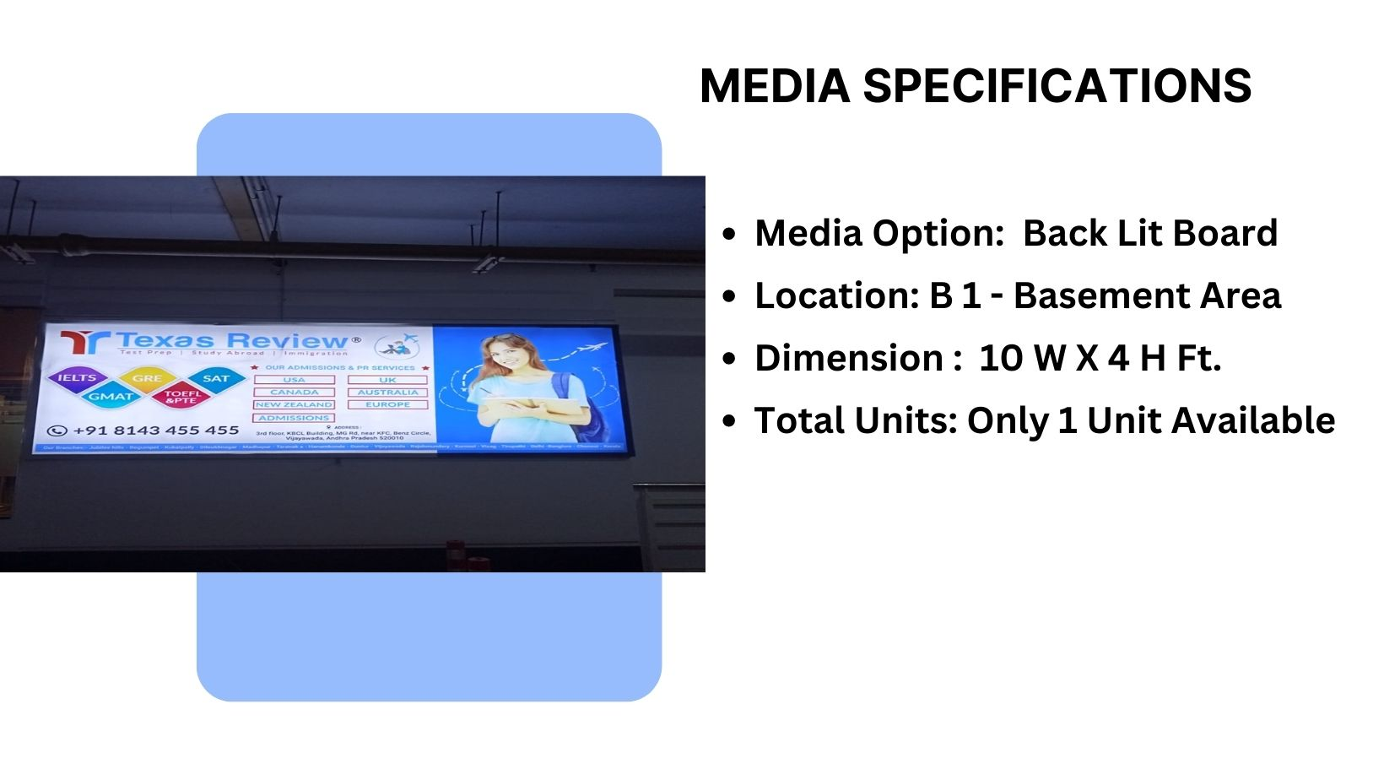
Site Code – MF4
Material – Backlit Flex

Slide 4
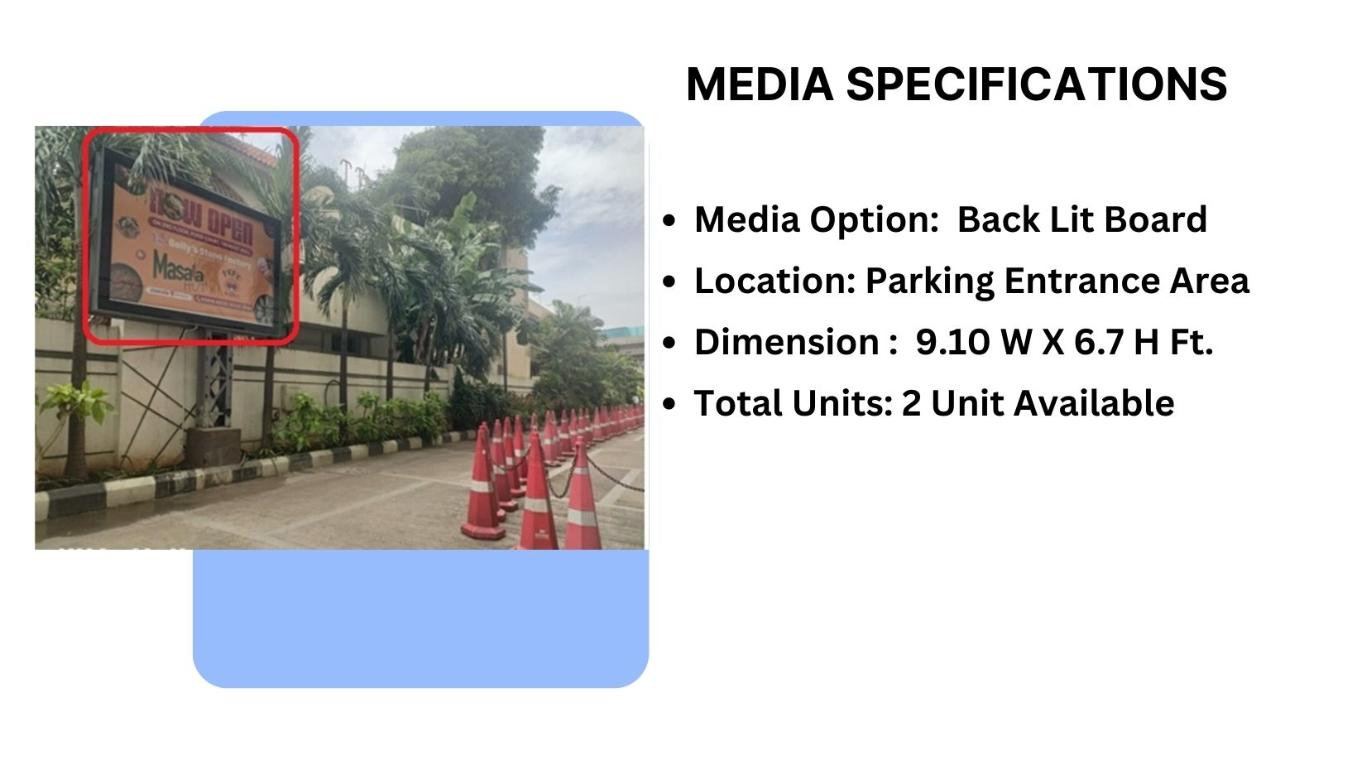

Site Code – PTW 1
1 Units Available
Material – Star Flex

Slide 5
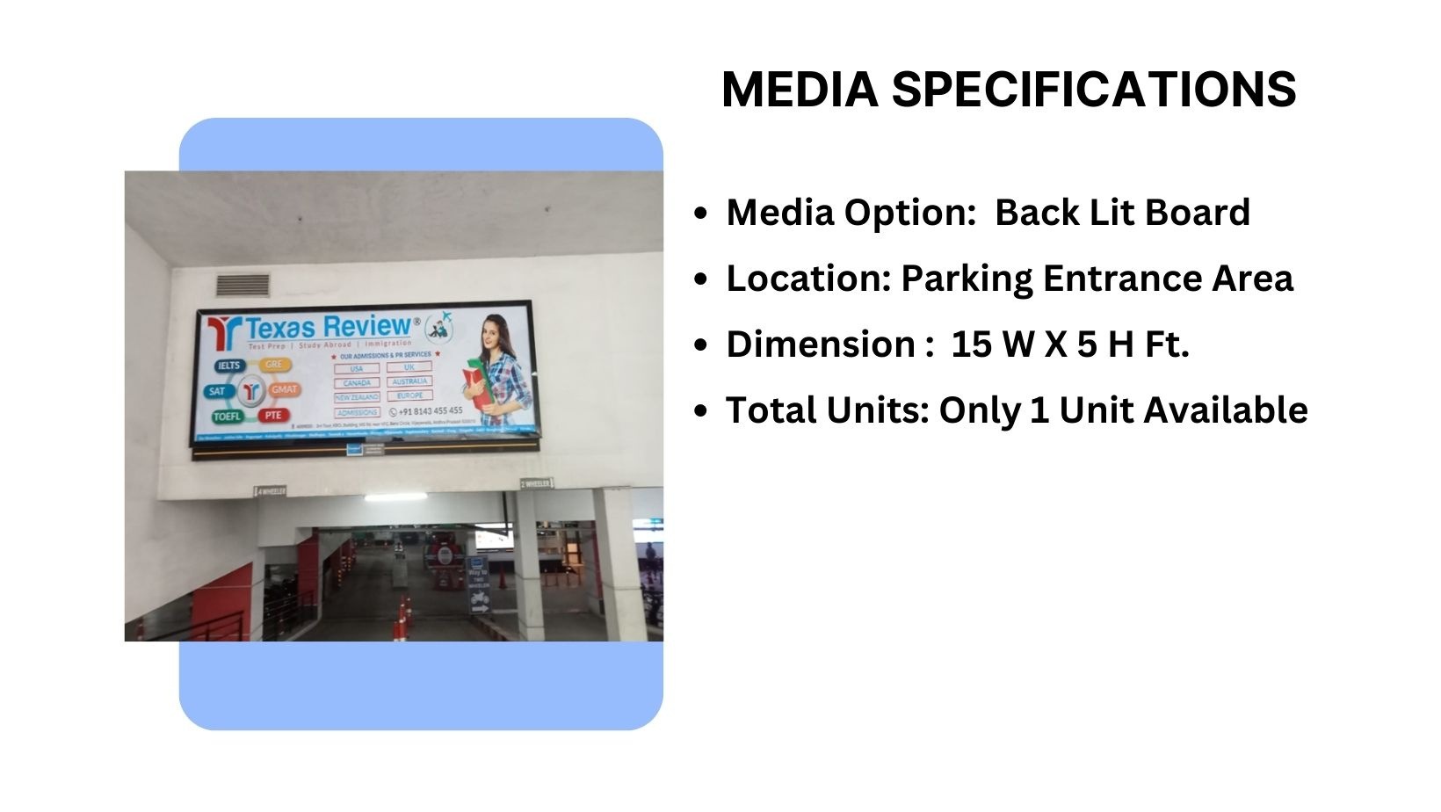
Site Code – PE 1
Material - flex

Slide 6











Thank You

