Slide 1
















Static Branding

Slide 2
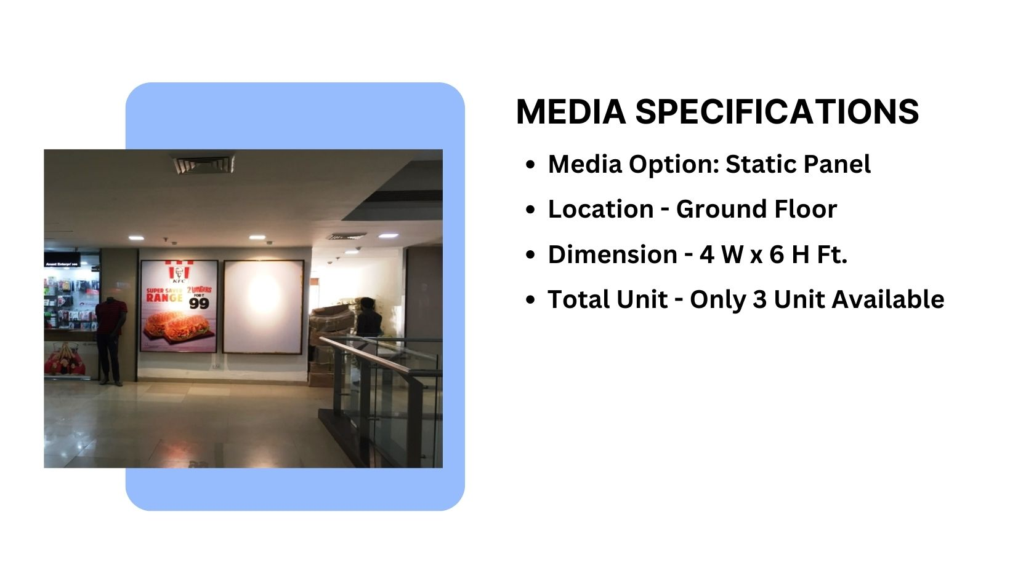
Façade Branding

Slide 3
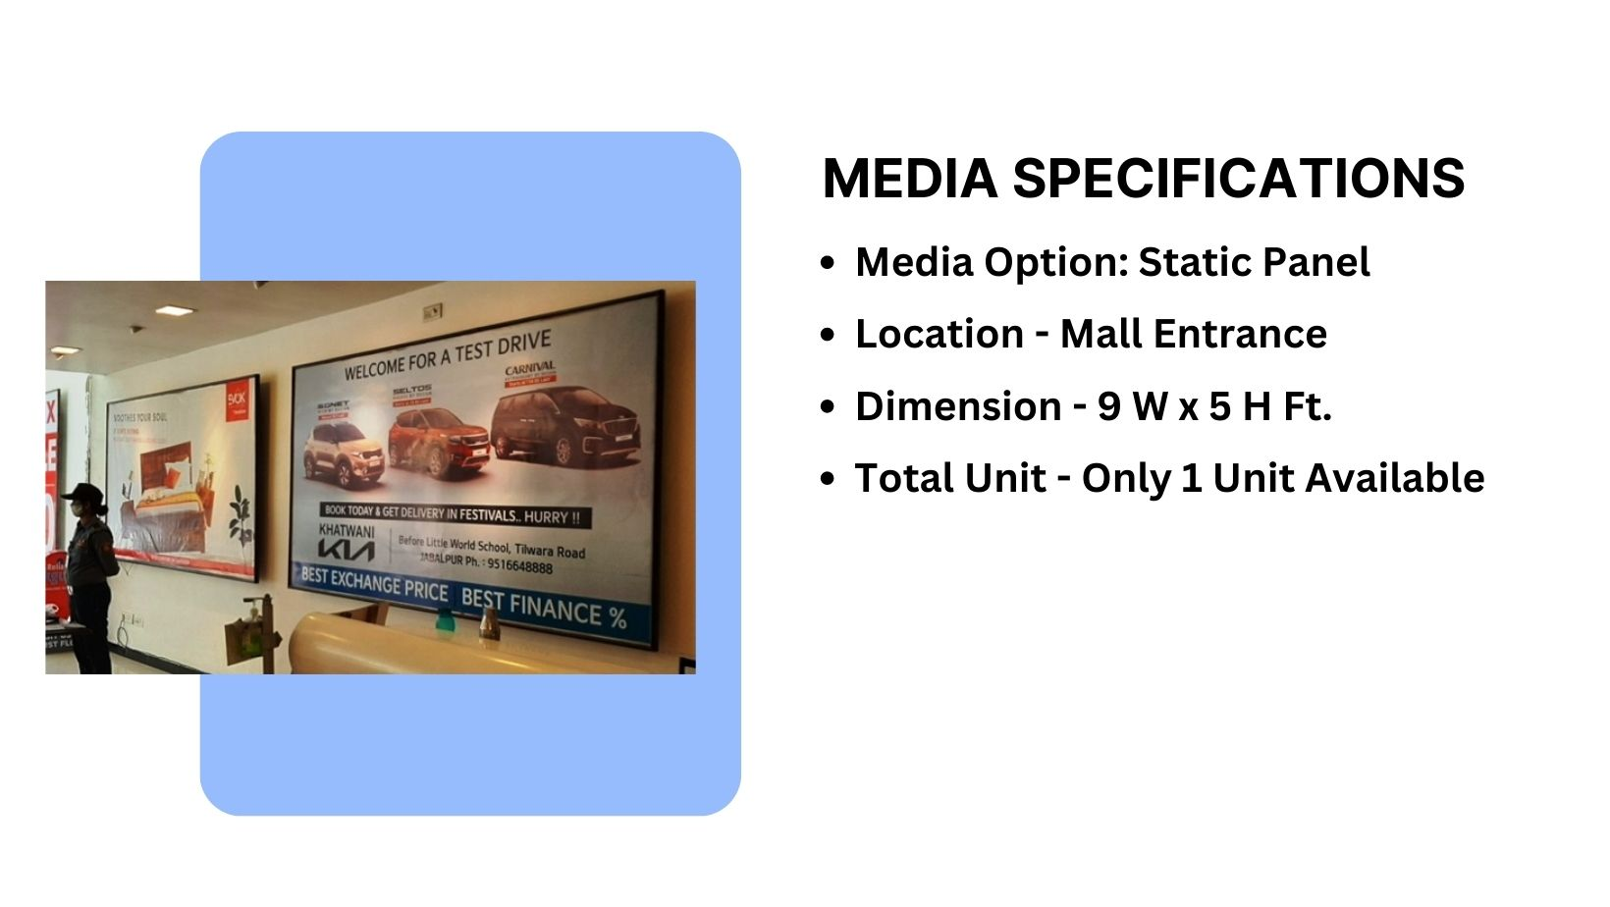
Façade Branding

Slide 4
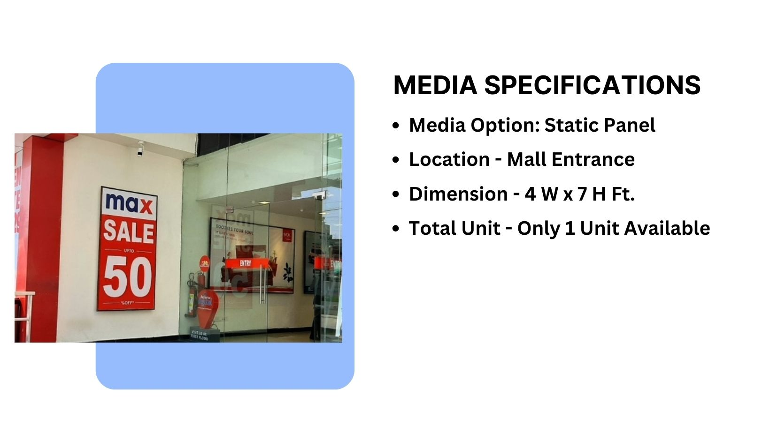
Façade Branding

Slide 5
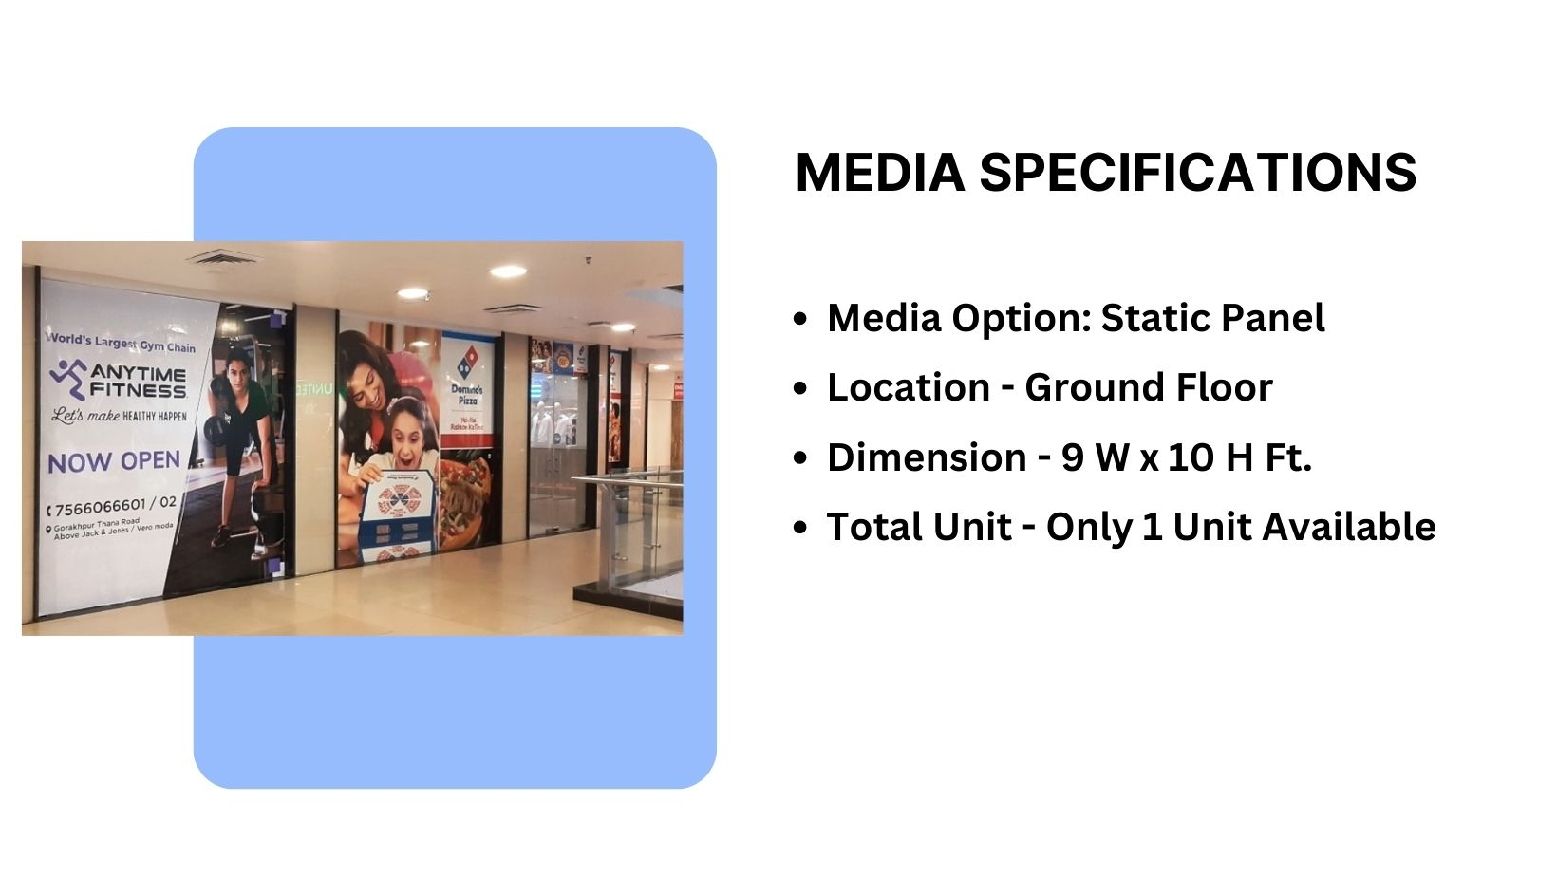
Façade Branding

Slide 6











Thank You

