Slide 1
















Kiosk Detailed Dimension Branding

Slide 2
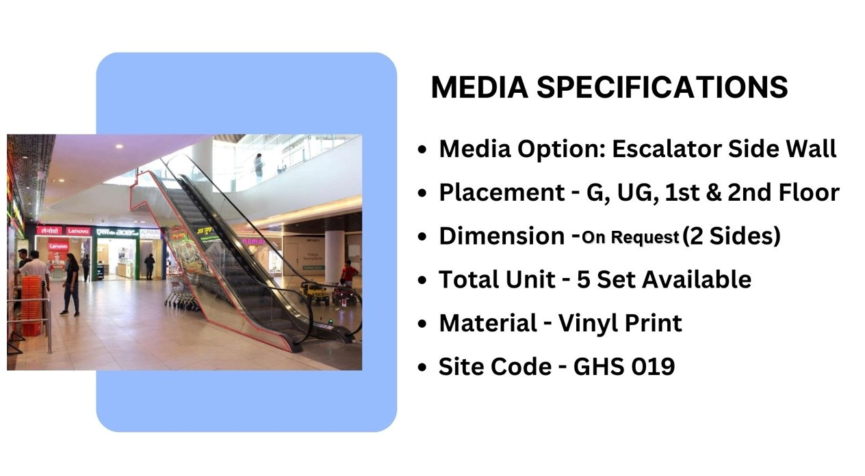
Façade Branding

Slide 3











Thank You

