Slide 1
















Backlit Panel Branding

Slide 2
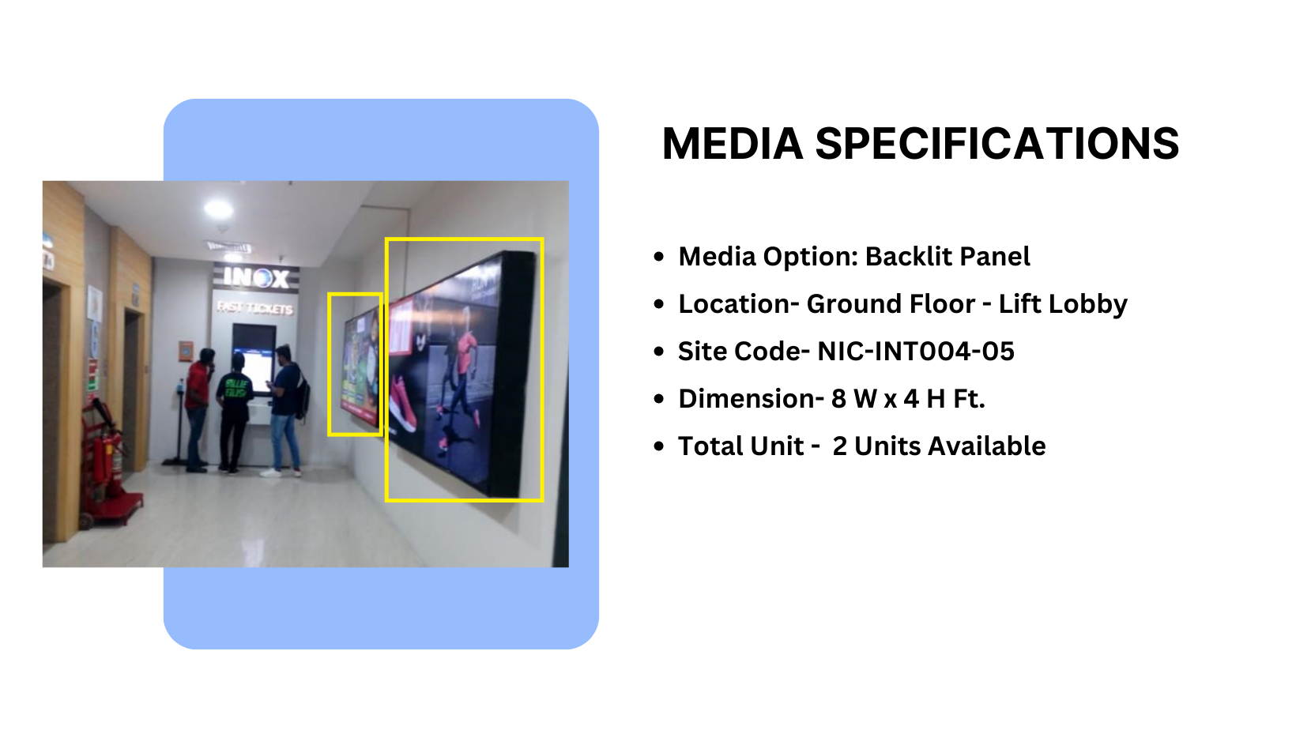
Façade Branding
Material – Backlit Flex

Slide 3
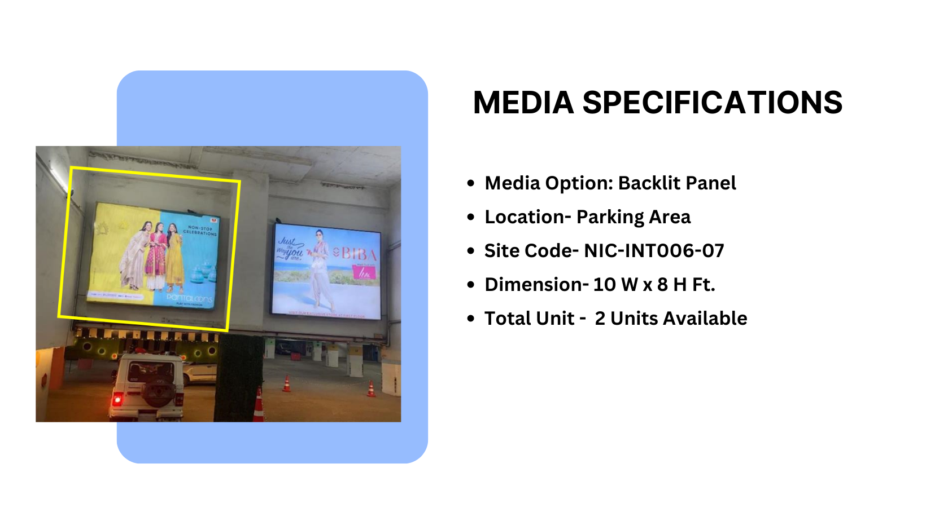
Façade Branding
Material – Backlit Flex

Slide 4
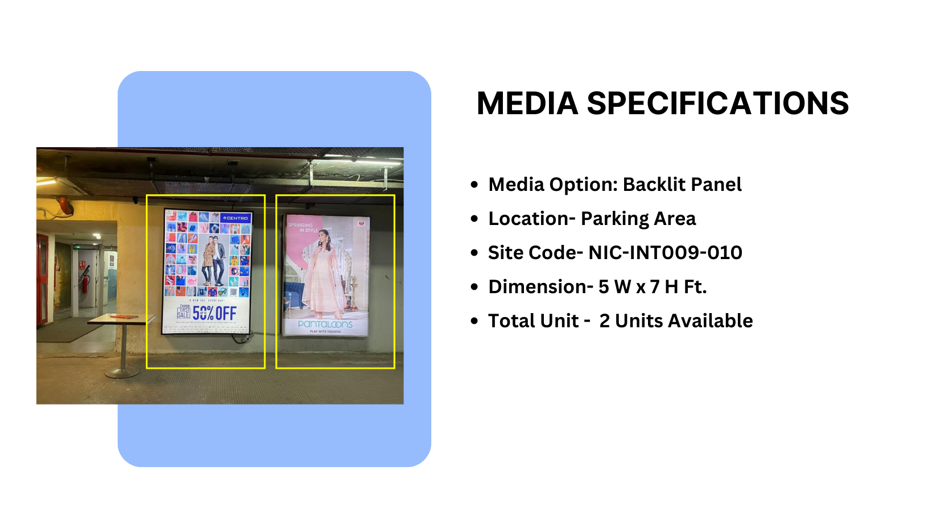
Façade Branding
Material – Backlit Flex

Slide 5
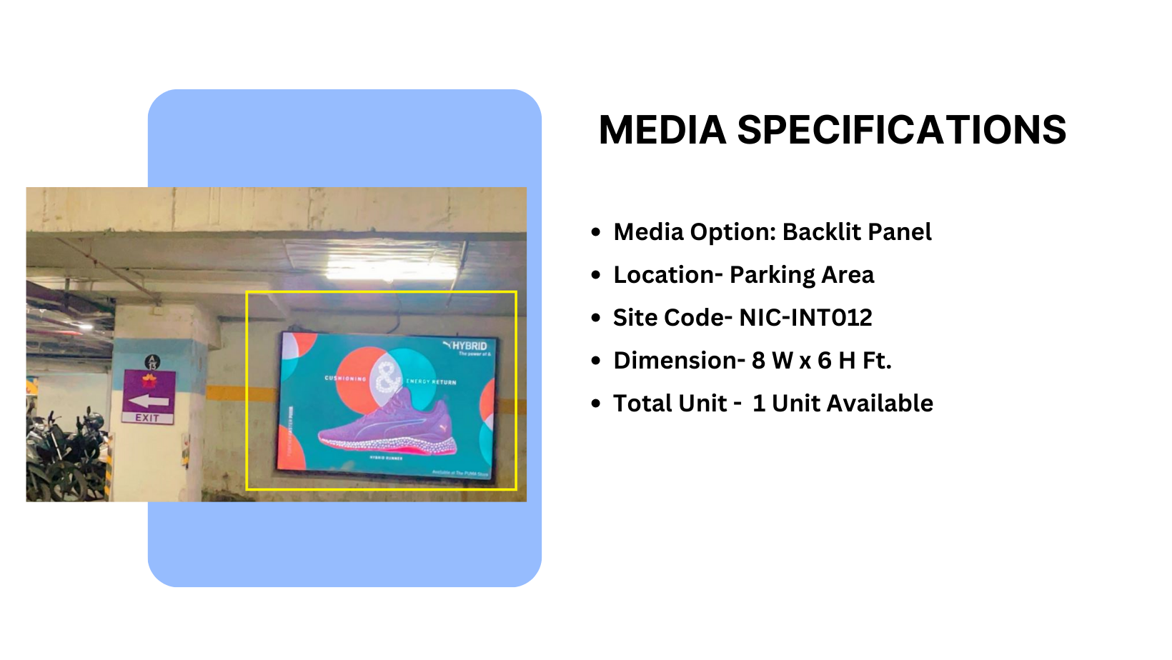
Façade Branding
Material – Backlit Flex

Slide 6
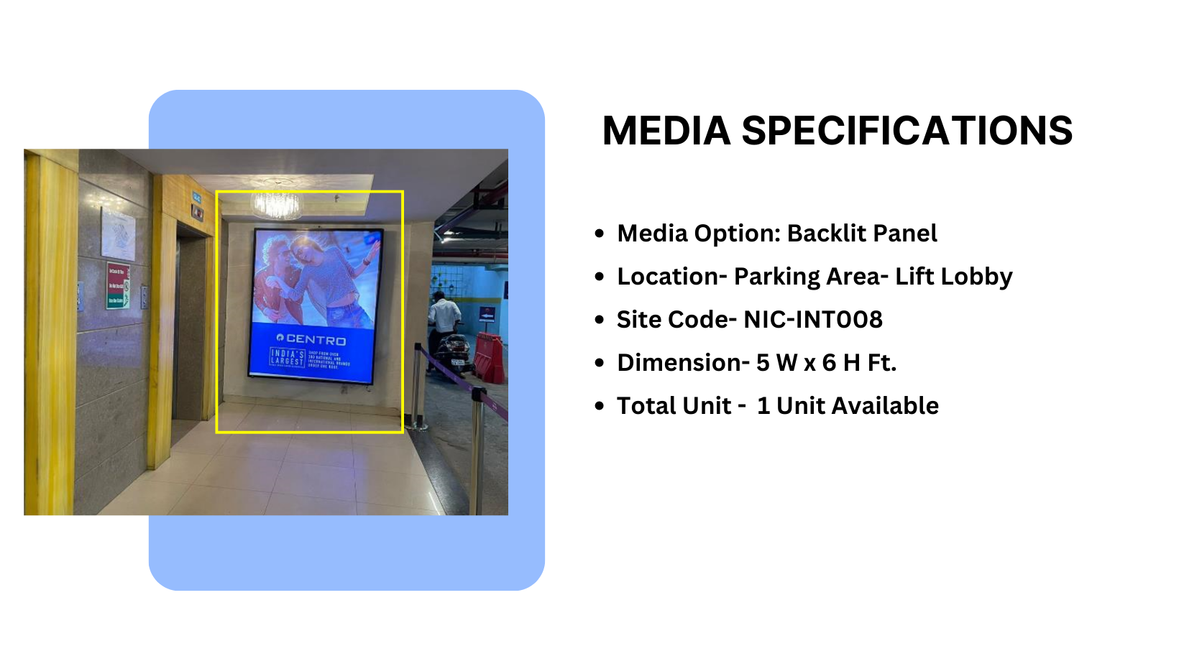
Façade Branding
Material – Backlit Flex

Slide 7











Thank You

