Slide 1
















Wall Signage Branding

Slide 2
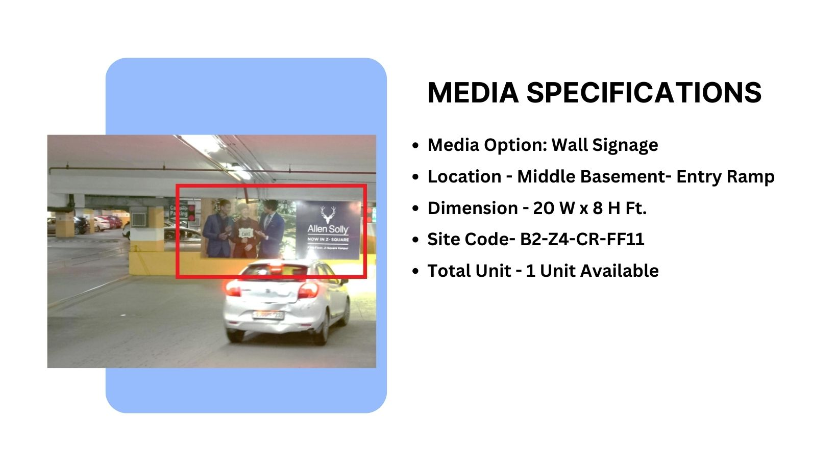
Façade Branding
Material – Glow Sign

Slide 3
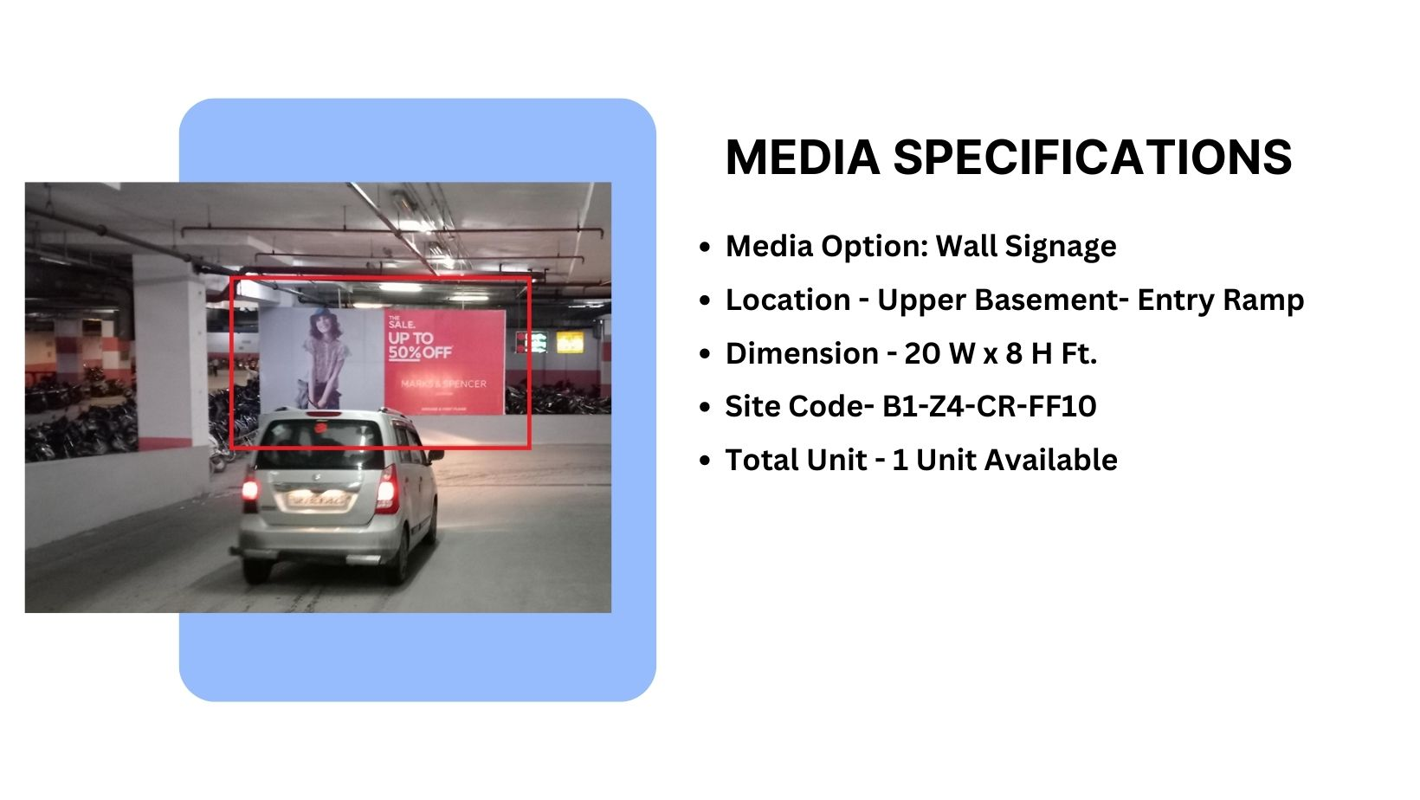

Façade Branding

Slide 4
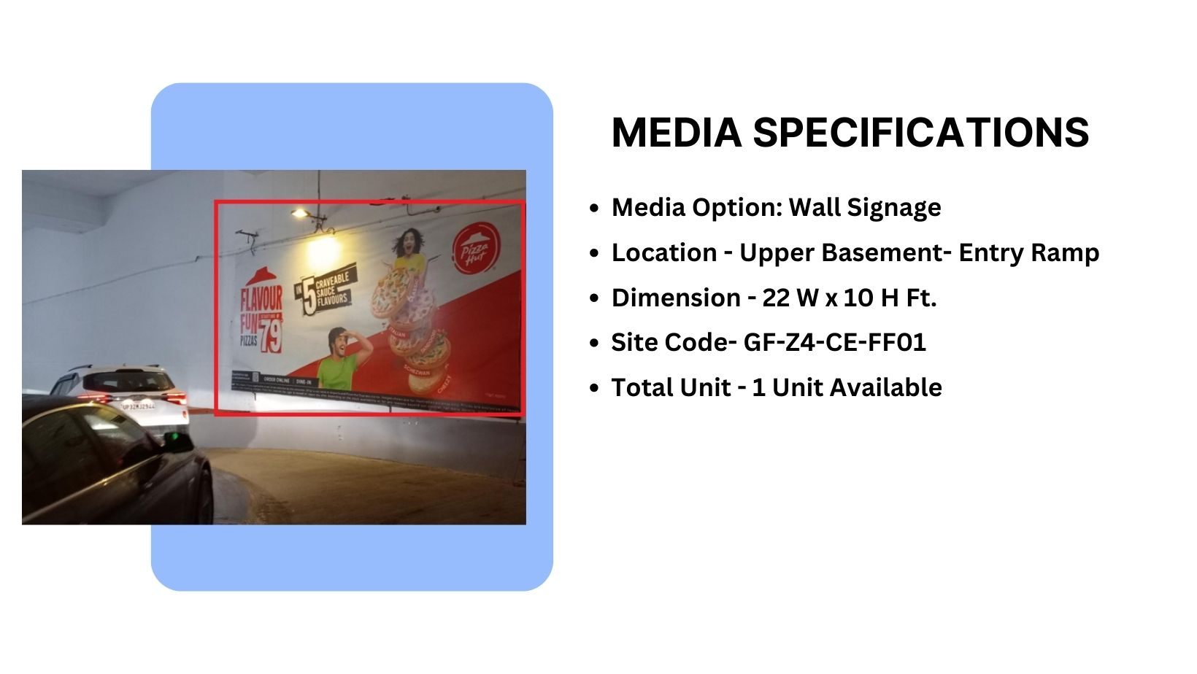
Façade Branding
Material – Flex Frame with Focus light

Slide 5
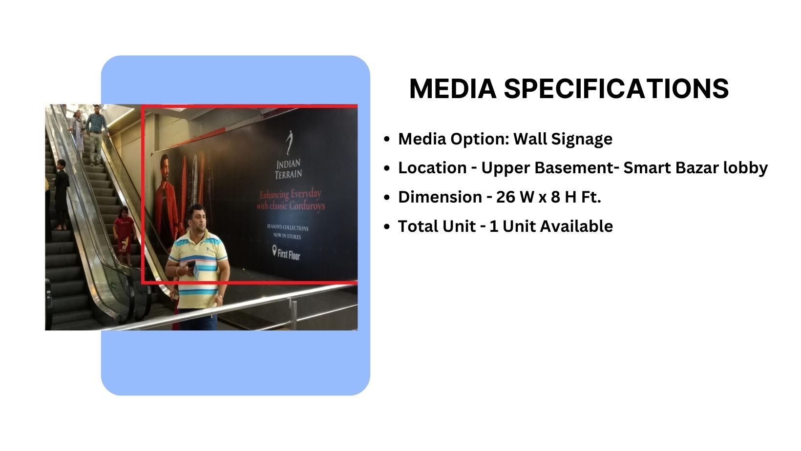
Façade Branding
Material – Flex Frame

Slide 6
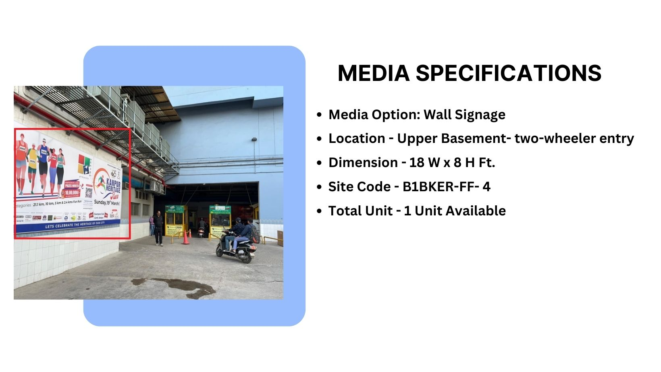
Façade Branding
Material – Flex Frame

Slide 7
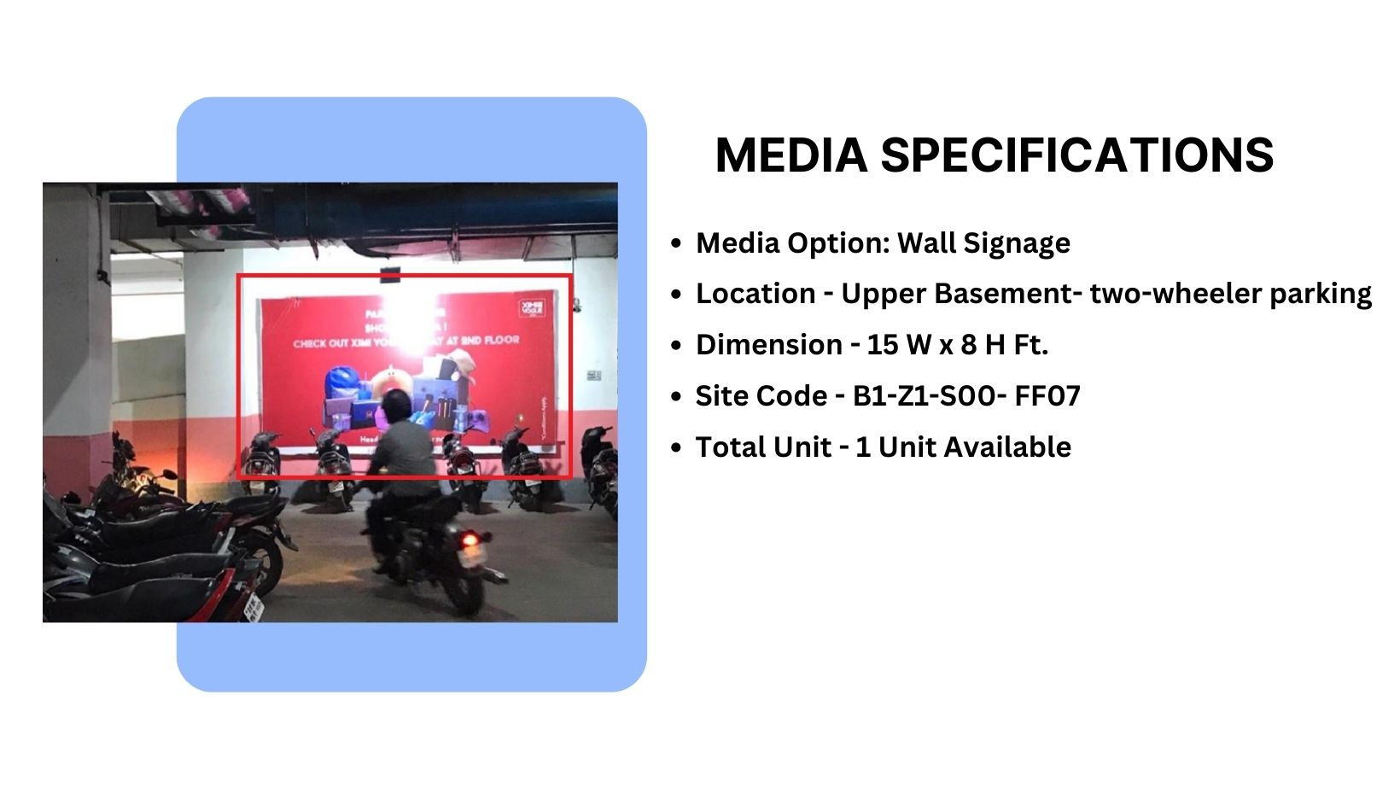
Façade Branding
Material – Flex Frame with Focus light

Slide 8











Thank You

