Slide 1
















Standee Branding

Slide 2
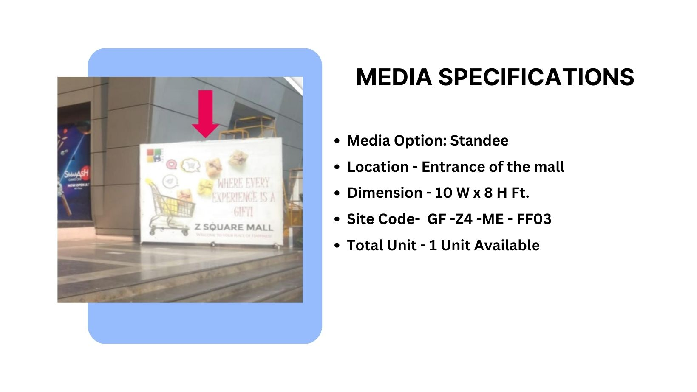
Ground Floor(Zone 4)
Façade Branding
Material – Flex Standee

Slide 3
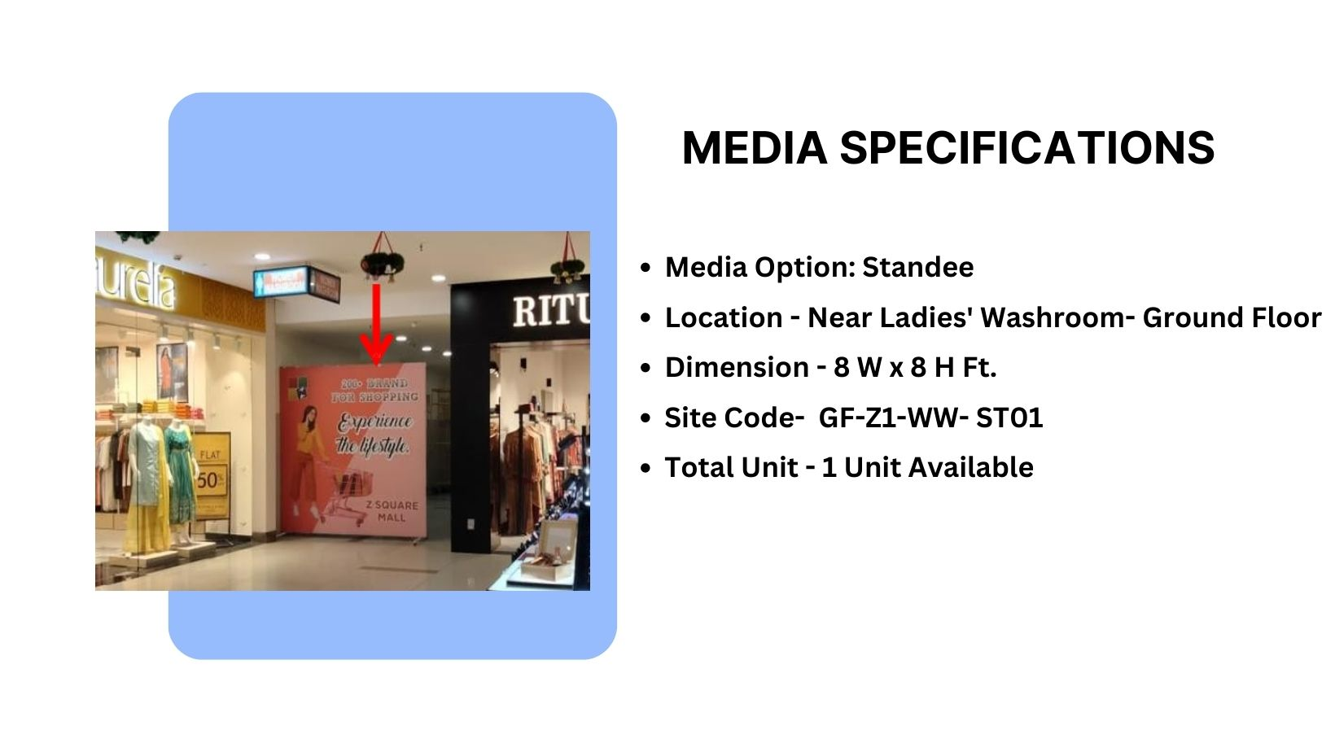
Façade Branding
(Zone 1)
Material – Standee

Slide 4
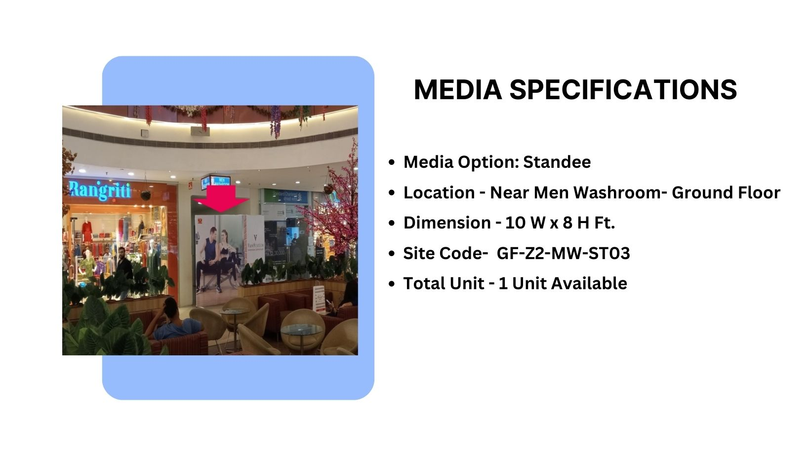
Façade Branding
(Zone 2)
Material – Standee

Slide 5
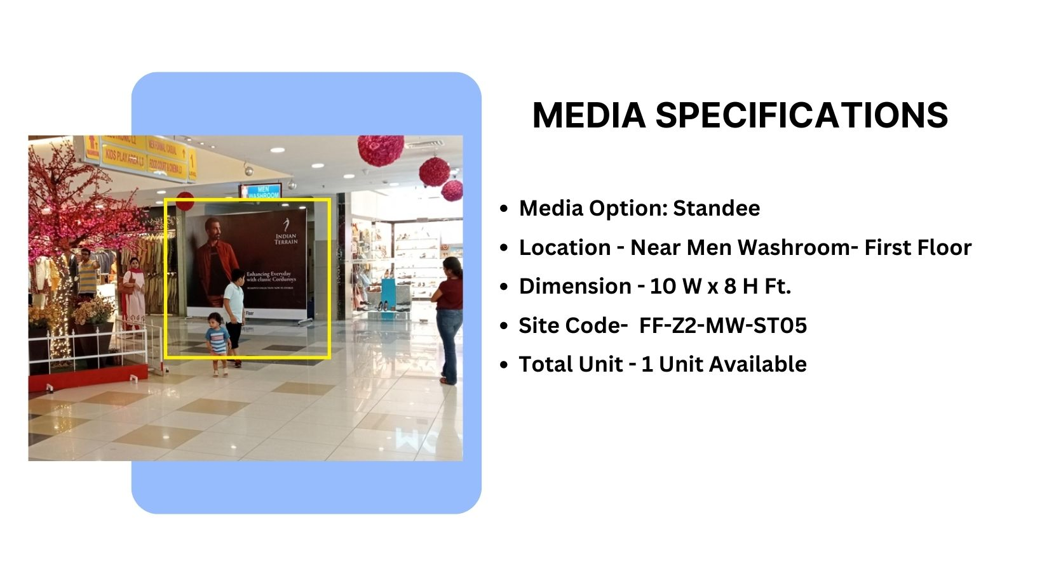
Façade Branding
(Zone 2)
Material – Standee

Slide 6
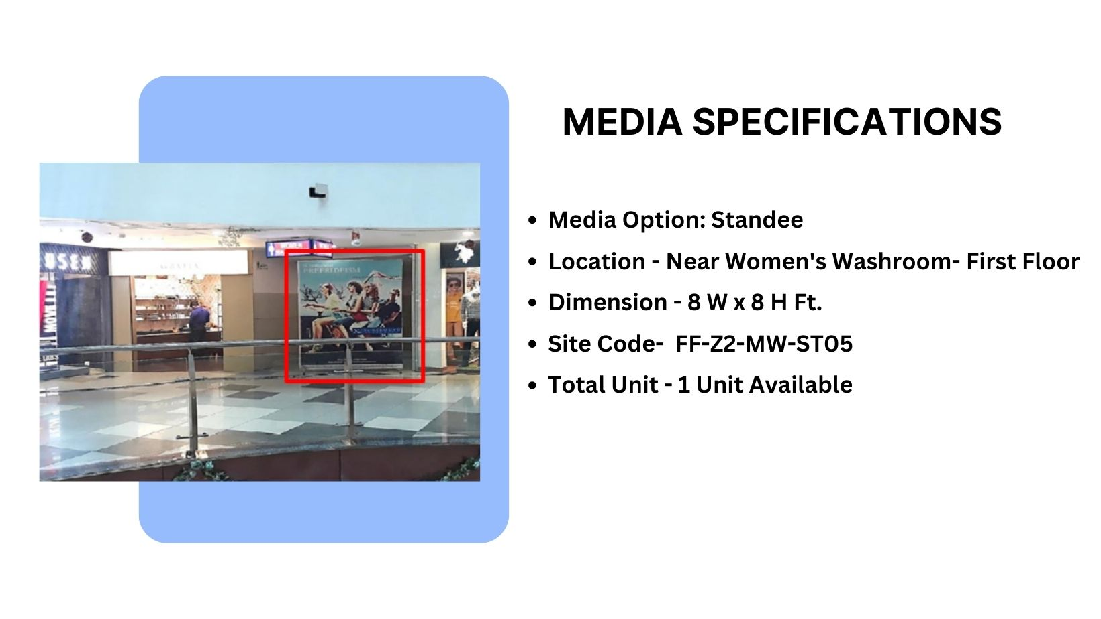
Façade Branding
(Zone 2)
Material – Standee

Slide 7
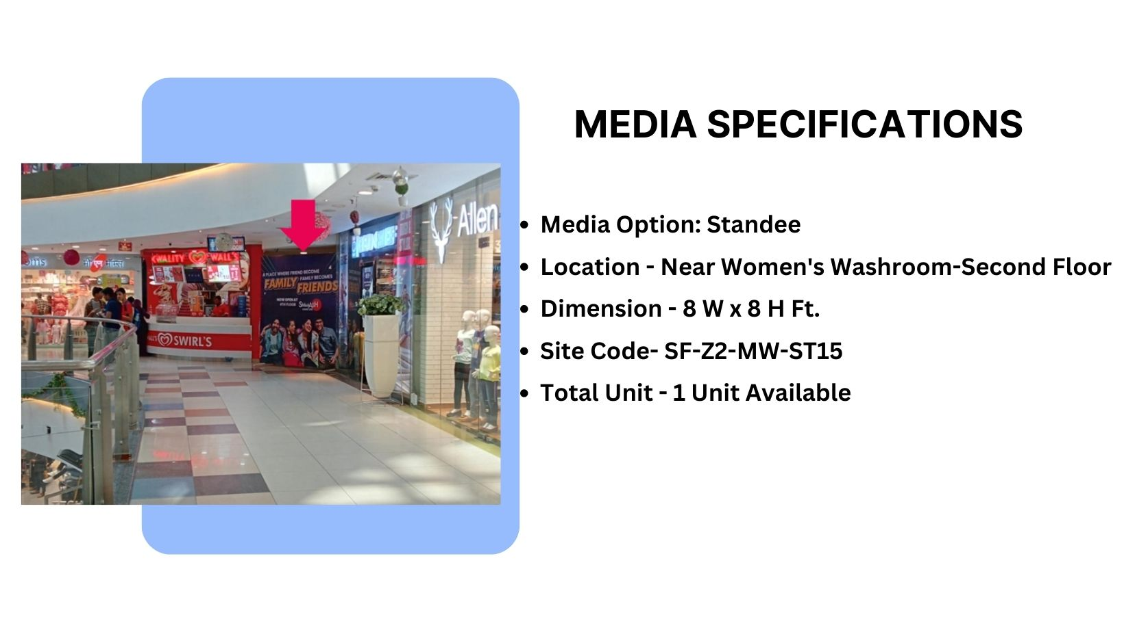
Façade Branding
(Zone 2)
Material – Standee

Slide 8
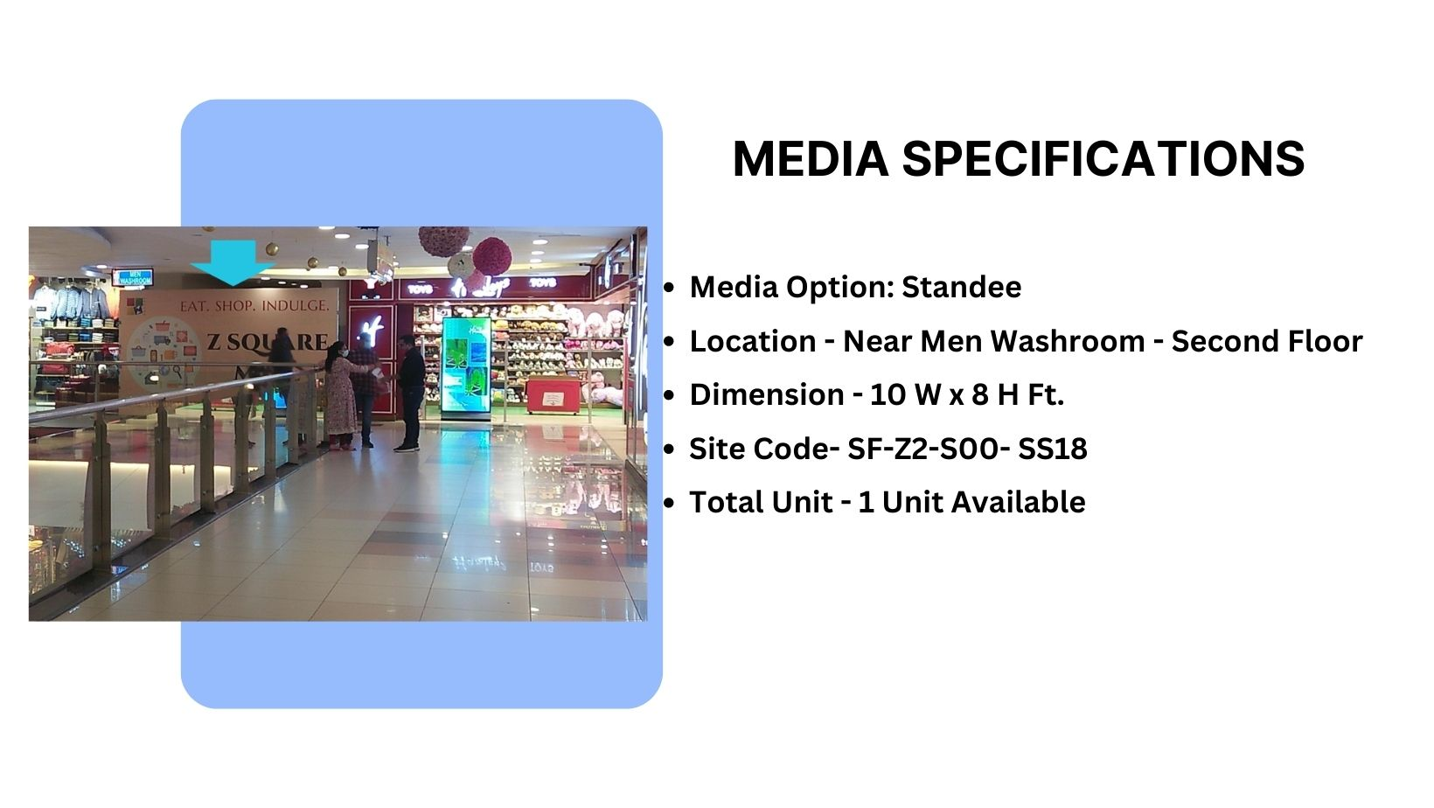
Façade Branding
(Zone 2)
Material – Flex

Slide 9
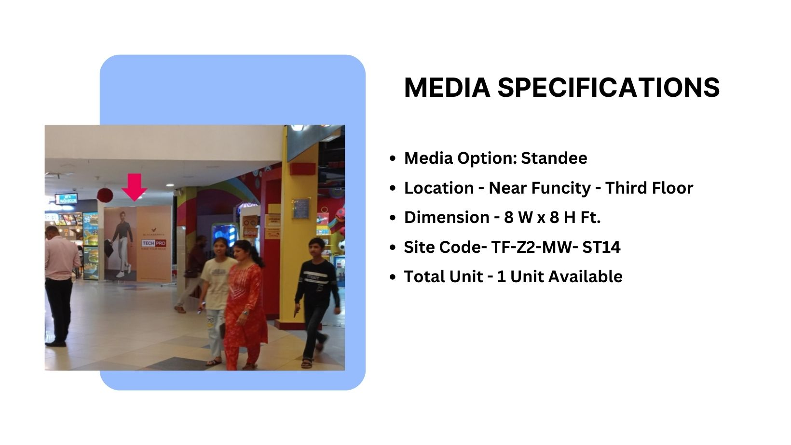
(Zone 4)
Façade Branding
Material – Standee

Slide 10
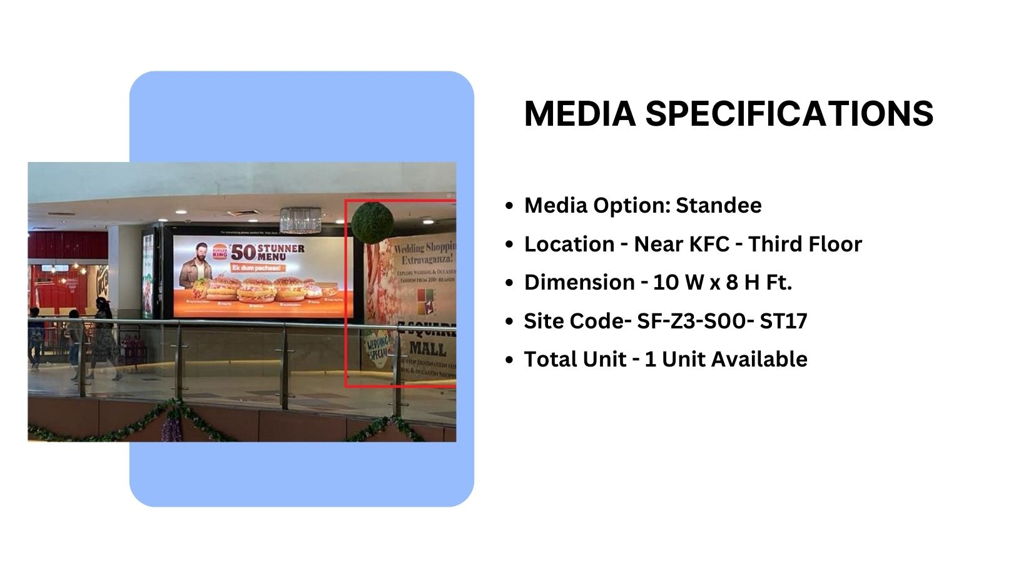
(Zone 3)
Façade Branding
Material – Standee

Slide 11











Thank You

